Slide 1
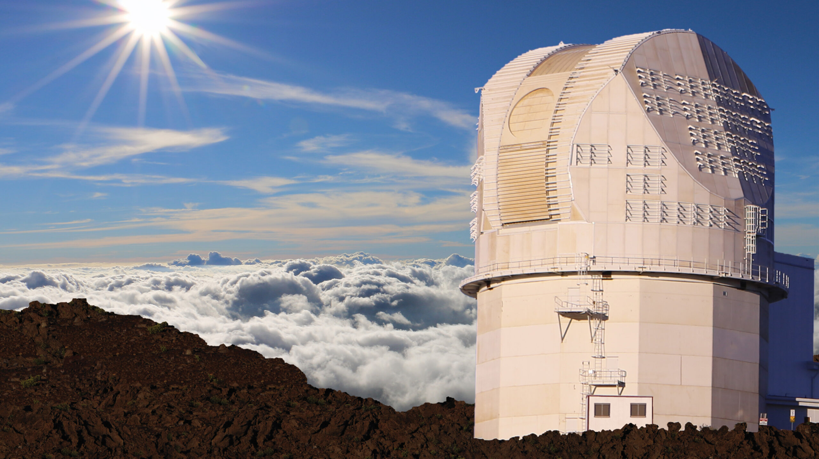
Building Modern Data Pipelines for the World’s Largest Solar Telescope
Alysa Derks
National Solar Observatory

Slide 2
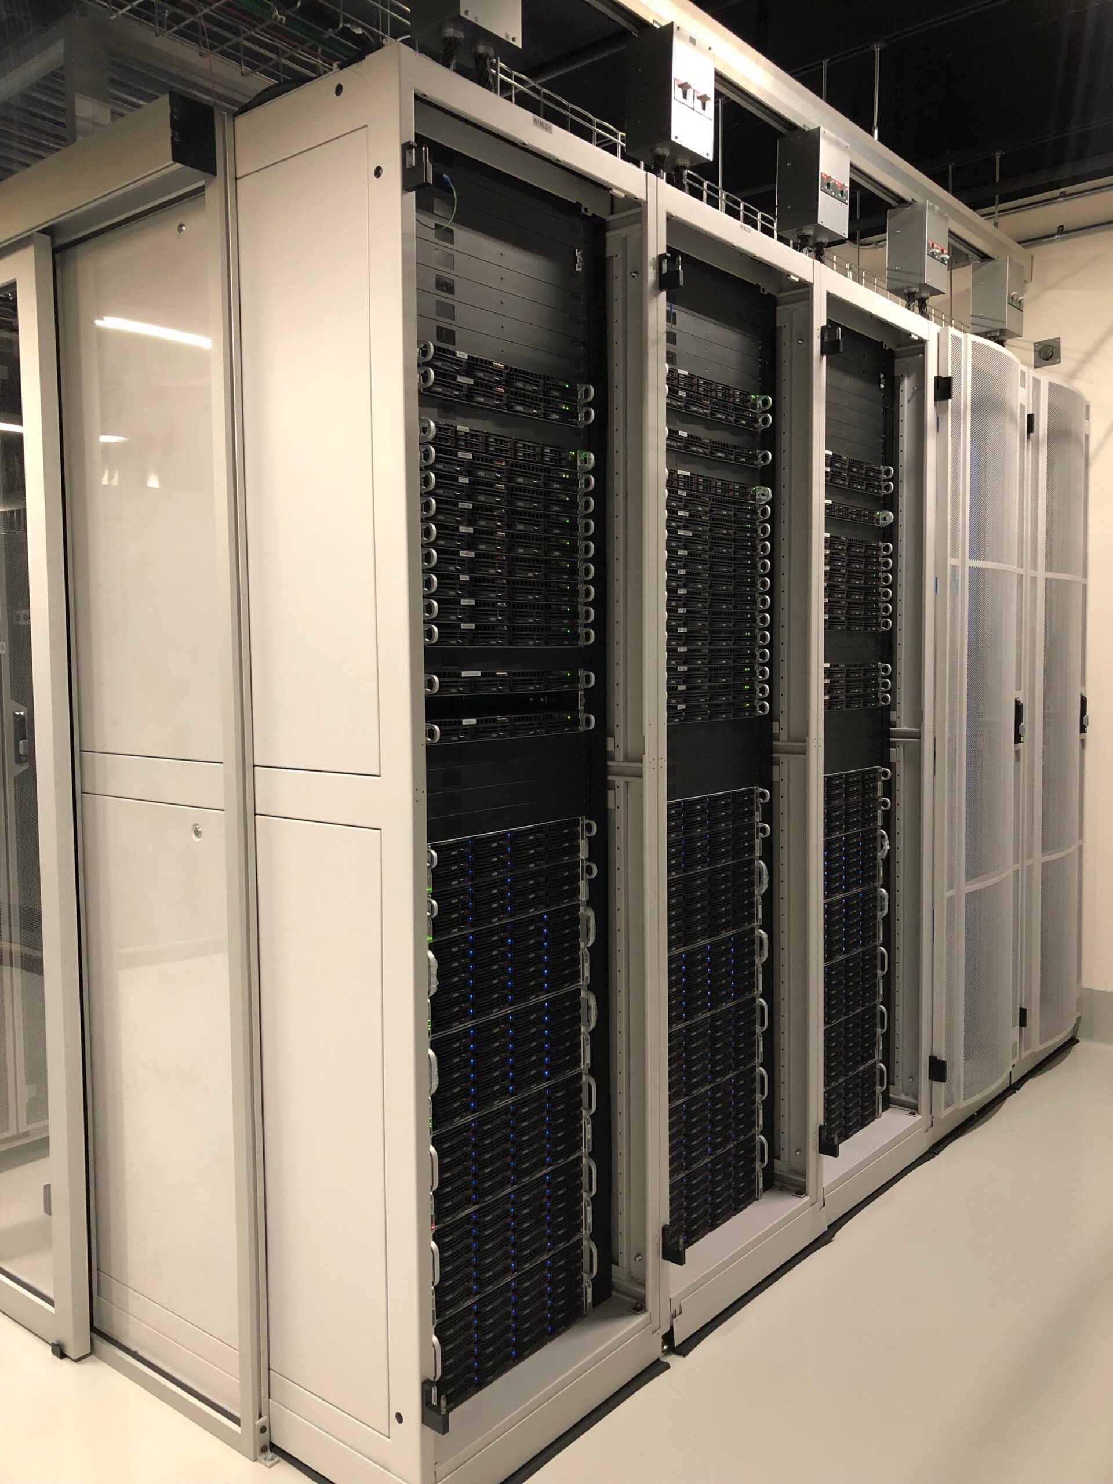
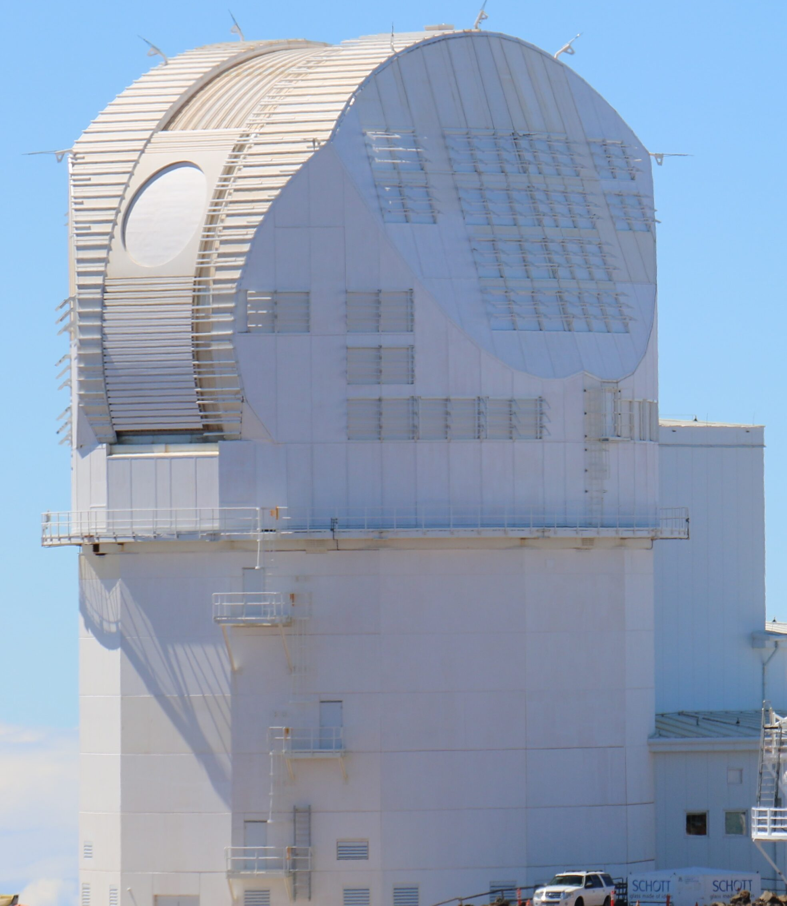
Telescope
Data Center
8TB/ Day
📍Maui, Hawai’i
📍Boulder, CO
Notes:
DKIST takes on average 8TB of data per day
At its peak will take 66TB per day
Sent to DC overnight
Currently the DC is staffed with 12 people, 4 of those being calibration engineers.
So we need to automate and scale some things

Slide 3
Telescope
Data Center
In full operations….
8TB/ Day
📍Maui, Hawai’i
📍Boulder, CO
Notes:
DKIST takes on average 8TB of data per day
At its peak will take 66TB per day
Sent to DC overnight
Currently the DC is staffed with 12 people, 4 of those being calibration engineers.
So we need to automate and scale some things

Slide 4
Telescope
Data Center
In full operations….
5 frames per second
8TB/ Day
📍Maui, Hawai’i
📍Boulder, CO
Notes:
DKIST takes on average 8TB of data per day
At its peak will take 66TB per day
Sent to DC overnight
Currently the DC is staffed with 12 people, 4 of those being calibration engineers.
So we need to automate and scale some things

Slide 5
Telescope
Data Center
In full operations….
5 frames per second
95 MB per second
8TB/ Day
📍Maui, Hawai’i
📍Boulder, CO
Notes:
DKIST takes on average 8TB of data per day
At its peak will take 66TB per day
Sent to DC overnight
Currently the DC is staffed with 12 people, 4 of those being calibration engineers.
So we need to automate and scale some things

Slide 6
Telescope
Data Center
In full operations….
5 frames per second
95 MB per second
So far….
8TB/ Day
📍Maui, Hawai’i
📍Boulder, CO
Notes:
DKIST takes on average 8TB of data per day
At its peak will take 66TB per day
Sent to DC overnight
Currently the DC is staffed with 12 people, 4 of those being calibration engineers.
So we need to automate and scale some things

Slide 7
Telescope
Data Center
In full operations….
5 frames per second
95 MB per second
So far….
~15 million frames (2 frames per second)
8TB/ Day
📍Maui, Hawai’i
📍Boulder, CO
Notes:
DKIST takes on average 8TB of data per day
At its peak will take 66TB per day
Sent to DC overnight
Currently the DC is staffed with 12 people, 4 of those being calibration engineers.
So we need to automate and scale some things

Slide 8
Telescope
Data Center
In full operations….
5 frames per second
95 MB per second
So far….
~15 million frames (2 frames per second)
300 TB of raw data (100 TB of calibrated data)
8TB/ Day
📍Maui, Hawai’i
📍Boulder, CO
Notes:
DKIST takes on average 8TB of data per day
At its peak will take 66TB per day
Sent to DC overnight
Currently the DC is staffed with 12 people, 4 of those being calibration engineers.
So we need to automate and scale some things

Slide 9
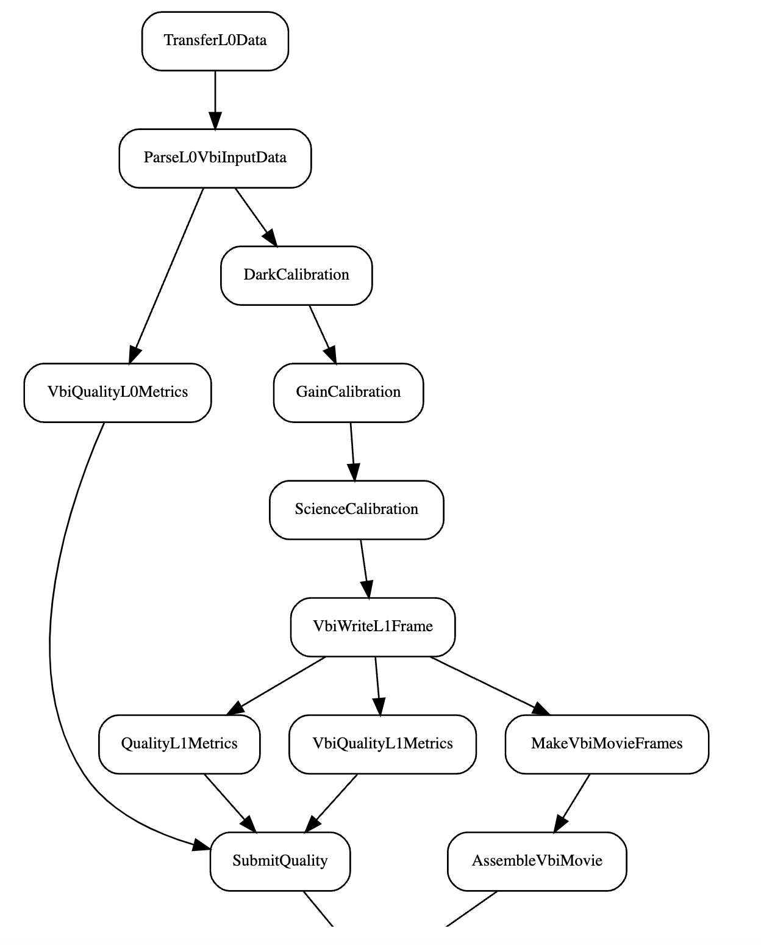
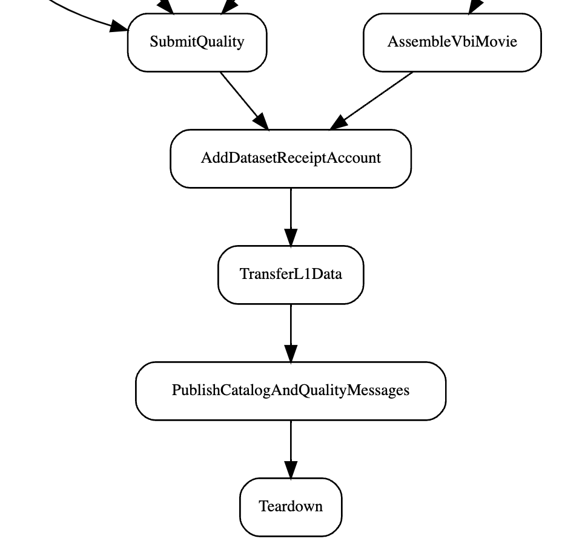
Notes:
5 instruments → 5 pipelines
Instrument calibration pipeline
Each box is a calibration task- i.e. dark calibration, polarization calibration, etc.

Slide 10
Notes:
Airflow- point at a computing cluster and it will schedule tasks for you
Airflow can parallelize some of these tasks to increase efficiency- saving valuable time
When a full dataset is transferred to us (our systems know), system queues it and sends it to the correct pipeline

Slide 11
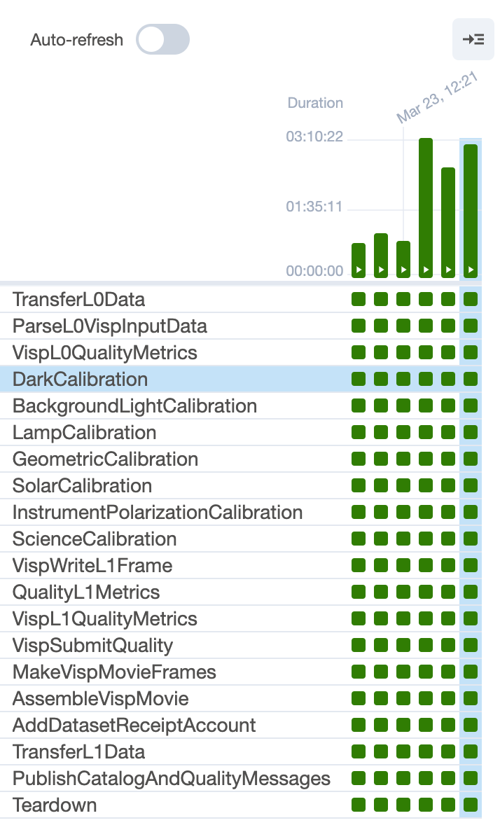
Notes:
Monitoring-
We can see in which task a pipeline failed and then we can click on that box, and get the traceback code to see exactly what went wrong

Slide 12
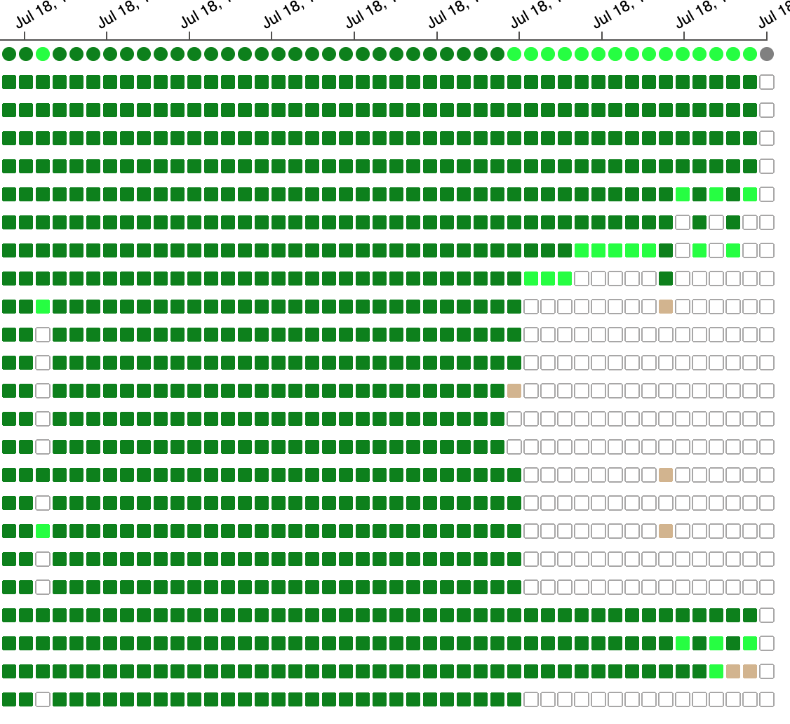
Notes:
Scalability-
Airflow can run many pipelines at a time
46 columns, can scale to 100 (hardware limited, software can handle much more)
Each column is a pipeline run,
Light green is happening
Circles are pipelines
Squares are tasks within

Slide 13
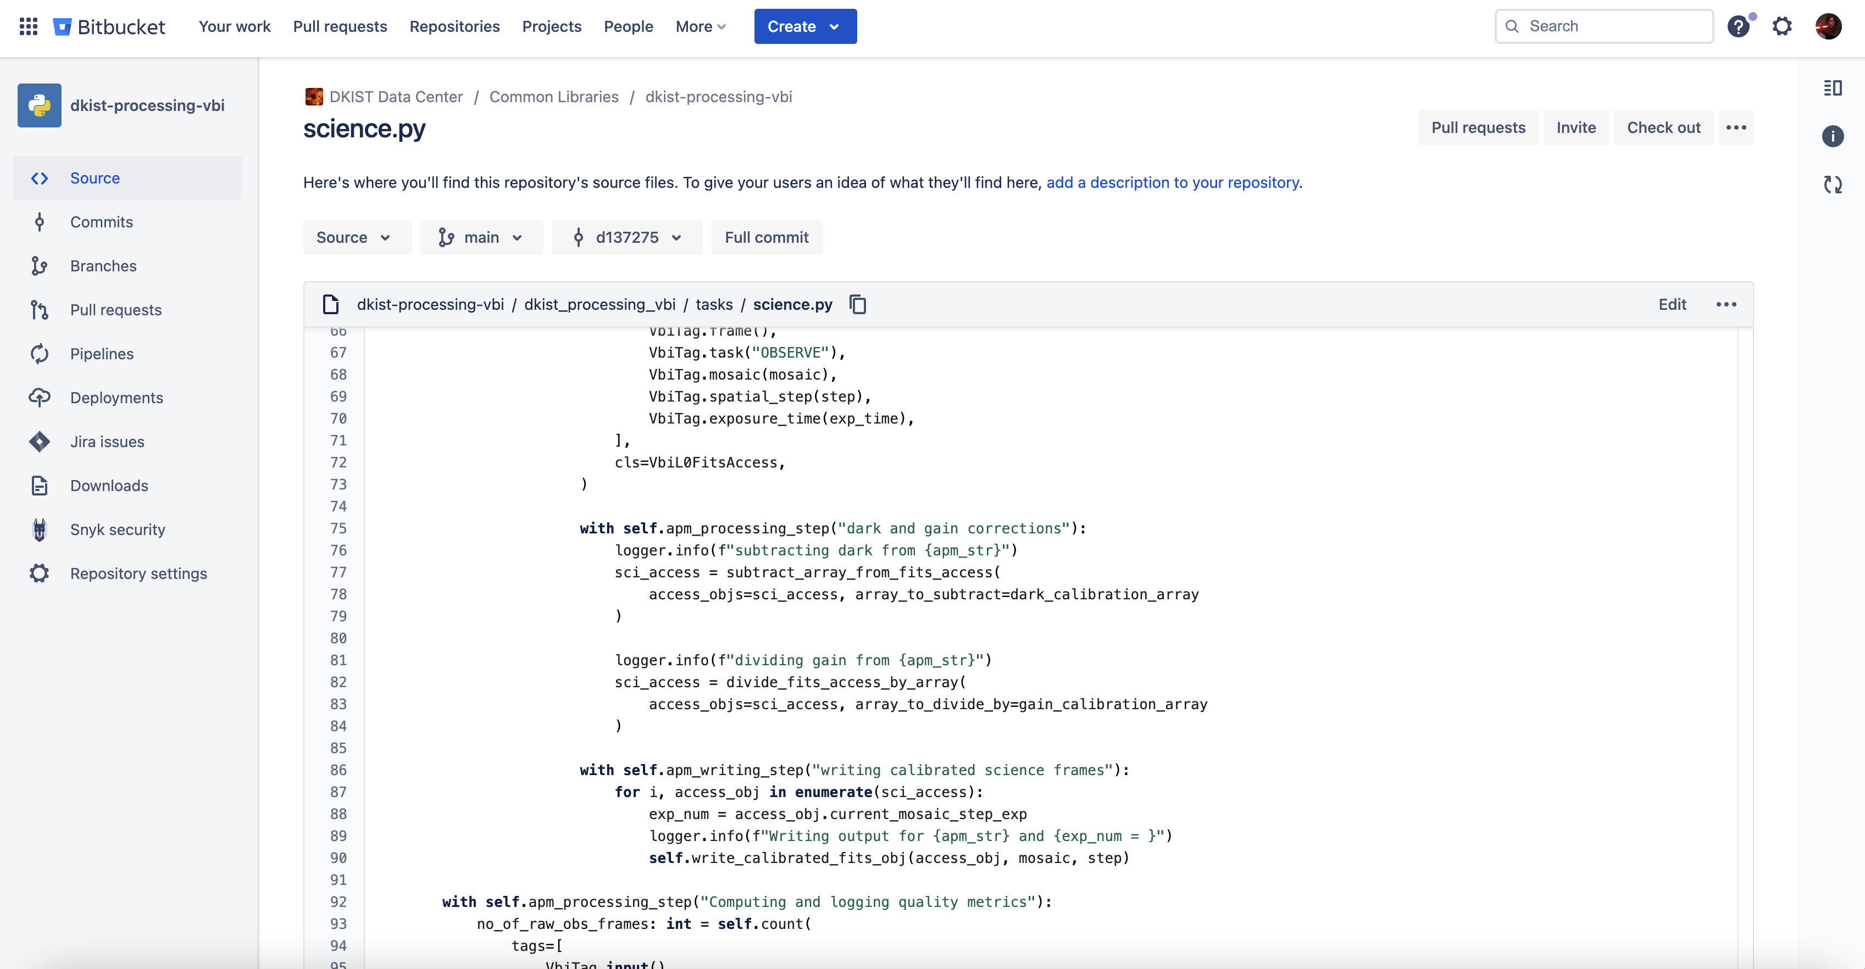
Notes:
Transparency-
We chose to write pipelines in python:
Chosen because it is free, everything we write is open source and available to the public
Python used because of library support available to it. Don’t have to reinvent the wheel in many cases
Quick rework loop, great for development
2. Everything is available for the public to see on Bitbucket. Users can run our pipelines on their local machines

Slide 14
Notes:
Transparency and traceability
Important to keep everything, especially docs, relevant and up to date
In our code, we imbed sphinx markup → Automatically deploys to RTD and creates documentation for the user
When there is a major change to our code, we version it, and create a build. That build is now the latest software that we are using.
Output frame headers are marked with the version used to calibrate it. RTD has documentation for every single version of our pipelines to ever exist.
So, users will always have
1. a description of the algorithms we used for their data
2. The order in which we applied steps to the data
3. The actual code that was applied to the data

Slide 15
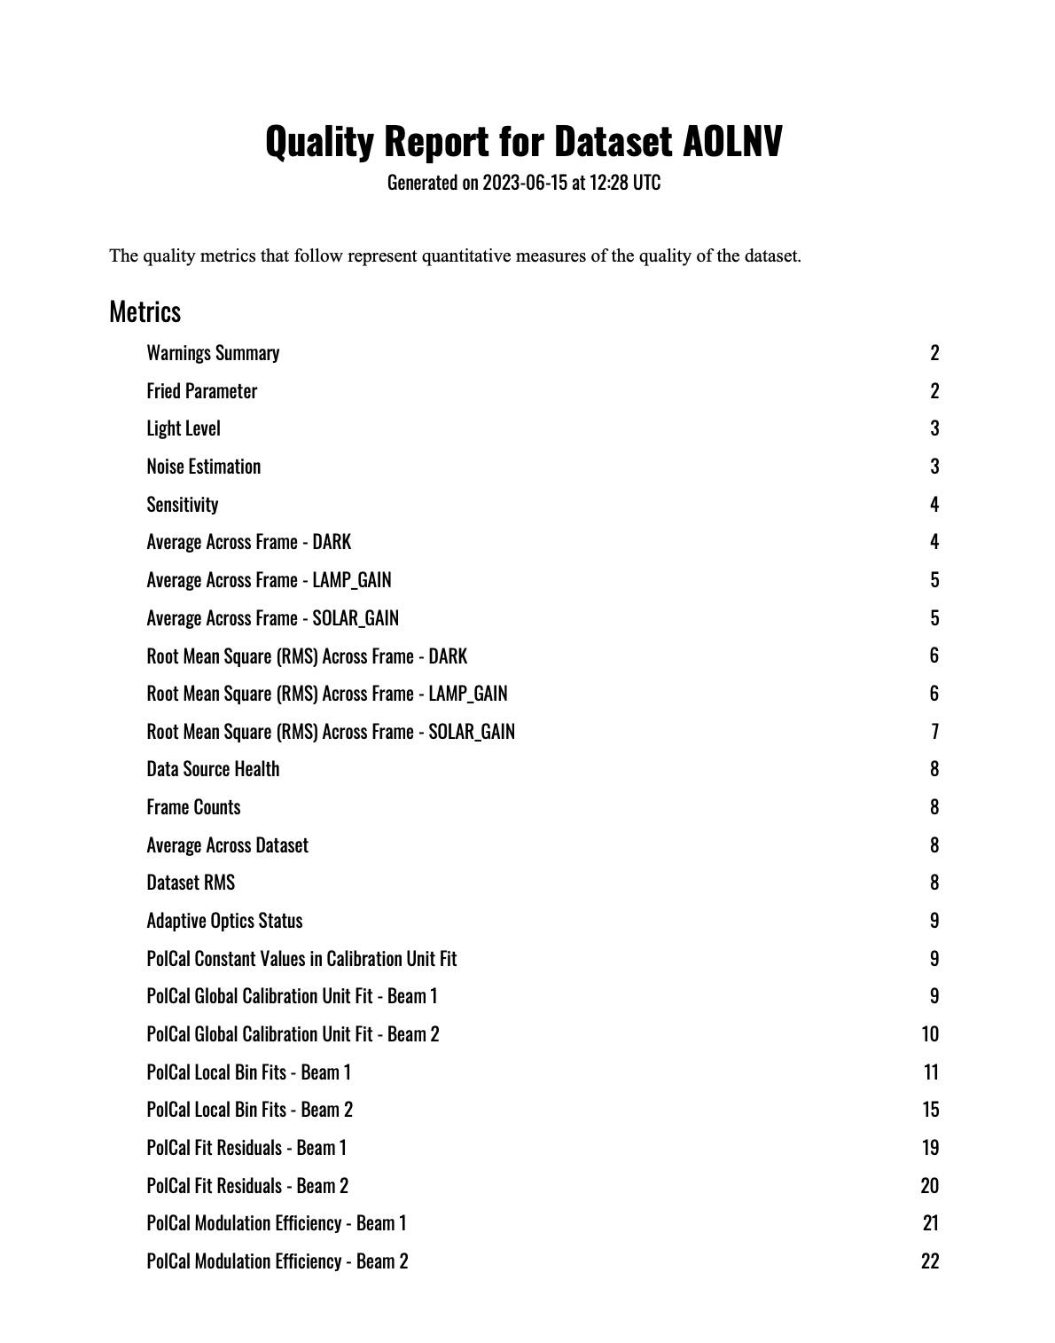
Notes:
Quality monitoring
Not something that every observatory does
Automatically generate quality metrics within our calibration pipelines
Short and long term monitoring
Short term across a single dataset. Provided to users
Long term to monitor not only pipeline health but also telescope health

Slide 16
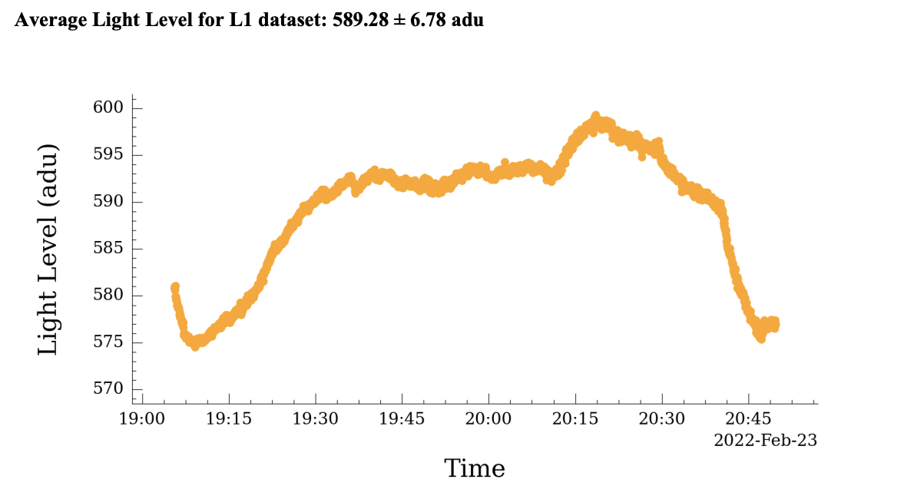
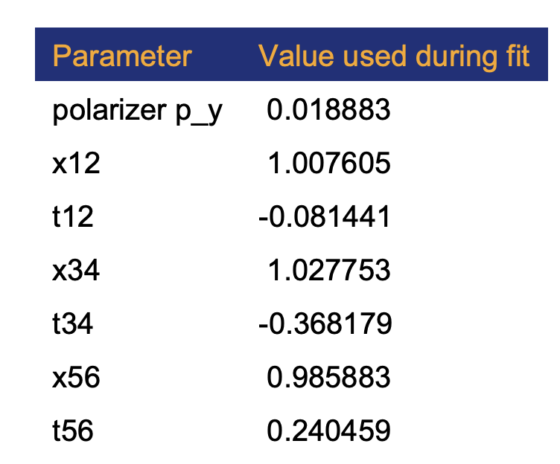

Slide 17
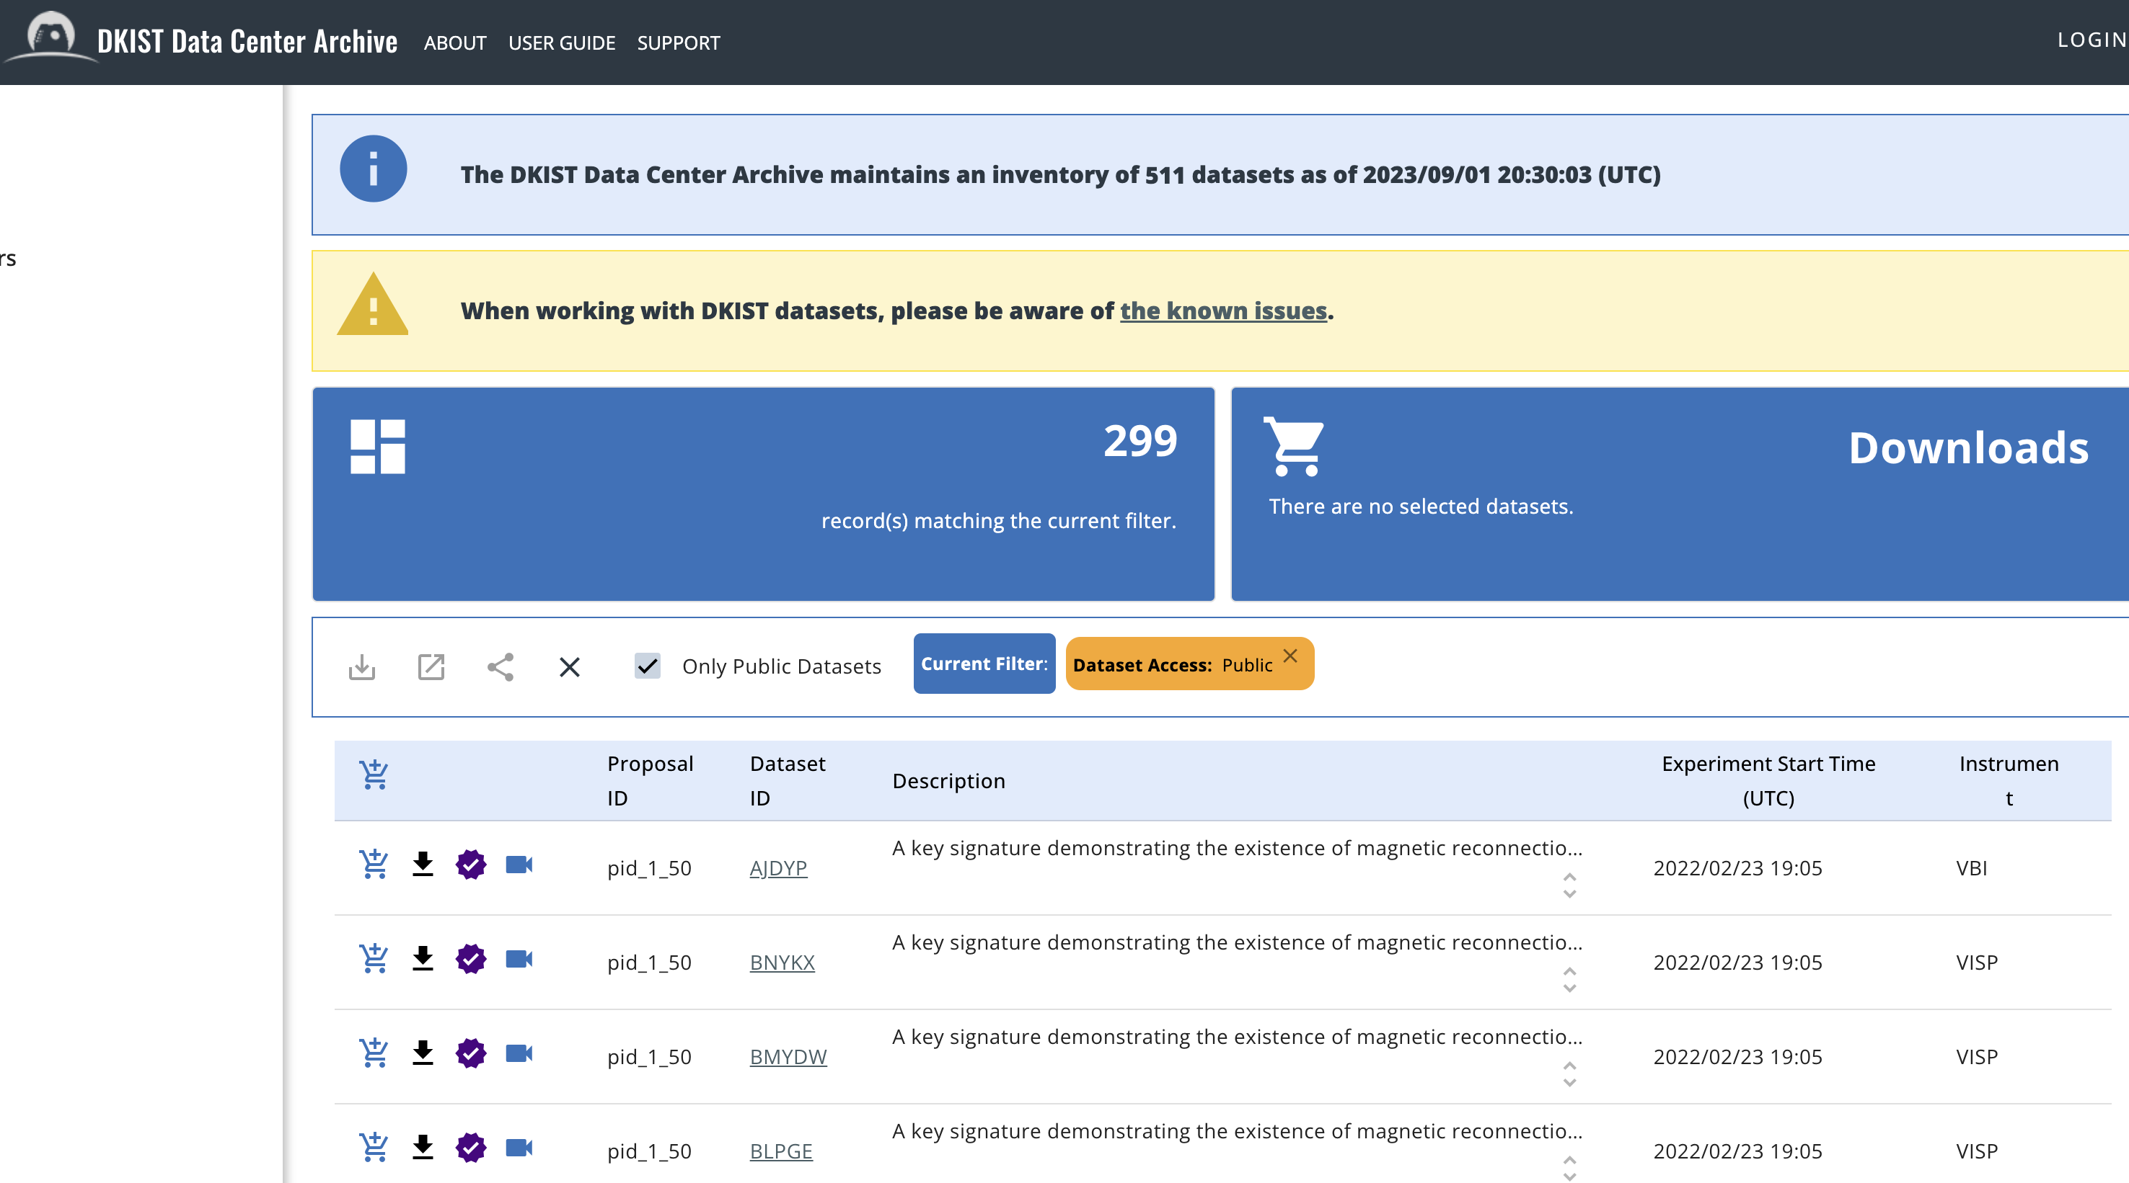
Notes:
Fully processed data is available to PI’s and CO-I’s with a half of a day of beginning calibrations exclusively for a period of six months, after which it is made publicly available.
Before even downloading data, users can glimpse into the data to decide if that dataset will be useful to them.

Slide 18
Notes:
Quick movie

Slide 19
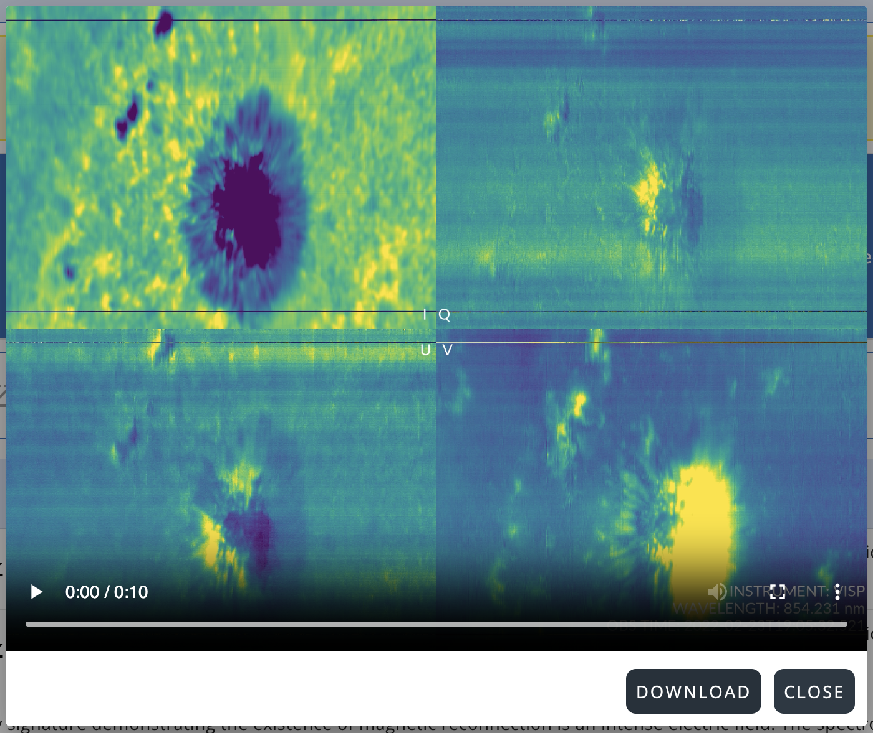

Slide 20
Notes:
Dataset quality report (pdf)

Slide 22
Notes:
ASDF file (metadata in a YAML file followed by binary or ASCII data)

Slide 23
Notes:
When a user is ready to download a dataset, they add it to their cart.

Slide 24
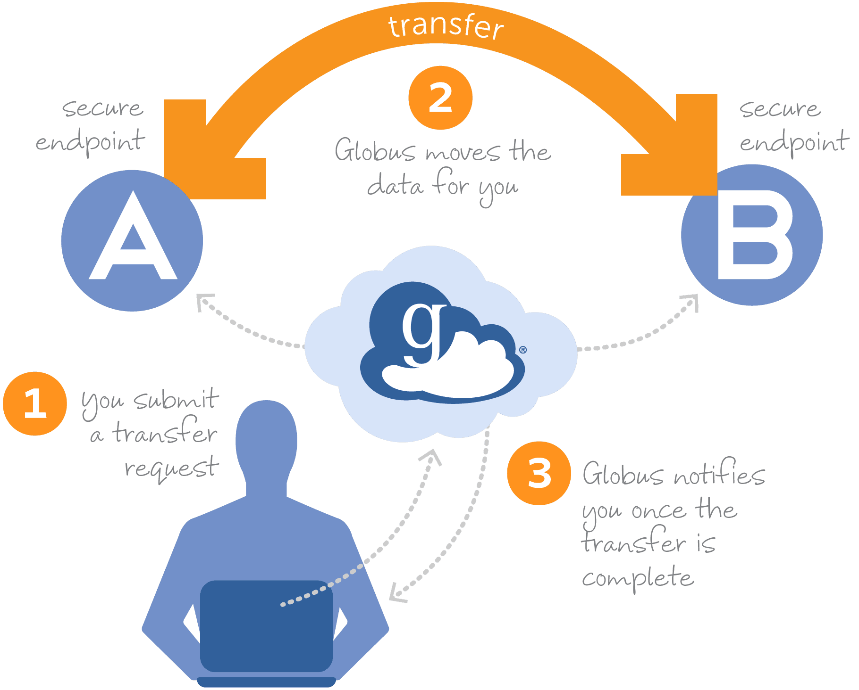
Notes:
We use a service Globus to transfer data.
Fast and secure way to move data.
Notifies you when a transfer is complete
If a network or system goes down in the middle of a transfer, Globus will automatically resume the transfer when the component comes back online
Users MUST create a globus account to download data

Slide 25
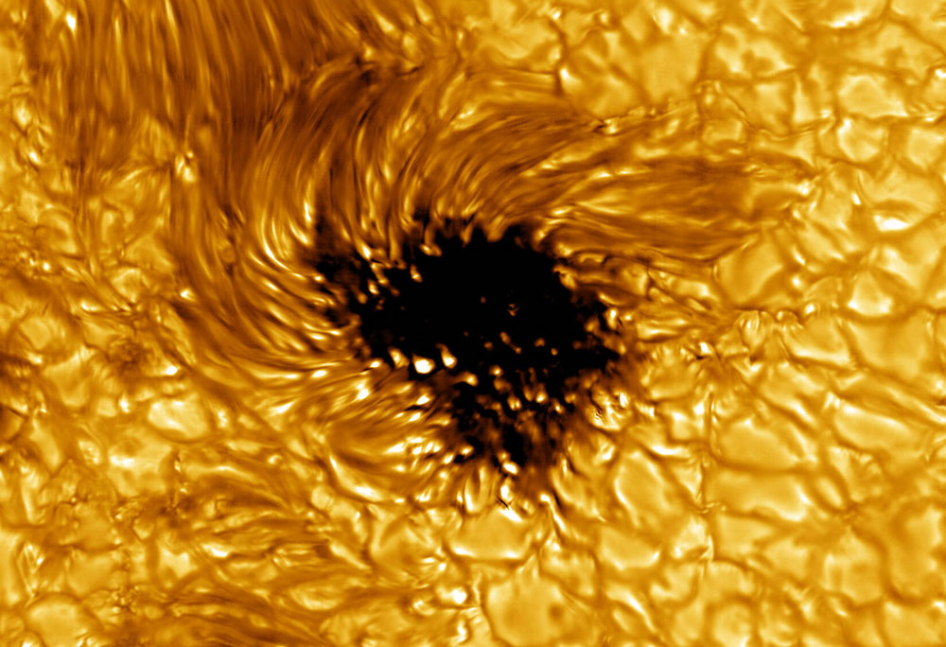
Data taken on the VBI instrument at 450 nm
https://dkist.data.nso.edu/
Notes:
299 available to the public

