Slide 1
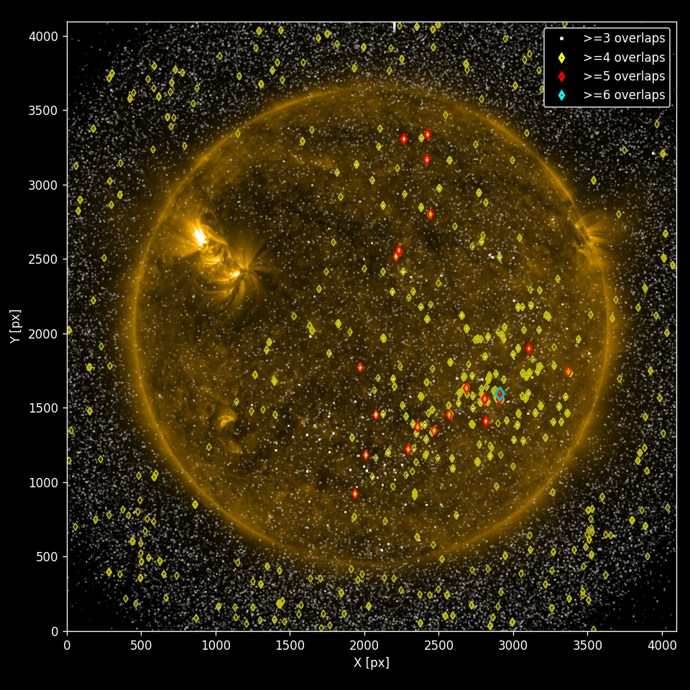
Finding the pixel in the haystack: brute-force versus ML-based approach
Raphael Attie - NASA GSFC / GMU
Michael Kirk – NASA GSFC
Srija Chakraborty - USRA
Barbara Thompson – NASA GSFC

Slide 2
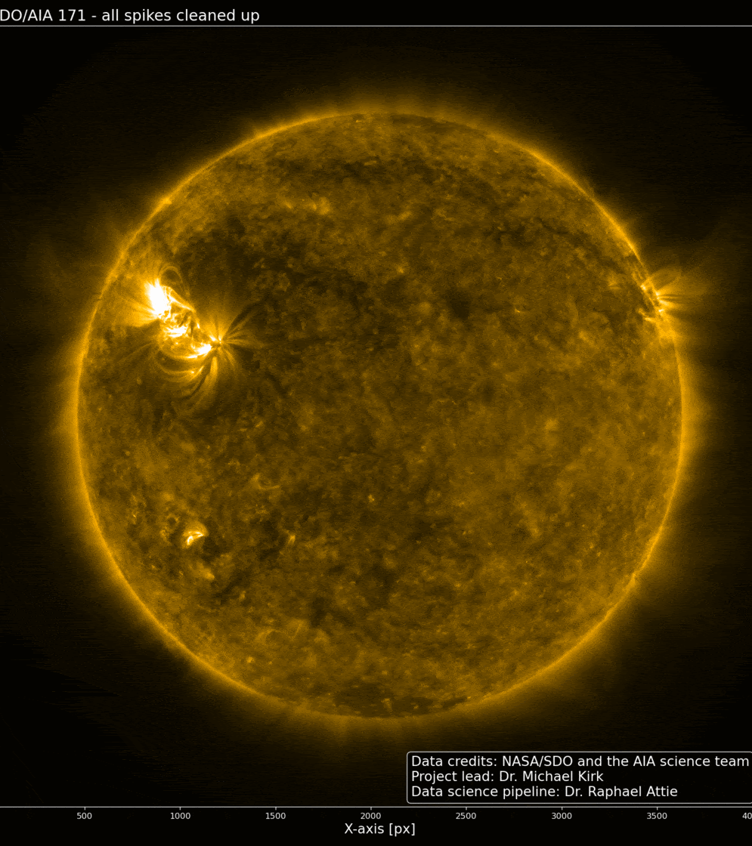
Pixel Trash
◀︎ Original Image
Cleaned Image ►
An automated algorithm cleans the image of cosmic ray spikes.

Slide 3
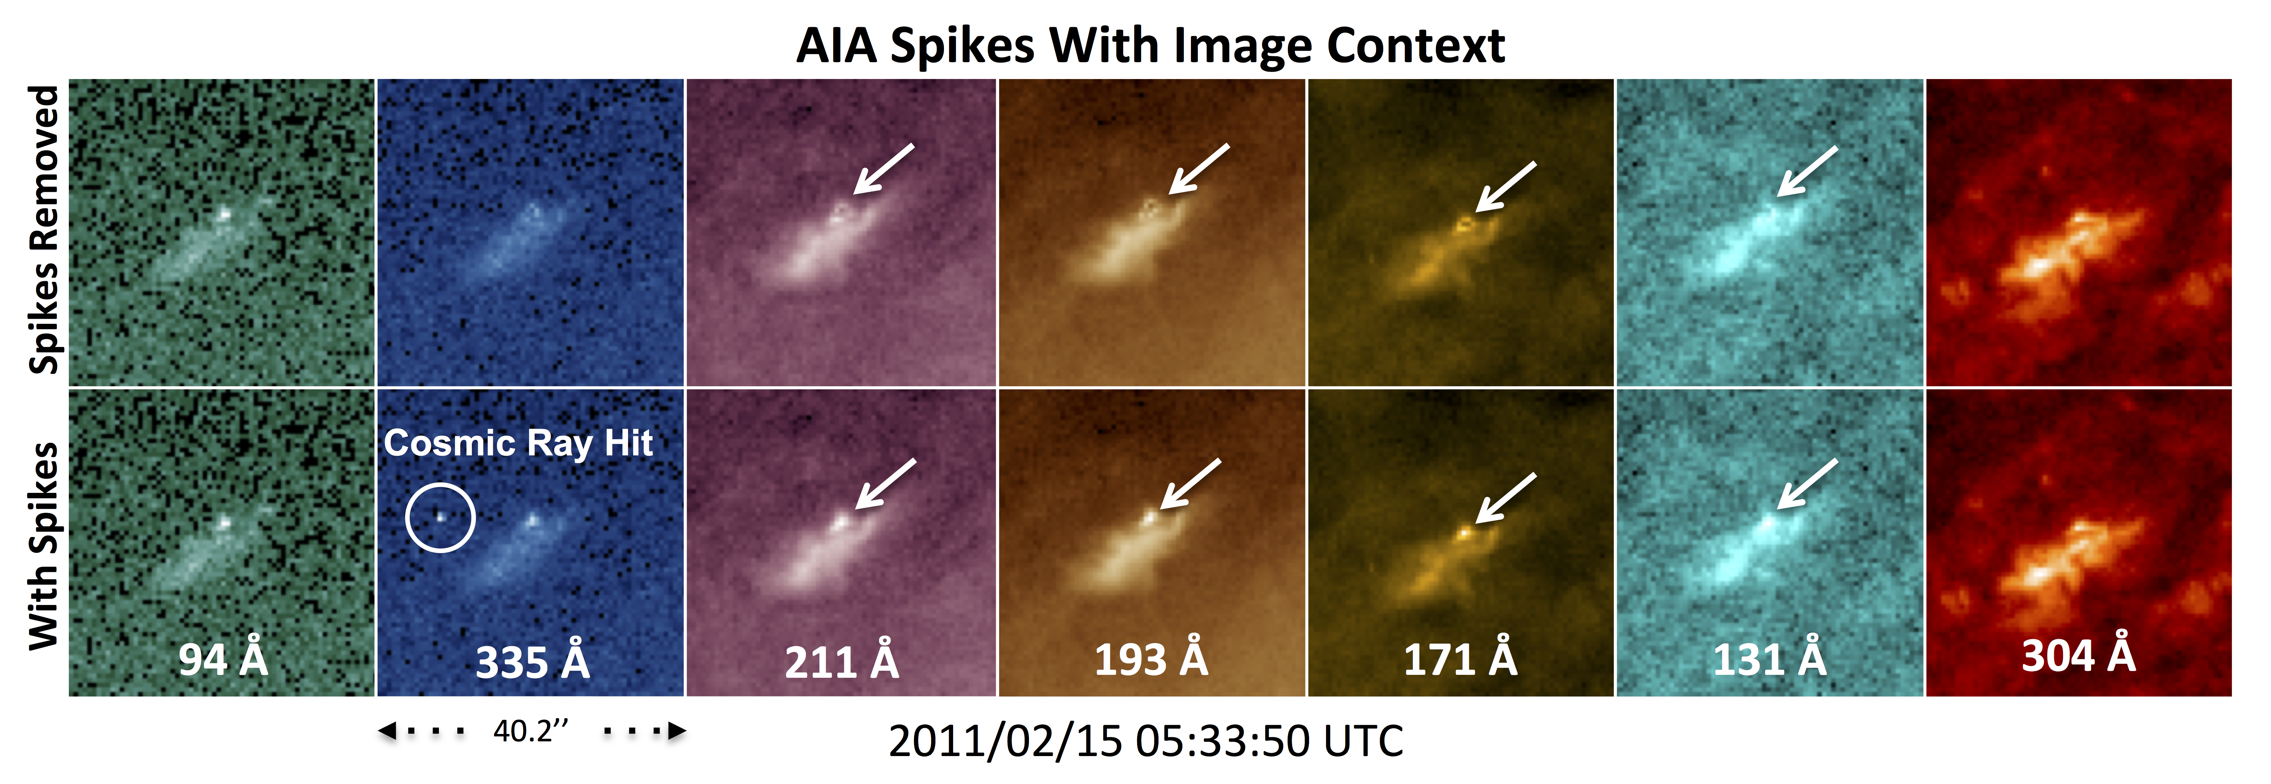
Science Question: Are all the “cosmic rays” really cosmic rays?

Slide 4
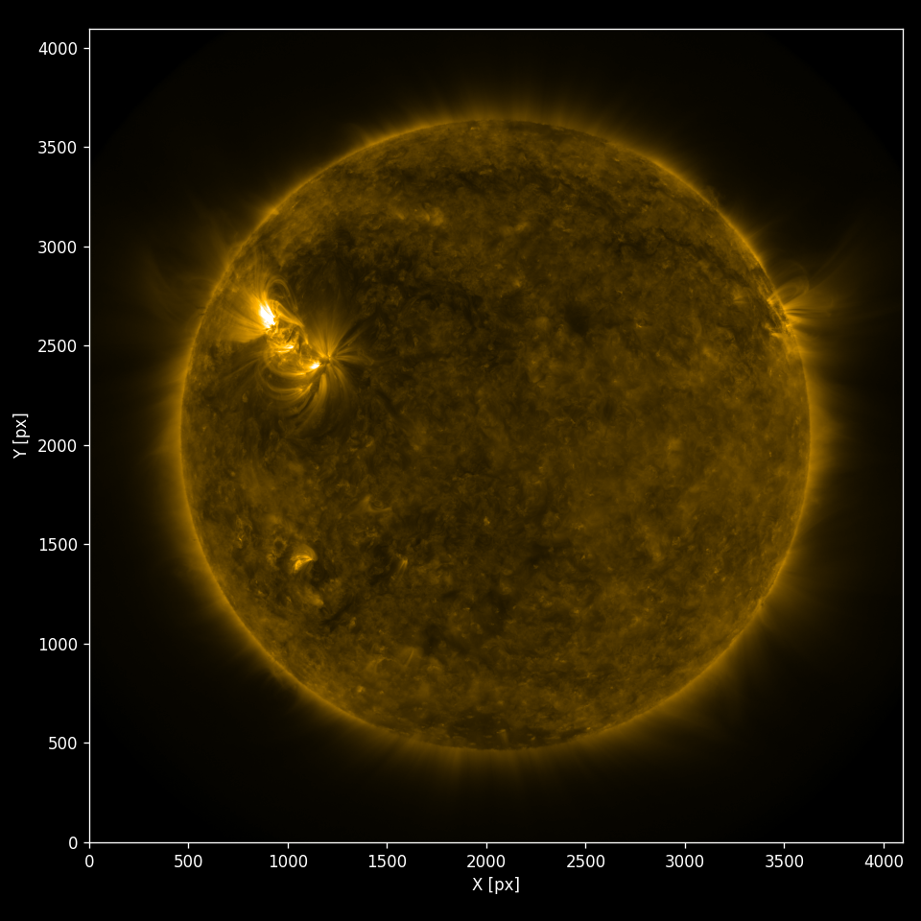
Needle in a haystack:
Extracted spikes data in separate metadata files
~200 Million files, each containing [10³ – 10⁴] spikes
Trillions Individual spikes in total
~25 TB data to comb.
~ 1.5 million positive detections exist
How do we find them?

Slide 5
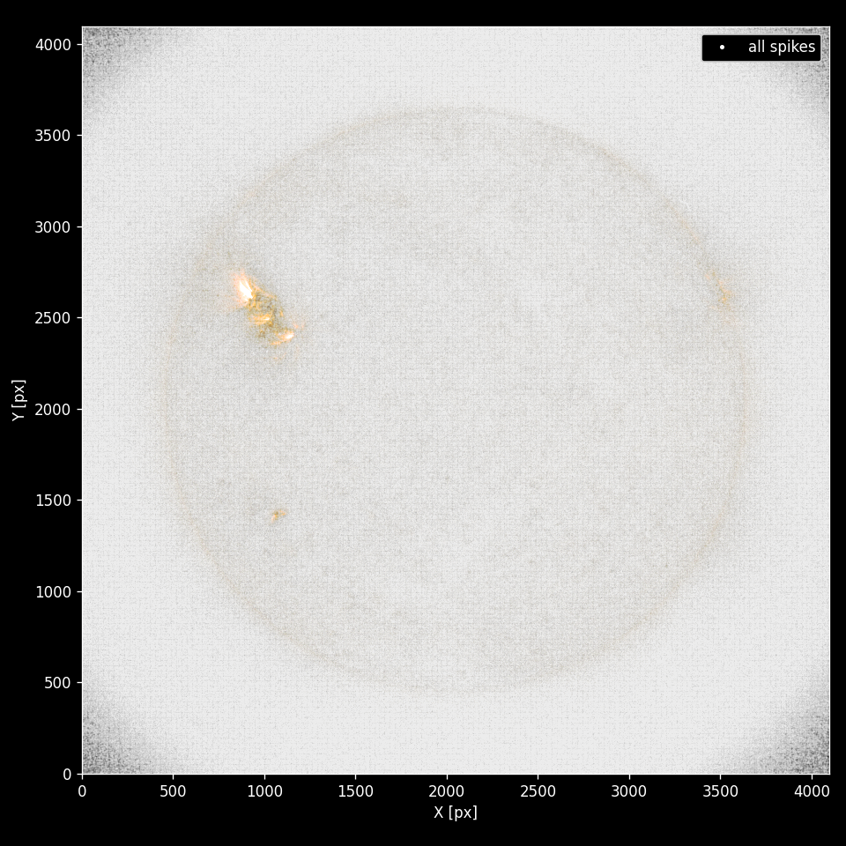
Needle in a haystack:
1 hr of all detected spikes, at all wavelengths
Extracted spikes data in separate metadata files
~200 Million files, each containing [10³ – 10⁴] spikes
Trillions Individual spikes in total
~25 TB data to comb.
~ 1.5 million positive detections exist
How do we find them?

Slide 6
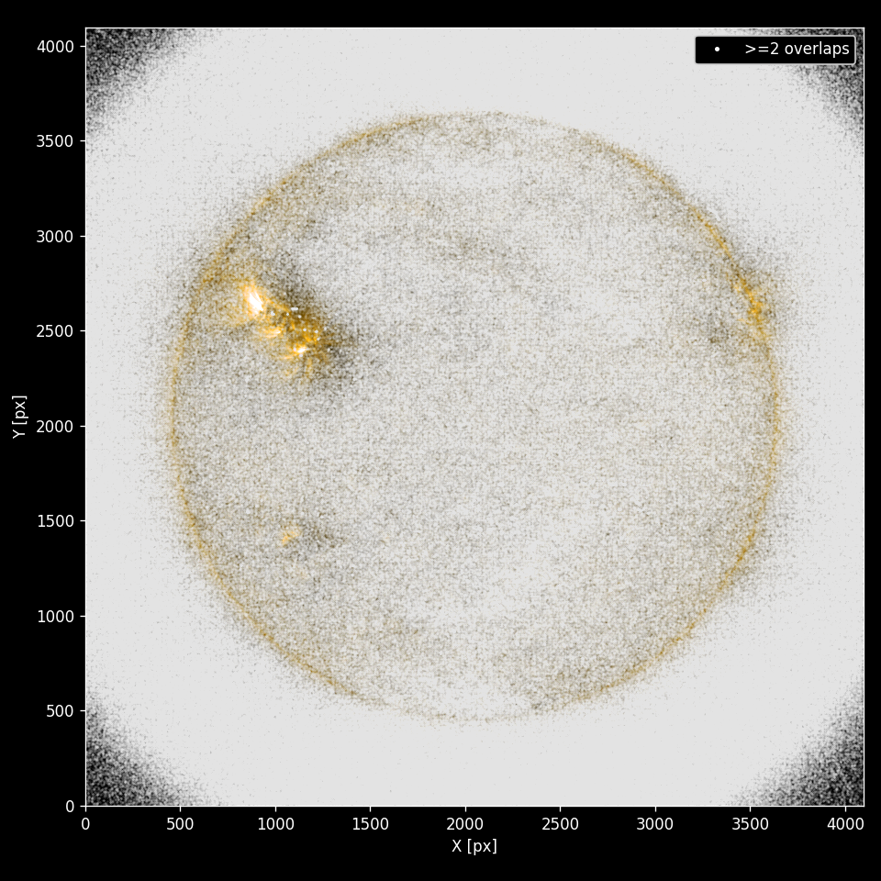
Needle in a haystack:
1 Day – >=2 overlapping wavelengths
Extracted spikes data in separate metadata files
~200 Million files, each containing [10³ – 10⁴] spikes
Trillions Individual spikes in total
~25 TB data to comb.
~ 1.5 million positive detections exist
How do we find them?

Slide 7
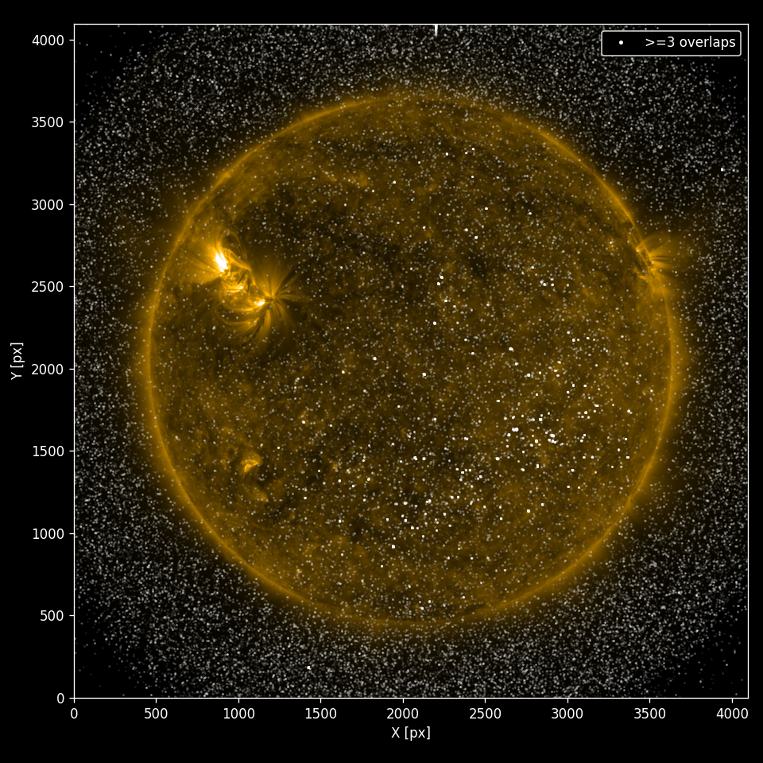
Needle in a haystack:
1 Day: >=3 overlapping wavelengths
Extracted spikes data in separate metadata files
~200 Million files, each containing [10³ – 10⁴] spikes
Trillions Individual spikes in total
~25 TB data to comb.
~ 1.5 million positive detections exist
How do we find them?
If a spike exists in more than 3-channels at the same time and location, it is probably good.

Slide 8
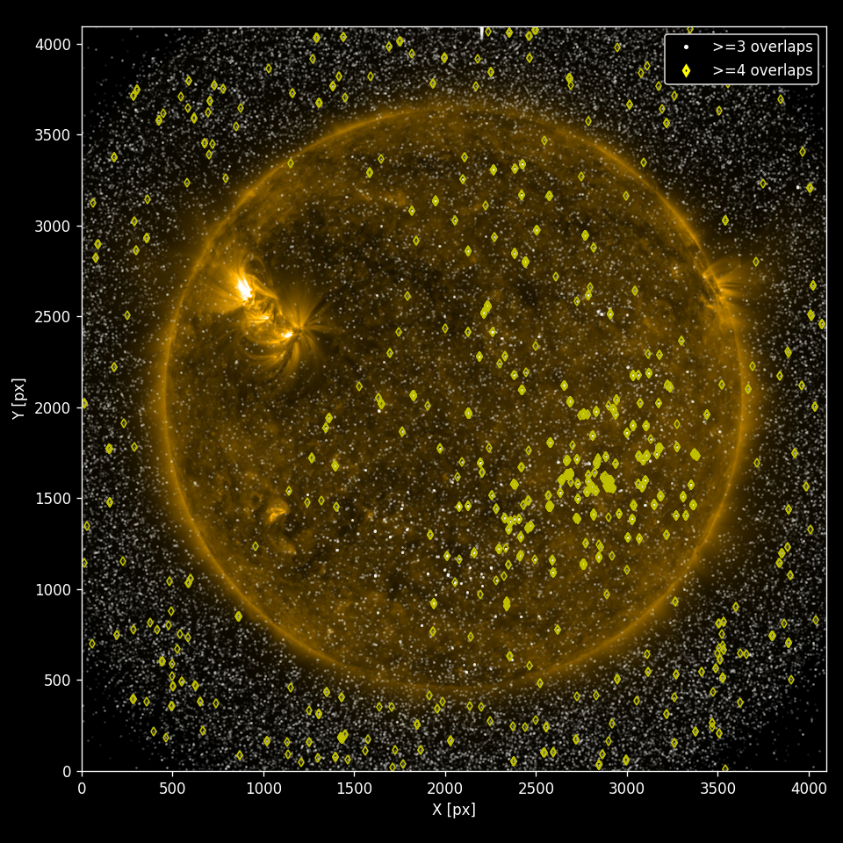
Needle in a haystack:
1 Day: >= 4 overlapping wavelengths
Extracted spikes data in separate metadata files
~200 Million files, each containing [10³ – 10⁴] spikes
Trillions Individual spikes in total
~25 TB data to comb.
~ 1.5 million positive detections exist
How do we find them?
If a spike exists in more than 3-channels at the same time and location, it is probably good.

Slide 9
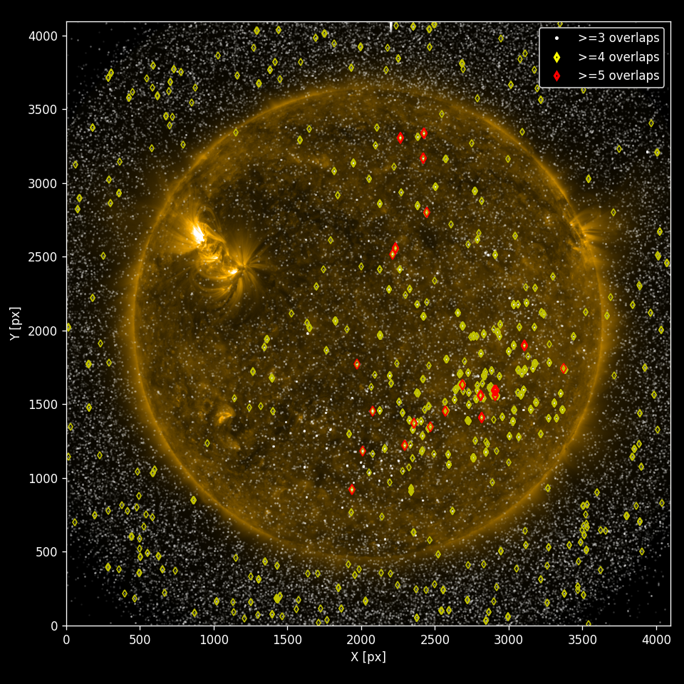
Needle in a haystack:
1 Day: >= 5 overlapping wavelengths
Extracted spikes data in separate metadata files
~200 Million files, each containing [10³ – 10⁴] spikes
Trillions Individual spikes in total
~25 TB data to comb.
~ 1.5 million positive detections exist
How do we find them?
If a spike exists in more than 3-channels at the same time and location, it is probably good.

Slide 10
Needle in a haystack:
1 Day: >= 6 overlapping wavelengths
Extracted spikes data in separate metadata files
~200 Million files, each containing [10³ – 10⁴] spikes
Trillions Individual spikes in total
~25 TB data to comb.
~ 1.5 million positive detections exist
How do we find them?
If a spike exists in more than 3-channels at the same time and location, it is probably good.

Slide 11
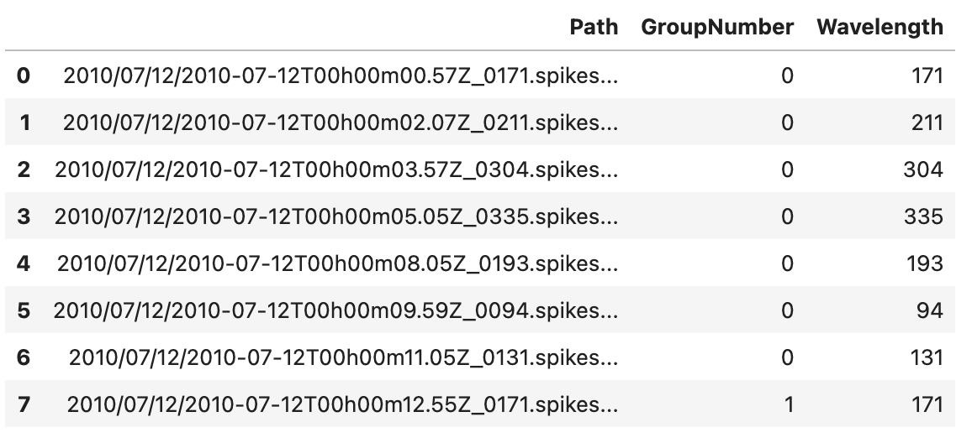
Data Overview
Spikes metadata in FITS files with 1 file per wavelength, with a 12-s cycle to produce spikes files for 7 wavelengths.
We grouped the data in series of 7 files (1 per wavelength), giving each 7-file series a unique group number.

Slide 12
Data Overview
Spikes metadata in FITS files with 1 file per wavelength, with a 12-s cycle to produce spikes files for 7 wavelengths.
We grouped the data in series of 7 files (1 per wavelength), giving each 7-file series a unique group number.
coords – coordinates of the spikes in 1D on the 4k x 4k image
int1, int2 – intensity before and after the correction of the spike.

Slide 13
Data Overview
Spikes metadata in FITS files with 1 file per wavelength, with a 12-s cycle to produce spikes files for 7 wavelengths.
We grouped the data in series of 7 files (1 per wavelength), giving each 7-file series a unique group number.

Slide 14
Data Overview
Features:
GroupNumber – A “group” is defined as a series of 7 files; one from each wavelength filter. Thousands of coordinates associated with the same group number.
coords – coordinates of the spikes in 1D (converted to 2D on-the-fly)
int1, int2 – intensity before and after the correction of the spike.
wref – wavelength filter of the measurement. An integer within [0 – 6]
W0,...,W6 – truth matrix of the presence of an overlapping spikes measured in all 7 wavelengths.
Overlaps: total number of spectral overlaps
Feature vector

Slide 15
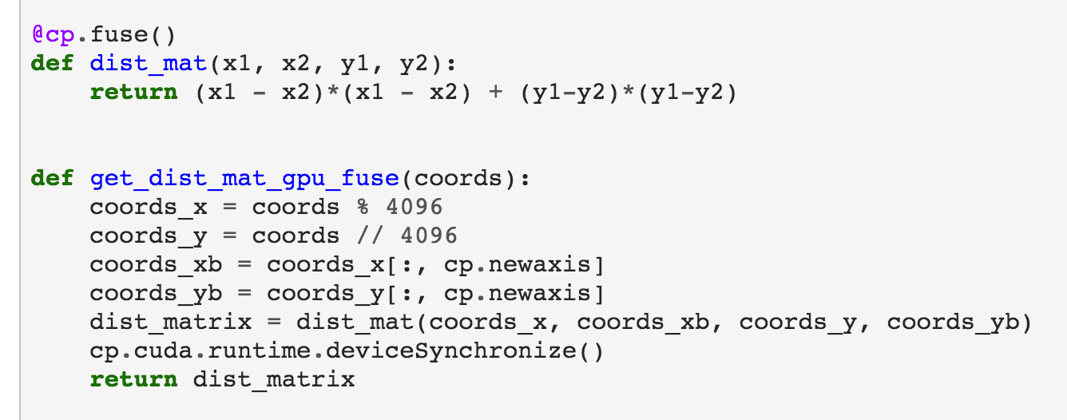
Example for processing 200 group: (1 day has ~7000 groups, thousands of spikes per group)
Brute force: Looking for “clusters” of at least 2 pixels across the 7 wavelengths, accounting for 1-pixel shifts between wavelengths due to instrument pointing discrepancies. This requires calculating distance matrices.
CPU version
GPU version

Slide 16
Example for processing 200 group: (1 day has ~7000 groups, thousands of spikes per group)
Brute force: Looking for “clusters” of at least 2 pixels across the 7 wavelengths, accounting for 1-pixel shifts between wavelengths due to instrument pointing discrepancies. This requires calculating distance matrices.
CPU version
GPU version

Slide 17
Example for processing 200 group: (1 day has ~7000 groups, thousands of spikes per group)
Brute force: Looking for “clusters” of at least 2 pixels across the 7 wavelengths. This requires calculating distance matrices.
Need to find all overlaps between all possible permutations of 7 wavelengths to detect “clusters” of spikes.

Slide 18
Example for processing 200 group: (1 day has ~7000 groups, thousands of spikes per group)
Brute force: Looking for “clusters” of at least 2 pixels across the 7 wavelengths. This requires calculating distance matrices.
Need to find all overlaps between all possible permutations of 7 wavelengths to detect “clusters” of spikes.
With optimum CPU parallelization it would take a few months… The process is 50 % I/O bound / cpu-bound.

Slide 19
Example for processing 200 group: (1 day has ~7000 groups, thousands of spikes per group)
Brute force: Looking for “clusters” of at least 2 pixels across the 7 wavelengths. This requires calculating distance matrices.
Need to find all overlaps between all possible permutations of 7 wavelengths to detect “clusters” of spikes.
With optimum CPU parallelization it would take a few months…
GPU computation costly due to high-memory needs, not accessible to the regular SDO data user who wants to quickly re-spike images on a regular laptop.
Explore fast ML methods, use GPU computation to create enough “ground-truth” validation/test sets.

Slide 20
Apply on validation set
Anomaly Detection (extraction)
Clustering
(identification)
Analyze anomaly subclasses using reconstruction error vector of most anomalous bands
Background Modeling using RXD (c), AE(d), VAE(3)
Labels: Detections
Training Dataset
Labels: Background
(a) TRAINING: Extraction and Identification
Tune detector threshold

Slide 21
Apply on validation set
Anomaly Detection (extraction)
Clustering
(identification)
Clustering
Subclass 1
.
.
.
Analyze anomaly subclasses using reconstruction error vector of most anomalous bands
Detections
Background Modeling using RXD (c), AE(d), VAE(3)
Labels: Detections
Unseen Observations
Training Dataset
Anomaly detector
Subclass N
Labels: Background
Background
(a) TRAINING: Extraction and Identification
Tune detector threshold
(b) TEST: Applying trained models to unseen data

Slide 22
Apply on validation set
Anomaly Detection (extraction)
Clustering
(identification)
Clustering
Subclass 1
.
.
.
Analyze anomaly subclasses using reconstruction error vector of most anomalous bands
Detections
Background Modeling using RXD (c), AE(d), VAE(3)
Labels: Detections
Unseen Observations
Training Dataset
Anomaly detector
Subclass N
Labels: Background
Background
(a) TRAINING: Extraction and Identification
Tune detector threshold
(b) TEST: Applying trained models to unseen data
Anomaly Detectors:
Anomalies (high distance/ anomaly score)
Input dimension 2
background
Input dimension 1
(1) Simplified 2-D representation of Reed Xiaoli Detector

Slide 23
Apply on validation set
Anomaly Detection (extraction)
Clustering
(identification)
Clustering
Subclass 1
.
.
.
Analyze anomaly subclasses using reconstruction error vector of most anomalous bands
Detections
Background Modeling using RXD (c), AE(d), VAE(3)
Labels: Detections
Unseen Observations
Training Dataset
Anomaly detector
Subclass N
Labels: Background
Background
(a) TRAINING: Extraction and Identification
Tune detector threshold
(b) TEST: Applying trained models to unseen data
Anomaly Detectors:
reconstruction
input
Anomalies (high distance/ anomaly score)
$$x_{i}^{1}$$
$${\hat{x}}_{i}^{1}$$
Input dimension 2
$$x_{i}^{2}$$
$${\hat{x}}_{i}^{2}$$
.
.
.
.
.
.
background
Input dimension 1
$$x_{i}^{b}$$
$${\hat{x}}_{i}^{b}$$
(1) Simplified 2-D representation of Reed Xiaoli Detector
encoder
decoder
(2) Autoencoder: high reconstruction error - anomalies

Slide 24
Apply on validation set
Anomaly Detection (extraction)
Clustering
(identification)
Clustering
Subclass 1
.
.
.
Analyze anomaly subclasses using reconstruction error vector of most anomalous bands
Detections
Background Modeling using RXD (c), AE(d), VAE(3)
Labels: Detections
Unseen Observations
Training Dataset
Anomaly detector
Subclass N
Labels: Background
Background
(a) TRAINING: Extraction and Identification
Tune detector threshold
(b) TEST: Applying trained models to unseen data
Anomaly Detectors:
reconstruction
input
reconstruction
input
Anomalies (high distance/ anomaly score)
$$x_{i}^{1}$$
$${\hat{x}}_{i}^{1}$$
$$x_{i}^{1}$$
$${\hat{x}}_{i}^{1}$$
Input dimension 2
$$x_{i}^{2}$$
$$μ$$
$${\hat{x}}_{i}^{2}$$
$$x_{i}^{2}$$
$${\hat{x}}_{i}^{2}$$
.
.
.
$$z$$
.
.
.
.
.
.
.
.
.
$$σ$$
background
$$x_{i}^{b}$$
Z: sampling from stochastic latent space
$${\hat{x}}_{i}^{b}$$
Input dimension 1
$$x_{i}^{b}$$
$${\hat{x}}_{i}^{b}$$
Probabilistic encoder
Probabilistic decoder
(1) Simplified 2-D representation of Reed Xiaoli Detector
encoder
decoder
(2) Autoencoder: high reconstruction error - anomalies
(3) Variational Autoencoder high reconstruction error-anomalies

Slide 25
Summary
We look for coincidental spikes overlapping in the spatial and spectral domain in a haystack of trillions of pixel events
The data volume is too big to employ brute-force algorithms that would calculate distance matrices for each possible permutation of set of spectral channels
We seek to accelerate this process using unsupervised clustering and anomaly detection methods, which we evaluate using ground-truth trainings sets created with the brute-force method.

