Slide 1
A Benchmark Data Set for Coronal Hole Detections: Results from a Community Wide Assessment Project
==================================
K. Muglach (NASA/GSFC, CUA)
M.A. Reiss (CCMC), E. Mason (Pred. Sci.), S. Chakraborty (Virginia Tech.)
and Coronal Hole Boundary Working Team

Slide 2
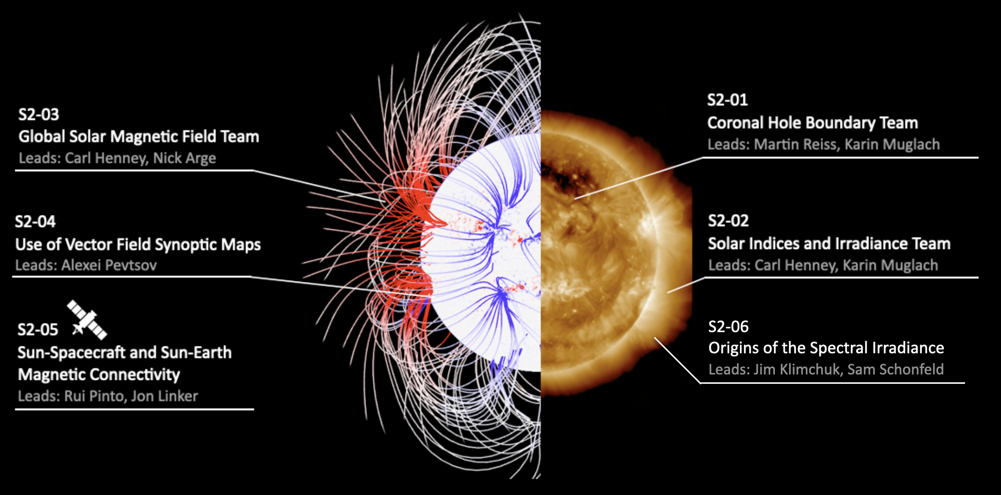
COSPAR International Space Weather Action Team Cluster S2:
Ambient Solar Magnetic Field, Heating and Spectral Irradiance
https://iswa-cospar.org/s2
List of People
^{Young &….}

Slide 3
A Benchmark Data Set for Coronal Hole Detections: Results from a Community Wide Assessment Project
=============================================
Why study coronal holes and coronal hole boundaries?
Large CHs and their High Speed Streams have space weather impact at Earth:
Geomagnetic storms and increase of electron density in the radiation belts (can lead to spacecraft anomalies), HSSs can change CME propagation
CH boundaries are used in semi-empirical solar wind models (e.g. WSA)
Identify the source of the slow solar wind
Note: CH boundaries can not be validated as we do not know the ground truth!
Solar wind models can be validated via in-situ solar wind measurements.

Slide 4
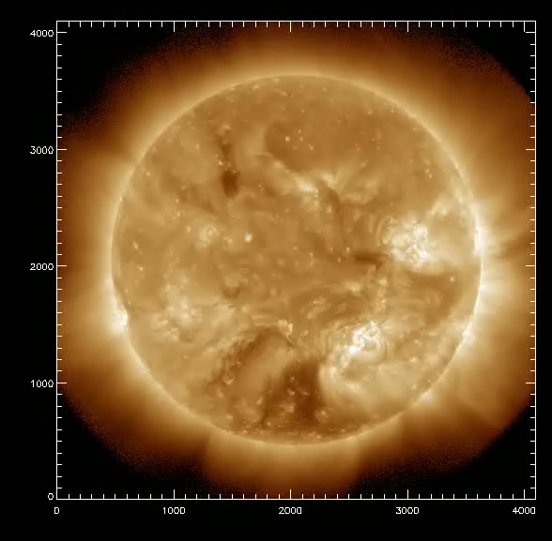
SDO/AIA and SDO/HMI
A Benchmark Data Set for Coronal Hole Detections: Results from a Community Wide Assessment Project
=============================================
Data to be used:
29 full disk images were selected (2014-2019)
all AIA EUV channels and HMI LOS magnetograms can be used
AIA 193 A shown here as example

Slide 5
A Benchmark Data Set for Coronal Hole Detections: Results from a Community Wide Assessment Project
=============================================
Comparison of 15 methods with contour overlays (2015-08-20):
a) Probability map, b) largest and smallest contour on AIA 193 A, c) largest and smallest contour on HMI magnetogram
Reasonable agreement of CH boundary

Slide 6
A Benchmark Data Set for Coronal Hole Detections: Results from a Community Wide Assessment Project
=============================================
First results published: Reiss et al. 2021, ApJ 913, #28
Follow-up paper under review
Community benchmark data set will be made publicly available!
AIA and HMI images, ID masks, labelled images, complete identification statistics
Intended as comparison data set for future CH detection schemes!
Want to join the ISWAT team?
https://iswat-cospar.org/S2-01

Slide 7
Participants:
Team leads:
M. A. Reiss SRI, Graz, Austria
K. Muglach, NASA/GSFC, Greenbelt, MD, USA
Aug. 2019: 6 participants, from 2 institutions
Jan. 2021: 22 participants, from 12 institutions
Jun. 2021: 31 participants, from 17 institutions
update: Sep. 2022: 38 participants, from 25 institutions

Slide 8
Participating methods:
(list as of August 2023)
ACWE New Mexico State University Boucheron et al. 2026)
CATCH University of Graz Heinemann et al. (2019)
CHARM University of Colorado Krista & Gallagher (2009)
CHIMERA Trinity College Dublin Garton et al. (2018)
CHIPS Virginia Tech Reiss et al. (2023)
CHMAP Predictive Science Inc. Caplan et al.2016)
CHORTLE Southwest Research Institute Lowder et al. (2014)
CHRONNOS University of Graz Jarolim et al. 2026
CNN193 Moscow State University Illarionov & Tlatov (2018)
SPoCA Royal Observatory of Belgium Delouille et al. (2018)
SPoCA-HEK Royal Observatory of Belgium Verbeeck et al. (2014)
SYNCH University of Oulu Hamada et al. (2018)
WWWBCS University of Warwick Reiss et al. (2023)
TH35

Slide 9
Coronal Hole Boundaries: Results from a Community wide Assessment Project
==================================
What are coronal holes ?
Observational answer: dark regions in solar coronal images.
- dark due to reduced temperature and density
- reduced density due to magnetic field lines reaching far
into the heliosphere (‘open field lines’)

Slide 10
Context:
This activity is part of the COSPAR initiative:
International Space Weather Action Teams (ISWAT)
which is a global hub for collaborations addressing challenges across the field of space weather
https://iswat-cospar.org/

Slide 11
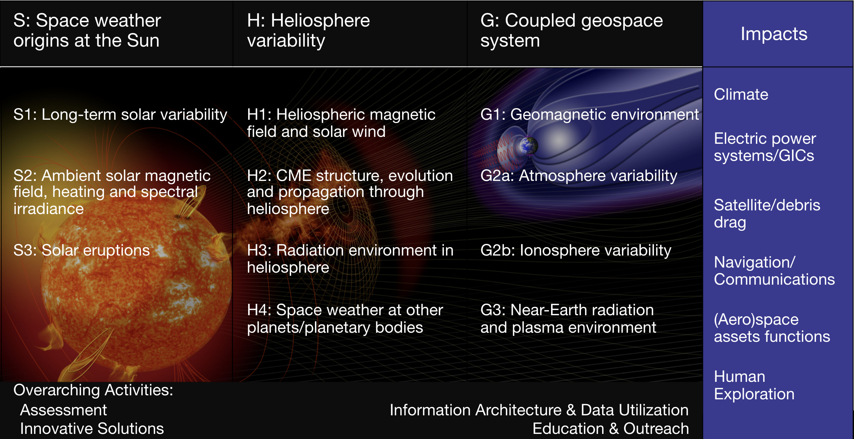
ISWAT overview:
List of People
^{Young &….}

Slide 12
General objectives of project:
Study and compare different automated coronal hole detection methods provided by the space weather community
Develop strategies to quantitatively assess the spatial and temporal uncertainty of coronal hole boundary locations
Use this information to further improve the predictive capabilities of ambient solar wind models.
close collaboration with ISWAT H1-01:
Ambient Solar Wind Validation Working Team

Slide 13
Specific objectives of project:
Study and compare different automated coronal hole detection methods provided by the space weather community
Evaluate CH boundaries derived from these methods:
- compare location of boundary (gives observed uncertainties of
CH boundaries)
- compare CH parameters derived from these boundaries:
e.g. average coronal intensity inside the CH, average
photospheric signed magnetic flux in CH, average unsigned
flux in CH

