Slide 1
Lessons Learned Publishing the First Executable Paper in Heliophysics
Shawn Polson, Rebecca Ringuette, Lutz Rastaetter, Eric Grimes, Jon Niehof, Nick Murphy, Yihua Zheng
Notes:
TODO: REWATCH MY TALK RECORDING FROM SAN DIEGO to plan speaker’s notes script.
TODO: During talk, have DeepNote open in one browser tab, locally-running Docker image in another.
All right. We’re going? Good. Well, hi everybody! My name is Shawn, Tech Lead of PyHC, and I’m here to talk to you today about executable papers. My team and I just published the first one in the field of Heliophysics back in March, in the journal Frontiers in Astronomy and Space Sciences, and honestly we were surprised to be the first! Hah, so I’m here trying to get the word out about them.

Slide 2
In This Talk
Open Science and Reproducibility Problems
Executable Papers Intro
Lessons Learned
Notes:
In this talk, I’ll set the stage with the open science and reproducibly issues that executable papers address. Then I’ll talk about what they are and the lessons I learned publishing one.

Slide 3
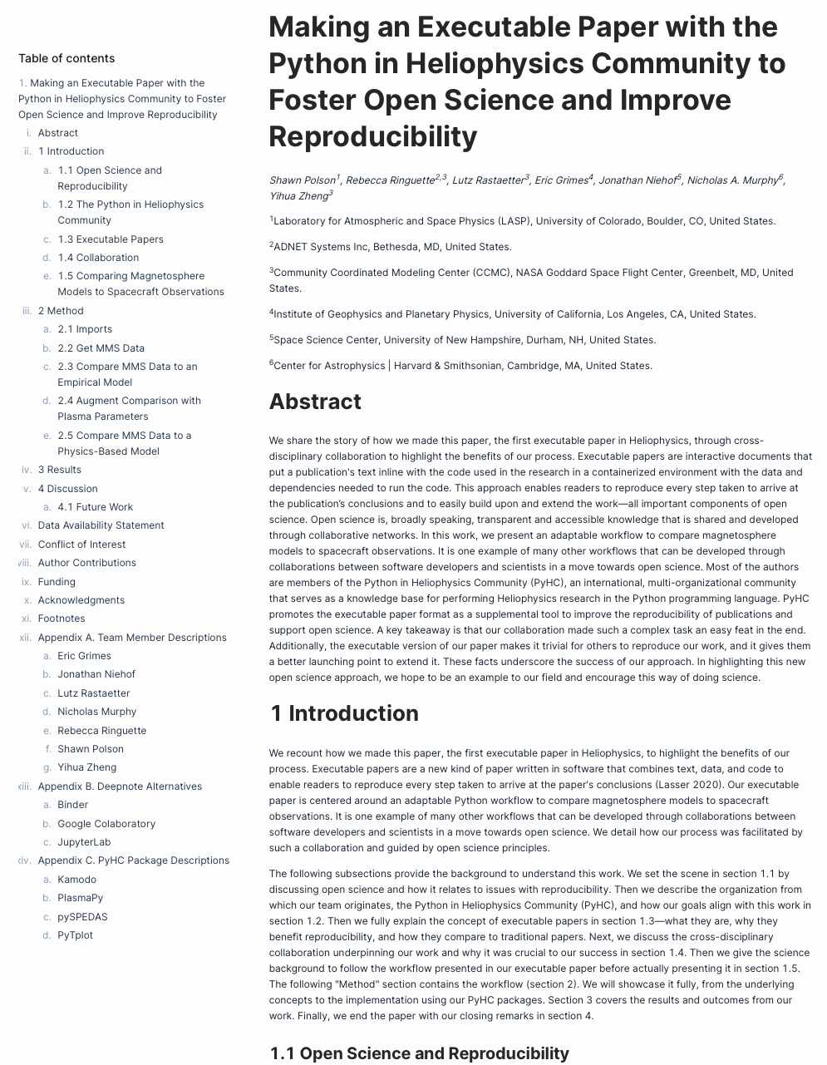
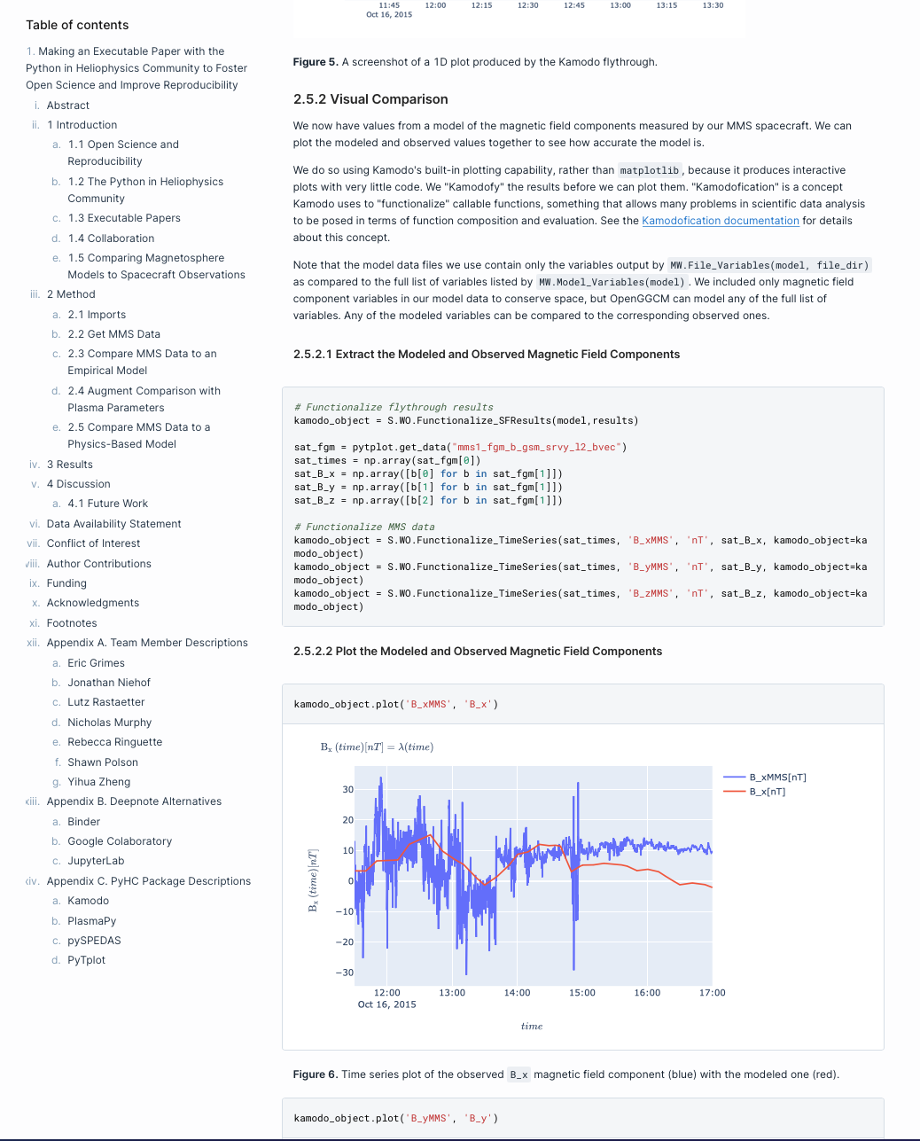
An Executable Paper
Notes:
Executable papers. So, to break the suspense early, this is what I’m talking about when I say “an executable paper.” This is a screenshot of mine in Deepnote, the online platform where we host it.
The 5-second explanation is you write your entire paper in a Jupyter notebook—abstract, introduction, references at the bottom, the whole thing. And any time your work used code to get a result, like to perform a calculation or generate a plot, you put that code right above the result, in-line with the paper’s text, such that the reader can now directly replicate your work by simply running the notebook top to bottom. Pretty cool, so why would we wanna do this?
First thing to notice is it’s a paper. You know, it’s got an abstract, an introduction, there’s references at the bottom, all the stuff you’re used to seeing. But what makes it special is that any time code was used in the research to generate a result, that code appears in-line with the text directly above the result. So like, over here on the right you see this plot from my paper, and there’s the code that made the plot right above it. Pretty cool. So why do care about these?
---
To break suspense early, here’s what I’m talking about
1st: it’s a paper (abstract, intro, references, all the stuff you’re used to)
What makes them special is any time code generates a result, appears in-line with the text above result (point right)
Pretty cool.

Slide 4
Open Science
and Reproducibility Problems
Notes:
Well,

Slide 5
Open Science and Reproducibility Problems
Six years since Nature “lifted the lid on the reproducibility crisis”
Notes:
I probably don’t have to tell this group about the concept of the reproducibility crisis that Nature kicked off six years ago. “SO I’LL SKIP THIS SLIDE.”
Where more than 70% of researchers tried and failed to reproduce someone else’s paper.
Now, the severity of the crisis, or whether there is one at all, is still debated.
But it did get people thinking about reproducibility, and ultimately spawned initiatives like this Year of Open Science we’re in now (and my work!).

Slide 6
Open Science and Reproducibility Problems
Traditional publications face reproducibility problems
Missing raw or original data
Lack of a tidied-up version of the data
No source code available
Lacking software to run the experiment
Notes:
The issue is there are these recurring problems when we try to reproduce traditional papers.
We might be missing the raw data the researchers started with,
or a tidied-up version they used.
It’s also not uncommon for source code to be left unpublished,
or you might just not have some software they used to run the experiment.

Slide 7
Open Science and Reproducibility Problems
Traditional publications face reproducibility problems
Missing raw or original data
Lack of a tidied-up version of the data
No source code available
Lacking software to run the experiment
Even when available, replication can be non-trivial
Notes:
Even worse, even when all these components are available,
deprecated dependencies or just a lack of documentation can make replication a non-trivial task.

Slide 8
Executable Papers
Notes:
So in come executable papers which, in contrast, include all components of the research together.

Slide 9
Executable Papers
“Interactive pieces of software that combine text, data, and code to enable readers to reproduce every step taken to arrive at a publication’s conclusions”
Notes:
It’s a pretty novel paper format without a clear definition, but I’ve been liking this one lately: They’re “interactive pieces of software that combine text, data, and code to enable readers to reproduce every step taken to arrive at a publication's conclusions.” That’s everything from the raw data to the polished figures and everything in-between.
---
It’s a pretty novel paper format without a clear definition.
But I’ve been liking this one, they’re
(Read)
“That’s everything from the raw data to the polished figures and everything in-between”

Slide 10
Executable Papers
Notes:
Let’s look again at this screenshot of my paper.
It’s a whole paper written inside a Jupyter notebook. Technically, it doesn’t have to be a Jupyter notebook, executable papers are a concept more abstract than notebooks, there just isn’t a better implementation to use right now. What makes it special is the paper gets containerized with 100% of all the data and software used in the research. Like in a Docker container. So once you have the paper there is never a need to go find and download data nor install anything.
You won’t have to worry about future updates to package either, because the versions you used are all safely preserved in the container.
--
If you were thinking to yourself a second ago, “that sounds a lot like a Jupyter notebook,” well, you’re right. Because at the moment executable papers are Jupyter notebooks—for Python research, anyway. It doesn’t have to be this way, executable papers are a concept more abstract than notebooks, there just isn’t a better implementation to use right now. What makes them special is the paper gets containerized with all the data and software used in the research. Like in a Docker container. So once you have the paper there is never a need to go find and download data nor install anything.
This containerization adds stability to the paper too, future-proofing it so that it should work the next time someone tries to use it. As in, you know, maybe numpy version 1000 is gonna be very different and very incompatible with the version we use today, but that won’t matter because the current version is preserved in working order inside the container—which helps.
---
Let’s look again at this screen of my paper.
If you were thinking to yourself a second ago, “that sounds a lot like a Jupyter notebook,” well, you’re right
At present they’re Jupyter notebooks—for Python research anyway
Doesn’t have to be this way; they’re a more abstract concept
Just isn’t a better implementation right now
Special: Containerized with data and software used
there is never a need to find and download data nor install any software
Adds stability
Future-proofed so it should work next time someone tries
(e.g. numpy v1000 very different, very incompatible),
the current version is preserved in working order inside the container (helps)

Slide 11
Publishing Executable Papers
Journals don’t yet accept executable papers
Not unheard of to reference 80–100 year-old papers
Hard to fathom that level of support for any software
Who hosts them?
Include them with traditional paper submissions
Notes:
So that’s a quick “what are executable papers.” What’s it like publishing one of these? Well,
The first thing to know is most journals don’t yet accept executable papers as formal submissions. Because there’s some unsolved issues with the format.
Stability being a leading one. Because it’s not unheard of to reference a paper that’s, say, 80-100 years old. But it’s hard to fathom that level of support being given to executable papers—or software of any kind for that matter.
There’s also the political question of who will host them and pay for all that storage space.
So, not having good answers to these issues, what you do at the moment is you include an executable version with your traditional paper submission.
First thing: (Most?) journals.
I don’t know of one.
Internet hasn’t even existed for 80 years! Only half that!
Jan 1 1983 is internet’s official birthday (making it 40yo)
Political problem: hosting
Would love to see journals accepting, but no bright ideas here
It’s a supplemental tool; doesn’t replace the traditional submission
Get DOI for container and link to it somehow
PAUSE FOR QUESTIONS!!
---
This is great, and not overly complicated, so why hasn’t the practice caught on better? I think probably a leading reason is that journals don’t accept executable papers as formal submissions yet. Maybe I should say “most” journals—I don’t know of one. And that’s because there are some unsolved problems with the format here. Stability is a big one. You know, it’s not unheard of to reference a paper that’s 80-100 years old. But it’s hard to fathom that level of support being given to actually any software of any kind. You know, heck, the internet’s not even 80 years old yet. If you didn’t know, Jan 1 of 1983 is considered the internet’s birthday, which makes it 40yo today. Who knows what software is gonna look like 100 years from now. And there are some unsolved political problems. Like, who’s going to host all this? If we’re attaching all this data and all this software to these papers that are getting published, someone’s gotta pay for that server storage somewhere. Even worse, they have to archive it and maintain it indefinitely. So um, yeah, I’d love to see journals accept these things but I don’t have any bright ideas there.
So, at the moment, what you do is you include an executable version of your paper with your traditional submission. And the good way to do that is to get a DOI for your container. And then link to it somehow. Which is what I did. And I can show that to you here in a demo.
Which I’m ready to get onto, but I’ll pause here for a moment in case anyone has any questions about what I’ve said so far? I’ll give you just a minute to think about it. Going once… going twice… No? Okay cool. Then let’s go to a demo!

Slide 12
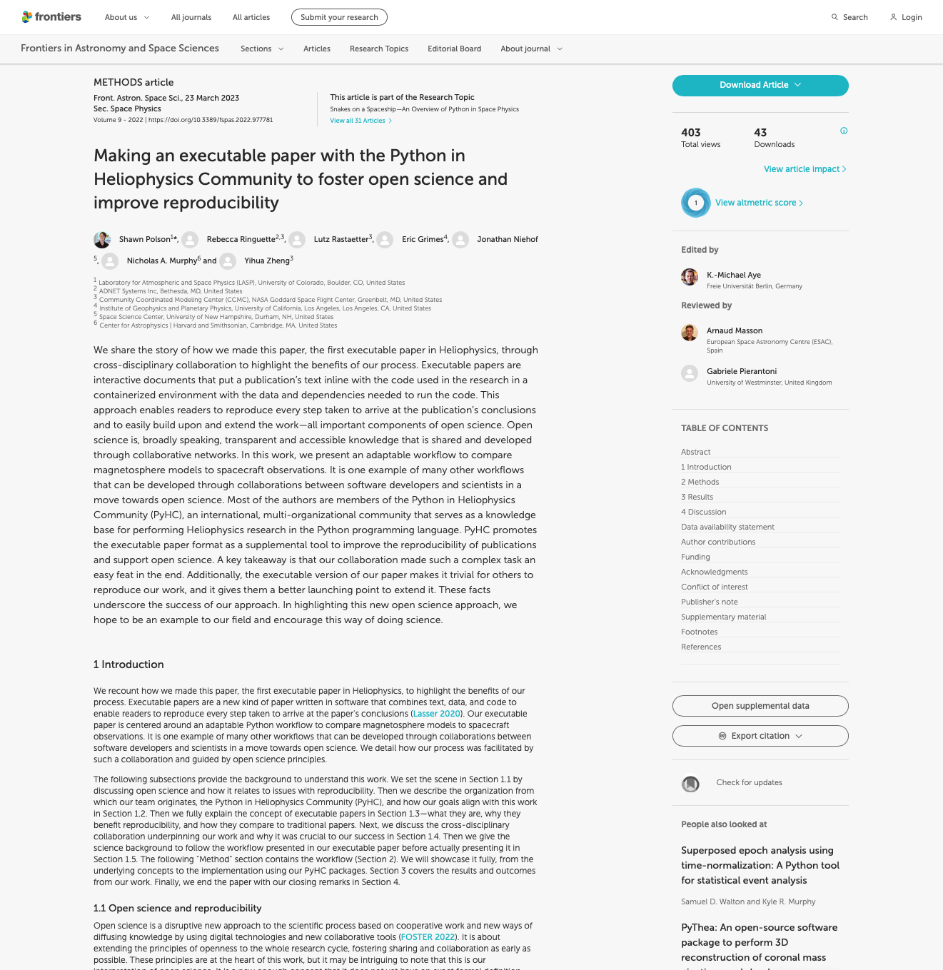
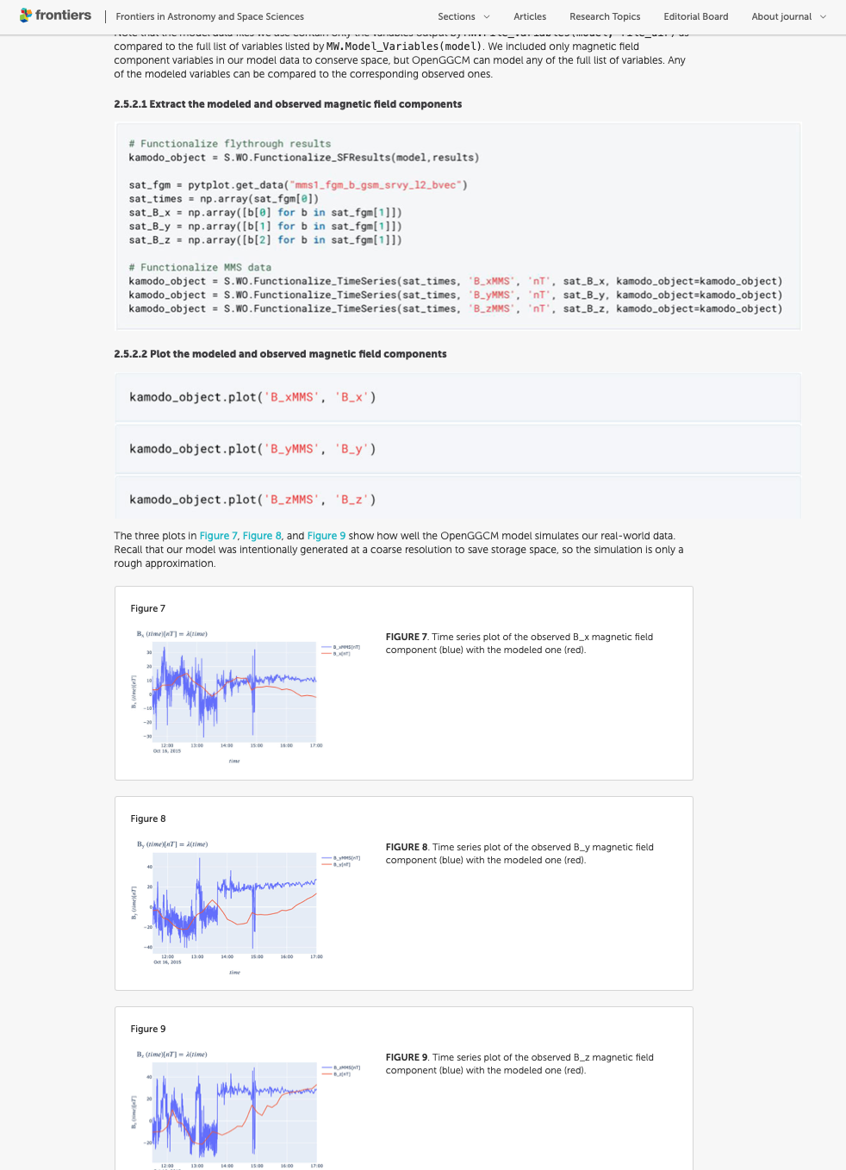
“Include them with traditional paper submissions”
Notes:
And that’s what we did!
Here’s another screenshot of my paper, but this time it’s the static version we made for Frontiers. We submitted this version like any other traditional journal submission.
It looks basically identical, but you can’t actually execute or interact with any of the code in this version because it’s all just static pictures here.
Frontiers in Astronomy and Space Sciences, vol. 9, id. 977781
Pub Date: March 2023

Slide 13
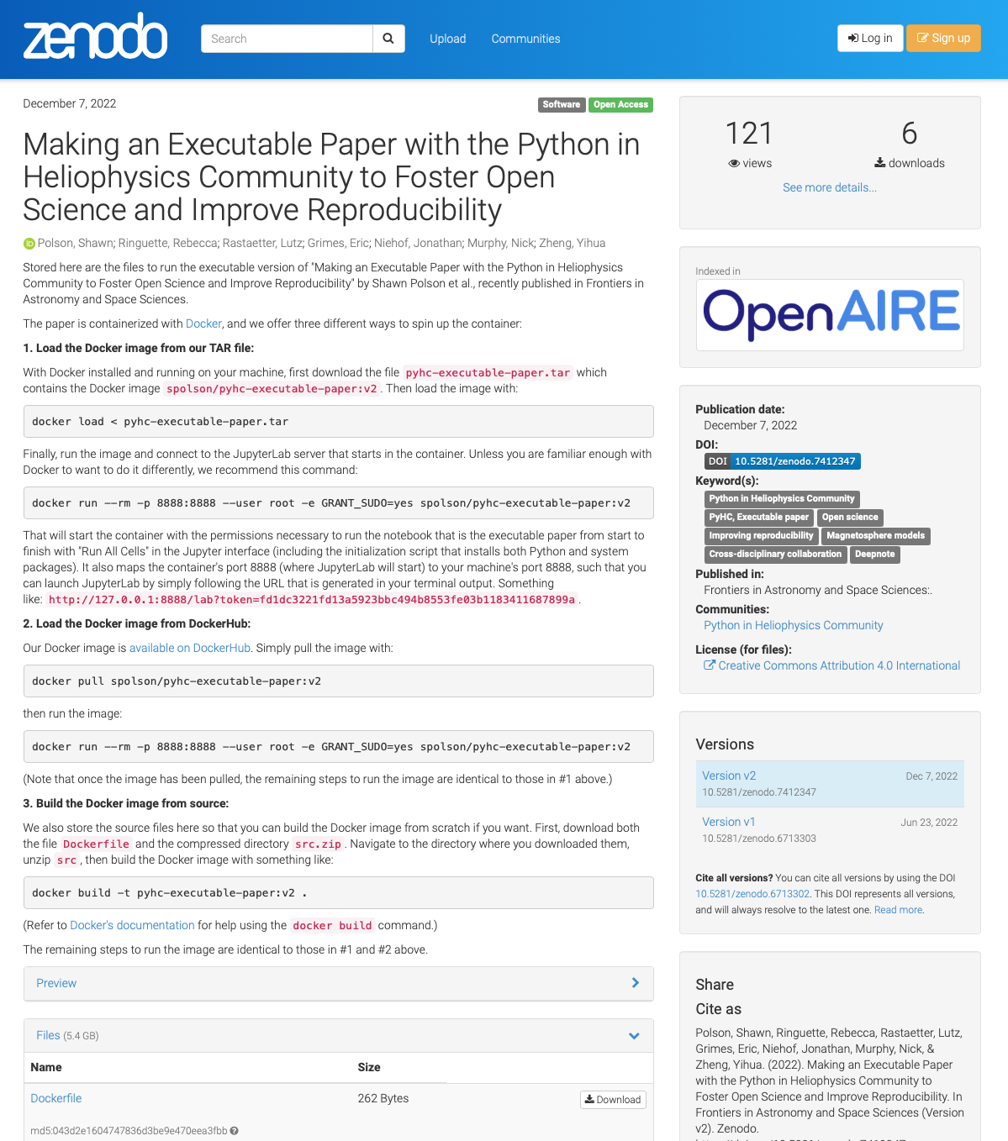
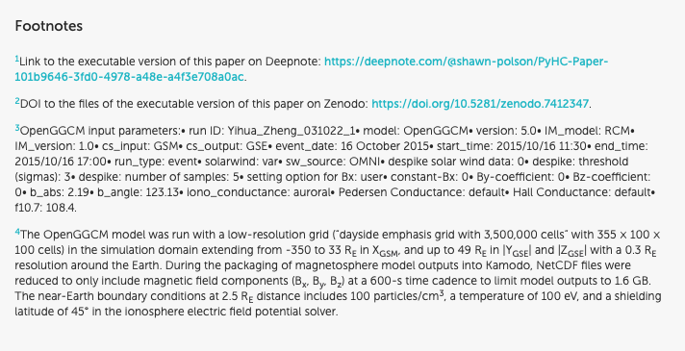
“Include them with traditional paper submissions”
Notes:
So what we did was, in footnotes (which you see here on the left) we put a link to the executable version. [POINT AND READ]
But, because that link isn’t guaranteed to work forever, we got a DOI for the container files and linked to them too, since DOIs do come with more guarantees about long-term stability. So if that link breaks they can still rebuild the container themselves and run it.
And notice here on the right how I wrote these nicely detailed instructions on the Zenodo page for how to use the files to spin up the container to access the executable paper.

Slide 14
Lessons Learned
Notes:
So okay, I published this executable paper, the first in Heliophysics. What did I learn from it?

Slide 15
Lessons Learned
Executable papers solve problems
Big data is a challenge
Journals decide how you represent code
Working with typesetters was tricky
Notes:
I’d say I can summarize most of what I learned into four main points:
First, executable papers really do solve the reproducibility problems traditional papers have; they’re worth making.
Second, big data is a challenge for executable paper authors, and in some cases may even be a deal breaker.
Different journals will have different rules for how they want you to represent code in your paper. And…
Working with typesetters was tricky. We’re basically trying to replicate the structure of a Jupyter notebook in a journal, which is super nonstandard and causes headaches for typesetters.
Now I’ll expand on each of these a little and that’ll be the end of my talk.

Slide 16
Executable papers solve problems
Traditional publications face reproducibility problems
Missing raw or original data Have all data
Lack of a tidied-up version of the data Have all data
No source code available Have all source code
Lacking software to run the experiment Have the software
Even when available, replication can be non-trivial Trivial replication
❌
❌
❌
❌
❌
Notes:
So, executable papers do solve the reproducibility problems traditional papers face.
They have all the data used in the research,
They have all the source code right there next to the text,
You’re not missing the software used in the research,
And they’re trivial to replicate (in most cases you just hit one “Run” button, and boom you’ve directly replicated the research).

Slide 17
Big data is a challenge
Storage Limits
Deepnote: 5GB free
GitHub: 100MB files / 100GB repos (under 5GB recommended)
Google Colab: 2GB files / ~77GB proj free (Pro offers up to 700GB)
CoCalc: 3GB free (64GB–64TB offered for astronomical prices)
Self-hosted container: whatever you can afford indefinitely
Can’t link to cloud storage in your paper
Notes:
Big data is a challenge when you’re making executable papers because you have to fit 100% of all the research components inside the paper’s container, or else you forfeit stability. You can’t just store large amounts of data in the cloud and link to it, because the moment that link breaks or changes, your executable paper is no longer valid; readers won’t be able to run your notebook because they won’t have the data.
So if your paper requires more data storage than what can fit in the container, that’s honestly a deal breaker and you probably should NOT try to make an executable paper. (that’s just how it is at the moment)
This all means that you’re at the mercy of whatever storage limits your chosen platform imposes.
I included storage limits for some popular platforms here.
Deepnote’s, what we used, is 5GB per project. Which was limiting (we had to use a smaller model than originally planned), but the good thing is the storage was free, which isn’t always the case. And this is important, because when you’re supposed to host these things indefinitely (80-100 years or more!) you REALLY don’t want monthly fees. Like Colab and CoCalc both offer way more than 5GB of storage, but they’re paid tiers so we didn’t even consider them.
This limit actually mattered for us because at one point we were using an OpenGGCM model that was hundreds of GB large. We ended up bailing on it and shrunk it way down to a couple gigs, to the point it was useless for scientific analysis, but enough to still make our point
GitHub is free too. You might store your notebook files there them host them in Binder. But GitHub’s limits are 100MB per file or about 100GB per repo (although they strongly recommend staying under 5GB, and support may start emailing you if you surpass 5GB).
Google Colab has a free tier with at most 2GB files and about 77GB per project (although that fluctuates). They have paid tiers too, starting around $10/mo and going up to even 700GB of project storage for $50/mo (or more at pay-as-you-go-rates) but note that taking on a monthly cost is a SERIOUS consideration when you’re supposed to host these indefinitely (for 80-100 years or more!). Realistically, funds dry up and you eventually won’t be able to maintain those costs.
CoCalc seems to have the highest storage limit offering at a whopping 64TB, but that’d cost you thousands per month. Their cheaper plans start at $13/mo. But again, you really want something free.
Deepnote’s, what we used, is 5GB per project. We bailed on a large portion of the OpenGGCM model in our paper because of the file size.
GitHub support may start emailing you if you surpass 5GB
Colab prices: $10/mo Pro, $50/mo Pro+, $50/500 compute units Pay As You Go
CoCalc starts at $13/mo but gets into $thousands/mo

Slide 18
Journals decide how you represent code
Text vs images
Special fonts?
Which images count as figures?
Figure limits
Typesetting figures
Notes:
Going back to how different journals will have different rules for how they want you to represent code in your paper… There are a few logistical considerations.
(Note, I published a “technology and code” article, but ours was the first in the journal to actually have code! Everyone else was just abstractly describing what their code did in prose! [or math equations])
So, when I approached them, there were these questions:
Should code blocks be written text or screenshots from your code editor? (Ours were screenshots.)
If text, what font? Does the journal have a standard monospace font? And do they allow colored fonts for syntax highlighting?
If screenshots, do both the code blocks and their outputs count as figures? Or just the outputs? (like ours, only the outputs were “figures”.) (Also remember you gotta take good screenshots)
It matters what images count as a figure when there’s a figure limit for articles (ours was 15; would’ve exceeded that if code blocks counted)
And lastly, typesetters follow weird rules for where to place figures; keeping code blocks next to outputs can be hard given them (as we’ll see next slide)

Slide 19
Working with typesetters was tricky
Notes:
Honestly, typesetting this article was probably the hardest part of the whole process.
I must’ve went through at least 10 different authors proofs:
It was so bad, we eventually had to get Frontier’s Design Team involved to get it right
(the Design Team ended up getting an acknowledgement in our paper for their hard work, actually)
The biggest problem was keeping code blocks together with their outputs, and convincing them to print it as a single column.
Because when you’re making the notebook, there’s a very defined order to things: text blocks, code block, the code’s output, then another text block, etc.
Meanwhile, typesetters are used to letting images float around and land wherever on whichever page they land.
The first authors proof I got back had code blocks appearing outside the sections in which they were talked about, none of the code’s output figures were anywhere near the blocks that generated them, it was a mess.
What made it worse was the first few proofs were set in a two-column format:
(because I was told formatting it as a single column “greatly went against their style guide.”)
So even after I finally got code blocks paired their outputs, they were all crammed to the left or right side of the page such that no image was ever allowed to fill the full width of a page (which is a waste of space).
When you think about it, it really just doesn’t make sense to put a Jupyter notebook in a zig-zagging two-column format…
which really makes no sense for an executable paper:
I mean think about how you would separate a Jupyter notebook into two columns; it’s hard to imagine how you’d do that; it just doesn’t work.
In the best proof I got, the code blocks were correctly paired with their outputs, but they were all squeezed into one side of the page to stay within their column, such that no images filled the full width of a page (and they were all tiny). What a waste of space.
It was a fight to convince Frontiers to publish our paper as a single column. I got told that formatting it as a single column “greatly goes against their style guide.”
I eventually had to get in touch with the journal’s Production Manager and convince her that our paper deserved special treatment because it was the first of its kind doing something new. So I did get my single column.
But it’s still not perfect!
Actually if you look closely at the plots on the bottom right here, you’ve got 3 lines of code then the outputs all grouped together as figures 7,8,9.
Which is different from the PDF I approved! [SKIP TO NEXT SLIDE]

Slide 20
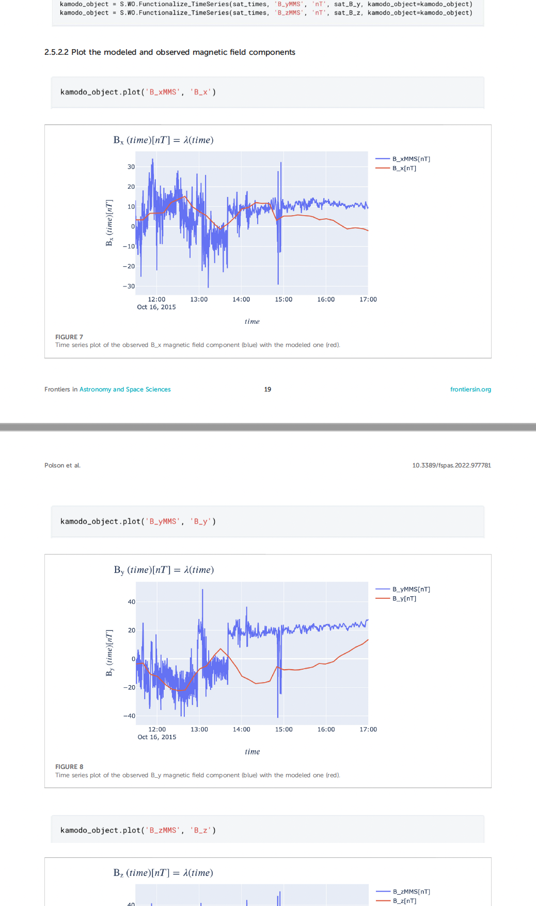
Working with typesetters was tricky
Notes:
This is just a screenshot of that same page but from the PDF version that I actually did approve.
And you’ll notice it goes code plot, code plot, code plot.
So I guess that’s the last thing I’ll note:
That even if you try your hardest, there still might be some formatting differences between the PDF you approve and how they present it online.
So you just gotta be aware of that.
--
Still not perfect:
The figures on the right aren’t with their code blocks.
Online formatting won’t be identical to approved PDF proof

Slide 21
In Conclusion
Traditional papers face open science and reproducibility problems
Executable papers combine text and code
Lessons Learned:
Executable papers solve problems
Big data is a challenge
Journals decide how you represent code
Working with typersetters was tricky
Notes:
Aaaaand that’s all I have.
In conclusion, I talked about:
the reproducibility problems faced by traditional papers,
how executable papers combine text and code to address those problems,
and what lessons I learned from publishing the first one in heliophysics. Namely that:
Executable papers really do improve the reproducibility of traditional papers
Big data is a challenge for authors
And you’ll have to work closely with your journal to nail down the formatting of the published static version of your paper.

Slide 22
Thank you
Contact me: shawn.polson@lasp.colorado.edu
Notes:
Questions?

