Slide 1
Assessment of thermospheric models in NASA/CCMC ecosystem
Jack WANG, Jia YUE
CCMC, NASA GSFC, USA
Catholic University of America, USA
Richard MULLINI, Chiu WIEGAND, Masha M. KUZNETSOVA,
M. Leila MAYS,
CCMC, NASA GSFC
Sean BRUINSMA
Centre National D’Etudes Spatiales, France

Slide 2
Aerodynamic Drag in the Thermosphere
= Space Object Positioning Error
drag force
$$=\frac{1}{2}$$
$$ρ$$
$${\text{AC}}_{i}v^{2}$$
Expected position
neutral density
Actual position
The major source of uncertainty in determining the precise orbital location of objects
in Low Earth Orbit is the computation of the acceleration due to atmospheric drag

Slide 3
COSPAR ISWAT initiative:
Thermosphere model assessment under storm conditions
International Space Weather Action Team G2A
http://www.iswat-cospar.org
Achievements
Operationally-relevant metrics for modeled neutral density under storm conditions have been developed (Bruinsma+, 2021).
Assessment during 13 storms was done for semi-empirical models (NRLMSISE-00, JB2008, DTM2013, DTM2020), and physics-based thermosphere-ionosphere models (TIE-GCM, CTIPe).

Slide 4
Thermosphere model assessment:
dataset & CCMC involvement
community challenges/campaigns
Runs-on-Request
Kamodo
CAMEL
Simulation
Analysis
Validation
High-fidelity thermosphere density data download from the CHAMP, GRACE, GRACE-FO, GOCE, and Swarm missions @ ftp://thermosphere.tudelft.nl
Reformatted observation dataset is publicly accessible
@ https://git.smce.nasa.gov/ccmc-share/camel-data

Slide 5
Thermosphere model assessment:
CCMC involvement Ⅰ
In the current project, multiple unique time periods during storm times are selected for the assessment.
In addition to the aforementioned models, NRLMSIS 2.0, GITM, WACCM-X were run in-house at CCMC Runs-on-Request system and accessed.
semi-empirical
physics-based thermosphere
physics-based whole atm.
DTM2020
WAM-IPE
NRLMSIS 2.0
JB2008
DTM2013
WACCM-X
GITM
TIE-GCM
CTIPe
CCMC Model Catalog
Runs-on-Request (ROR) is a free service open to any user interested in running the space science/space weather models hosted at the CCMC. Simulation output can also be directly downloaded at result pages.

Slide 6
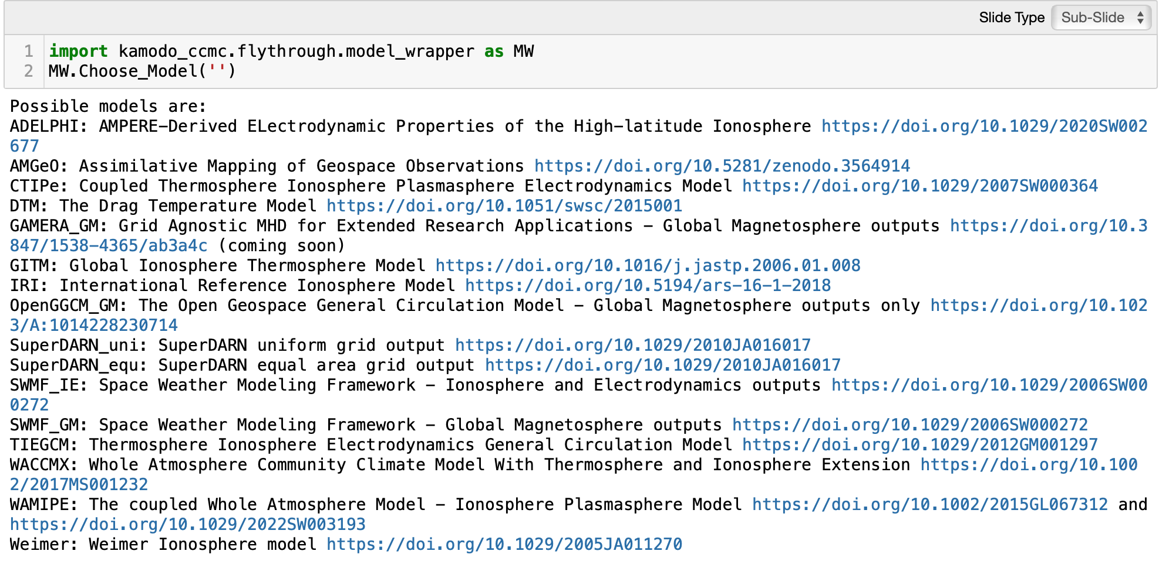
Thermosphere model assessment:
CCMC involvement Ⅱ
Simulation Output
The CCMC-hosted physics-based model flythrough is conducted by
Simplify validation workflow.
Kamodo is a Python open-source software package developed by the CCMC, which offers a model-agnostic satellite flythrough capability.
Kamodo GitHub repo

Slide 7
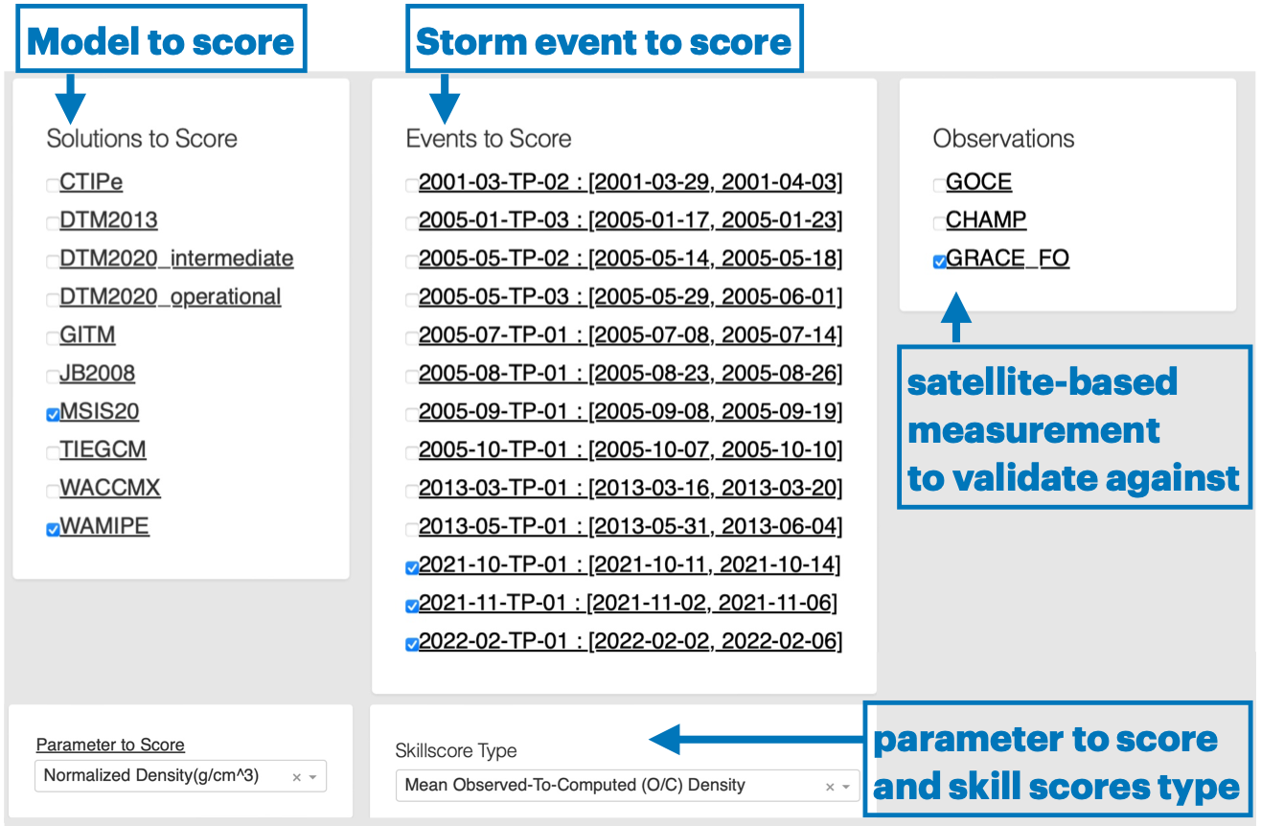
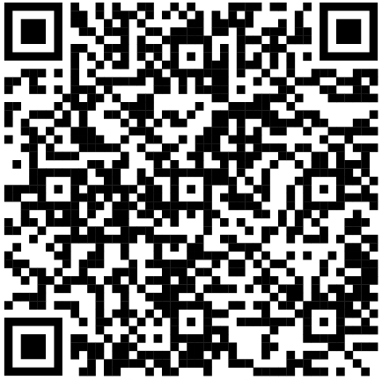
Thermosphere model assessment:
CCMC involvement Ⅲ
The neutral density validation project is built upon the CAMEL (Comprehensive Assessment of Models and Events Using Library Tools) framework developed and hosted by the NASA CCMC.
https://webserver1.ccmc.gsfc.nasa.gov/camel/NeutralDensity/

Slide 8
CAMEL Neutral Density Validation:
Definition of storm phase

Slide 9
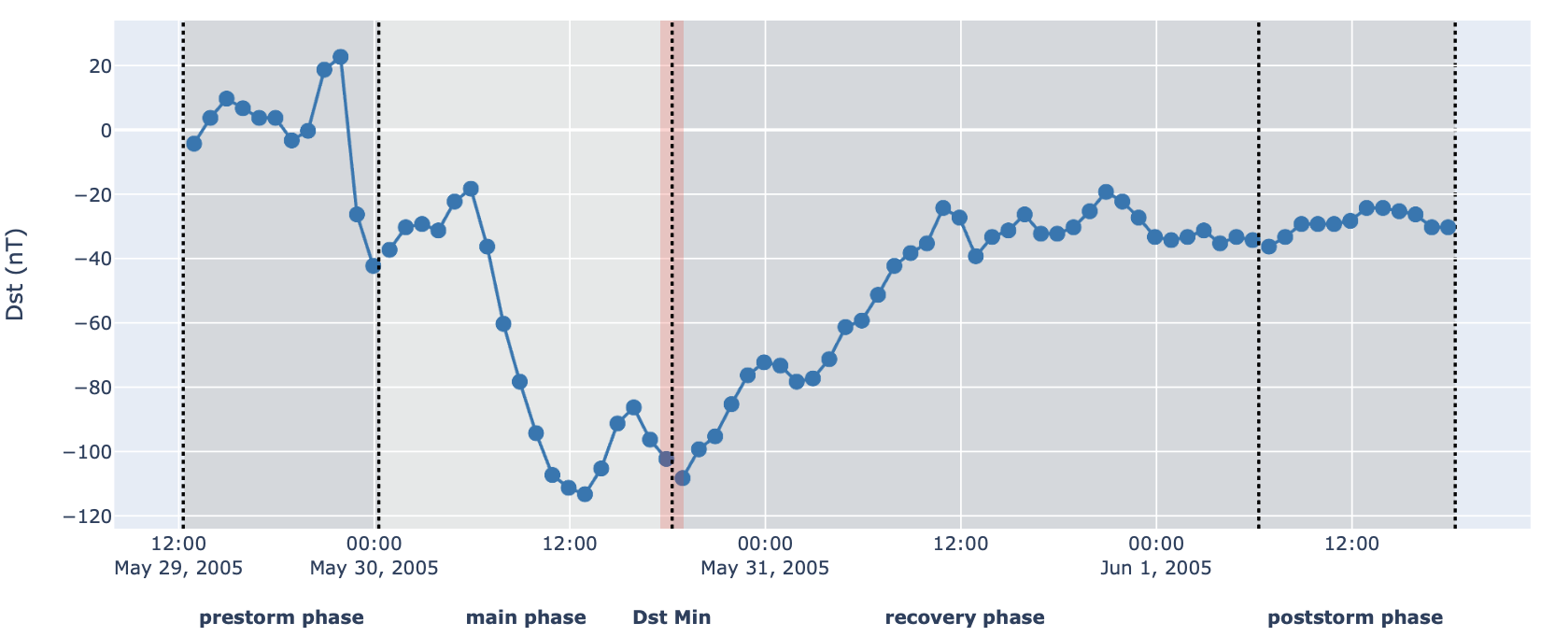
CAMEL Neutral Density Validation: Definition of storm phase
storm phase
pre-storm
main
recovery
post-storm
18 hours
36 hours
Dst min
debias
metrics (Bruinsma+, 2021):
mean normalized (debiased) O/C ratio
standard deviation
O: observation
C: computed (model solution)

Slide 10
CAMEL Neutral Density Validation: Single Event Data Plots
parameter | Density, Normalized density, Observed-to-Computed (O/C) ratio, Normalized O/C ratio

Slide 11
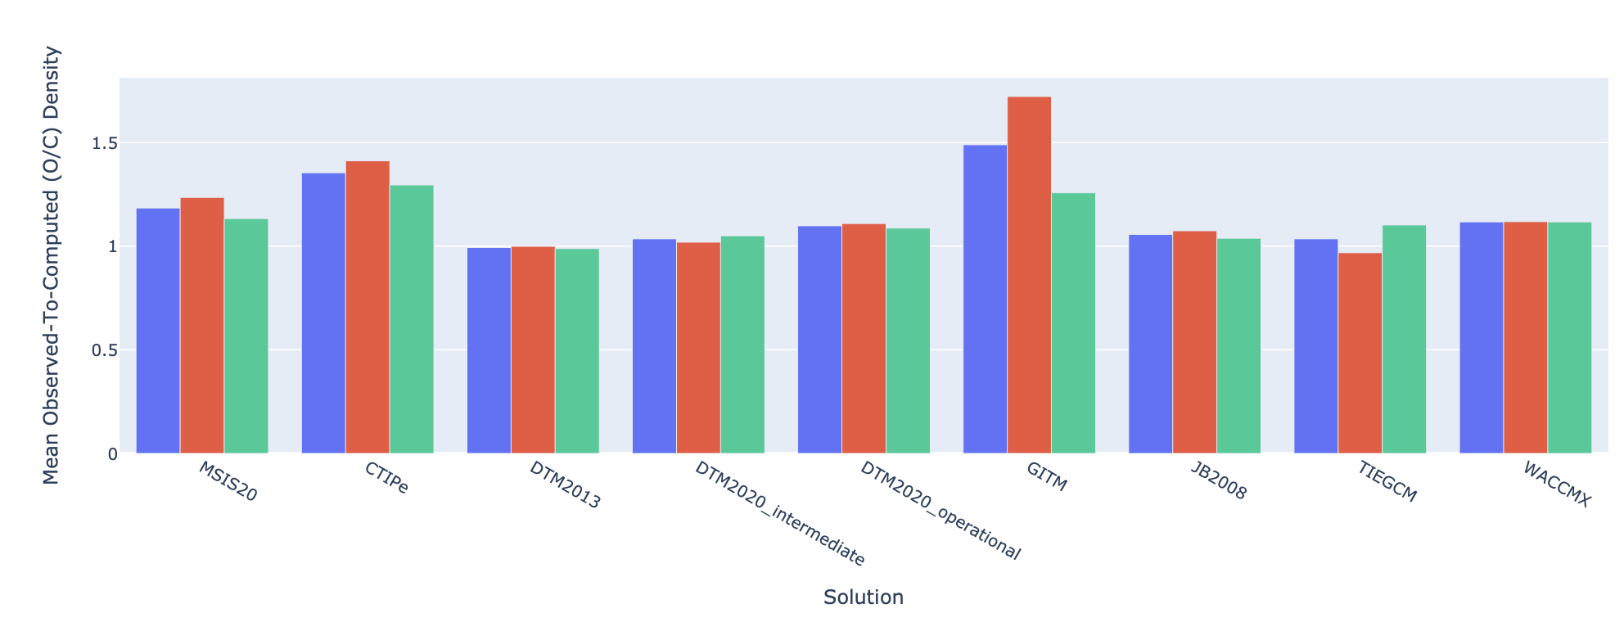
CAMEL Neutral Density Validation:
Skillscore - Mean of Normalized Density Ratio
>1 underestimated
1 = best score
<1 overestimated
main phase
skills by phase
recovery phase
average
1.129
1.141
1.116
1.316
1.071
1.190
1.171
1.116
1.297
1.279
1.001
1.210
1.042
1.018
1.023
1.045
1.059
1.023
1.048
1.033
1.094
1.083
0.986
1.099
0.984
0.983
0.943
CTIPe
GITM
JB2008
DTM2013
DTM2020
intermediate
DTM2020
operational
TIE-GCM
WACCM-X
NRLMSIS 2.0

Slide 12
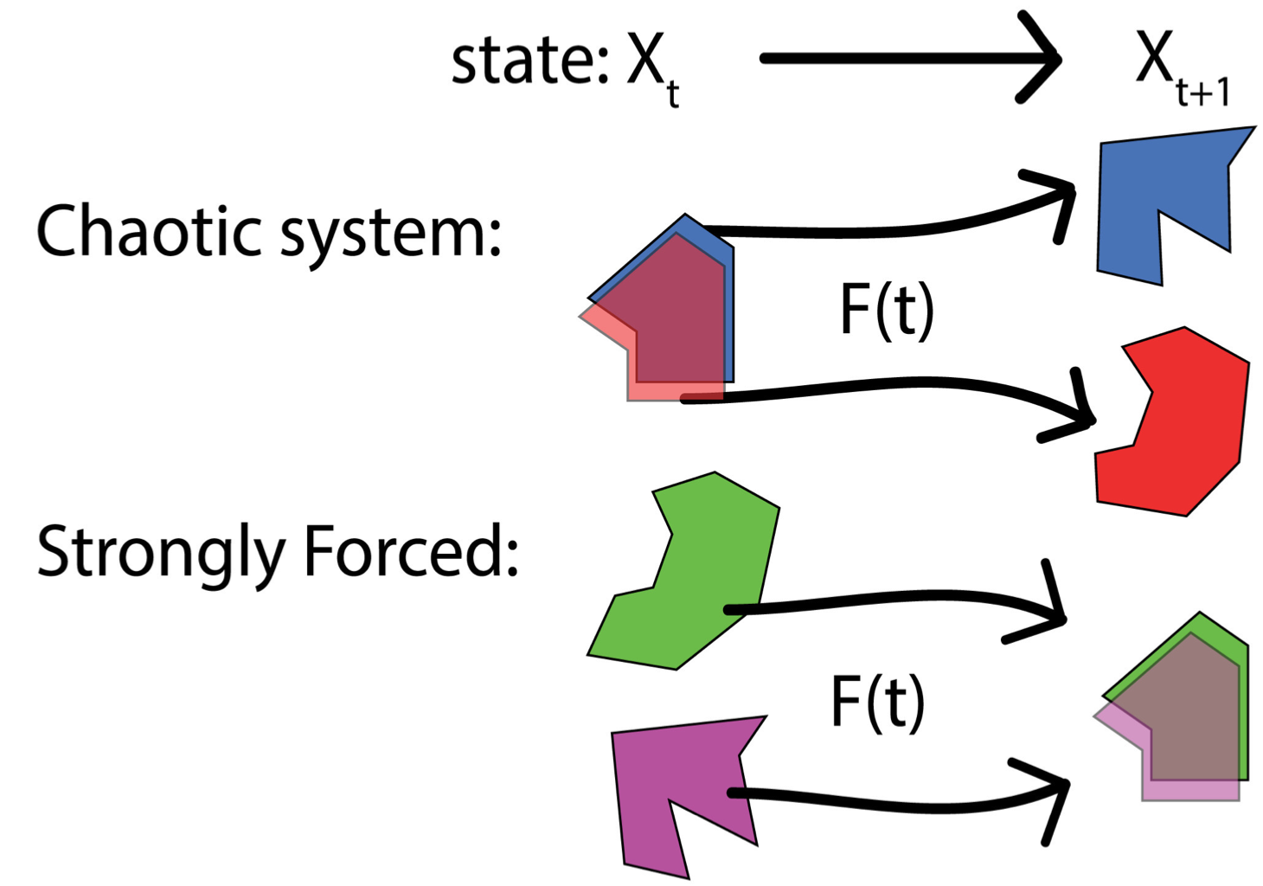
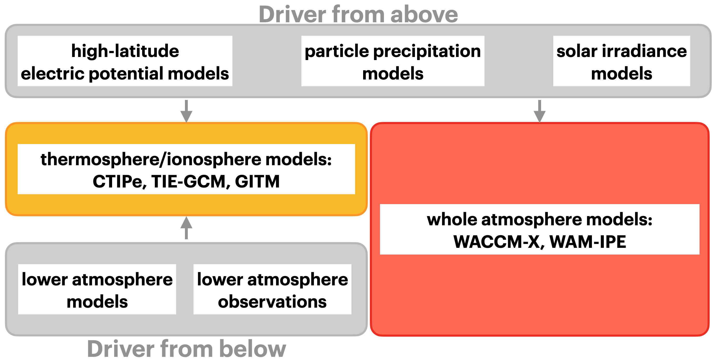
Future outlook: unify drivers for model assessment
Initial Condition Dominated
weather
thermosphere/
ionosphere
magnetosphere
Forcing Dominated

Slide 13
Future outlook: unify drivers for model assessment
Initial Condition Dominated
weather
thermosphere/
ionosphere
magnetosphere
Forcing Dominated
Driver from above
high-latitude
electric potential models
particle precipitation
models
solar irradiance
models
thermosphere/ionosphere models: CTIPe, TIE-GCM, GITM
whole atmosphere models:
WACCM-X, WAM-IPE
lower atmosphere
models
lower atmosphere
observations
Driver from below

Slide 14
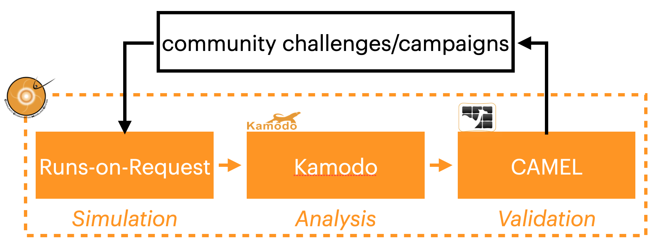
CCMC CAMEL tool ensures transparency, inclusion, and community involvement in the validation studies.
model developers
Simulation
Notes:
The CCMC CAMEL tool ensures the transparency, inclusion, and collaboration in validation studies.

Slide 15
Summary
NASA CCMC, as a participant of the COSPAR ISWAT action team G2A, has built and hosted the interactive neutral density validation web tool upon CAMEL framework, with community involvement and coordination.
A follow-on study will upload quiet-time model datasets into CAMEL, and validated against the measurement by satellites.
The CAMEL front-end will also be upgraded after feedback from the community are received.
Notes:
The CCMC CAMEL tool ensures the transparency, inclusion, and collaboration in validation studies.

