Slide 1
NASA CCMC Model Validation Efforts Toward Open Science
Min-Yang Chou1,2, Jia Yue1,2, Jack Wang1,2, J. D. Huba3, Mostafa El Alaoui1,2, Maria M. Kuznetsova1, Lutz Rastätter1, Chiu Wiegand1, Tina Tsui1, Maksym Petrenko1
NASA Goddard Space Flight Center, Community Coordinated Modeling Center, Greenbelt, MD, USA,
Department of Physics, Catholic University of America, Washington, DC, USA,
Syntek Technologies, Fairfax, VA, USA,

Slide 2
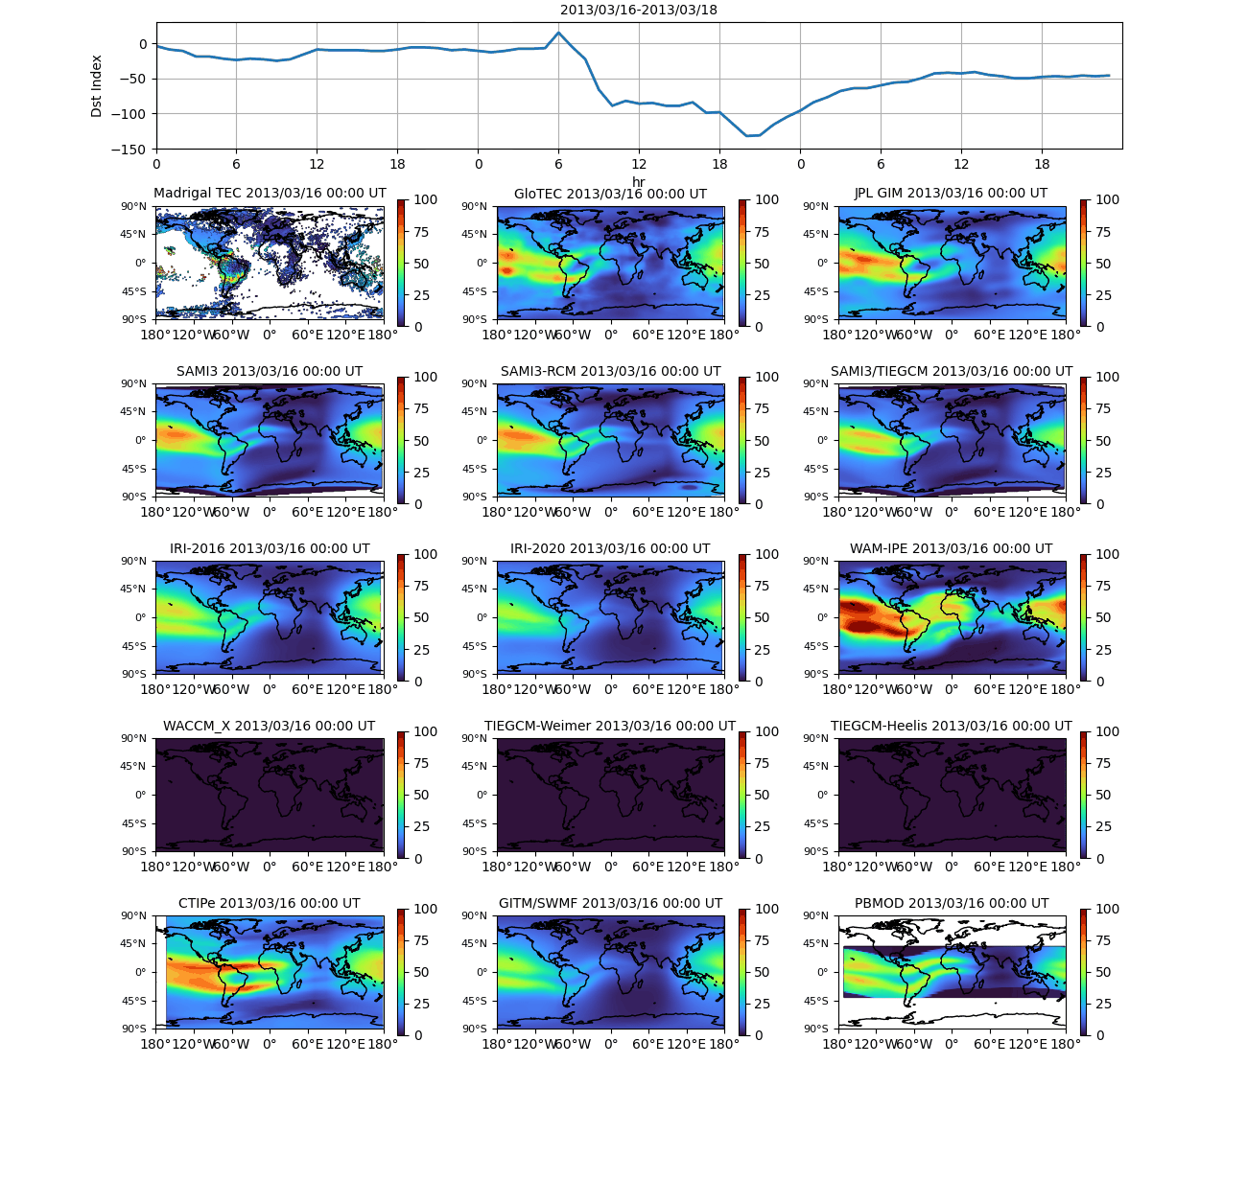
CCMC ionospheric TEC validation
NASA Goddard Space Flight Center Community Coordinated Modeling Center is a multi-agency partnership aimed at the research to support the dissemination and development of advanced space science and space weather models.
The CCMC hosts a large suite of state-of-the-art ionospheric models developed by the broad space weather and aeronomy community, providing the community access to these modern models to support space weather and space physics research.
Validation of modeled total electron content (TEC) from 14 ionospheric models, including empirical, physics-based, and data assimilation (DA) models, hosted by the NASA/NSF CCMC, NOAA SWPC, and NASA JPL.
Multiple metrics and skill scores are used to assess the performance of ionospheric models in capturing storm time TEC anomaly

Slide 3
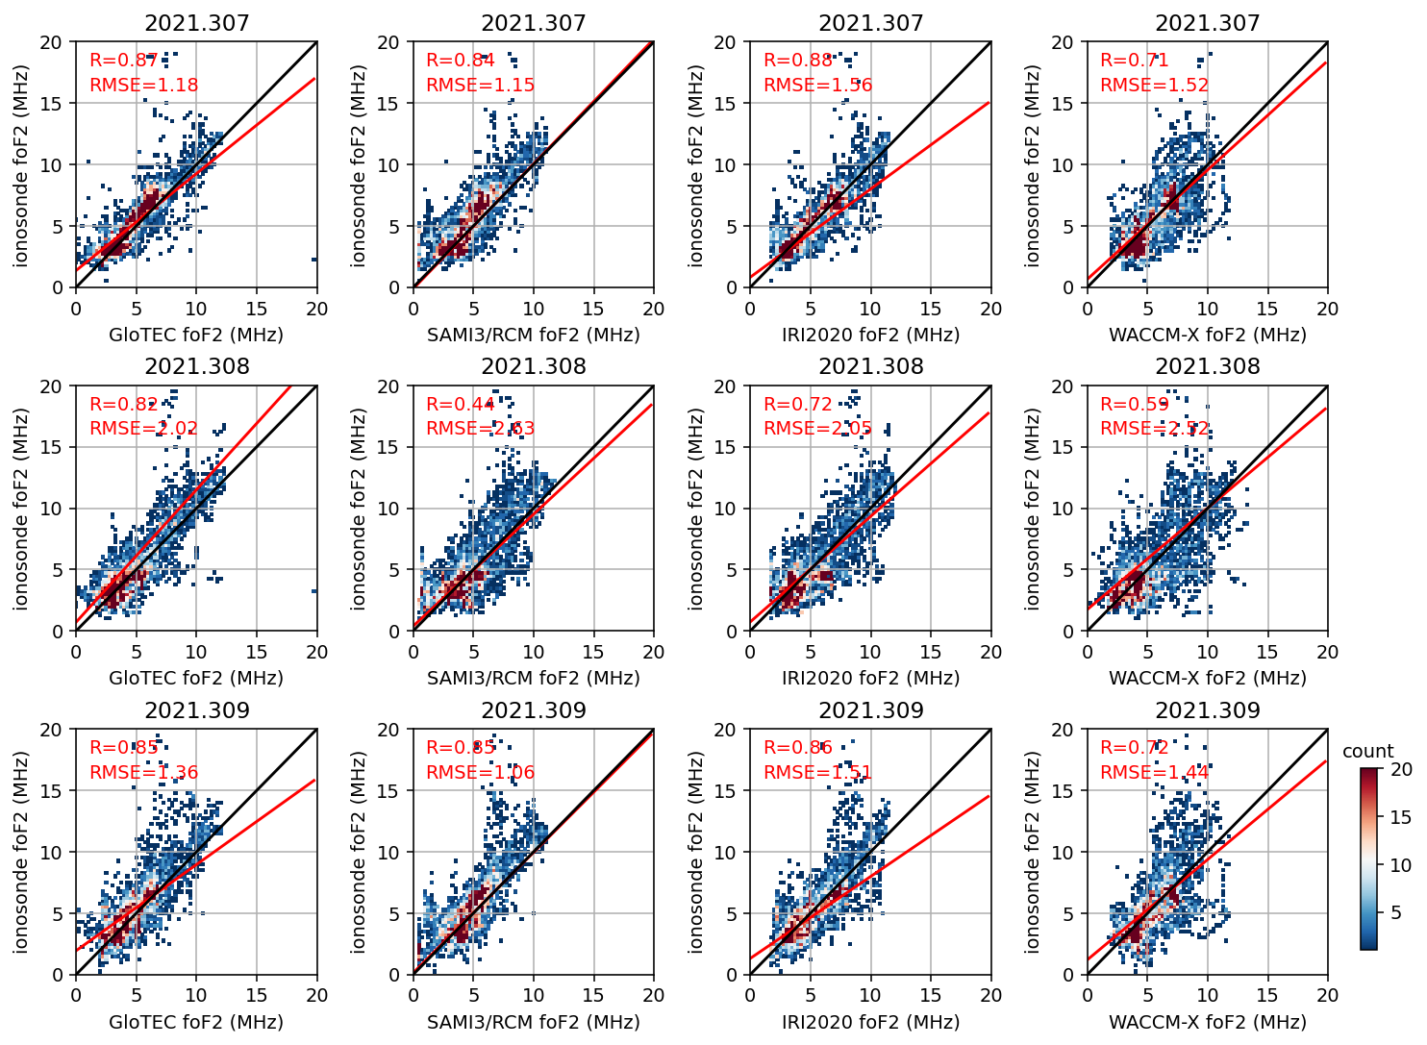
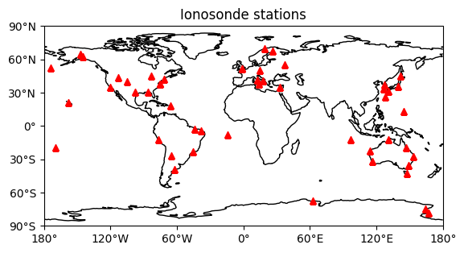
Ionospheric foF2 validation with ground-based ionosonde stations.
Ionospheric critical frequency (foF2) validation is important since it greatly impacts the HF radio wave communications.
foF2 validation during the 2021 November Storm is conducted at CCMC.

Slide 4
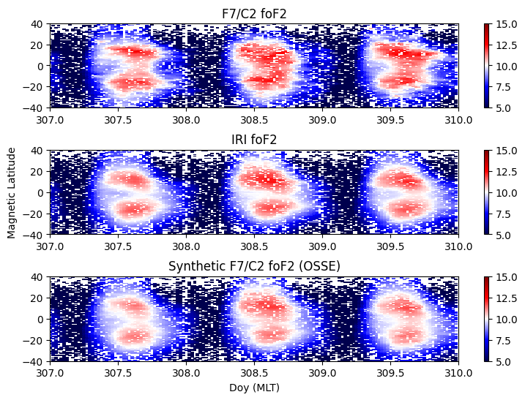
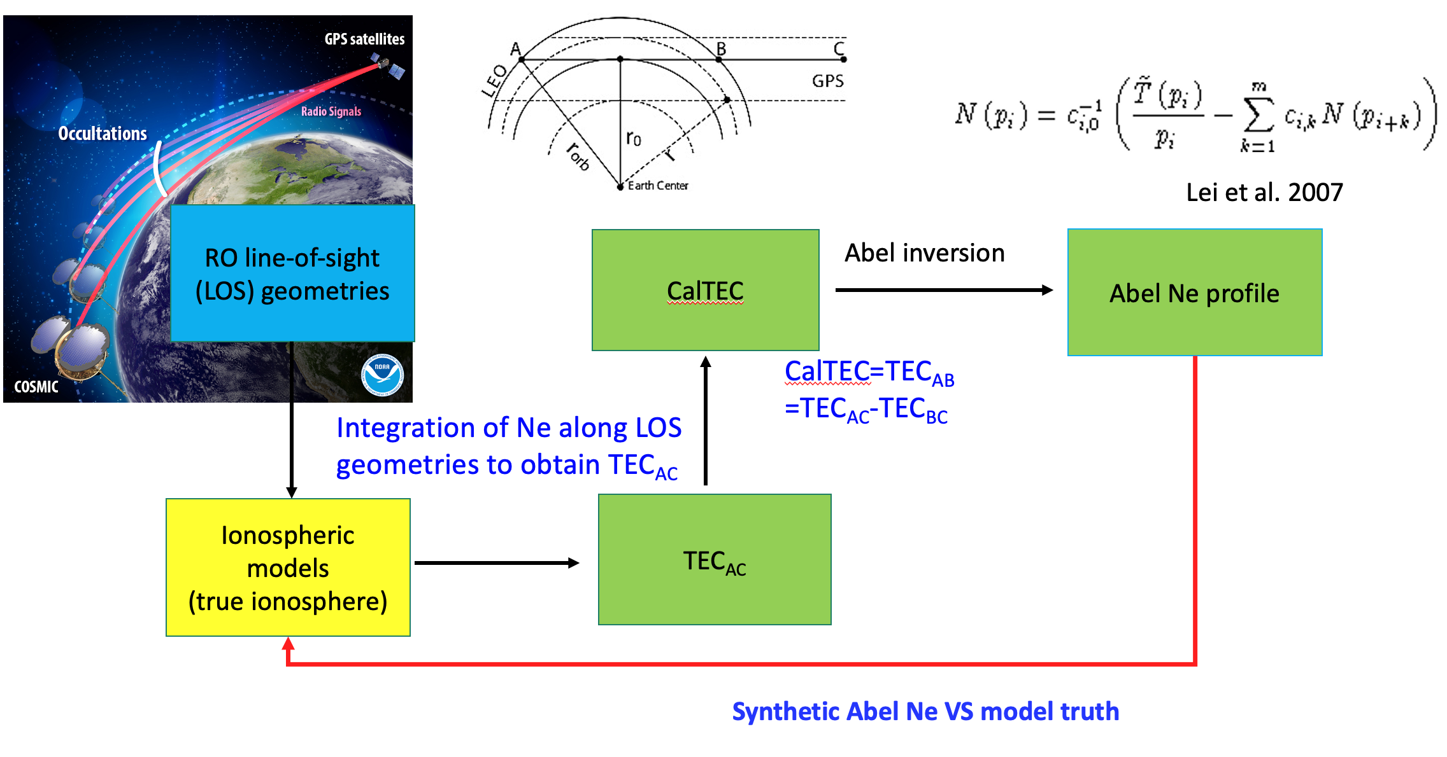
Ionospheric foF2 validation with FORMOSAT-7/COSMIC2 satellite
Address the limitation of ground-based instrument availability over oceanic regions.
The F7/C2 electron density has systematic errors that can introduce uncertainty in model validation.
OSSE is conducted to simulate F7/C2 observations using CCMC ionospheric models (OSSE truth).

Slide 5
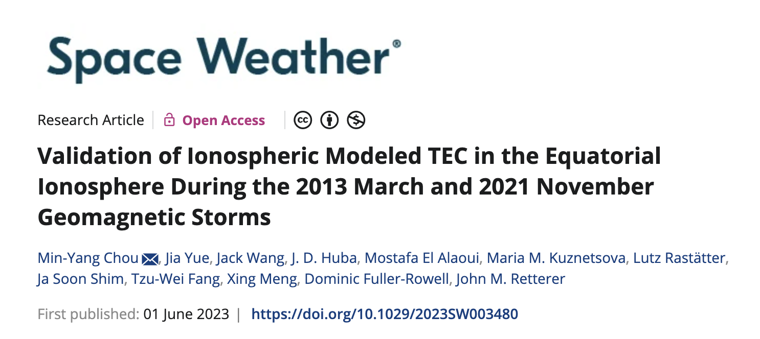
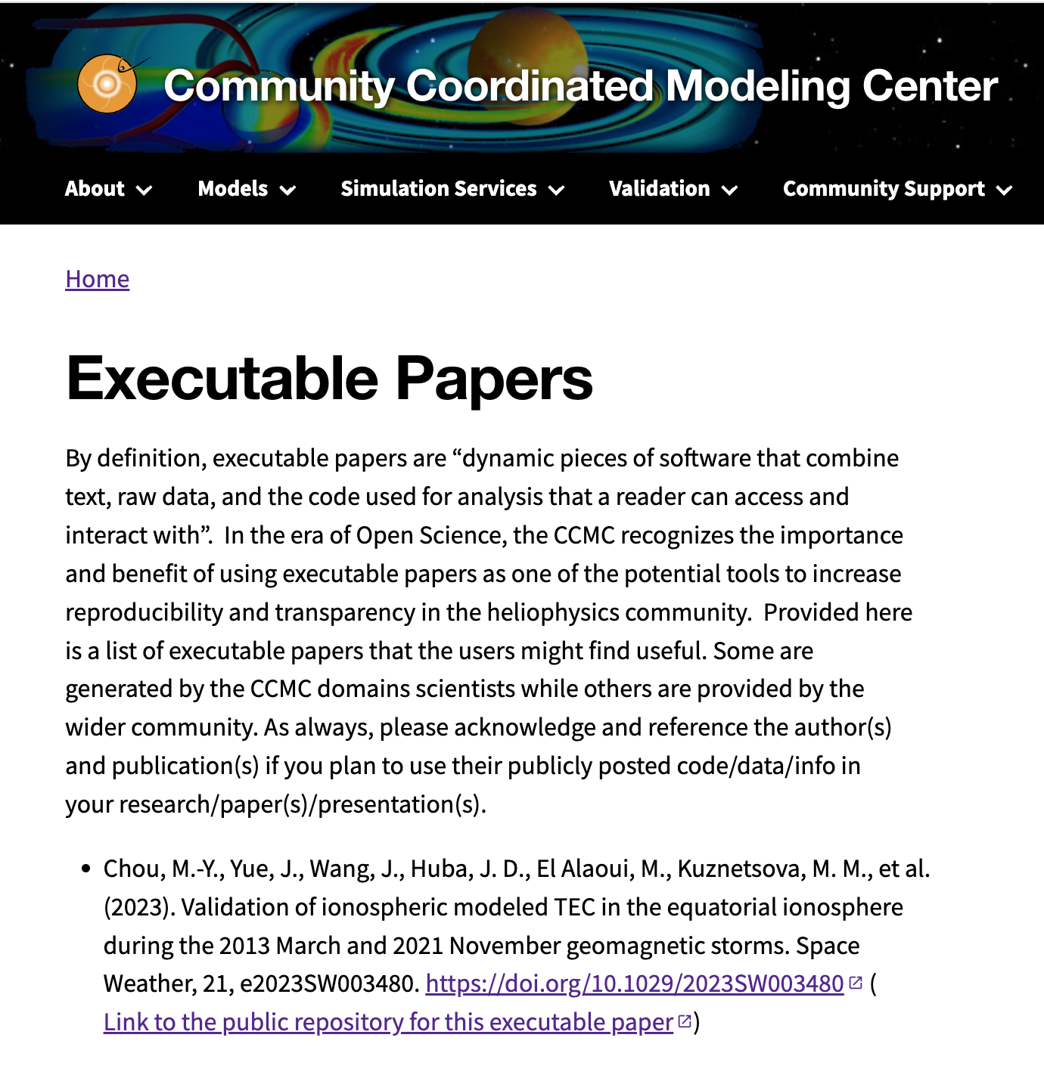
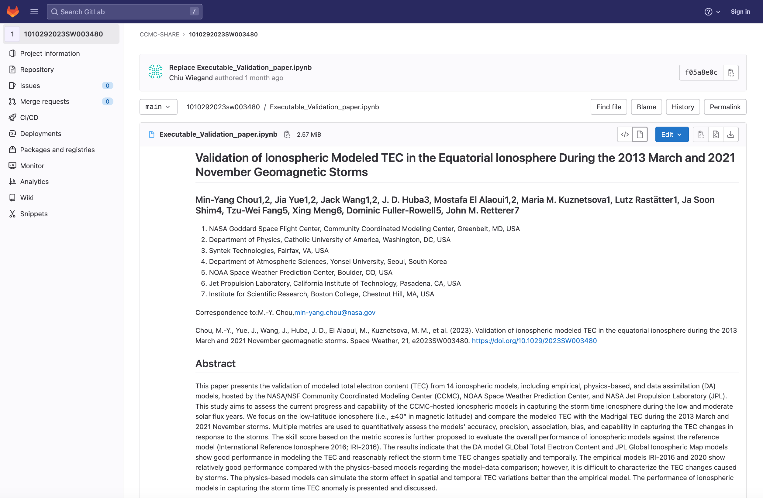
Executable Model Validation Paper is Available at CCMC

