Slide 1
IHDEA 2023 Meeting CDPP/CNES highlights

Slide 2
History and context (reminder)
IHDEA 2023
CDPP* activities are "historically" split into two connected activities
Long Term preservation, under CNES responsibility
Scientific valorization, under CNRS/INSU responsibility
2 separated databases
The CDPP archive in CNES
The AMDA tool database in IRAP
2 different data models “historically” created
The "CDPP model" for the archive
The "AMDA model"
Limited consistency → Limited interfaces and possibilities for sophisticated interactions
* More information on CDPP server http://www.cdpp.eu/

Slide 3
Goals
IHDEA 2023
Standardization and coherence of CDPP data models
Need to : * Be compliant to community standards * Use the same model for all the CDPP tools
Coordinated actions between CNES and IRAP to achieve :
Better usability
Better interaction/integration between CDPP tools
Offer new possibilities As examples : * Using archive data directly in CDPP scientific tools * Offer an unified access to the two databases (common tree, common search criteria,…)

Slide 4
Archive roadmap
IHDEA 2023
1st phase, CDPP archive in CNES is proceeding to a global migration
A software migration from SIPAD archiving system to REGARDS new tool (CNES softwares)
A new data model, compliant with SPASE
DOI implementation
A data treatment and ingestion chains migration (for 22 space missions, some of them still in flight)
→ This step is nearly finished, REGARDS will replace SIPAD by end of 2023
A long term infrastructure migration renewal due to current system obsolescence.
This will imply a data migration that should not impact user access to the archive (planned end-2024).
In a 2nd phase, integration with CDPP valorization tools will be reinforced
Visualization and command of the AMDA data through the Archive/REGARDS data tree Common search with common criteria (ex. search all Cassini data in both databases) → Activity will begin in 2024
Archive data in the new storage infrastructure will be accessible by the CDPP tools (webservices, OV protocols) → Performance will depend of the new storage infra availability (CNES data center common product) but CDPP software developments will begin in 2024

Slide 5
Archive roadmap
IHDEA 2023
December 2023: REGARDS replaces SIPAD
From 2024:
REGARDS + CDPP valorization tools reinforced
Mid 2024- end 2024 :
data migration, new long term storage system

Slide 6
Archive main activities since last IHDEA meeting 1/2
IHDEA 2023
REGARDS tool developments (Roadmap : One version per quarter).
Current version (V1.13.1) is available and used for CDPP archive end of migration validations.
Next Version 1.14 will be used for the opening of the archive to the users.
Data model migration
All datasets (> 1000) are now described according to SPASE data model
The new data model is now implemented (slight evolutions have been performed in SPASE standard to take into account CDPP specifications)
data ingestion chains have been developed and are operational with Regards (for the moment exploitation on both systems)
Data migration
Documents migration is nearly finished
Data migration is finished

Slide 7
Archive main activities since last IHDEA meeting 2/2
IHDEA 2023
DOI implementation
One DOI per dataset generated and included in SPASE metadata
Landing page accessible
AccessURL : direct link to dataset soon implemented
HPDE SPASE repository
All SPASE metadata generated and transferred on HPDE repository
https://hpde.io/CNES/

Slide 8
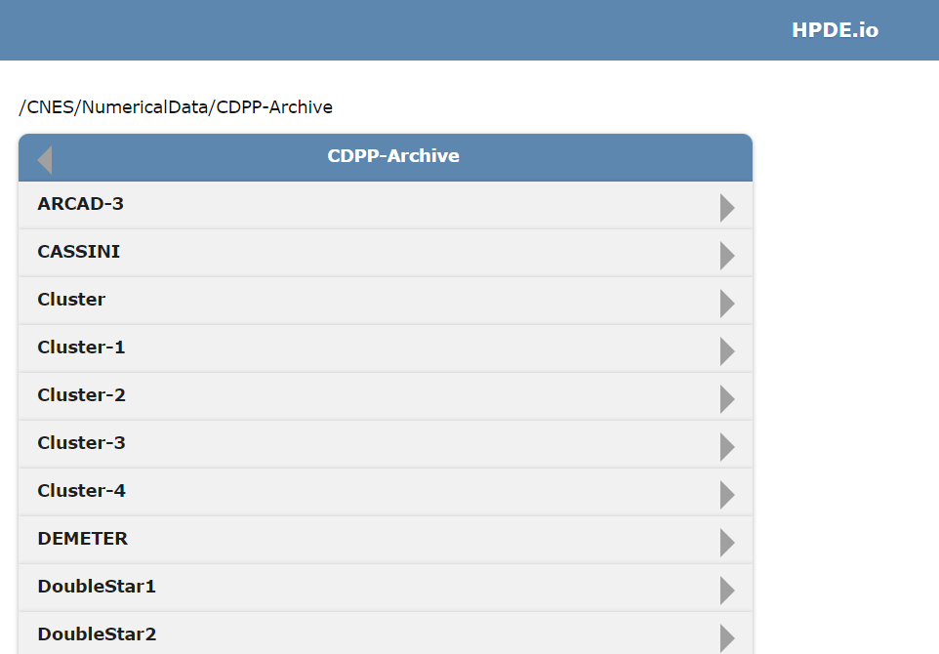
IHDEA 2023

Slide 9
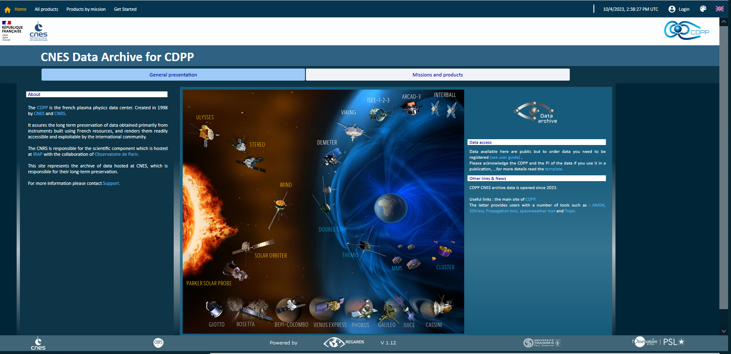
IHDEA 2023
Soon available

