Slide 1
Status report of DARTS (Data Archives and Transmission System) at JAXA
IHDEA Meeting 2023
H. Akihito Uchida (ISAS/JAXA)

Slide 2
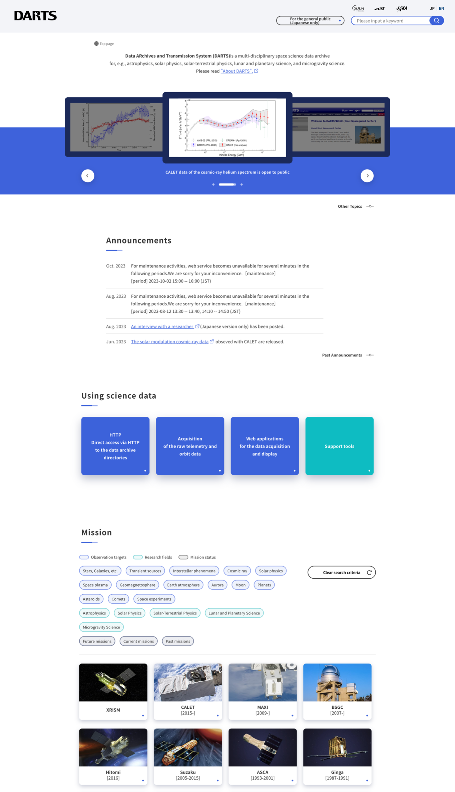
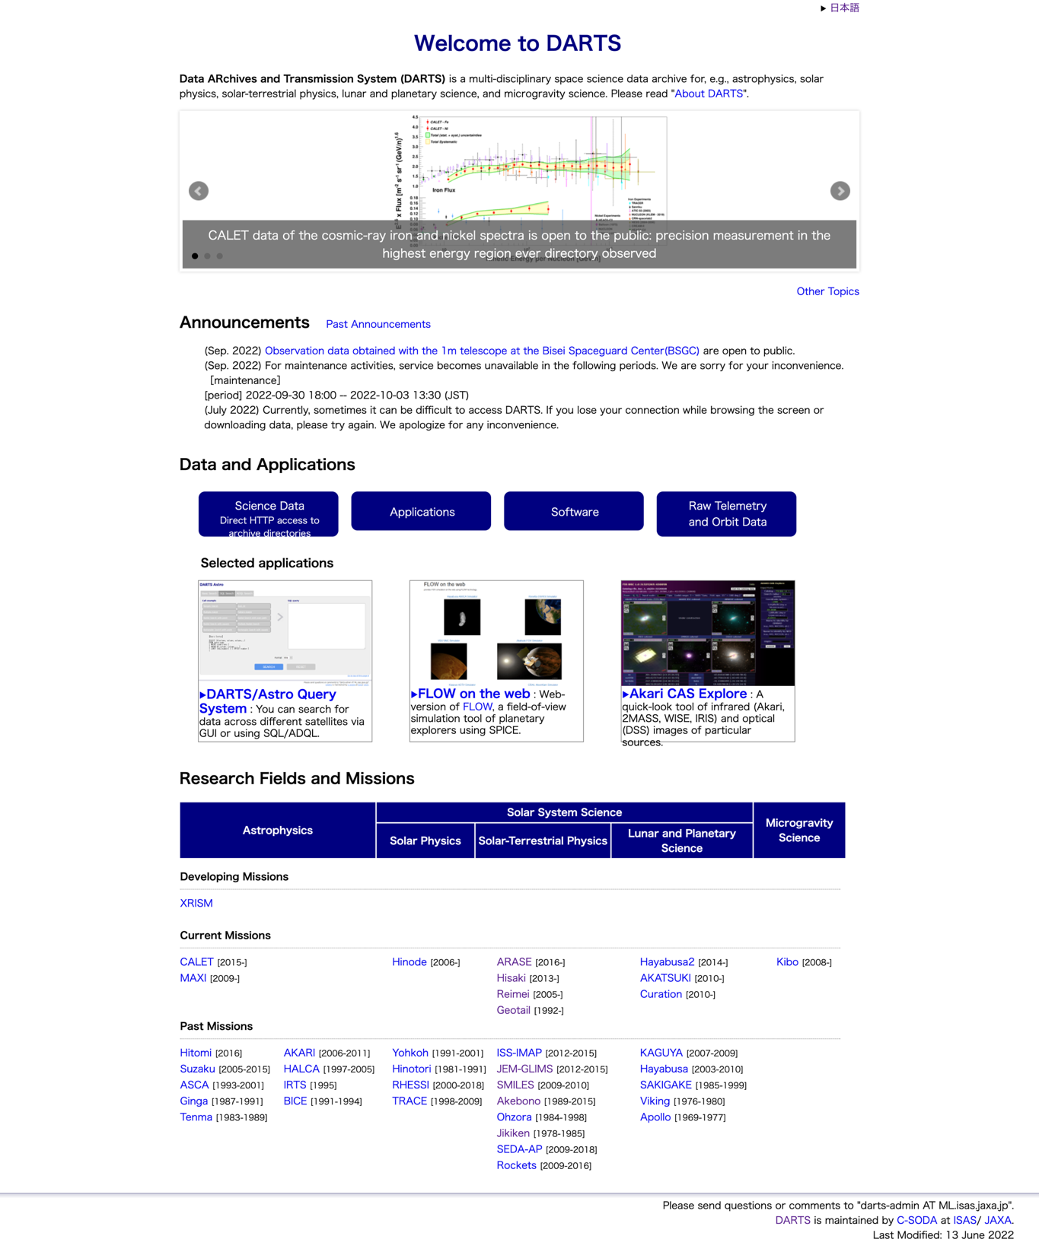
About DARTS
New
Top page!
https://www.darts.isas.jaxa.jp/
Data ARchives and Transmission System
JAXA’s multi-disciplinary scientific satellite database

Slide 3
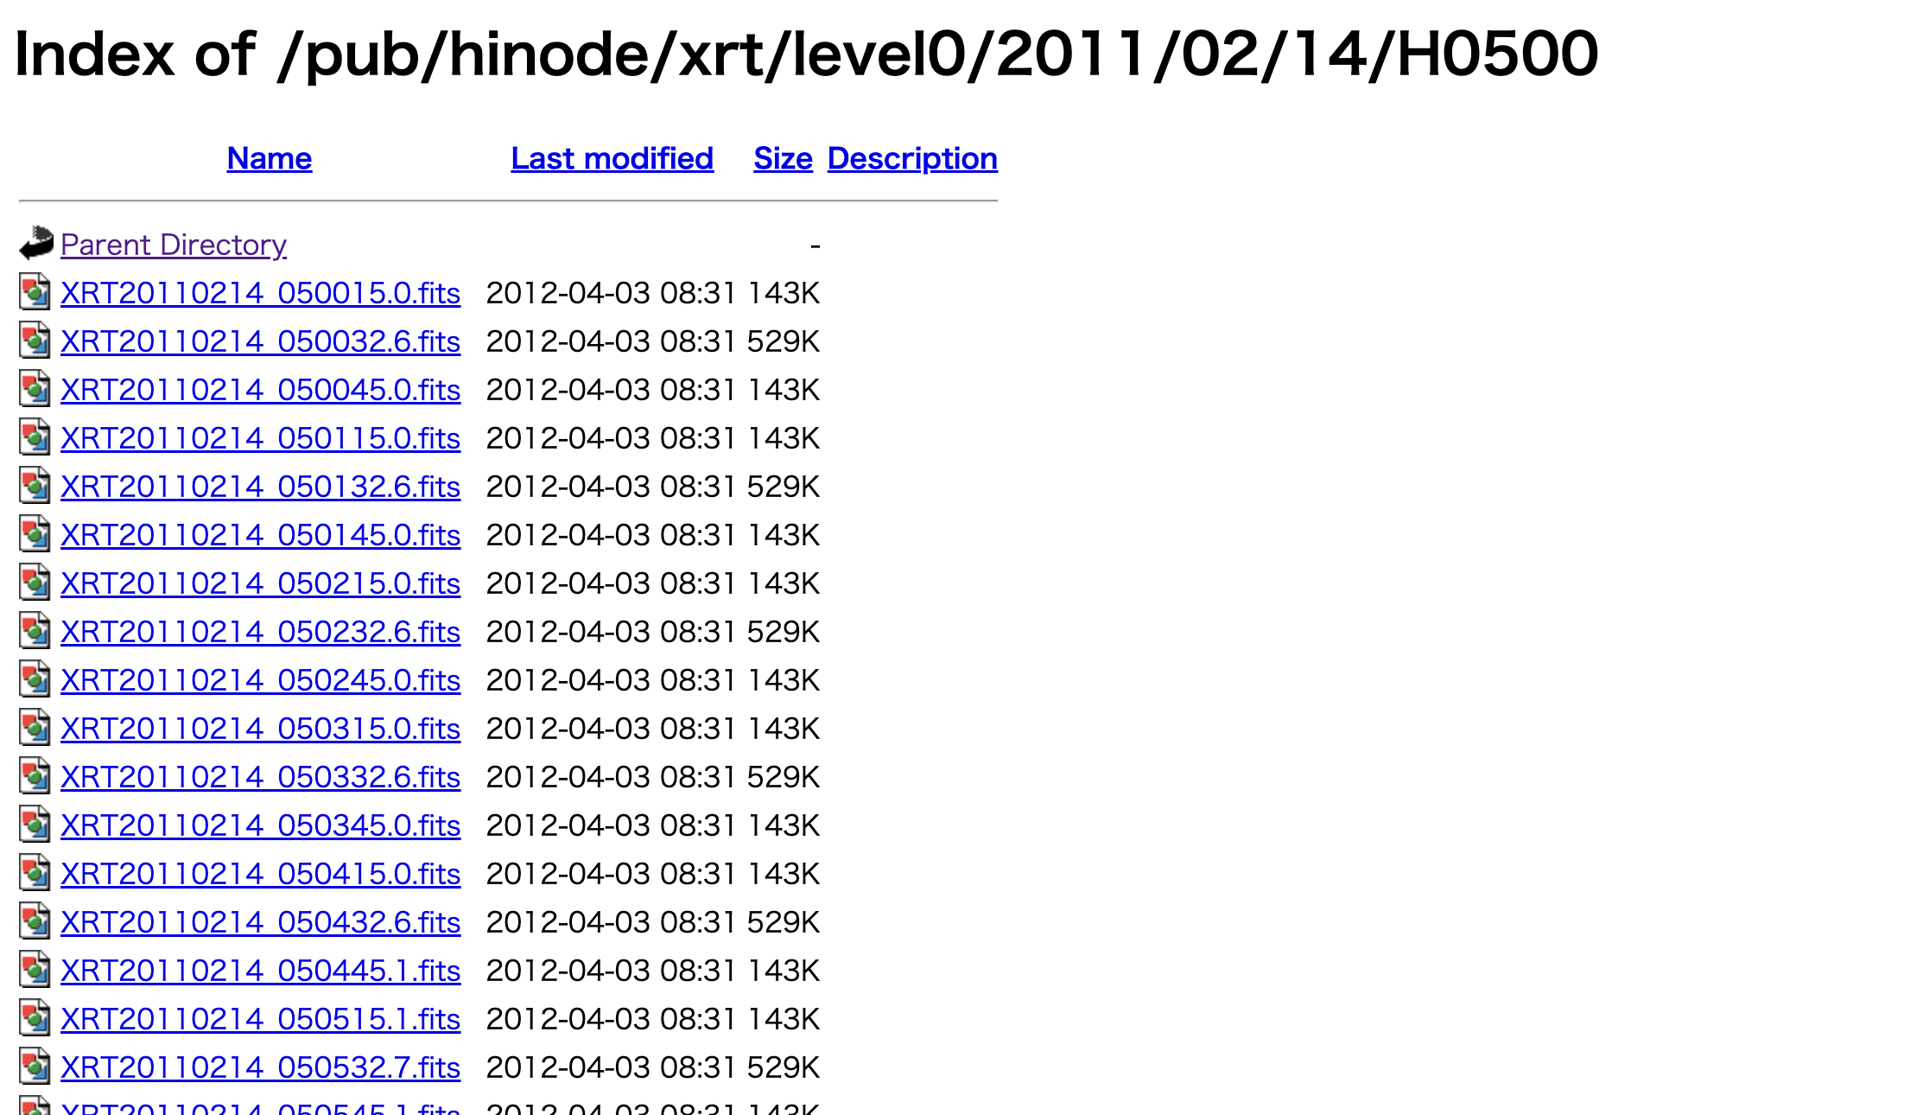
About DARTS
Direct data file download

Slide 4
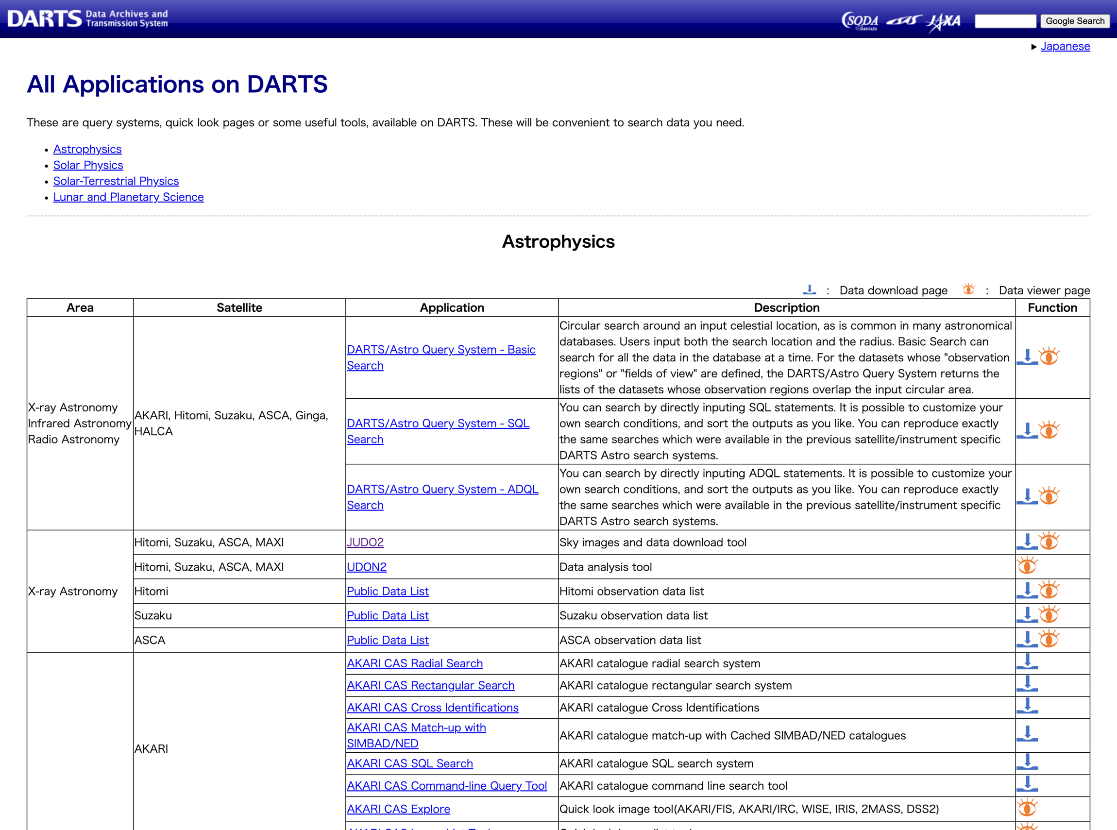
About DARTS
Applications

Slide 5
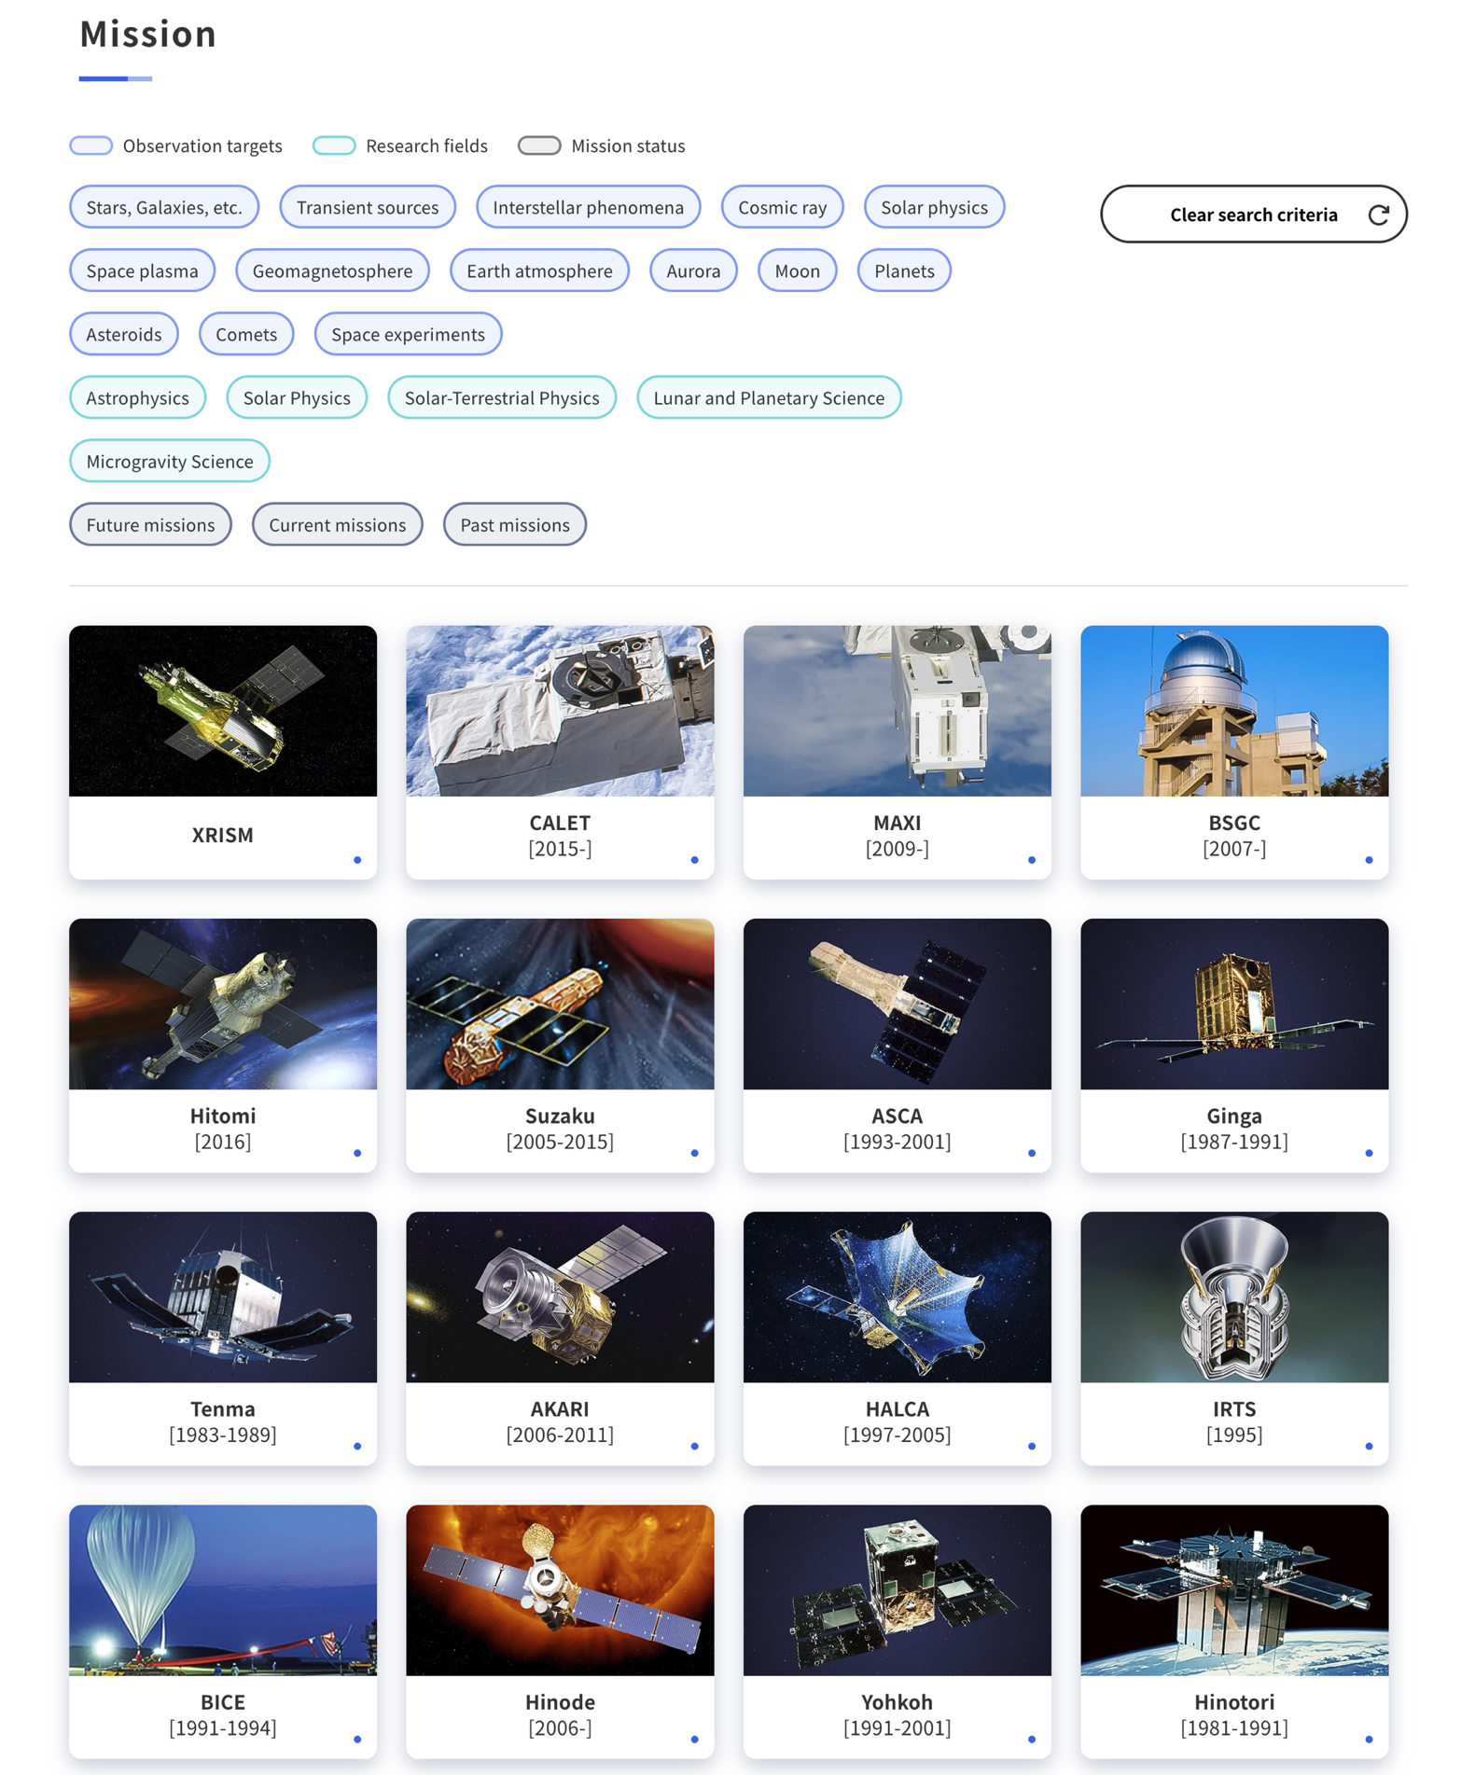
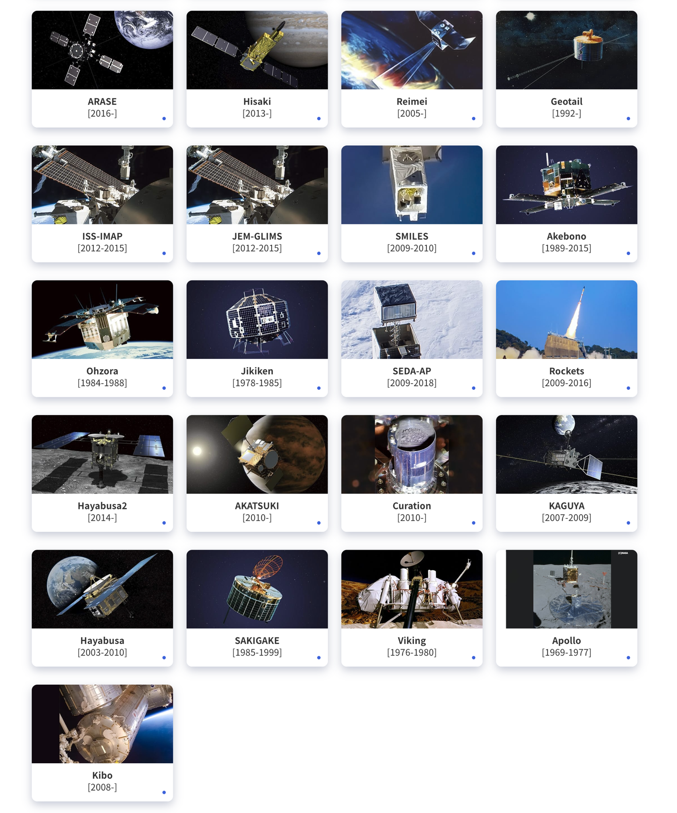
About DARTS
Mission

Slide 6
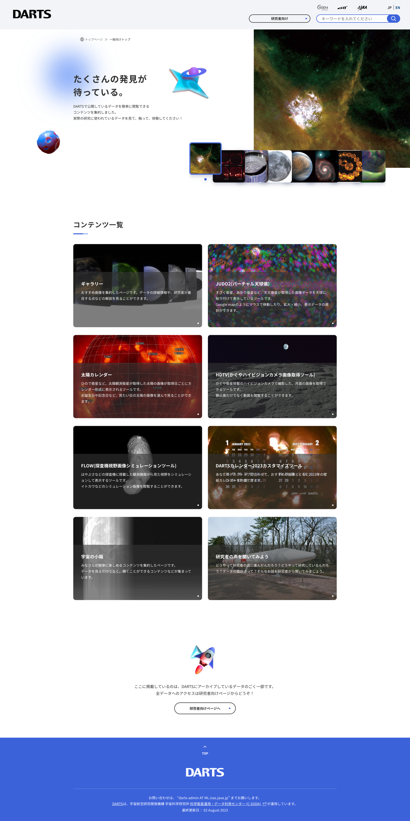
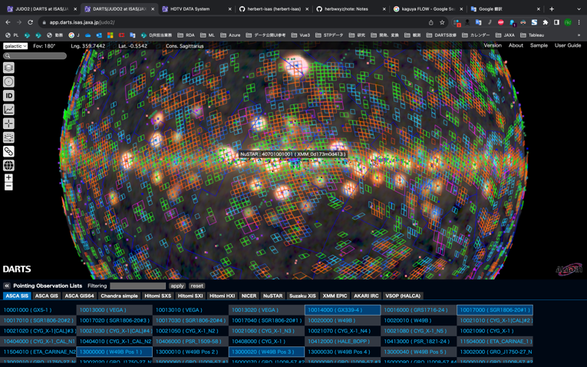
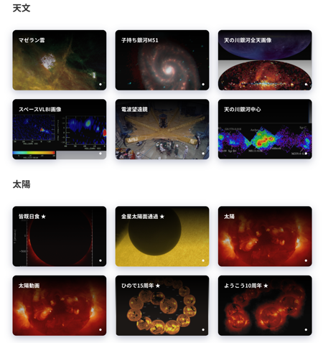
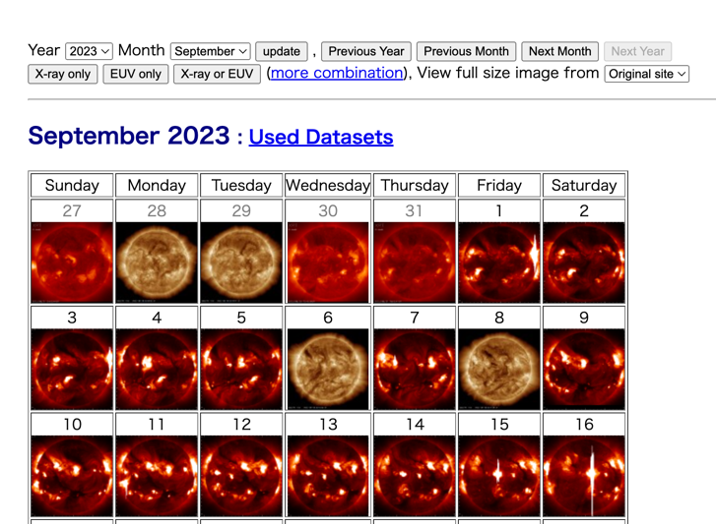
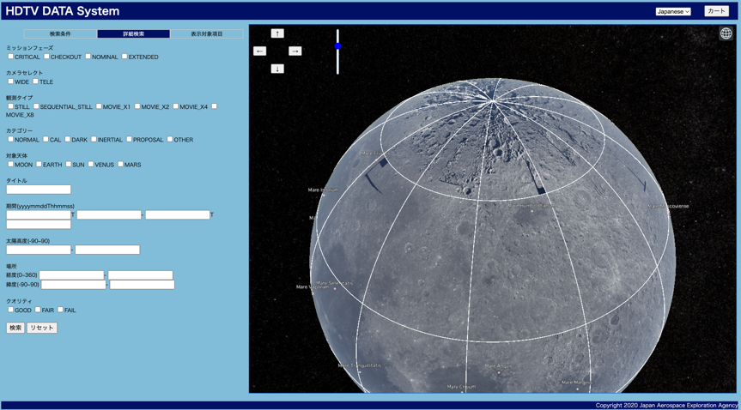
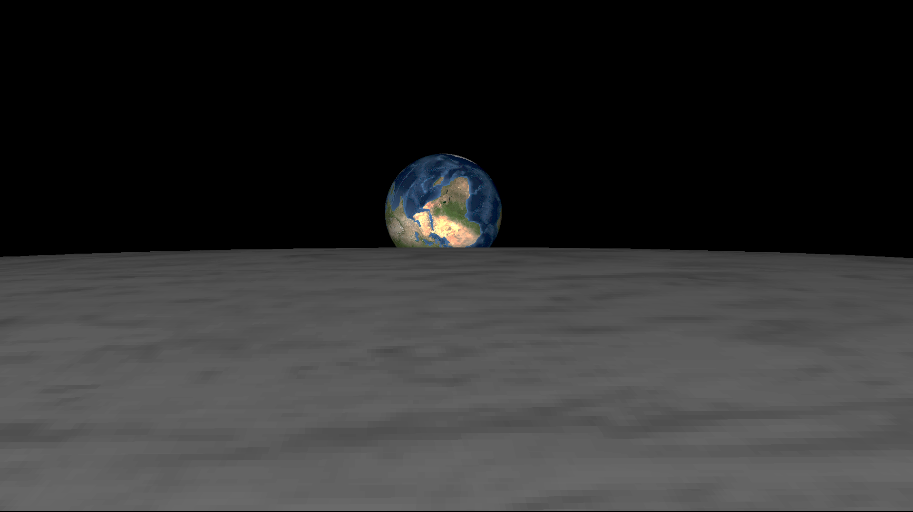
About DARTS
Virtual celestial globe
Top page for general purposes (Still in Japanese only)
Gallery
Solar Calendar
Selene HDTV DATA Viewer
Calendar generator
FieLd Of View Visualizer

Slide 7
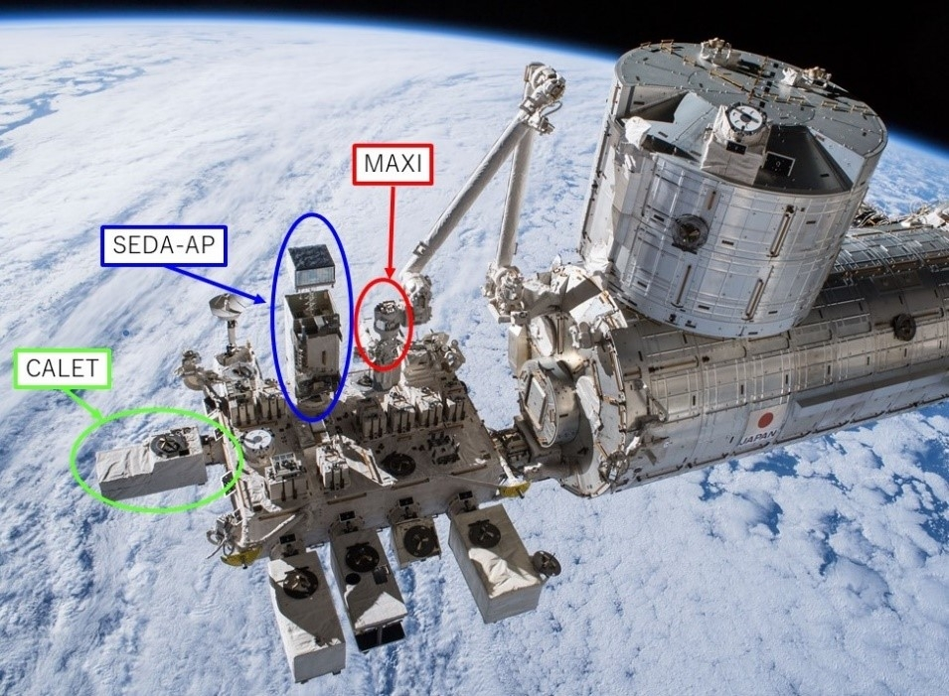
Example of cross-disciplinary research
5 min
(Source: JAXA/NASA)
Elapsed time since 14:47 UT on 4 Nov 2015
H. Ueno et al., 2019, Space Weather
Purpose of each instruments are different:
SEDA-AP: Radiation environment on orbit
MAXI: X-ray astronomy
CALET: Cosmic ray physics
Time variation of the energy distribution
Exposure dose during the REP event can be calculated
Improvement of data access and search functions beyond the boundaries of instruments/research fields are important.

Slide 8
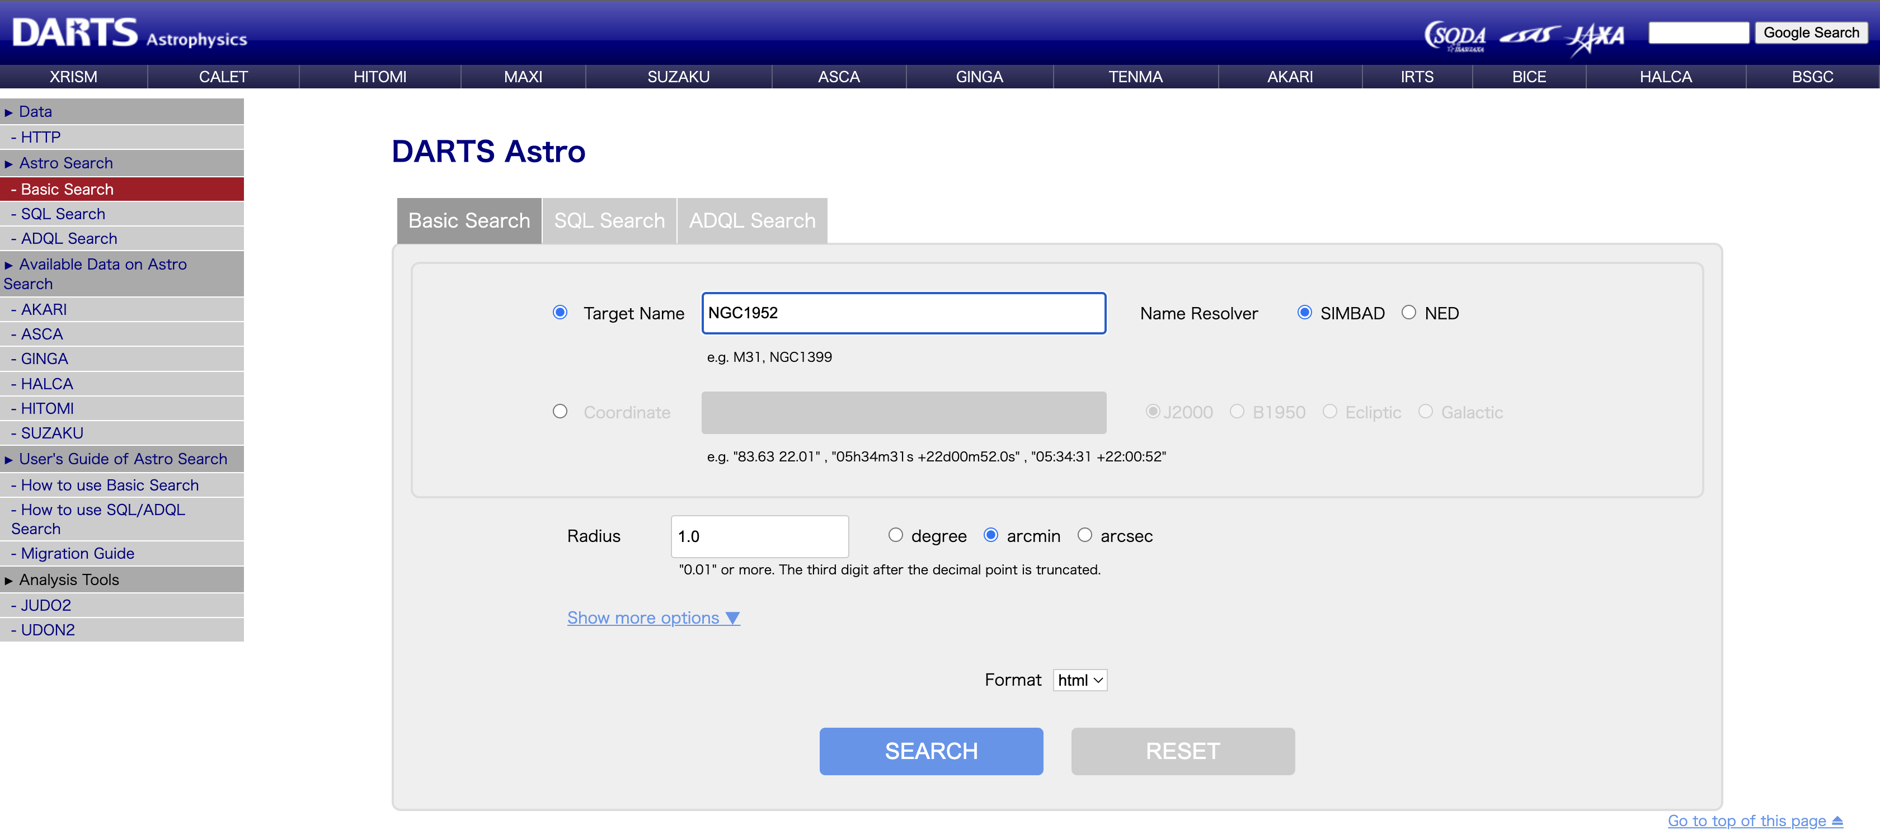
Example: Astro Query System
Circular search around a celestial location (data from AKARI, XRISM, HITOMI, SUZAKU, ASCA, GINGA, HALCA)

Slide 9
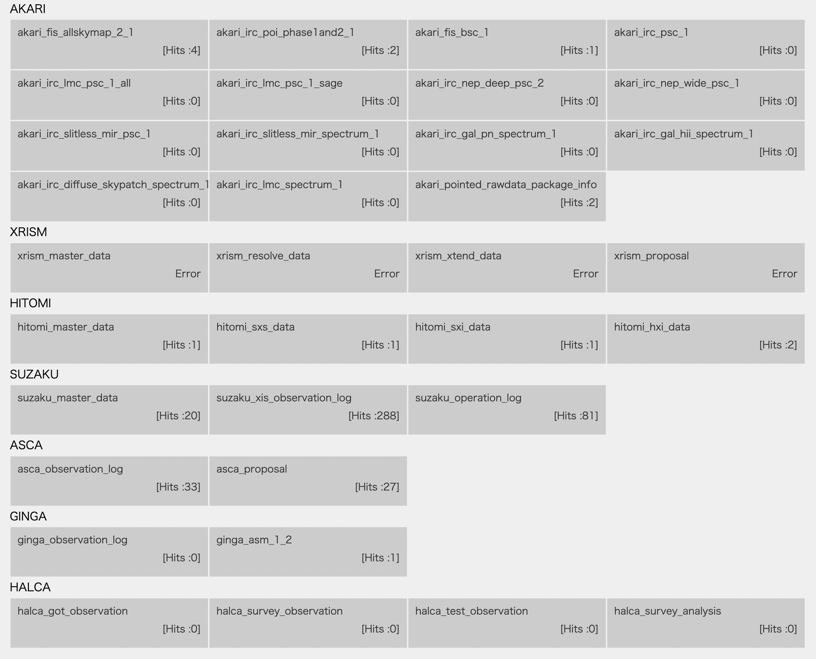
Example: Astro Query System
Circular search around a celestial location (data from AKARI, XRISM, HITOMI, SUZAKU, ASCA, GINGA, HALCA)

Slide 10
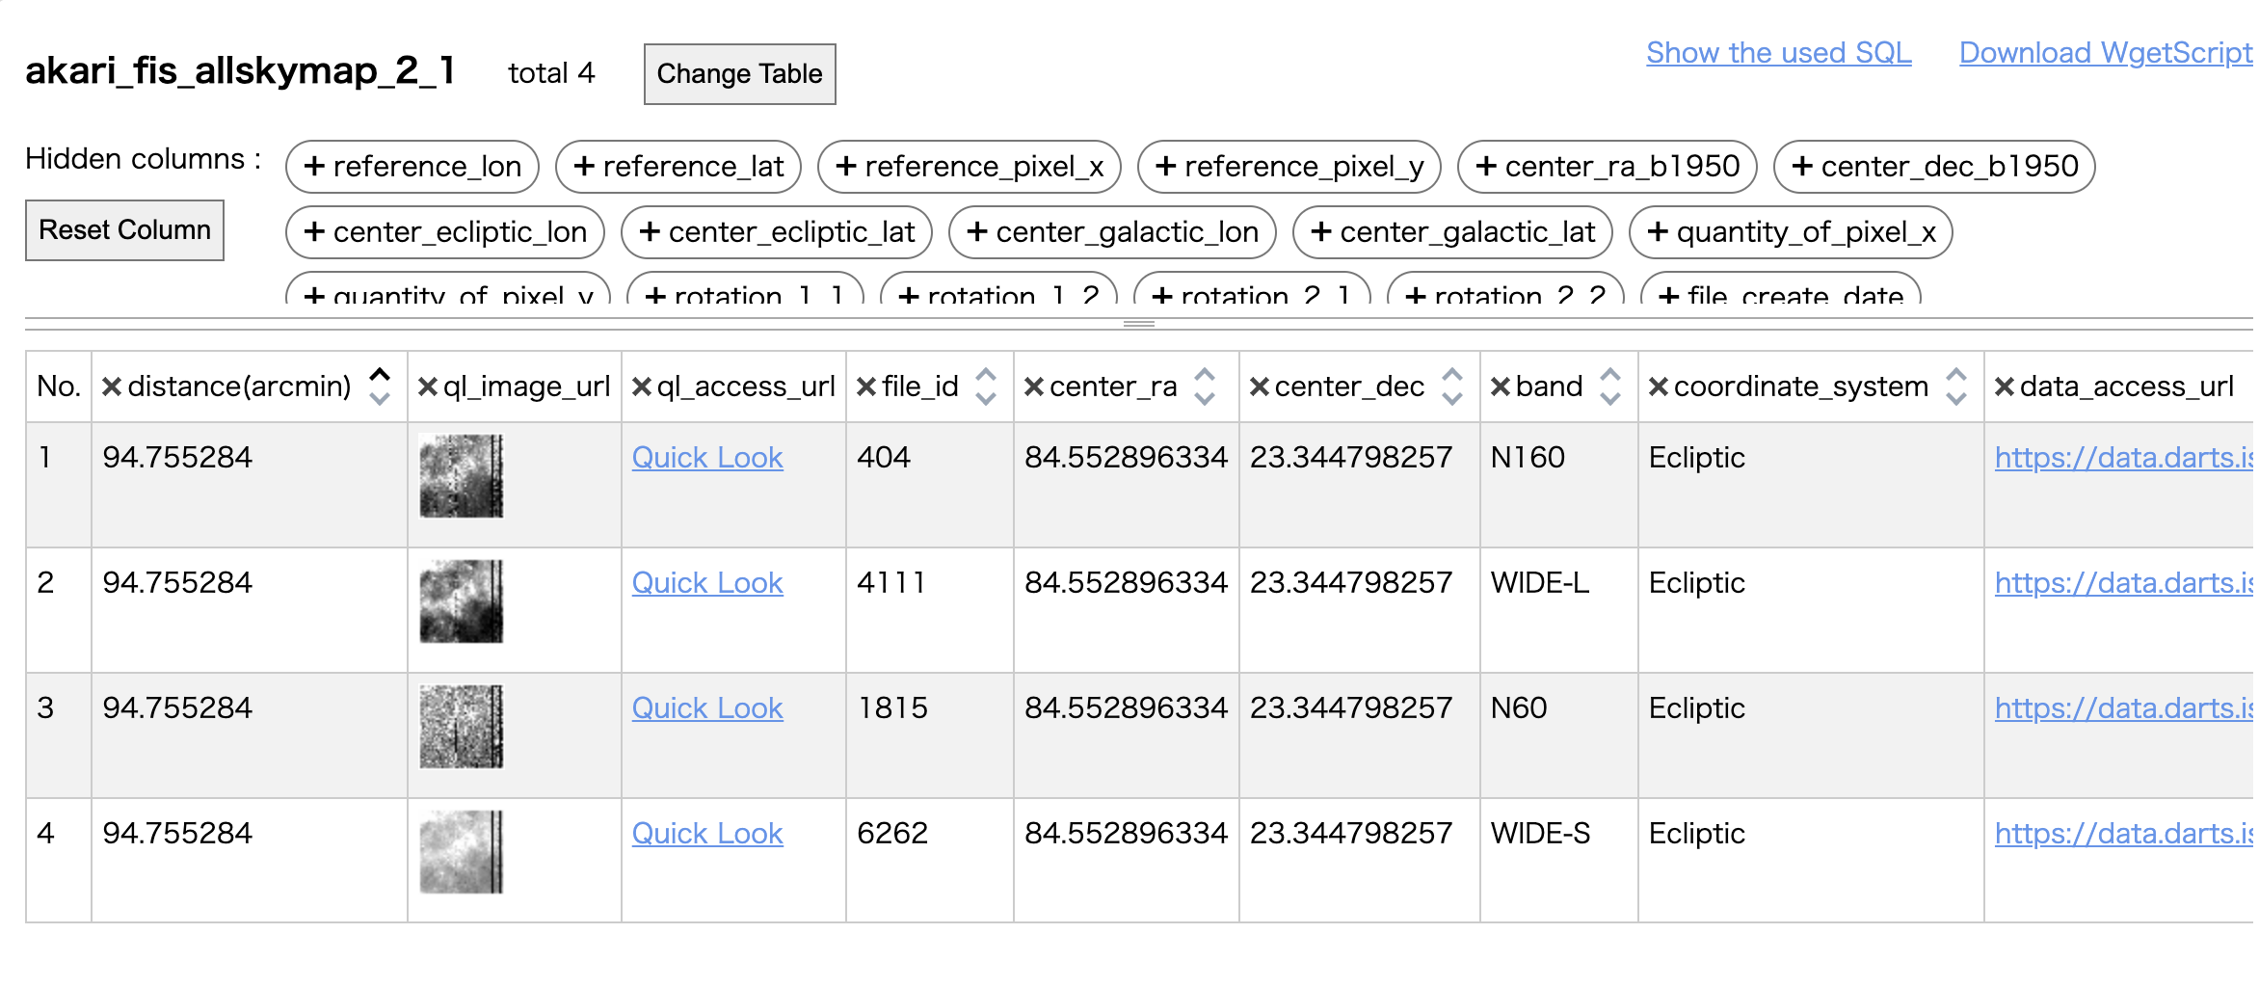
Example: Astro Query System
Circular search around a celestial location (data from AKARI, XRISM, HITOMI, SUZAKU, ASCA, GINGA, HALCA)

Slide 11
Ongoing activities on DARTS
Current problems:
Difficult to use valuable data
Poor accessibility to data that is only available in DARTS
Limitations of UI
Unsuitable for statistical studies
Boundary of research fields
Development divided by research fields
Data characteristics are not considered
Solutions:
Data-driven
Application automatically uses data when added
API and metadata DB
Programmable data acquisition
Unified infrastructure
Eliminate barriers between research fields
Reduce development costs by using cloud platforms
⇨ We try to re-design our system based on the characteristics of the data.

Slide 12
Ongoing activities on DARTS
Re-designing concept: based on the characteristics of the data
Data characteristics in 4 types:
Metadata
Data (Set) description
Snapshot data
Data organized by observation file or observation ID
Monitor data
Data organized in continuous time
Map data
Data organized in spatial orientation (mainly created by higher-order processing)

Slide 13
Ongoing activities on DARTS
Concept of service configuration and cloud utilization
On-premiss
Cloud platform
high-level processing for visualization
Storage
(Open data)
data for display
Micro service
App
App
DARTS server
Read data
Micro service
Micro service
App
Data download
API
Use app
Use app
User
Future plan
(currently under development)
Current

Slide 14
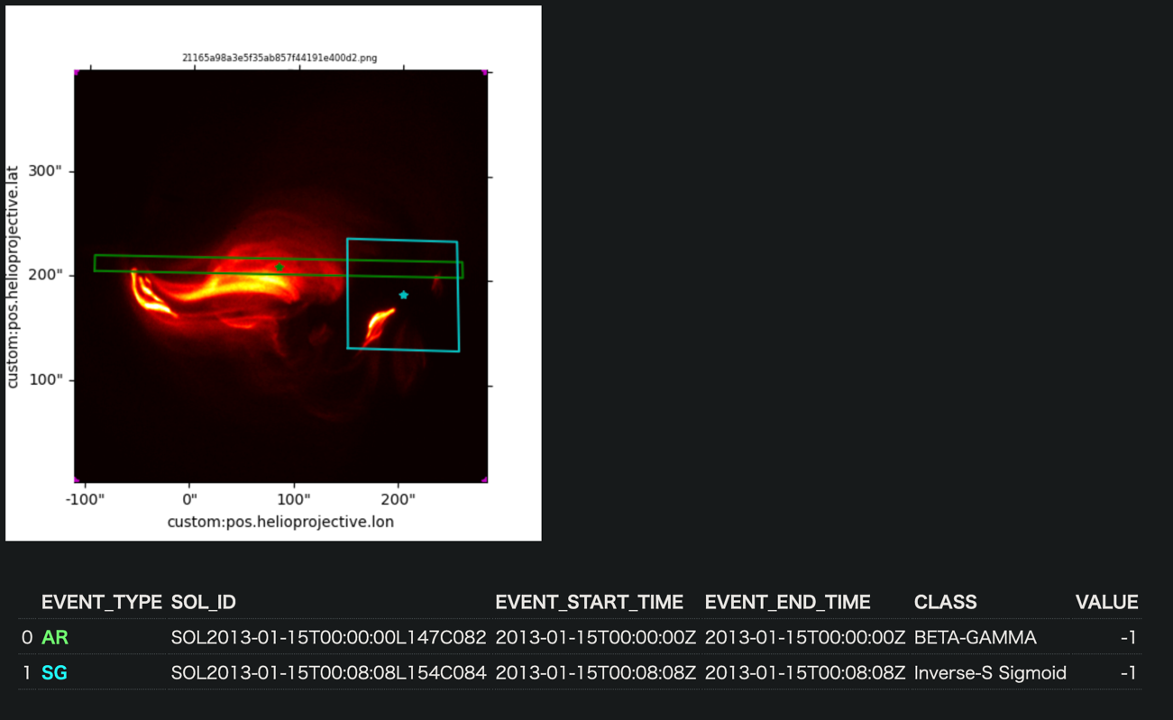
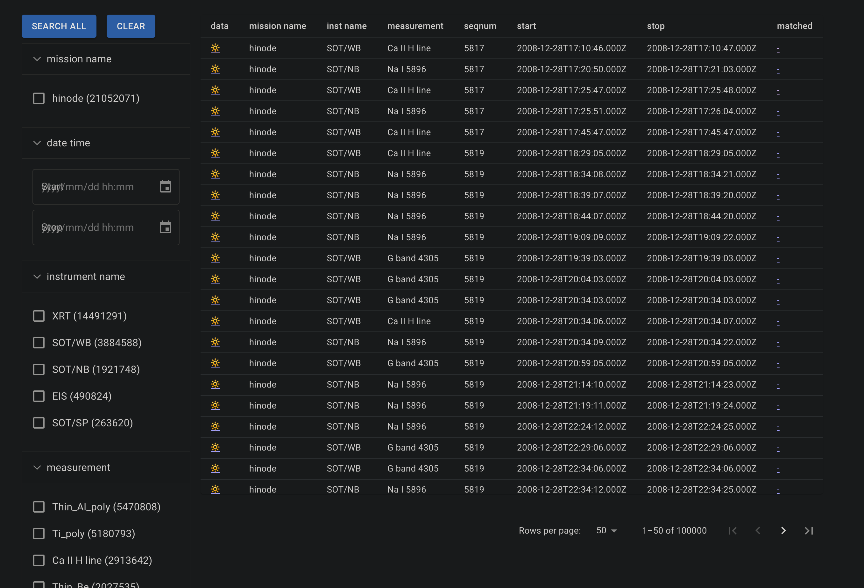
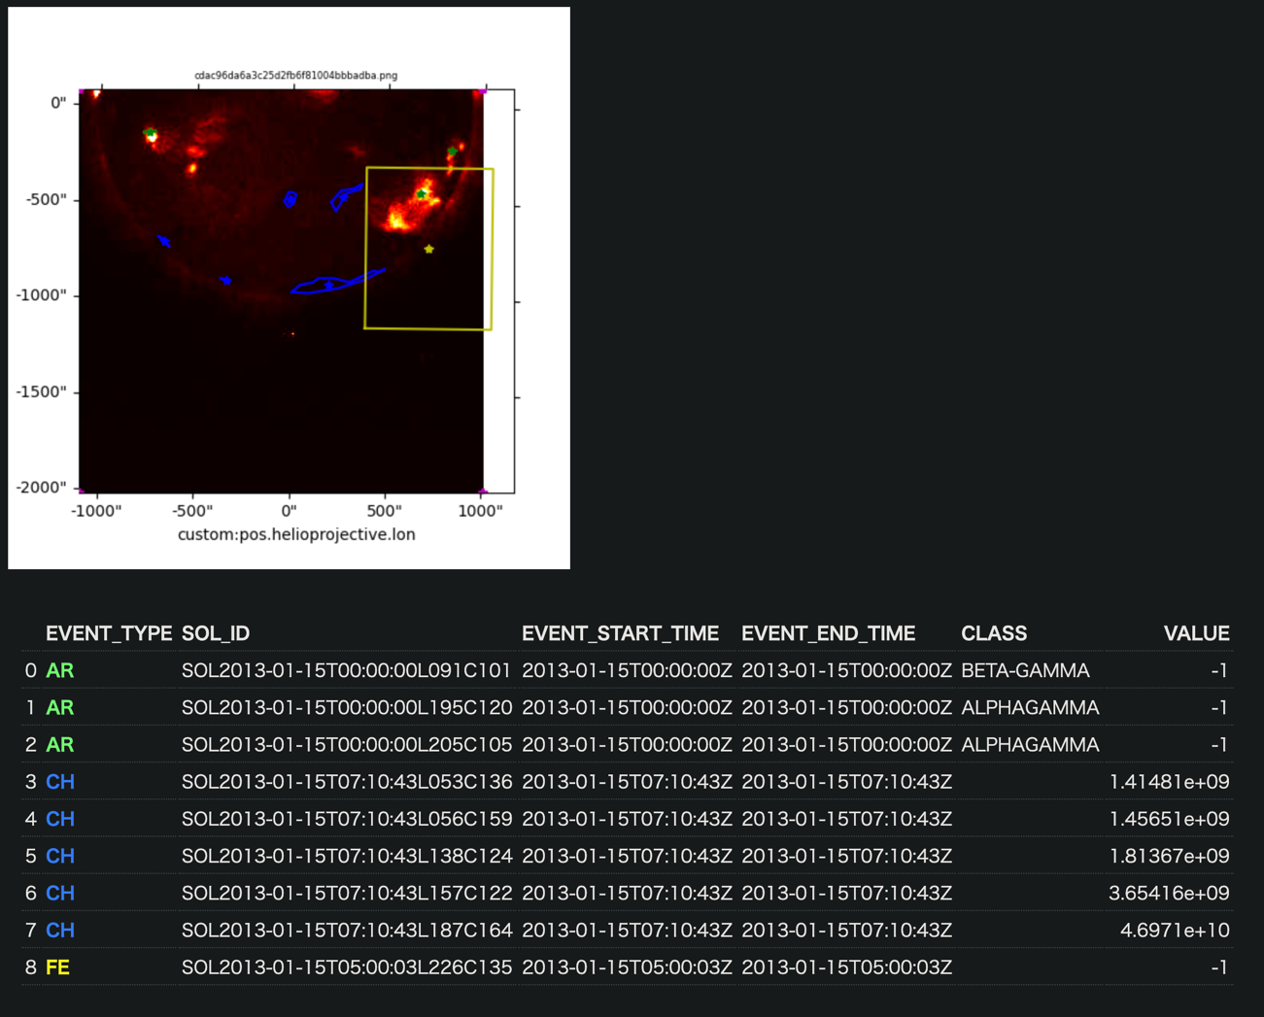
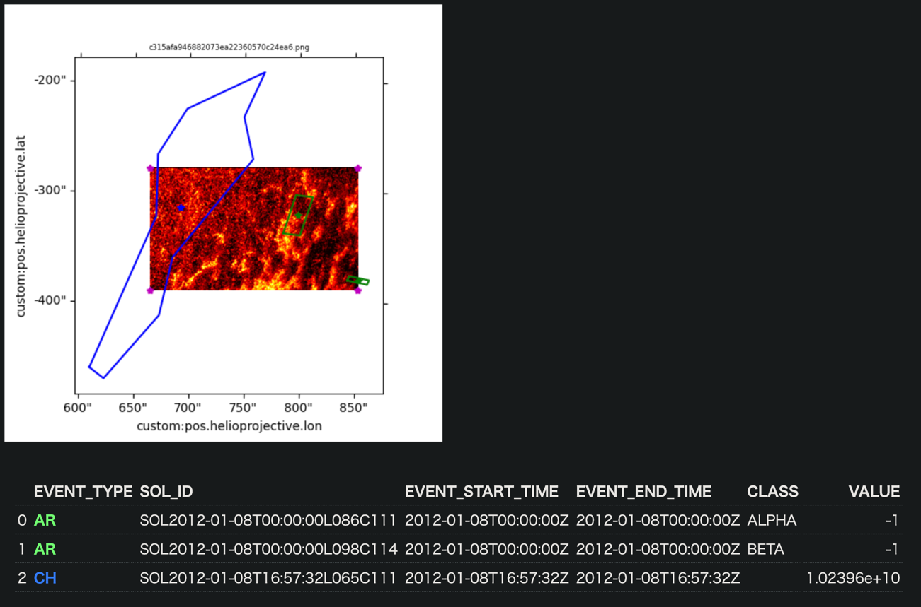
Example of search application
Matching HINODE level-0 data with HEK database
Built using cloud service (MS Azure) functionality
Implemented faceted search and confirmed that aggregation on ~21M rows of data works responsively.

Slide 15
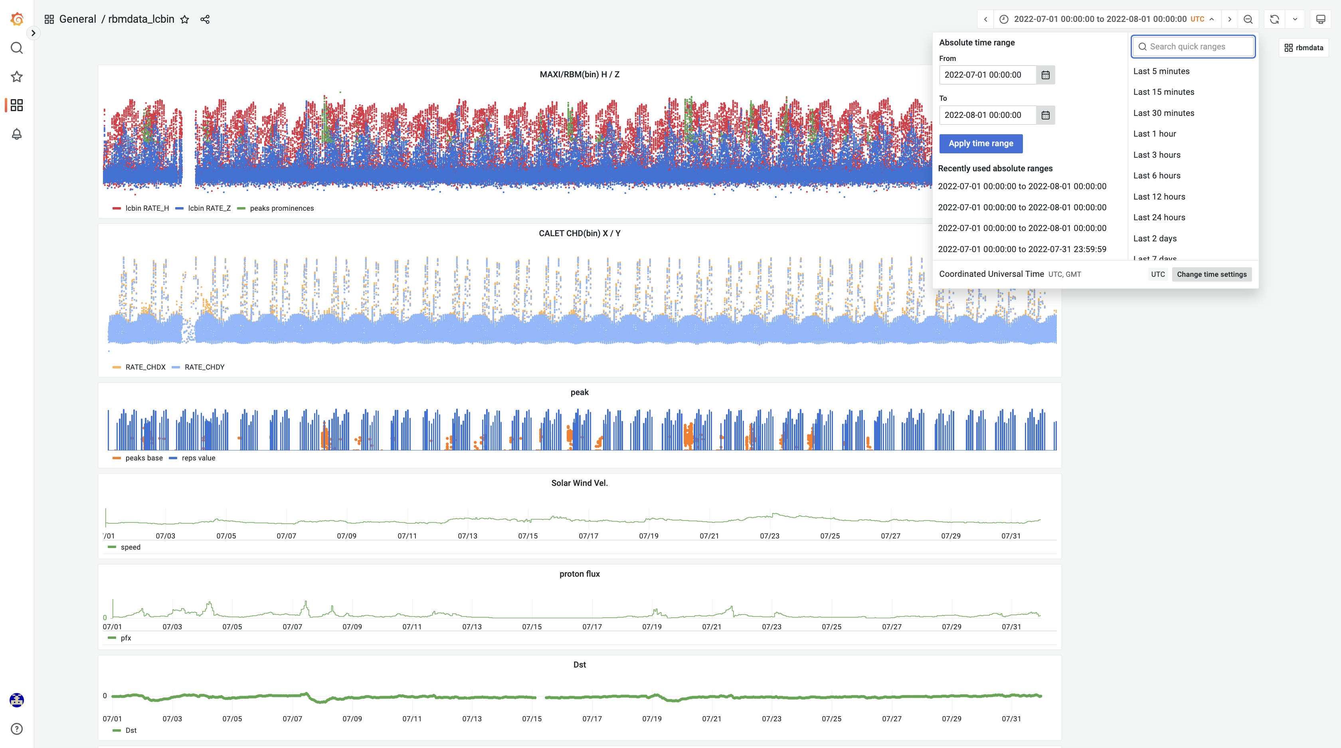
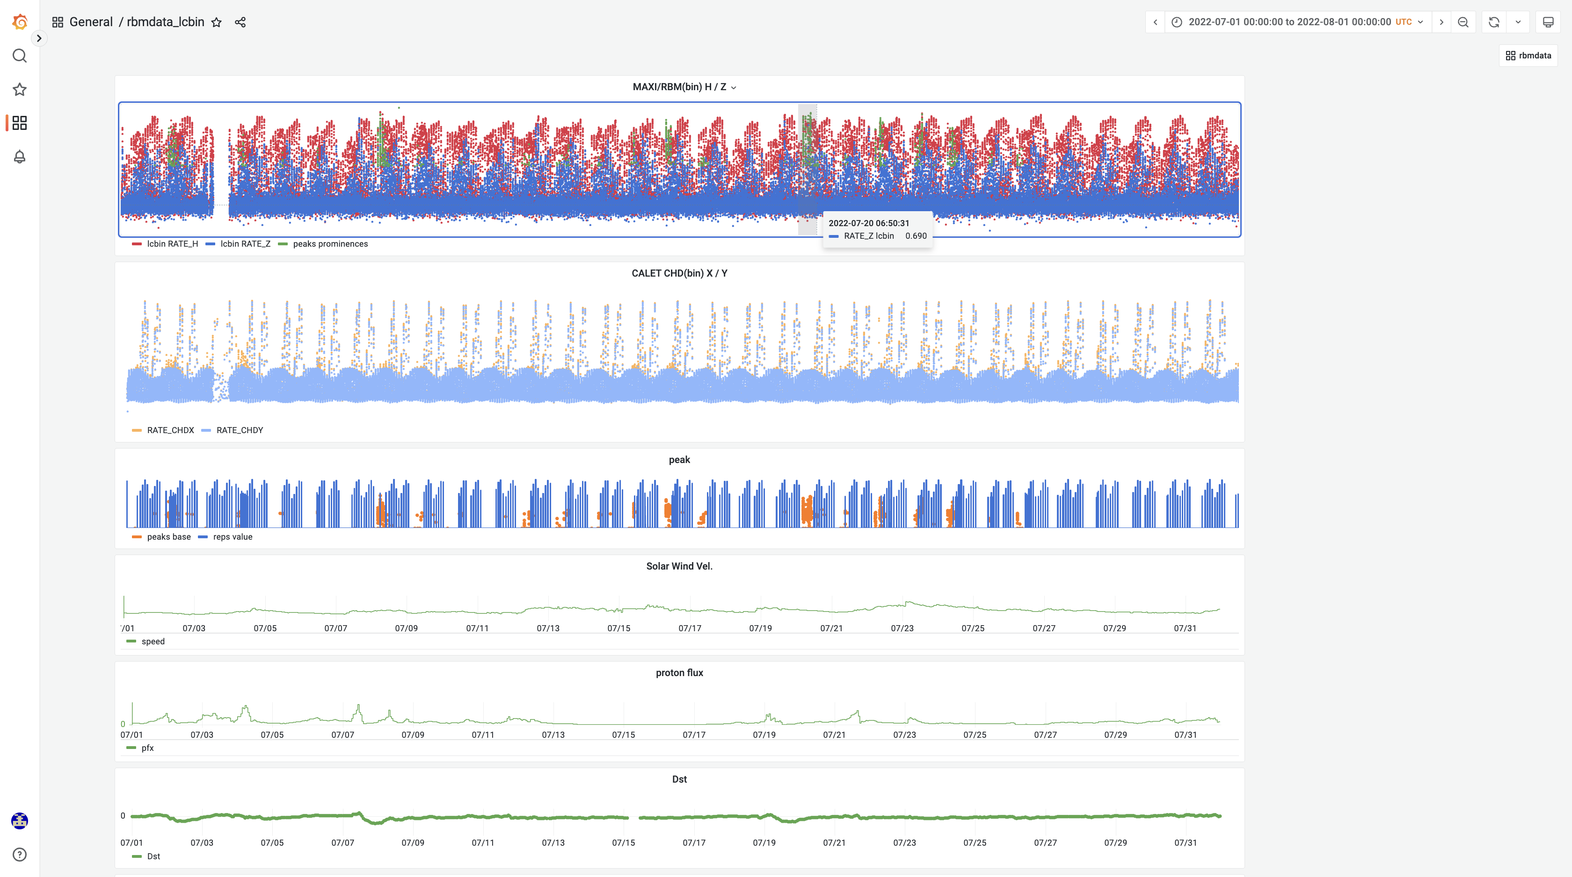
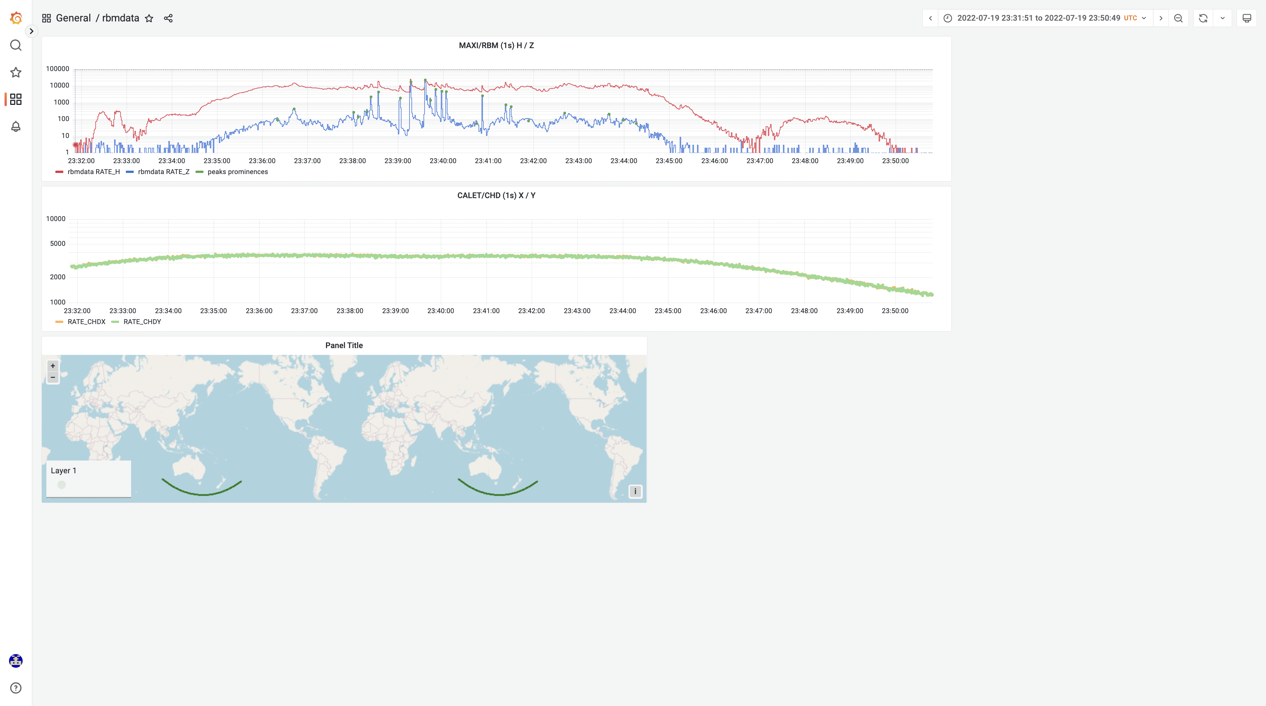
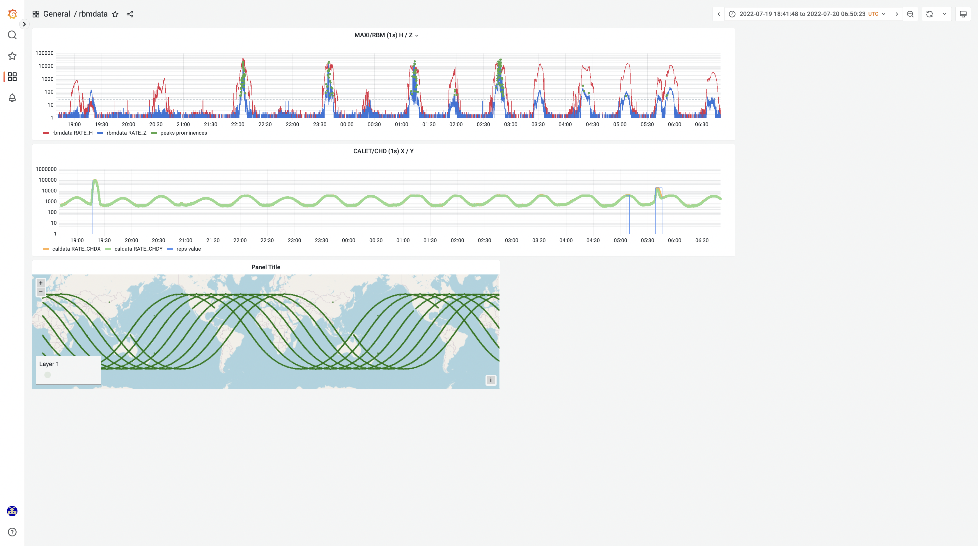
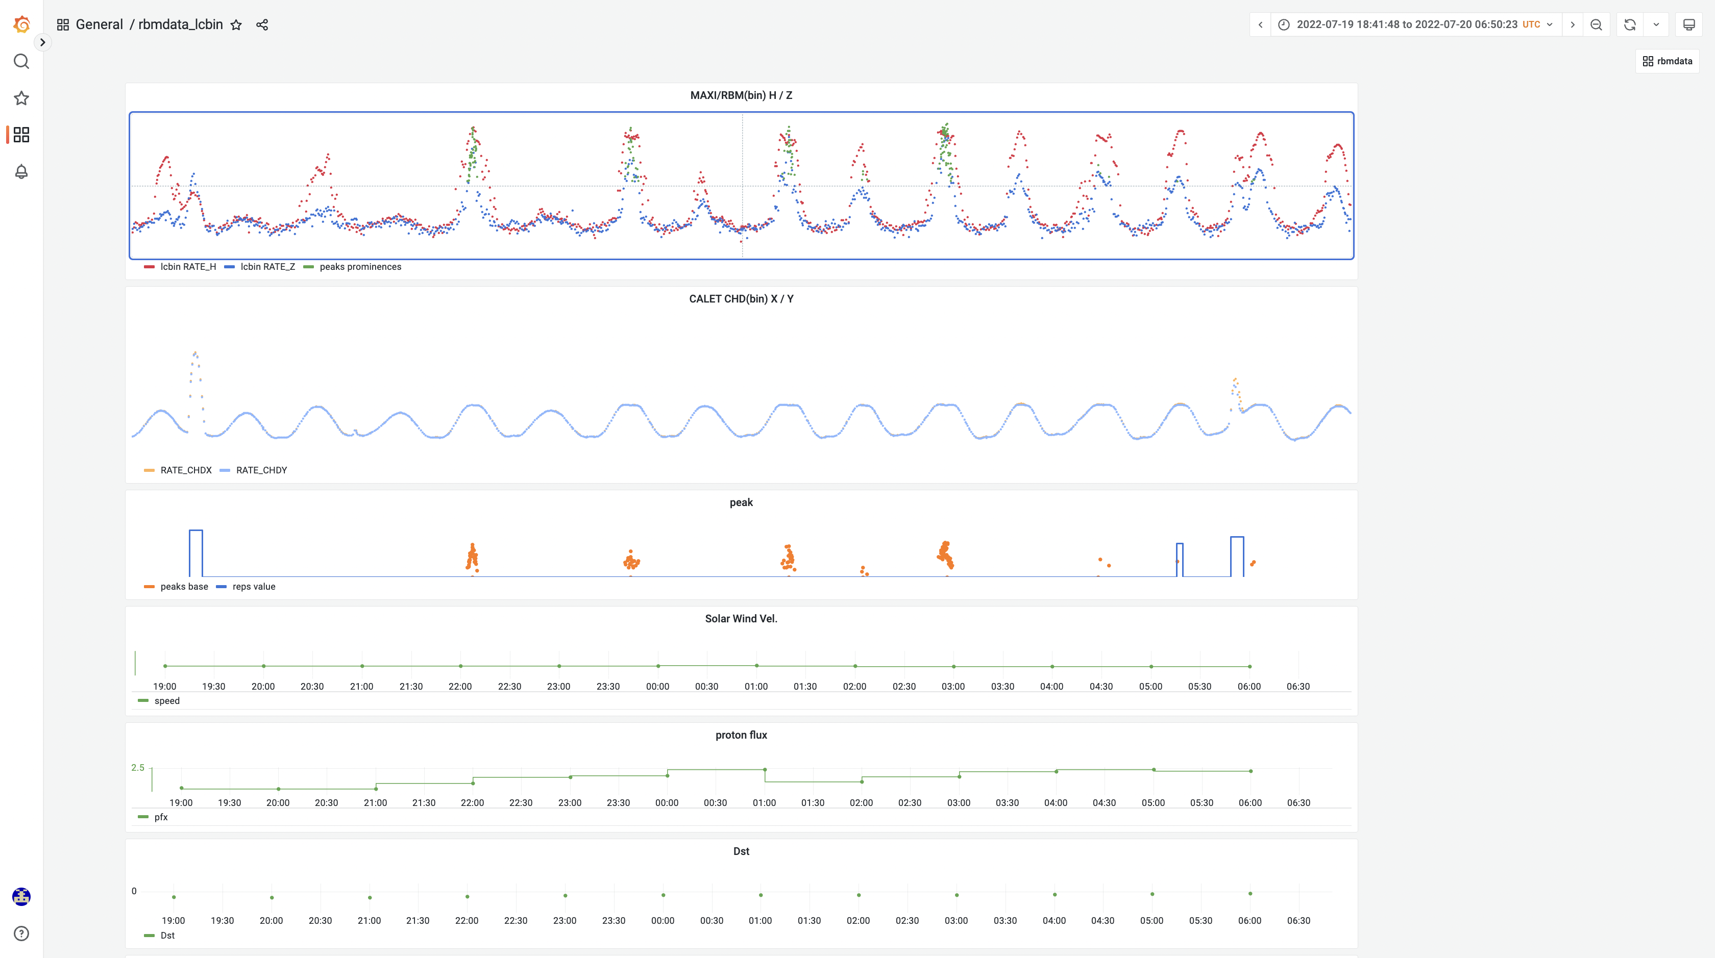
MAXI(RBM), CALET(CHD) Data viewer

Slide 16
Thank You!
Please Visit DARTS Web Page:
https://www.darts.isas.jaxa.jp/

Slide 17
HEK-Hinode DB

