Slide 1
Recent activities of the IUGONET project
Yoshimasa Tanaka^{1,2,3}, Shuji Abe⁴, Atsuki Shinbori⁵, Shun Imajo⁶, Satoru UeNo⁷, Masahito Nosé⁸,
and IUGONET project team
¹ Polar Environment Data Science Center, Joint Support-Center for Data Science Research, Research Organization of Information and System,
² National Institute of Polar Research,
³ Department of Polar Science, Graduate University for Advanced Studies (Sokendai),
⁴ International Research Center for Space and Planetary Environmental Science (i-SPES), Kyushu University,
⁵ Institute for Space-Earch Environmental Research, Nagoya University,
⁶ Data Analysis Center for Geomagnetism and Space Magnetism, Graduate School of Science, Kyoto University,
⁷ Kwasan and Hida Observatories, Graduate School of Science, Kyoto University.
⁸ Nagoya City University.

Slide 2
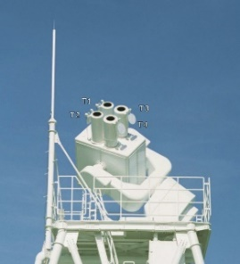
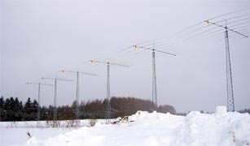
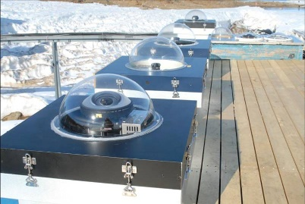
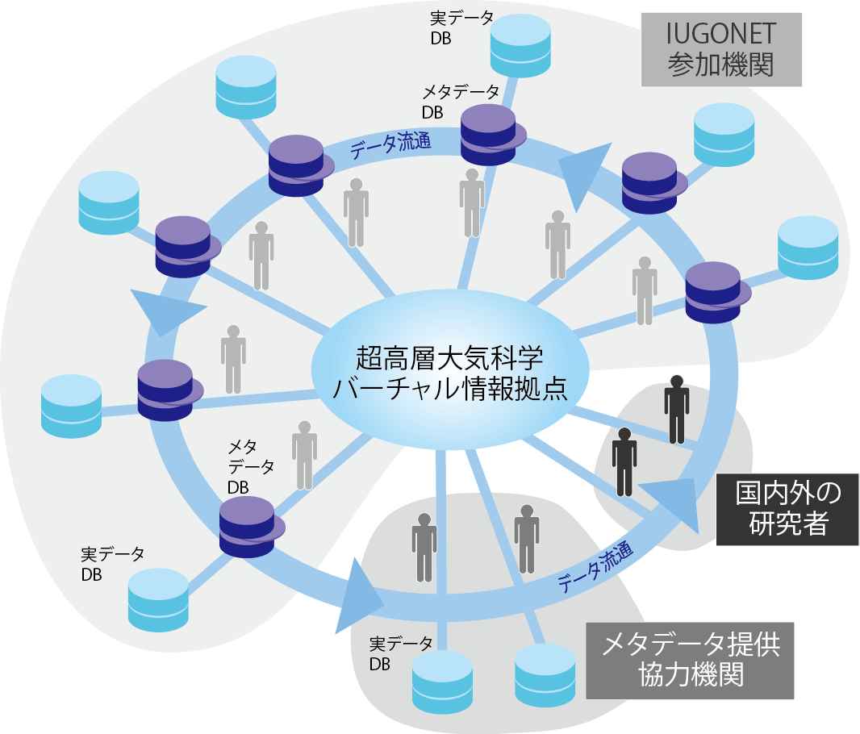
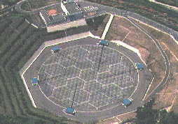
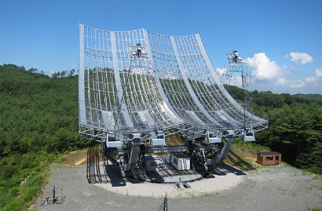
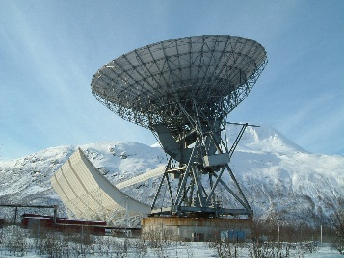
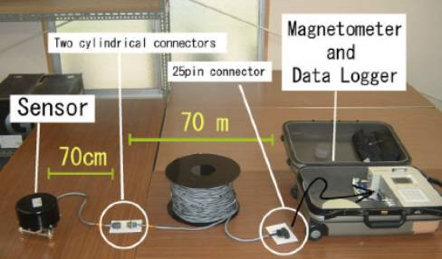
IUGONET project
(Inter-university Upper atmosphere Global Observation NETwork)
ISEE,
Nagoya Univ.
Astro. Obs.,
Kyoto Univ.
NIPR
RISH,
Kyoto Univ.
PPARC, Tohoku Univ.
WDC geomag., Kyoto Univ.
STP missions in Japan
i-SPES, Kyushu Univ.
Partner Univ./Insti.
The goals of the IUGONET project are to share the upper atmospheric data that have been separately archived by Japanese universities and institutes and accelerate STP research.
We have developed some advanced tools (metadata database and analysis tools), which enable data sharing and comprehensive data analysis.
Notes:
まず、初めに、大学間連携プロジェクト「IUGONET」の活動について、説明します。
日本語名は、超高層大気長期変動の全球地上ネットワーク観測・研究です。
私は、2009年度から「IUGONET」プロジェクトを推進してきました。
このプロジェクトは、東北大、極地研、名大、京大、九大の5機関で始まったプロジェクトです。
本プロジェクトでは、全国の大学・研究機関に分散している多種多様な超高層大気データ（イメージャやレーダー、望遠鏡、磁力計等）の公開支援、効率的に解析するための研究基盤（メタデータデータベースや解析ツール）の開発、若手研究者育成のためのデータ解析講習会の開催等を実施しています。
私は、2009年より、解析ソフトウェア開発リーダーを、2014年度以降は、開発チームのリーダーを担当しています。

Slide 3
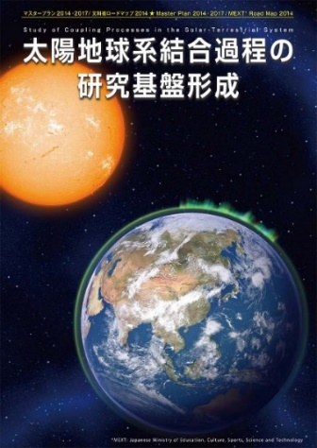
Domestic and international collaborations
Collaboration on
Metadata
Education of young researchers
Support for data publication
SPASE Consortium（NASA, CDPP, etc.)
USA
Asia
Africa
South America
etc.
Europa
Collaboration on
Analysis tools
Collaboration
UCLA
UCB
Other missions
国内外STP
プロジェクト
Collaboration
IUGONET metadata is based on the SPASE metadata format.
Developed a plug-in software for SPEDAS.
We regularly hold data analysis workshops online or on-site for researchers in Japan and abroad.
Master Plan 2014, 2017, 2020/
Road map 2014
“Study of Coupling Processes in the Solar-Terrestrial System”
Notes:
IUGONETは、国内だけでなく、海外の研究機関とも様々な連携をしてきました。
メタデータについては、米国NASAや欧州、日本のJAXA等が加盟している、SPASEコンソーシアムに加盟。定期的にミーティングに参加しています。
また、SPASEメタデータスキーマに、IUGONETが提案したメタデータ要素を追加する等の実績をあげています。
また、米国のUCLAやUCB、他ミッションとは、解析ツール開発で連携しています。
アジア、オセアニア、アフリカ、南米とは、特に、オンサイト/オンラインのデータ解析講習会を開催してきました。
また、国内では、大型研究計画マスタープランの重点計画やロードマップ採択計画である「太陽地球系結合過程の基盤形成」において、データ公開支援、基盤開発、データサイエンス推進を担当する計画です。
これらの活動により、IUGONETへの謝辞を含む査読付き学術論文や学位論文が、これまでに180編以上出版されています。

Slide 4
Data Life cycle and IUGONET supports
Data Life cycle
Creation
Processing
Analysis
Data providers are responsible for these stages
Reuse
Access
Preservation
④
Data analysis workshops
③
Development of analysis tools
②
Support for metadata creation
①
Support for data publication
IUGONET Type-A,
SPEDAS, pyspedas,
CDF, NetCDF, FITS
SPASE
IUGONET activities

Slide 5
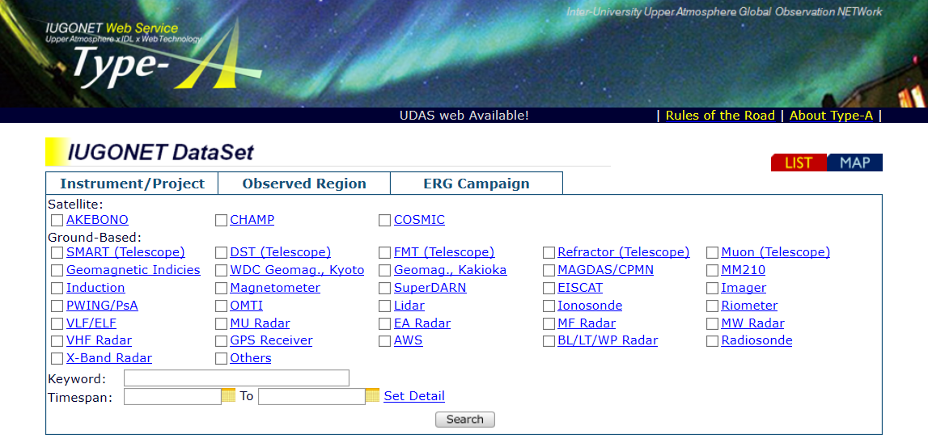
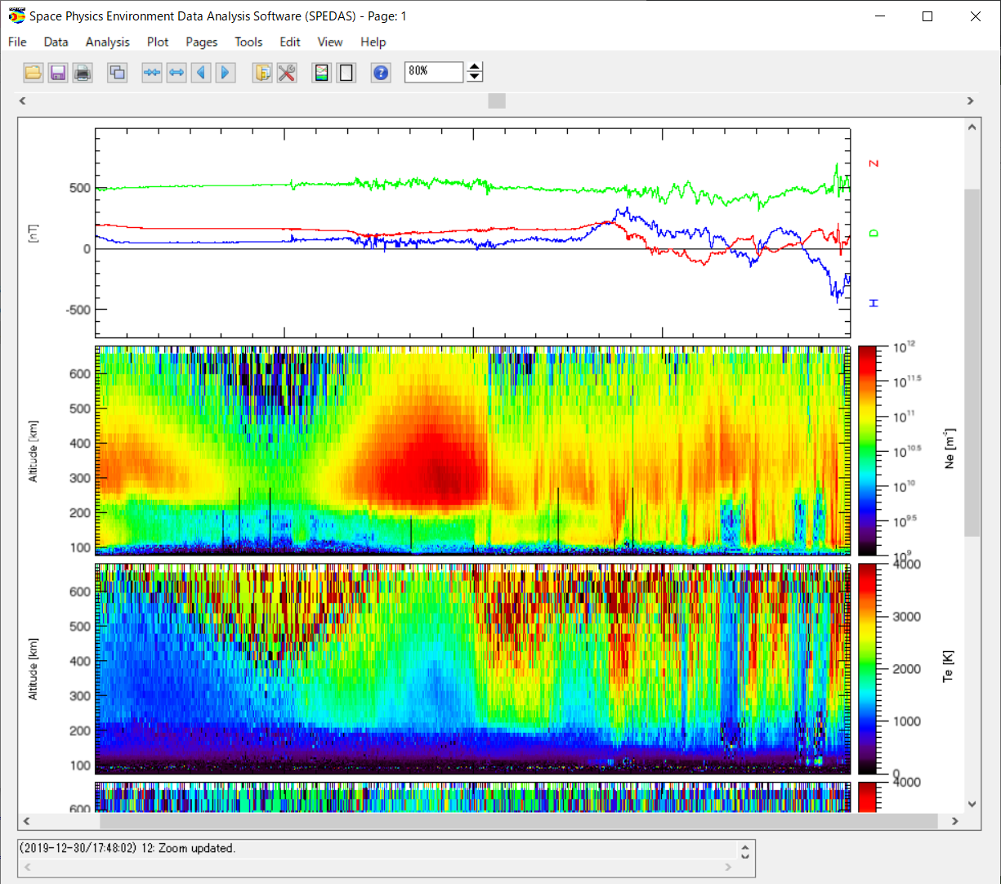
Tools developed by IUGONET
Metadata Database
Analysis Tool
1. Search
(find data and
event)
2. Know
(get metadata
& QL plot)
3. Examine
(plot interactively
with UDAS web)
4. Advance
(know how to
analyze data)
5. Analyze
(analyze data
with SPEDAS)
6. Create
(create figures
for papers)
IUGONET Type-A
SPEDAS
IUGONET metadata database (IUGONET Type-A) provides one-stop web service for researchers to search data, get the information of data, and interactively plot data.
More than 1300 metadata for upper atmosphere data have been registered to IUGONET Type-A.

Slide 6
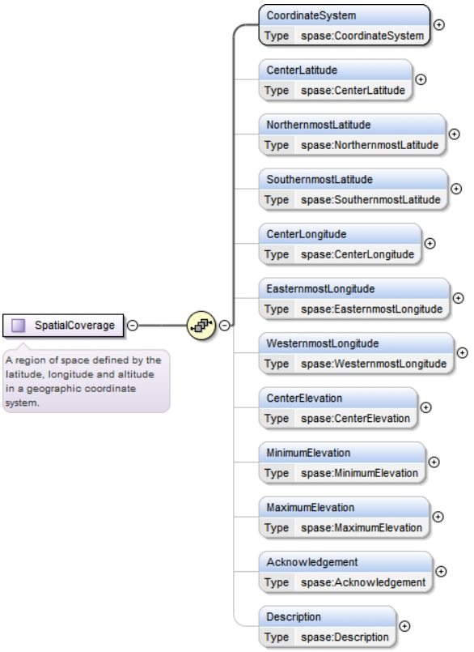
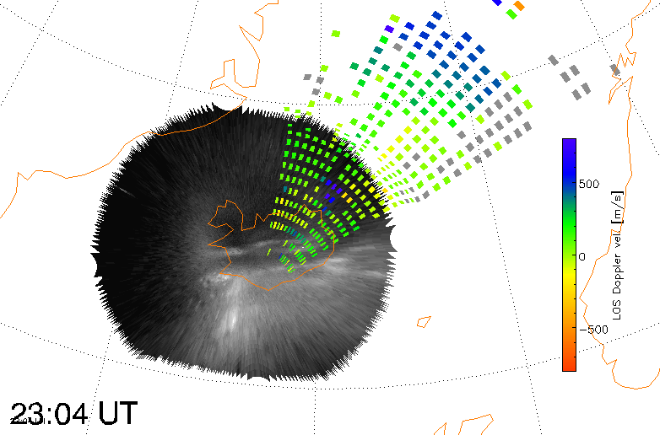
IUGONET metadata
The current IUGONET metadata (2.4.0.1) was created based on the SPASE 2.4.0 data model.
The IUGONET metadata includes an additional metadata element (SpatialCoverage).
SpatialCoverage
SpatialCoverage
The “SpatialCoverage” was redefined through discussions with the SPASE team and added to SPASE 2.4.2.
https://spase-group.org/

Slide 7
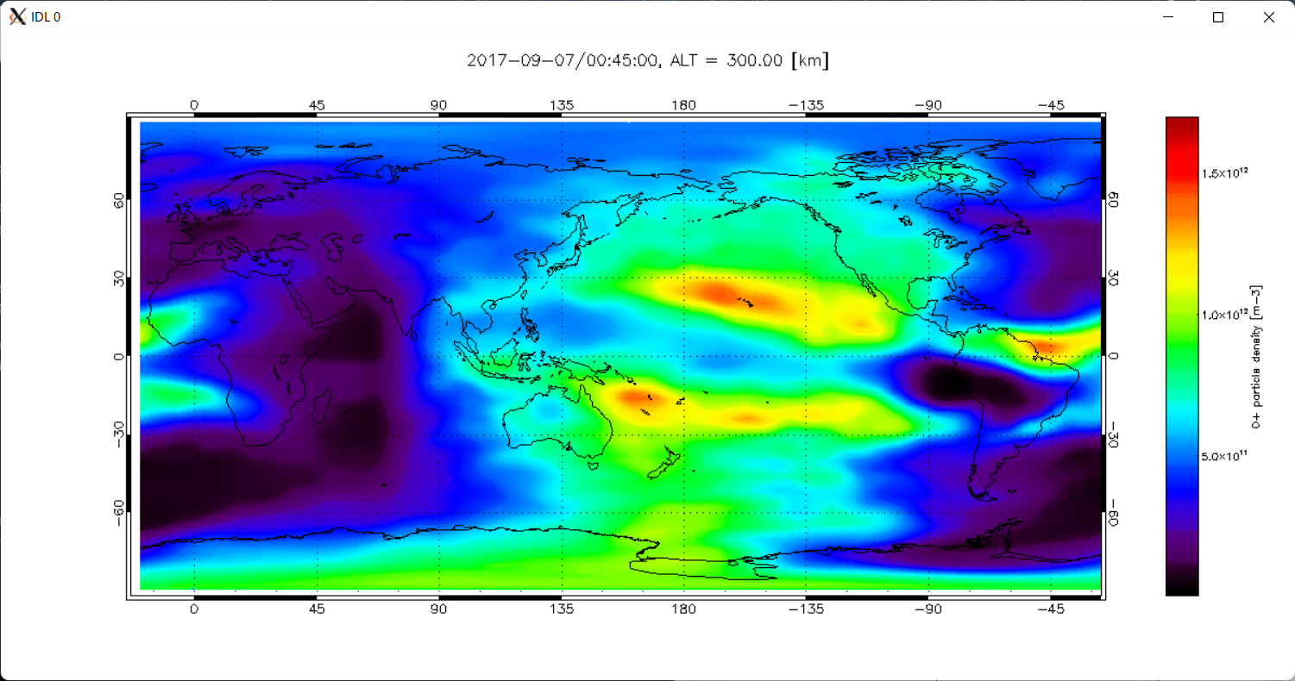
Metadata for simulation data
Since IUGONET has some simulation data (e.g., GAIA data), we plan to update the metadata to SPASE 2.6.0, which is able to handle simulation data.
Tomorrow, we will report the results of applying SPASE 2.6.0 to the GAIA simulation data (by Shinbori at 09:50-10:05 on Oct. 13).
After the update of metadata, we want to register the IUGONET metadata to the NASA Heliophysics Data Portal.
GAIA (Ground-to-topside model of Atmosphere and Ionosphere for Aeronomy) simulation data released by NICT

Slide 8
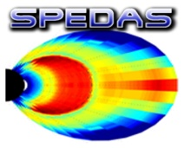
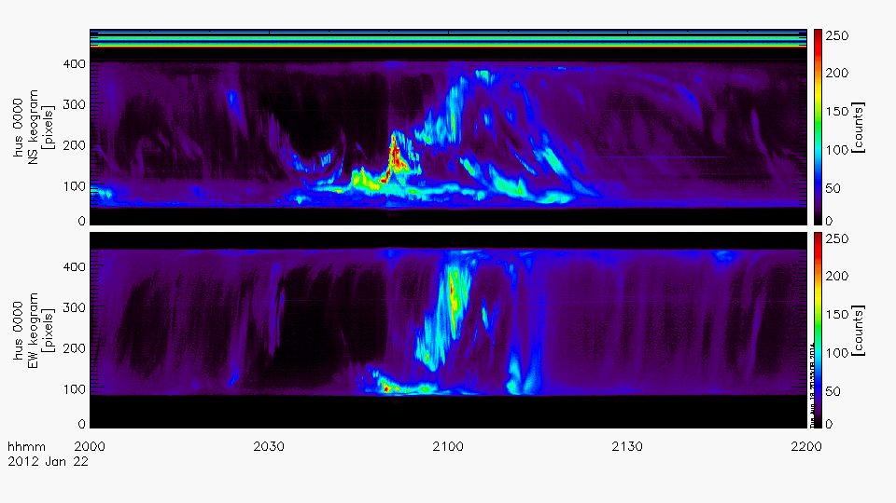
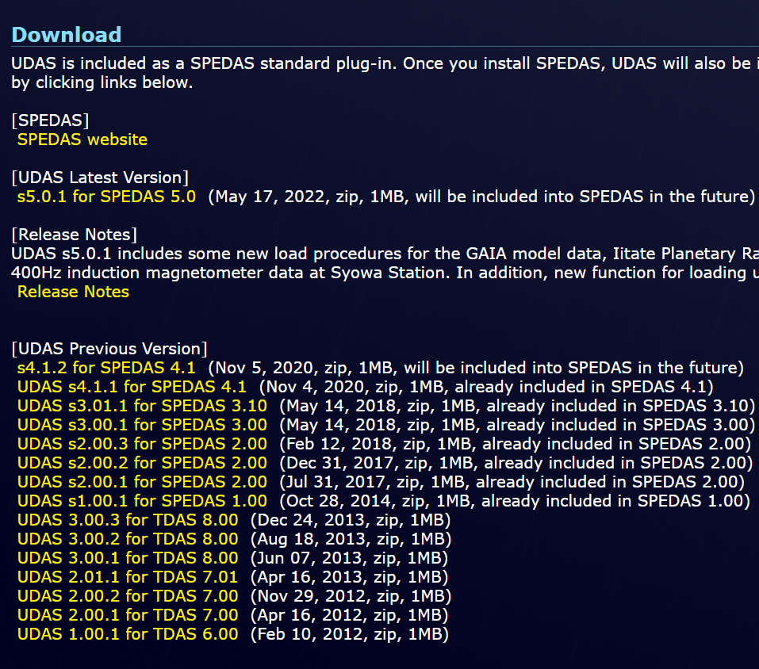
Plug-in software for SPEDAS
Our main analysis tool is based on Space Physics Environment Data Analysis Software (SPEDAS), written in Interactive Data Language (IDL).
We have provided a plug-in software for SPEDAS, which includes about 40 kinds of load procedures for the IUGONET data, including data from the magnetometers, radars, imagers, ionosondes, riometers, radio telescopes, and simulations).
The latest version of the plug-in can be downloaded from the IUGONET website (http://www.iugonet.org/).

Slide 9
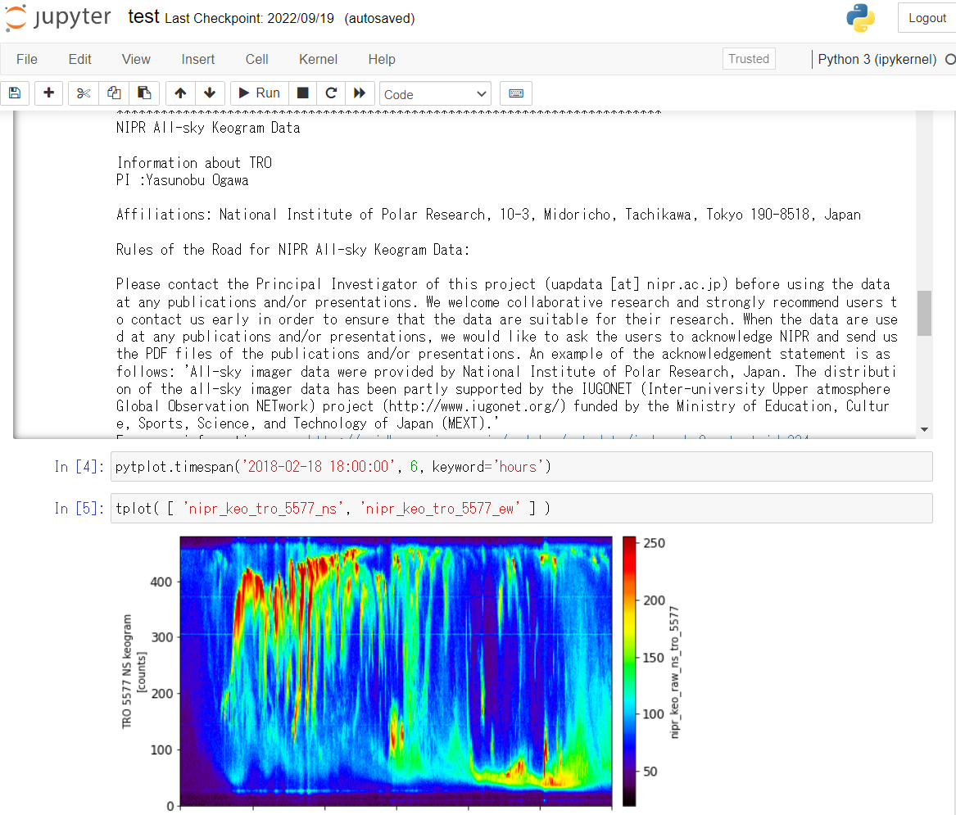
Development of IUGONET plugin for PySPEDAS
Python-based Space Physics Environment Data Analysis Software (PySPEDAS)
The ERG-SC plug-in for PySPEDAS was developed by ERG-SC before IUGONET.
In 2022 we started to develop a plug-in software (called pyUDAS) for PySPEDAS.
We first developed the template codes for loading CDF and NetCDF data files, by which we can easily create load functions.

Slide 10
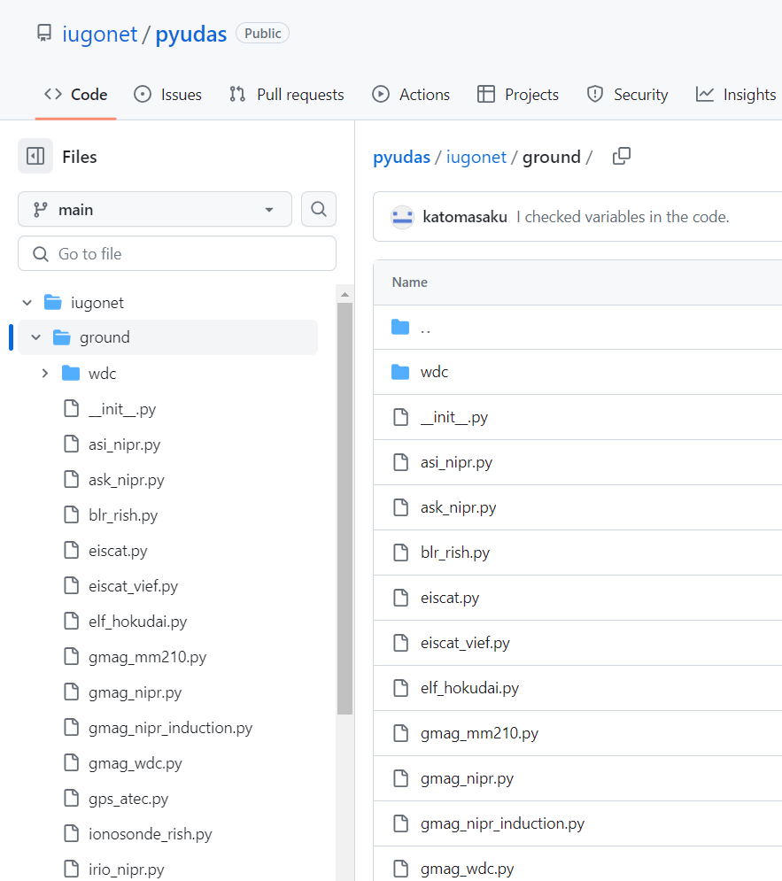
Development of IUGONET plugin for PySPEDAS
https://github.com/iugonet/pyudas/
The pyUDAS code is under development, but some load functions are available from GitHub.
We hope to add the plug-in to PySPEDAS in the future.

Slide 11
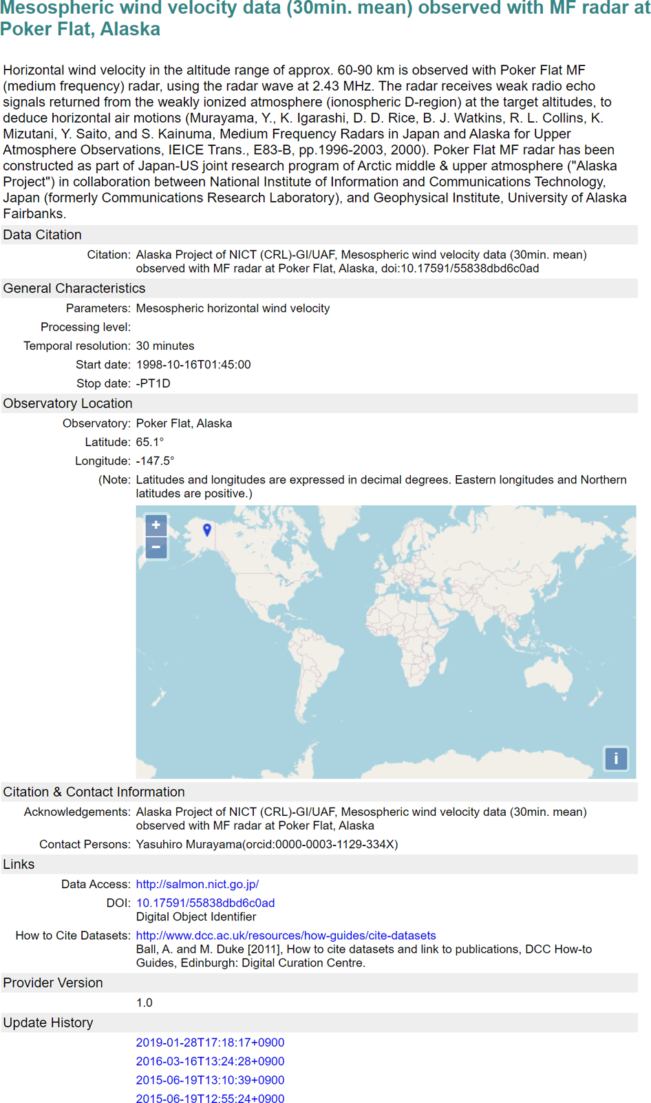
DOI minting system
DOI:10.17591/55838dbd6c0ad
Several WDS institutions and NICT in Japan have created a mapping table between IUGONET metadata schema (based on SPASE 2.2.2) and JaLC (Japan Link Center) metadata schema and developed a system that can mint DOIs using the IUGONET metadata.
In collaboration with NICT, we will update this mapping table and replace the system with new one that can mint DOIs using SPASE 2.6.0 metadata.

Slide 12
Summary
IUGONET has supported the metadata creation and data publication and developed the visualization and analysis tools. The data formats (CDF, NetCDF, Fits), metadata (SPASE), and tools (SPEDAS, PySPEDAS) used by IUGONET are based on the recommendations by IHDEA.
The current IUGONET metadata was created based on SPASE 2.4.0. In the near future, we will update the metadata to SPASE 2.6.0, which includes “Spatial Coverage” and is able to handle simulation data (e.g., GAIA data).
The IUGONET plug-in tool (pyUDAS) for PySPEDAS is still under development, but it is now available from GitHub.
We will develop a system that can mint DOIs using SPASE metadata (2.6.0) in collaboration with NICT.

