Slide 1
IHDEA 2023 ESA Heliophysics Archives HAPI & TAP Updates
Jonathan Cook & ESDC Helio team
12/10/2023

Slide 2
Heliophysics Application Programmer's Interface (HAPI)
The HAPI team have prepared a Java implementation packaged as a WAR file:
https://github.com/hapi-server/server-java
ESDC has packaged the WAR file into a Docker container and have an operational server is running at ESAC for CSA:
https://csatools.esac.esa.int/HapiServer/hapi
In the evaluation testing phase

Slide 3
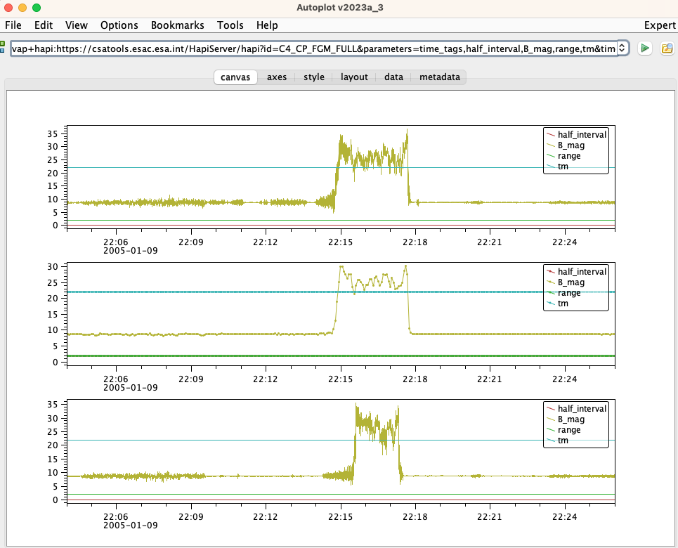
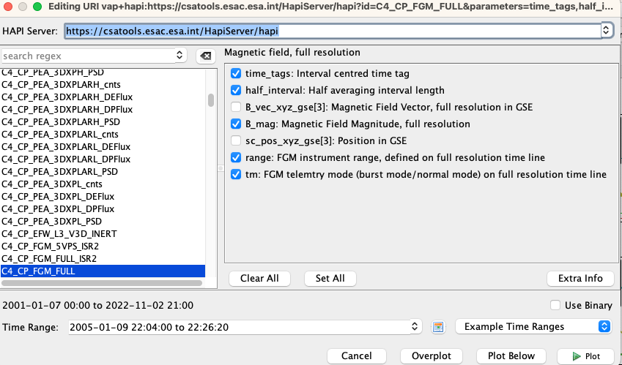
Heliophysics Application Programmer's Interface (HAPI)
Plotting Cluster FGM Data in Autoplot
https://journals.aps.org/prl/abstract/10.1103/PhysRevLett.107.215002

Slide 4
Heliophysics Application Programmer's Interface (HAPI)
Pending to define responsibilities with the current server between HAPI team and CSA team
e.g How to manage software updates properly
Pending to discuss how to extend this server to work with any Heliophysics Archive serving TS Data such as SOAR

Slide 5
TAP Updates
Updates to the latest version of TAP
Supports ADQL 2.1
Improve TAP compliance rating of all TAP services at the Euro-VO registry:
https://registry.euro-vo.org/evor/#home
SOAR data is available through the sunpy-soar package - A SunPy Fido plugin
https://github.com/sunpy/sunpy-soar

Slide 6
TAP Updates – Future plans
Pending to upgrade the current TAP servers to EPN-TAP to make all Heliophysics archives accessible through the European Commission (EC) supported VESPA pan-European project
Pending to make all solar archives, starting with Solar Orbiter, available through the VSO, Solar Software (SSW) and SunPy via our TAP servers

Slide 7
TAP Updates – Future plans - Metalink
To support large downloads for example:
A PI wants to download all his data (~ 1TB).
A SOAR user wants to download a complete set of SOOP Data (50+ GB)
Investigating and evaluating the use of Metalink in our TAP+ servers
Metalink an XML-based download description format. Metalink describes download locations (mirrors), cryptographic hashes, and other information. Clients can transparently use this information to reliably transfer files.
Others, like EO services and some NASA services already use this approach:
Aeolus
NASA EO Bulk Download
EO Data

