Slide 1


HAPI in the Access and
Discovery Landscape
Jon Vandegriff, JHU / APL
Robert S. Weigel, George Mason University
Jeremy Faden, d.b.a. Cottage Systems
Sandy Antunes, JHU / APL
Robert Candey, GSFC / SPDF
Doug Lindholm, LASP
What if every dataset you wanted to use was easy to access?

Slide 2
Outline
Review of What is HAPI? (review, if needed)
  Different aspects of HAPI within a data system
  HAPI reduces data wrangling
  HAPI as “HTTP for data”
Update on HAPI adoption
HAPI efforts in development
Leveraging HAPI and SPASE together

Slide 3
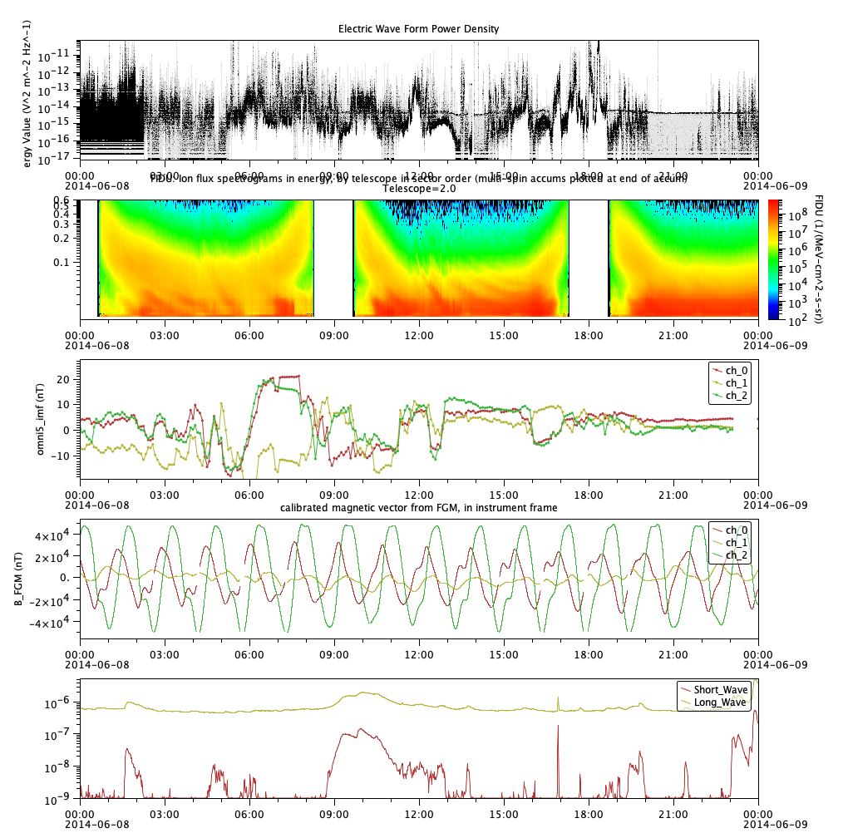
What is HAPI?
HAPI = Heliophysics Application Programmer’s Interface
Server
Client
server code for reading data from
disk
API
for data access
Request structure
client code for reading data from server
analysis program using reader library for data access
data
Defined Response
Plots / Analysis

Slide 4
HAPI is a specification
Server
Client
server code for reading data from
disk
HAPI
access specifi-cation
Request structure
client code for reading data from server
analysis program using reader library for data access
data
Defined Response
Plots / Analysis
This part is the HAPI specification – just an interface definition.

Slide 5
A HAPI server implements the specification
Server
Client
server code for reading data from
disk
HAPI
access specifi-cation
Request structure
client code for reading data from server
analysis program using reader library for data access
data
Defined Response
Plots / Analysis
The code on the server that implements the spec to deliver data is a HAPI server.

Slide 6
A HAPI client library knows how to read from HAPI servers
Server
Client
server code for reading data from
disk
HAPI
access specifi-cation
Request structure
client code for reading data from server
analysis program using reader library for data access
data
Defined Response
Plots / Analysis
The library that interacts with a HAPI server is the HAPI client library.
PyHC core package => HAPI Python client library.

Slide 7
A HAPI-enabled client uses a library to read data and then adapt it to an application
Server
Client
server code for reading data from
disk
HAPI
access specifi-cation
Request structure
client code for reading data from server
analysis program using reader library for data access
data
Defined Response
Plots / Analysis
The entire analysis program is then a HAPI-enabled client.
(there are more than just Python clients)

Slide 8
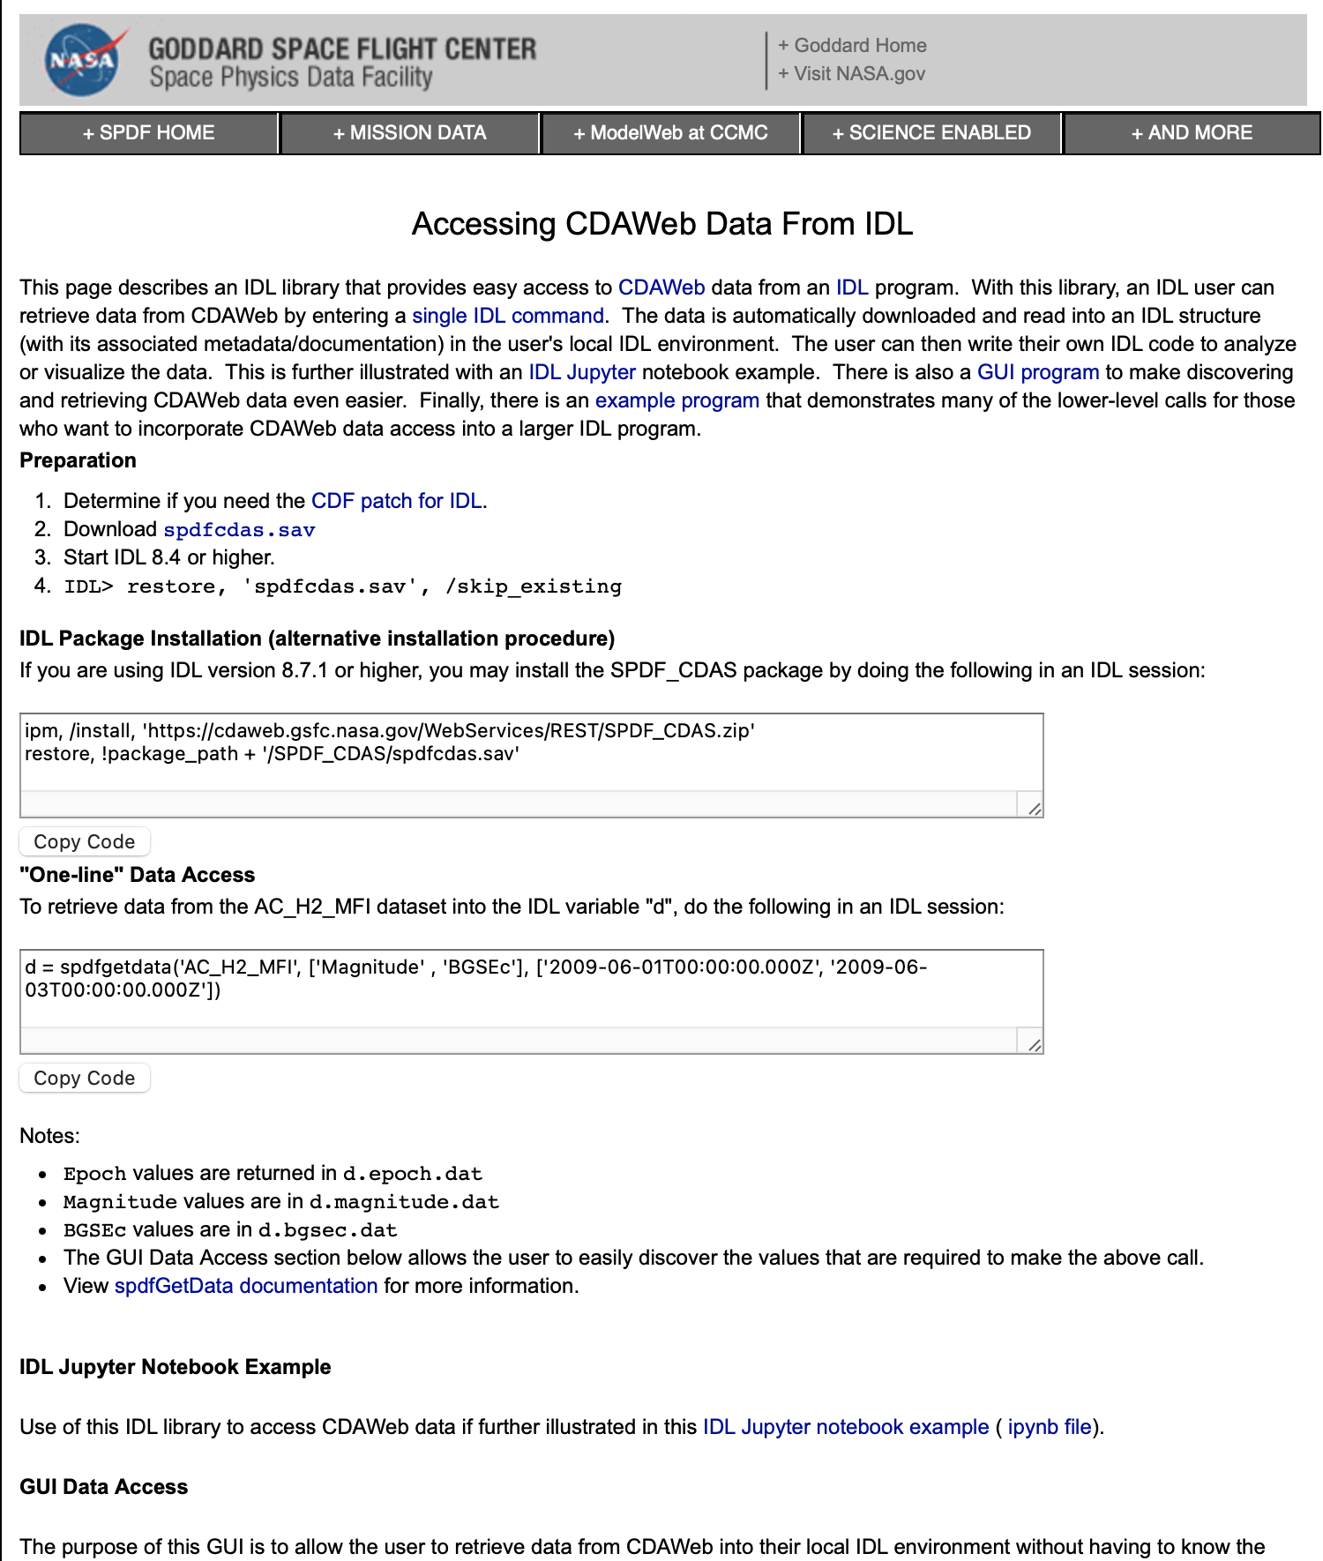

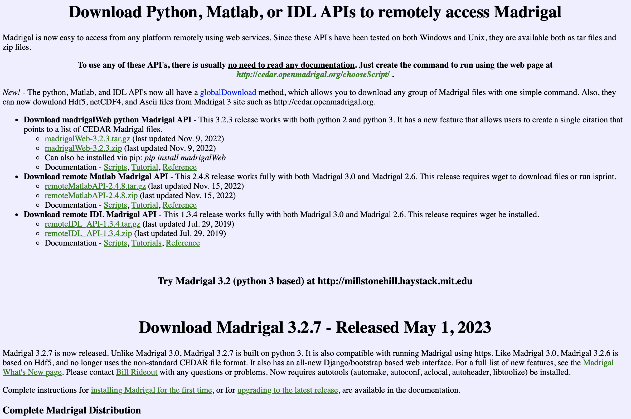
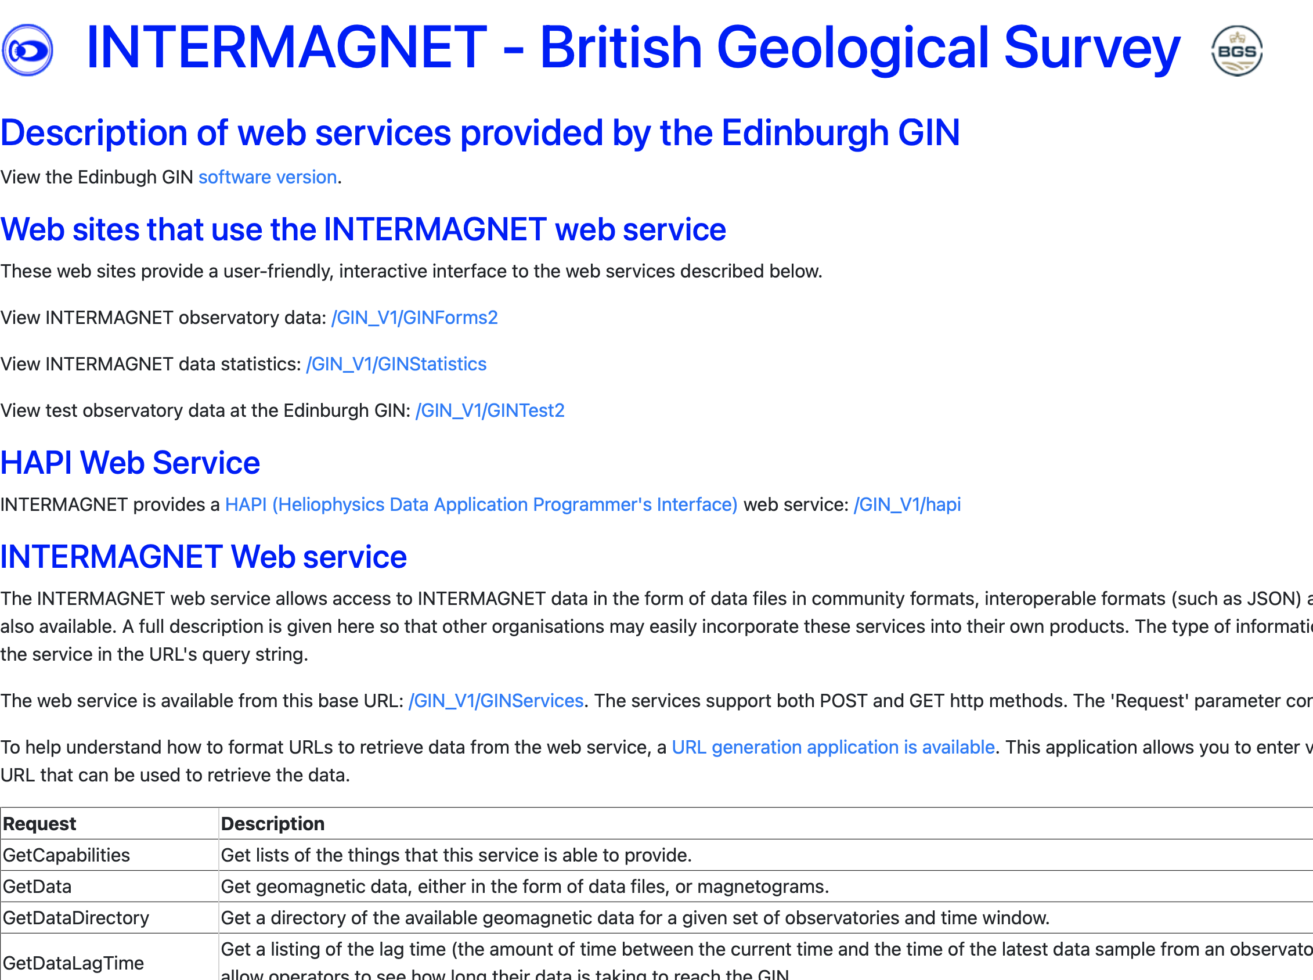
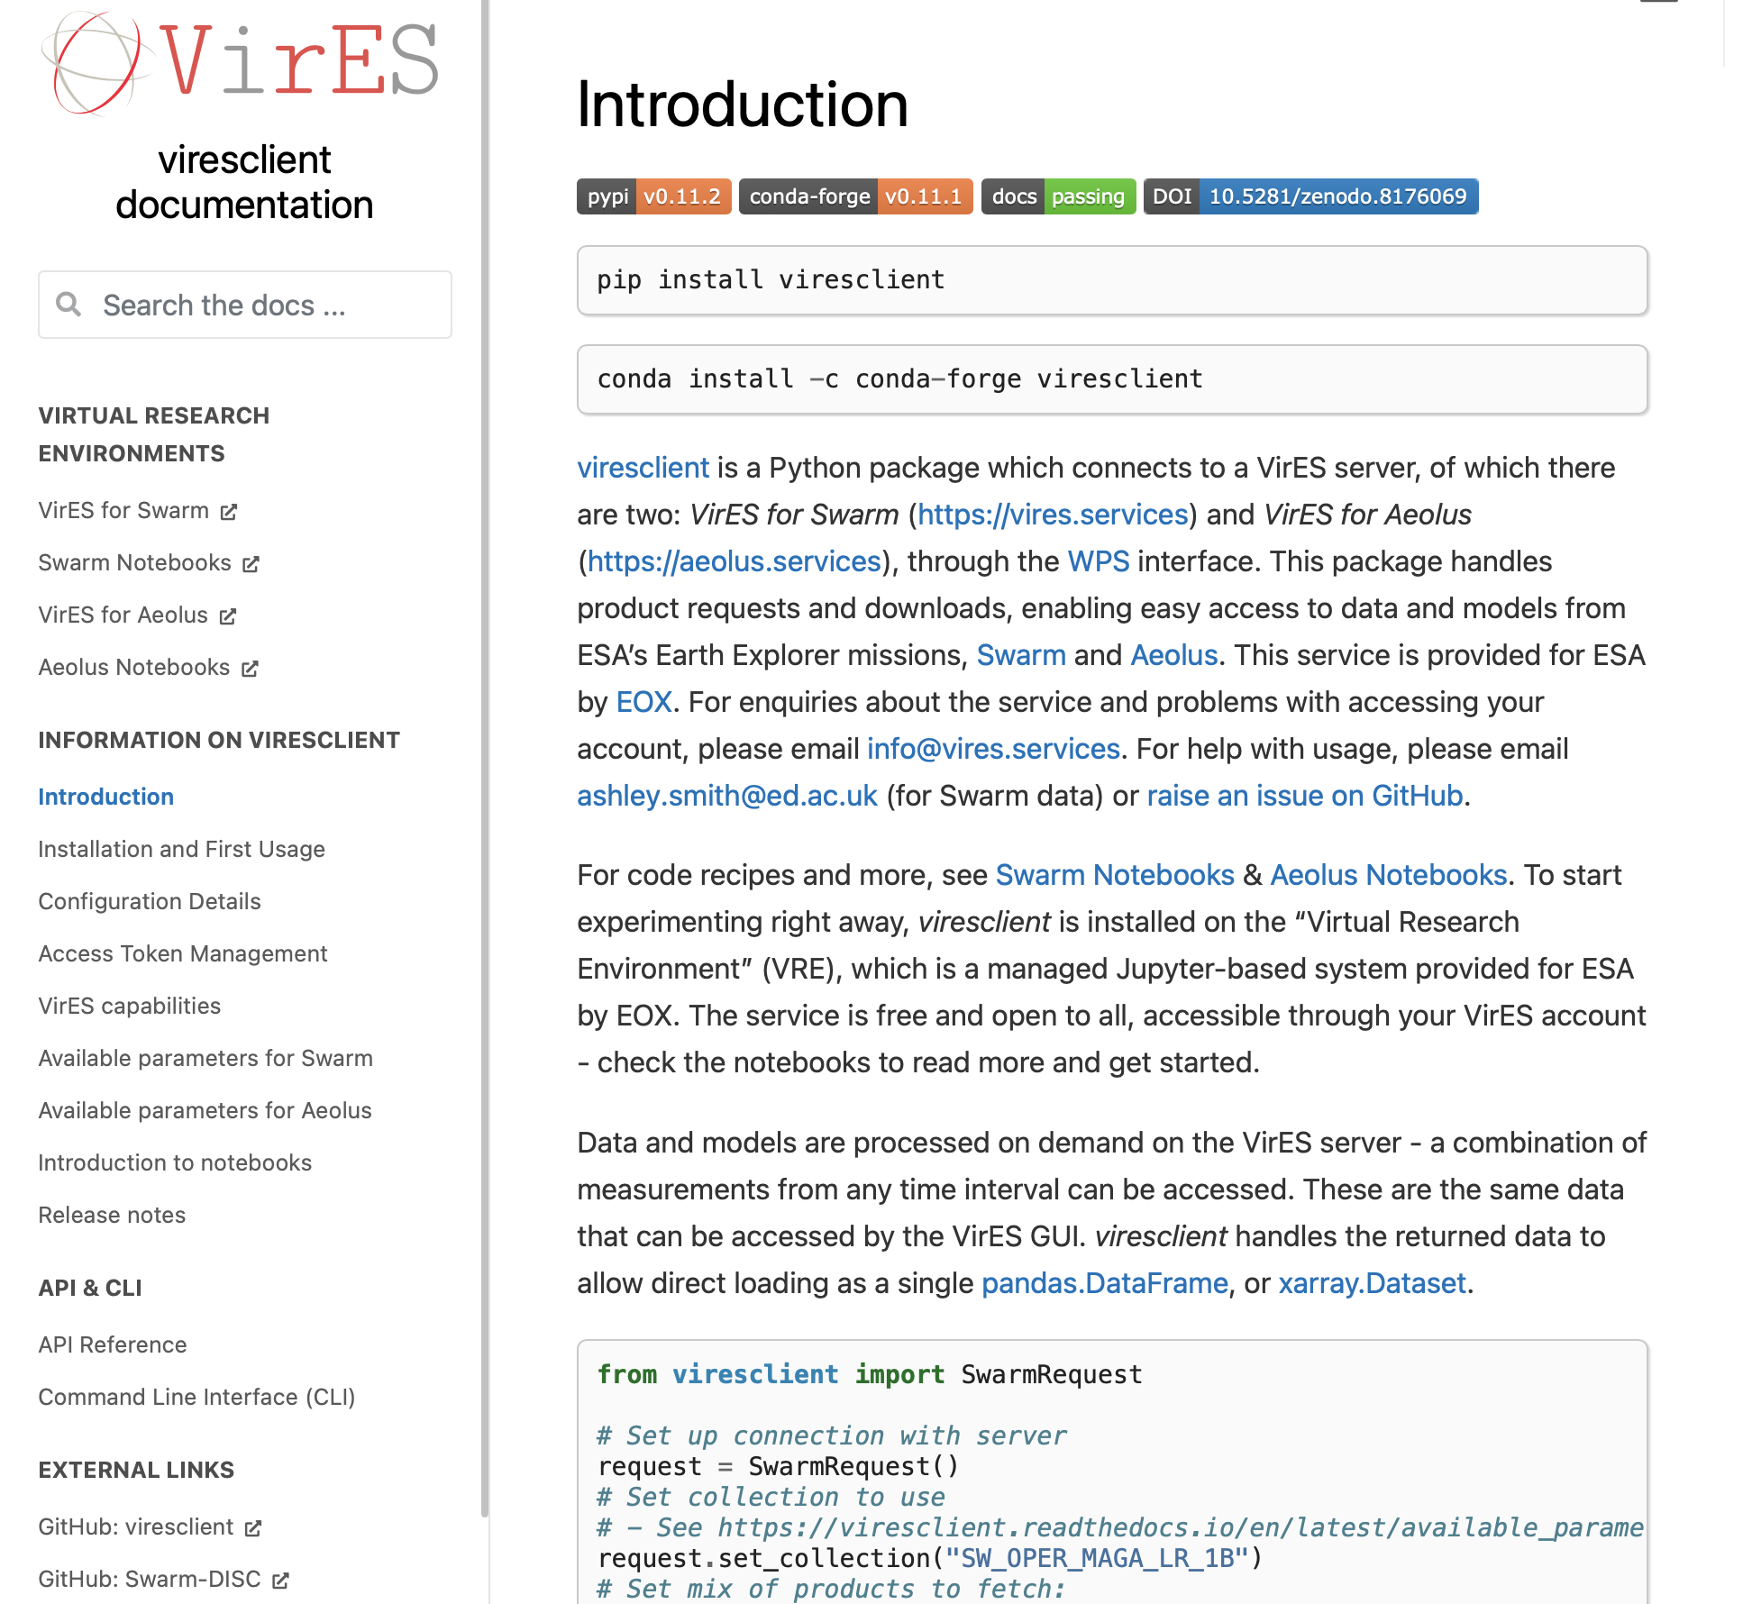
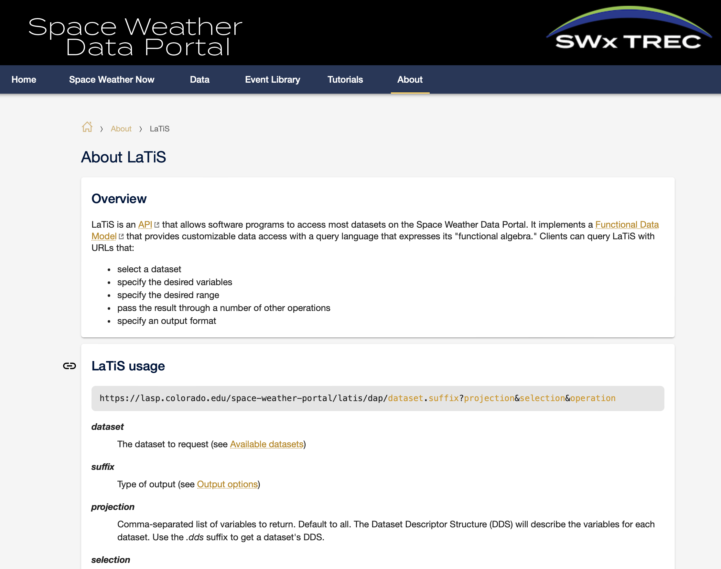
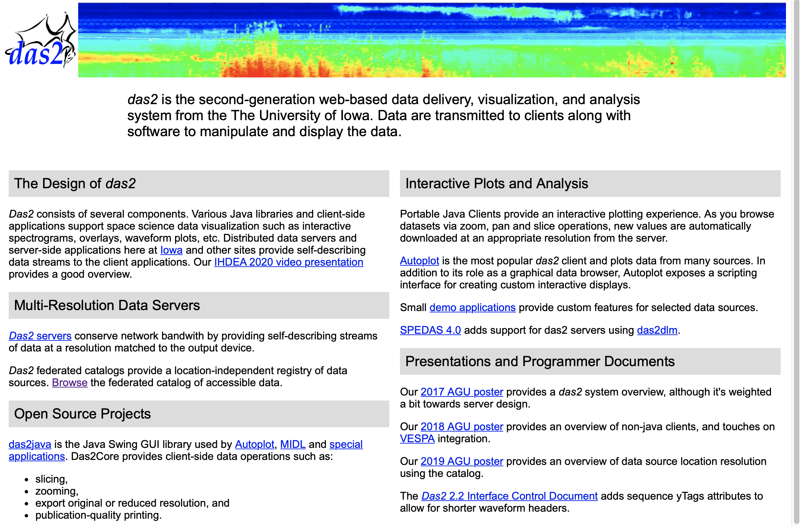
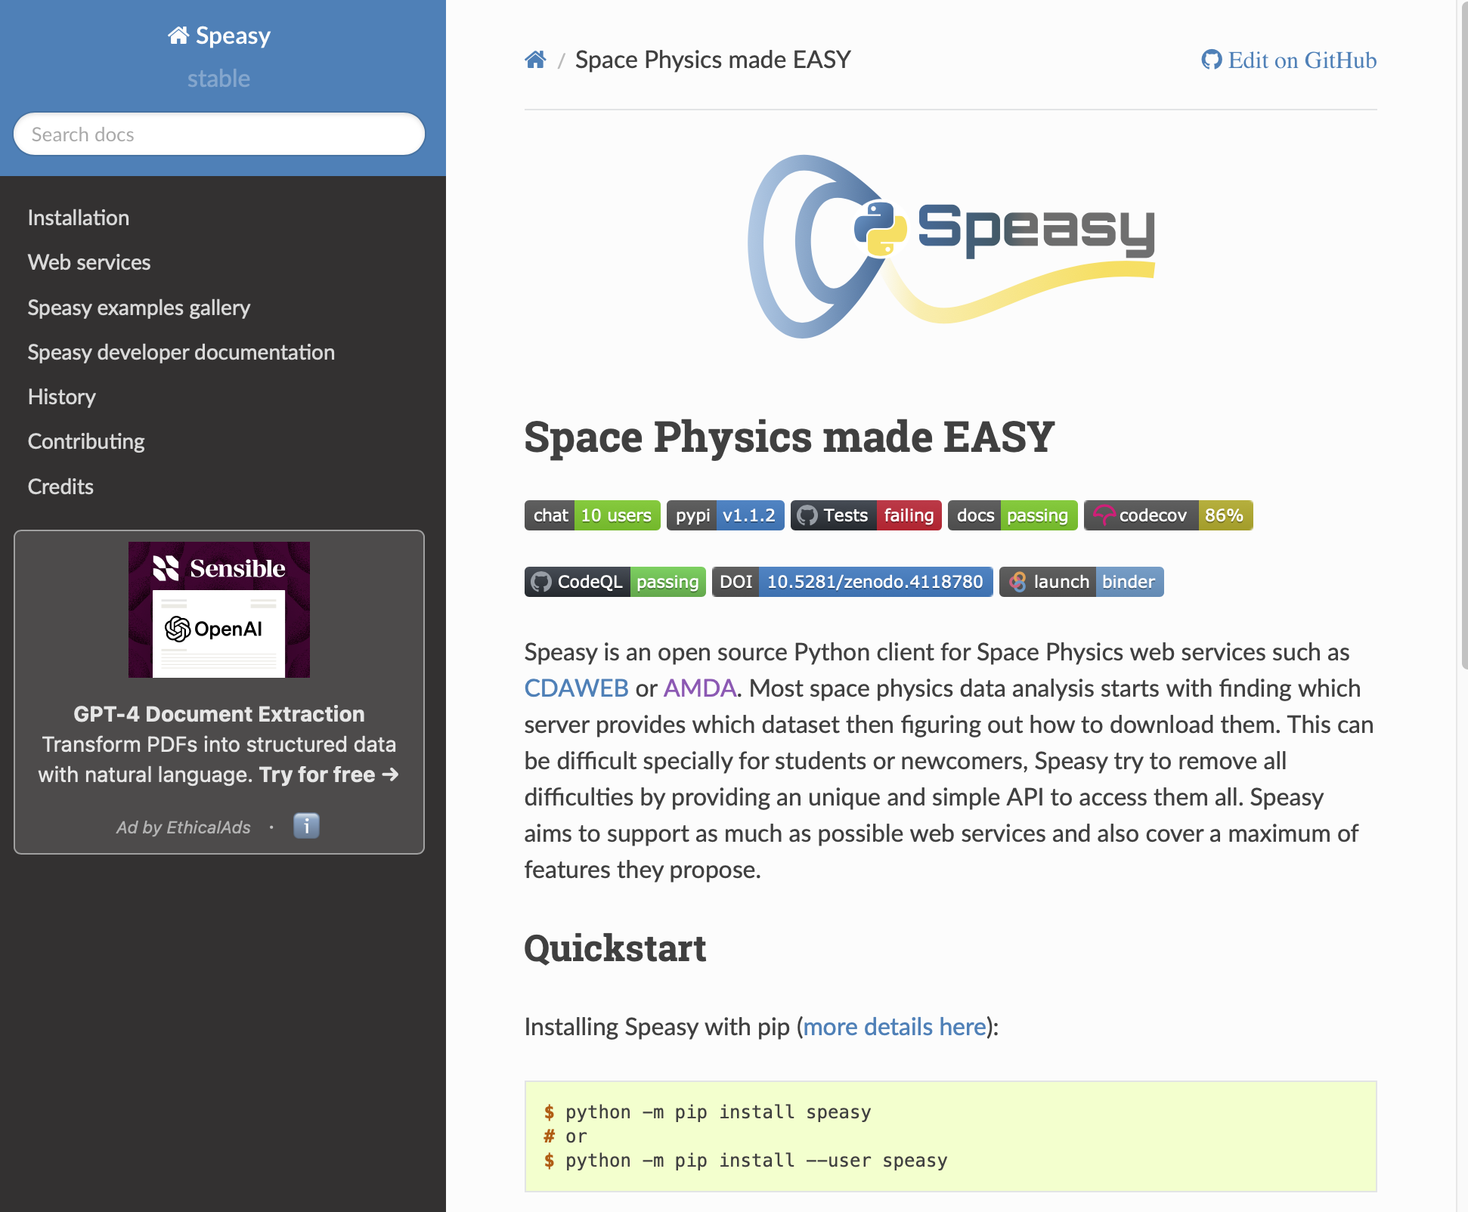
CDAWeb
data wrangling code 1
Custom
API
analysis code
Madrigal
Custom
code 2
INTER-MAGNET
Custom
code 3
VirES / SWARM
Custom
code 4
lots of data wrangling code!
AMDA

Slide 9
CDAWeb
HAPI
Custom
API
analysis code
Madrigal
HAPI
Custom
common wrangling code
If there is a common access mechanism,
much less wrangling code is needed.
INTER-MAGNET
HAPI
Custom
VirES / SWARM
The overall, long-term goal of HAPI: enabling common, universal, low-level access to all time series data
HAPI
Custom

Slide 10
Outline
Review of What is HAPI? (review, if needed)
  Different aspects of HAPI within a data system
  HAPI reduces data wrangling
  HAPI as “HTTP for data”
Update on HAPI adoption
HAPI efforts in development
Leveraging HAPI and SPASE together

Slide 11
HAPI defines 5 URL endpoints every server must have
Endpoints must be directly below a URL that ends with ‘hapi’
http://example.com/hapi/about
http://example.com/hapi/capabilities
    describes options implemented by the server
http://example.com/hapi/catalog
    list of datasets at the server
http://example.com/hapi/info
    show metadata for one dataset at a time (basically a data header)
http://example.com/hapi/data
    retrieve a stream of data content for one dataset over a specific time range

Slide 12
HAPI defines 5 URL endpoints every server must have
Endpoints must be directly below a URL that ends with ‘hapi’
http://example.com/hapi/about
http://example.com/hapi/capabilities
    describes options implemented by the server
http://example.com/hapi/catalog
    list of datasets at the server
http://example.com/hapi/info
    show metadata for one dataset at a time (basically a data header)
http://example.com/hapi/data
    retrieve a stream of data content for one dataset over a specific time range
Note: The intent is for computers to read from these endpoints, but humans can look at them easily too (web browser, curl, etc)

Slide 13
HAPI defines 5 URL endpoints every server must have
Endpoints must be directly below a URL that ends with ‘hapi’
http://example.com/hapi/about
http://example.com/hapi/capabilities
    describes options implemented by the server
http://example.com/hapi/catalog
    list of datasets at the server
http://example.com/hapi/info
    show metadata for one dataset at a time (basically a data header)
http://example.com/hapi/data
    retrieve a stream of data content for one dataset over a specific time range
Note: The intent is for computers to read from these endpoints, but humans can look at them easily too (web browser, curl, etc)

Slide 14
HAPI – a very simple request and response
Request:
http://server.org/hapi/info?dataset=ACE_MAG
(this assumes you already got dataset IDs from the catalog endpoint)

Slide 15
HAPI – a very simple request and response
Request:
http://server.org/hapi/info?dataset=ACE_MAG
(this assumes you already got dataset IDs from the catalog endpoint)
Response:
{
block of JSON metadata, including:
time range covered by data
lists of parameters that can be requested
can also include other metadata
either by reference or inclusion
}

Slide 16
{
"HAPI": "2.0",
"status": {"code": 1200, "message": "OK"},
”startDate": "1997-09-02T00:00:00Z",
"stopDate": "2023-08-20T23:00:00Z",
"resourceURL": "https://cdaweb.gsfc.nasa.gov/misc/NotesA.html#AC_H2_MFI",
"contact": "N. Ness @ Bartol Research Institute” "parameters": [
{ "name": "Time", "type": "isotime", "units": "UTC", "length":24, "fill": null },
{ "name": "Magnitude", "type": "double", "units": "nT", "fill": "-1.0E31",
"description": "B-field magnitude" },
{ "name": "BGSEc", "type": "double", "units": "nT", "fill": "-1.0E31", "size": [3],
"description": "Magnetic Field Vector in GSE Cartesian coordinates (1 hr)"},
{ "name": "BGSM", "type": "double", "units": "nT", "fill": "-1.0E31", "size": [3],
"description": "Magnetic field vector in GSM coordinates (1 hr)", },
{ "name": "SC_pos_GSE", "type": "double", "units": "km", "fill": "-1.0E31", "size": [3],
"description": "ACE s/c position, 3 comp. in GSE coord."},
{ "name": "SC_pos_GSM", "type": "double", "units": "km", "fill": "-1.0E31", , "size": [3],
"description": "ACE s/c position, 3 comp. in GSM coord.” } ],
}

Slide 17
HAPI – a very simple request and response
Request:
http://server.org/hapi/data

Slide 18
HAPI – a very simple request and response
data endpoint
Request:
http://server.org/hapi/data

Slide 19
HAPI – a very simple request and response
data endpoint
Request:
http://server.org/hapi/data?dataset=ACE_MAG
&start=2004-183T00:00Z
&stop=2004-184T00:00Z
(line breaks
for clarity)

Slide 20
HAPI – a very simple request and response
elements required by the data endpoint protocol
data endpoint
Request:
http://server.org/hapi/data?dataset=ACE_MAG
&start=2004-183T00:00Z
&stop=2004-184T00:00Z
(line breaks
for clarity)

Slide 21
HAPI – a very simple request and response
elements required by the data endpoint protocol
data endpoint
Request:
http://server.org/hapi/data?dataset=ACE_MAG
&start=2004-183T00:00Z
&stop=2004-184T00:00Z
(line breaks
for clarity)
Response:
2004-183T00:00:03.403Z, 1.0724e+02, -6.8993e+01, -5.1978e+02
2004-183T00:00:07.153Z, 1.0842e+02, -6.8956e+01, -5.1962e+02
2004-183T00:00:10.907Z, 1.0855e+02, -6.9063e+01, -5.2084e+02
2004-183T00:00:14.653Z, 1.0852e+02, -6.9049e+01, -5.2085e+02
2004-183T00:00:18.403Z, 1.0849e+02, -6.9035e+01, -5.2085e+02
2004-183T00:00:22.153Z, 1.0862e+02, -6.9142e+01, -5.2207e+02
2004-183T00:00:25.903Z, 1.0859e+02, -6.9128e+01, -5.2208e+02
(always the
same format
for all servers)

Slide 22
Outline
Review of What is HAPI? (review, if needed)
  Different aspects of HAPI within a data system
  HAPI reduces data wrangling
  HAPI as “HTTP for data”
Update on HAPI adoption
HAPI efforts in development
Leveraging HAPI and SPASE together

Slide 23

What data is available now with HAPI?
Institution | Server | Type of Data | Number of Datasets
 | CDAWeb | Heliophysics | 2800
 | SSCWeb | Ephemeris | 250
 | CCMC | Space Weather | 250
 | AMDA | Heliophysics and Planetary Data and Ephemeris | 500
University of Iowa | Das2 Server | Helio. & Planetary | 30
 | LISIRD | Solar Irradiance | 40
SWARM Mission | ViRES Data Server | Space Mag Data | 14
INTERMAGNET | INTERMAGNET | Ground-based Mag | ~1000
Netherlands Meteorological Institute | KNMI | Space Weather | ~1000
Note: European
and US buy-in.

Slide 24
Coming soon
Institution | Server | Server | Type of Data | Number of Datasets
 | ESAC | ESAC | Heliophysics | 2073
JHU / APL | SuperMAG | SuperMAG | global ground mag | ~500
JHU / APL | TIMED / GUVI | TIMED / GUVI | ionospheric images | ~10
 | PDS PPI Node | PDS PPI Node | Planetary Plasma, Particle, and Fields | ~1000
Eventually
CSA | Space Environment Canada (new initiative) |  | Ground-based ionospheric data | ~1000
CEDAR / NSF | Madrigal |  | Space Weather | 1000+ (??)
HamSCI | hamsci.org |  | Ionospheric RF propigation | 100’s

Slide 25
HAPI Clients
Python library (Bob Weigel)
IDL library (Scott Boardsen)
Java library (Jeremy Faden, Larry Brown)
Matllab library (Bob Weigel)
R library (Daniel Wilborn)
Libraries
try this one
to learn about
HAPI capabilities
SPEDAS (IDL, Eric Grimes, Jim Lewis)
PySPEDAS (Eric Grimes; uses above Python library)
Autoplot (Jeremy Faden – uses internal code)
hapi-server.org/servers (JavaScript, Bob Weigel)
CCMC Kamodo model/data comparisons
KNLM visualizer (JavaScript, Eelco Doornbos)
LASP Space Weather Data Portal (JavaScript, Jenny Knuth)
Applications
new!

Slide 26
JavaScript client generates Python code stubs for you
# example showing how to get OMNIWeb data
from hapiclient import hapi
server = 'https://cdaweb.gsfc.nasa.gov/hapi'
dataset = 'OMNI2_H0_MRG1HR'
start = '2021-10-25T00:00:00Z'
stop = '2021-12-01T00:00:00Z'
# parameters is a comma-separated list
parameters = 'DST1800,Proton_QI1800'
# Configuration options for the hapi function.
opts = {'logging': True, 'usecache': True, 'cachedir': './hapicache' }
# Get parameter data
data, meta = hapi(server, dataset, parameters, start, stop, **opts)

Slide 27
Multiple client applications are now leveraging HAPI

Slide 28
Autoplot – illustration using 5 different HAPI servers
ESAC HAPI Server
(test version running as a pass through)
Cluster-3 Electric Wave Form Power Density
CDAWeb HAPI Server
Van Allen Probes, RBSPICE Ion Energy Spectrogram
AMDA HAPI Server
Omni MAG data
Made with Autoplot
autoplot.org
talking to 5 different servers!
ViRES HAPI Server
GRACE-A MAG Data
CCMC ISWAT HAPI Server
GOES X-ray flux

Slide 29
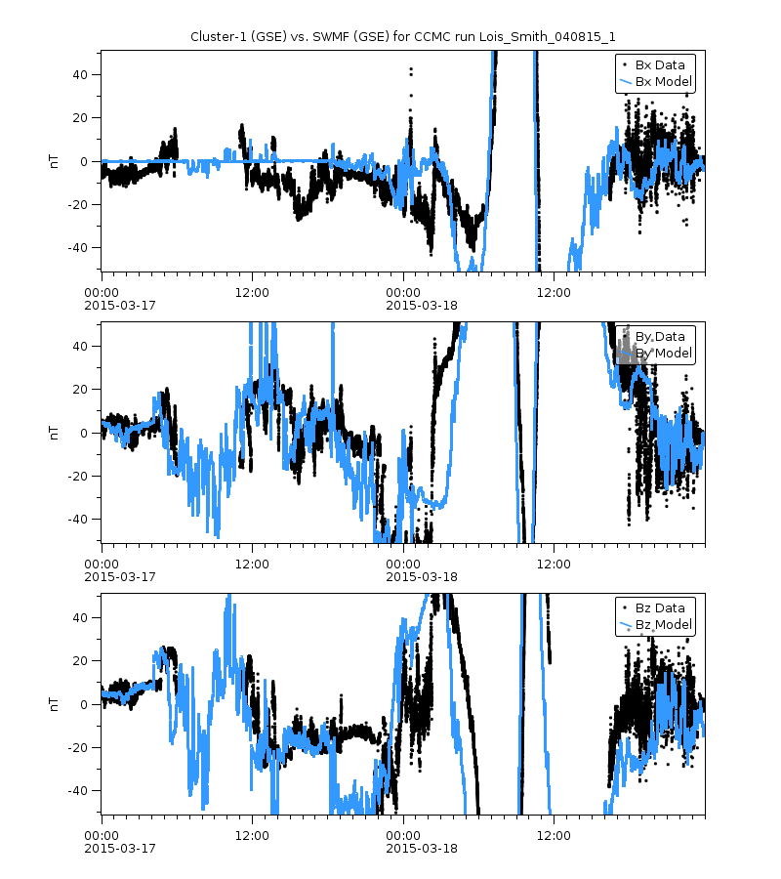
CCMC example: Data-Model Comparisons
Ephemeris from SSCWeb HAPI server
Observation Data from CDAWeb HAPI server
Model data from Kamodo
Steps:
Use model data from SWMF.
Get Cluster-1 ephemeris from SSCWeb HAPI server.
Fly the Cluster-1 trajectory through the model output to get mag data along this trajectory
Get Cluster-1 mag data from CDAWeb HAPI server.
This example is from the CCMC web page:
https://ccmc.gsfc.nasa.gov/ungrouped/GM_IM/GM_analysis.php?Pid=12870&Pt=BO&Ps=Cluster-1
Work is by Darren De Zeeuw.

Slide 30
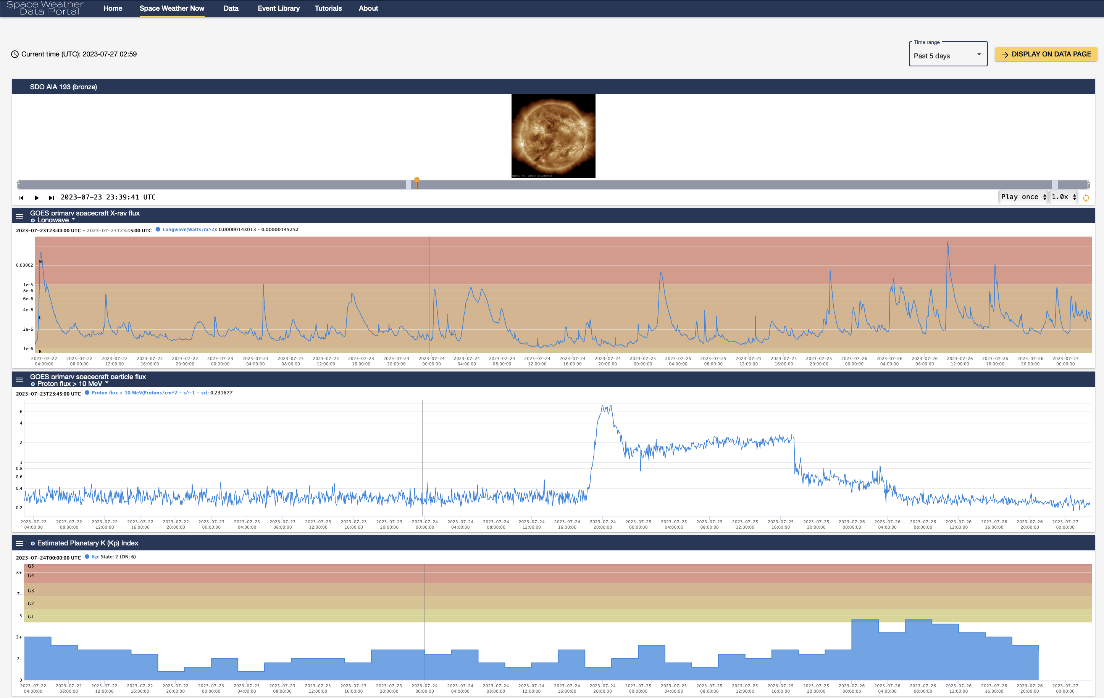
LASP
Space
Weather
Portal
Easy to add any
HAPI source.
Made by people
not on the HAPI
team.

Slide 31
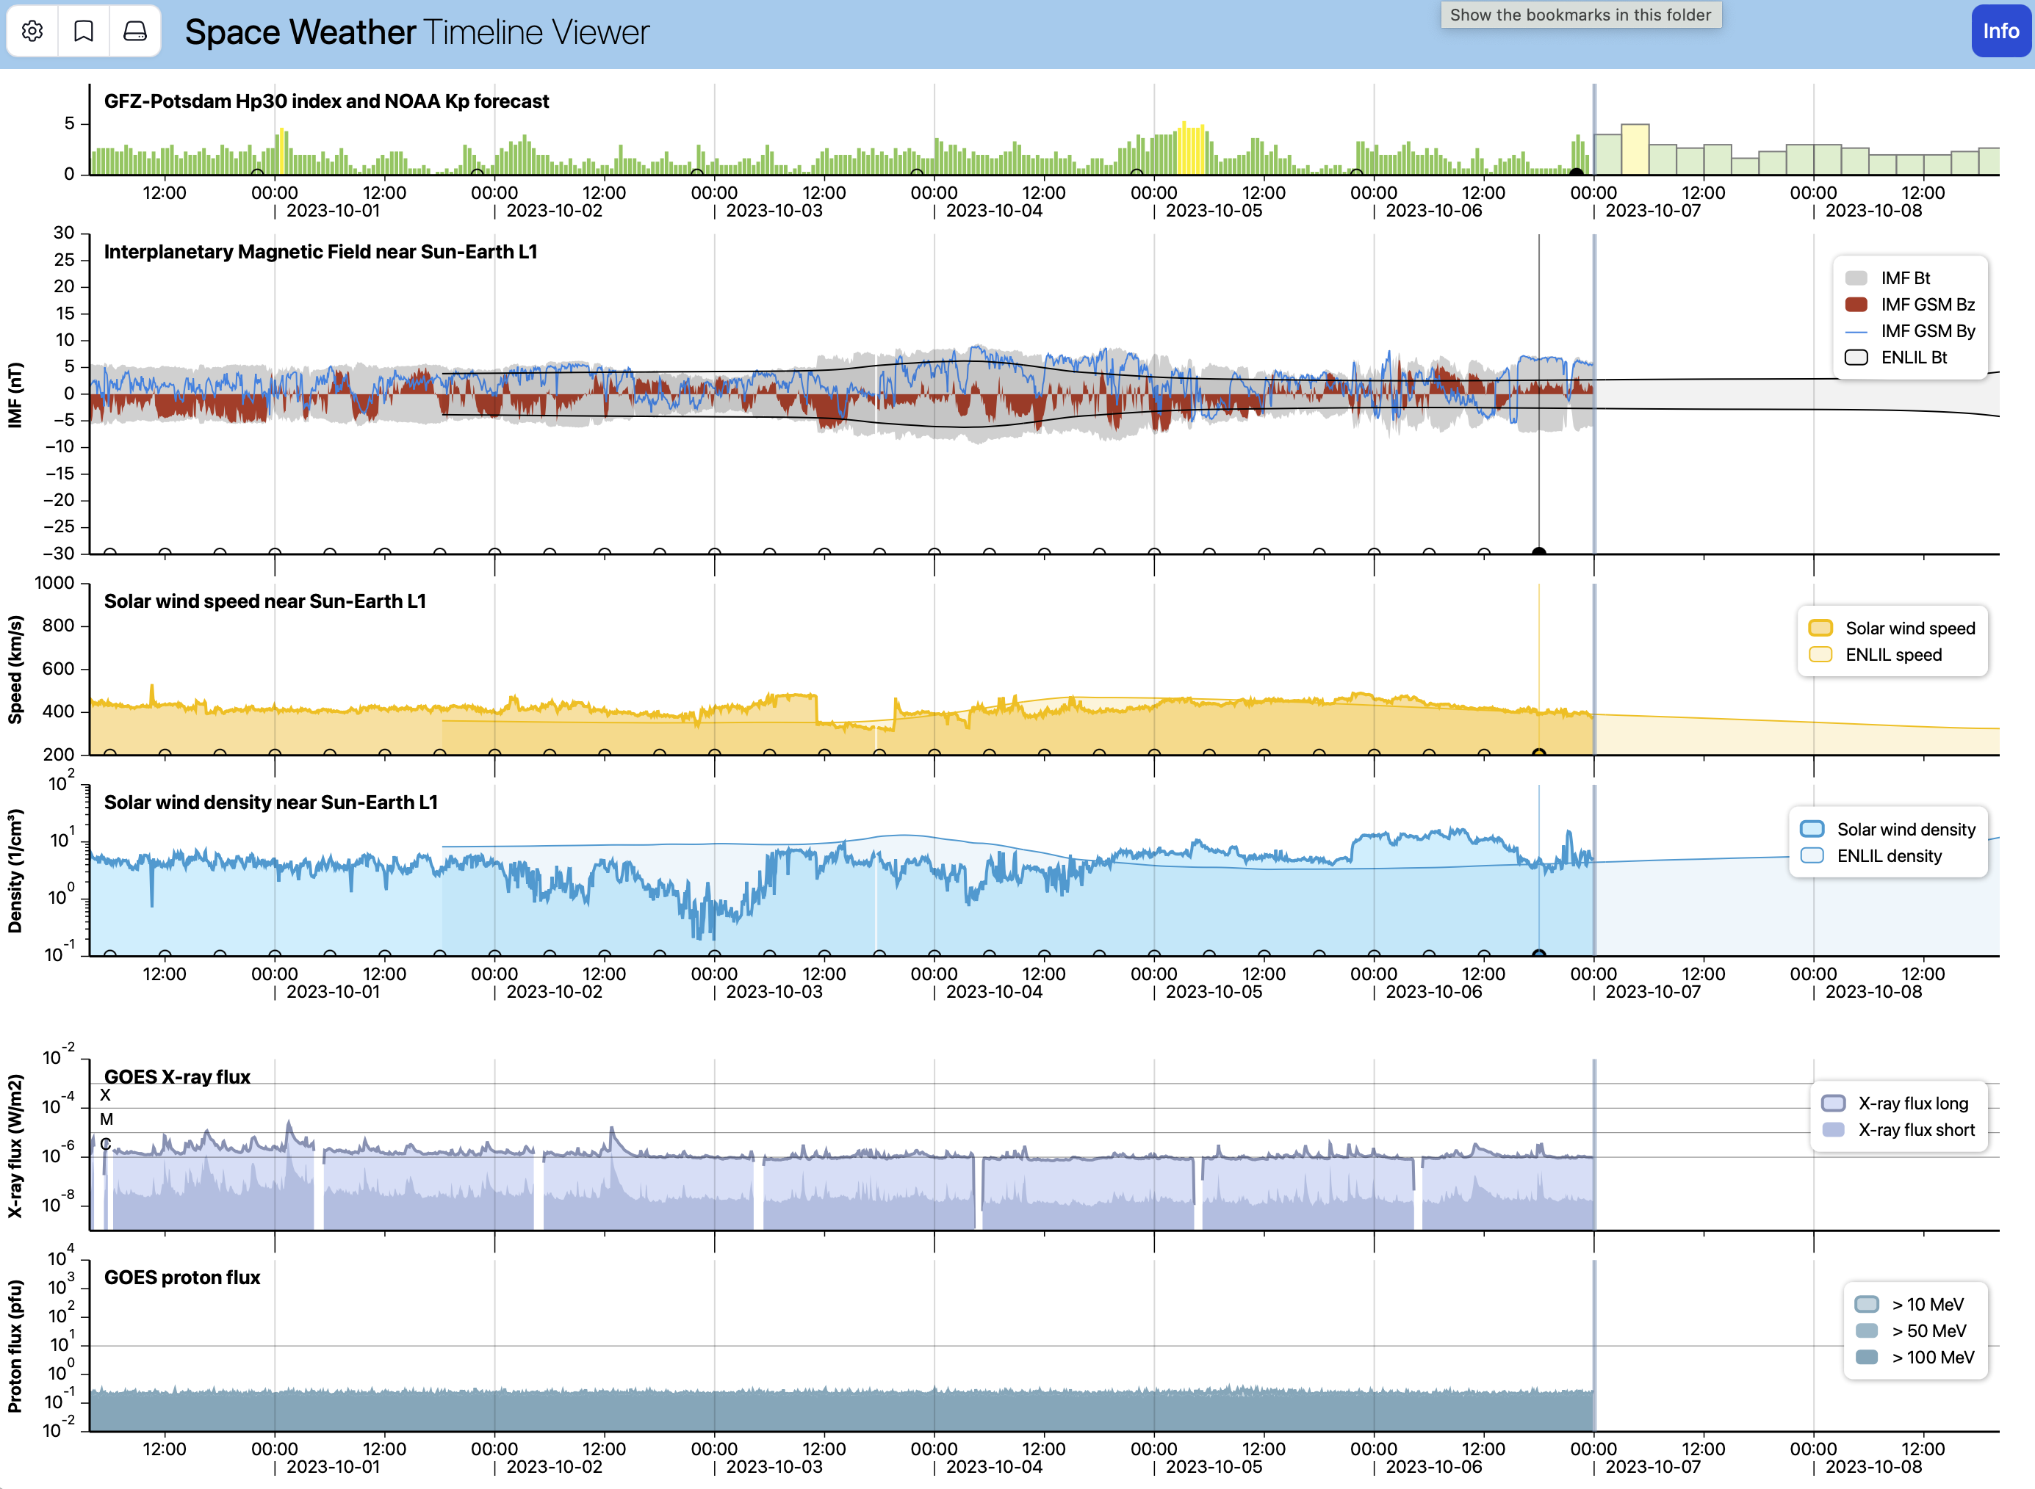
KNMI Timeline Viewer
HAPI back end
HAPI client as JavaScript
Little involvement from HAPI team
Client is Open Source!
https://gitlab.com/KNMI-OSS/spaceweather/knmi-hapi-timeline-viewer

Slide 32
Outline
Review of What is HAPI? (review, if needed)
  Different aspects of HAPI within a data system
  HAPI reduces data wrangling
  HAPI as “HTTP for data”
Update on HAPI adoption
HAPI efforts in development
Leveraging HAPI and SPASE together

Slide 33
Under development:
HAPI access for local data (run HAPI on your computer to make your non-public, or brand new data available via HAPI)
  Sandy Antunes via NASA Heliophysics Tools and Methods proposal
caching mechanism for all HAPI clients
new features in HAPI: JSON schema for validation
getting more servers I the community – reaching into ground-based area
potential efforts: adding a semantic layer on top of HAPI

Slide 34
Outline
Review of What is HAPI? (review, if needed)
  Different aspects of HAPI within a data system
  HAPI reduces data wrangling
  HAPI as “HTTP for data”
Update on HAPI adoption
HAPI efforts in development
Leveraging HAPI and SPASE together

Slide 35
Ways to link HAPI & SPASE for better discovery and access
HAPI can include the SPASE (or ISTP) metadata
Can we create SPASE records for data served by HAPI?
Can SPASE help users find HAPI servers?
Is describing data in SPASE enough info to drive a HAPI server for that data?

Slide 36
HAPI can include the SPASE (or ISTP) metadata
Multiple ways to reference SPASE record:
info (dataset) keyword: resourceID or resourceURL
  give the SPASE ID or a URL to the SPASE landing page
info keyword: additionalMetadata
  stuff the entire SPASE block into the HAPI info response
{ "additionalMetadata" : [
{ "name" : "SPASE",
"contentURL": "https://hpde.io/NASA/DisplayData/ACE/MAG/27-Day.xml",
--OR--
"content": "<just stsuff all the XML right here",
"aboutURL": "http://spase-group.org" },
{ "name" : "ISTP",
"content": { "json object (not shown) with the tree of ISTP keyword-value pairs" },
"aboutURL": "https://spdf.gsfc.nasa.gov/istp_guide/variables.html" },
{ "name" : "FITS",
"content": { "fits_header_keyword1" : "value1", "fits_header_keyword2": "value2" },
"aboutURL": "http://fits.gsfc.nasa.gov" }
]
}

Slide 37
Harvest HAPI metadata to create SPASE records
{
info
response
as JSON
}
transform
(and augment?)
<xml>
SPASE
record
</xml>
VirES / SWARM
HAPI
Custom
If your HAPI server has enough metadata (much is optional), it would be possible to transform the HAPI metadata (info response) into a SPASE record
Some people will not really be migrating to SPASE
  for example: communities such as NSF CEDAR folks, SuperDARN, SuperMAG, MADRIGAL
  The best pathway to capturing these systems is through a HAPI -> SPASE path

Slide 38
Harvest HAPI metadata to create SPASE records
foreach dataset in HAPI catalog {
}
{
info
response
as JSON
}
transform
(and augment?)
<xml>
SPASE
record
</xml>
VirES / SWARM
HAPI
Custom
If your HAPI server has enough metadata (much is optional), it would be possible to transform the HAPI metadata (info response) into a SPASE record
Some people will not really be migrating to SPASE
  for example: communities such as NSF CEDAR folks, SuperDARN, SuperMAG, MADRIGAL
  The best pathway to capturing these systems is through a HAPI -> SPASE path

Slide 39
Can SPASE records inform users about HAPI servers?
Within the SPASE AccessURL there is a HAPI Style:
<AccessInformation>
<RepositoryID>spase://SMWG/Repository/NASA/GSFC/SPDF</RepositoryID>
<Availability>Online</Availability>
<AccessRights>Open</AccessRights>
<AccessURL>
<Name>CDAWeb HAPI Server</Name>
<URL>https://cdaweb.gsfc.nasa.gov/hapi</URL>
<Style>HAPI</Style>
<ProductKey>AC_H2_EPM</ProductKey>
<Description>Web Service using the HAPI interface.</Description>
</AccessURL>
<Format>CSV</Format>
<Acknowledgement>Please acknowledge the ACE/EPAM team...</Acknowledgement>
</AccessInformation>
Note: it is not a callable HAPI URL:
  a SPASE client would need to understand how to construct a HAPI call
  it needs to understand HAPI anyway to make sense of the response!
  insulates against any future HAPI changes

Slide 40
Risks of relying on SPASE only for finding HAPI servers
Although HAPI links are in SPASE, they are only reliable if someone is running a unit test to verify that the HAPI URL is still valid.
URLs change!
  Assuming the HAPI server person will remember to tell the SPASE person the URL changed is unreliable.
Also, sometimes the server developers will change their HAPI server to have more parameters or to change parameter names.
Therefore - SPASE records would need to be updated automatically.
The core issue: Loose coupling between the HAPI server (the data) and SPASE
The many opportunities for “disconnection” make this a fragile system
So even if there were 100% coverage of CDAWeb in SPASE, we cannot base HAPI on that, since it will result in lots of HAPI failures that people will blame on HAPI and then stop using it.
Communication between people is not enough; automation is needed.

Slide 41
Can SPASE records be used to drive a HAPI server?
Server
CDFdata
server code
uses SPASE to fill out HAPI info response
and CDFs to provide data
HAPI
interface
SPASE
XML

Slide 42
Can SPASE records be used to drive a HAPI server?
If you have these four things:
  well-formed SPASE that maps one-to-one with data file contents
  a self-describing data format (CDF, netCDF, HDF); (not CSV, for example)
  well-formed file names that make it easy to tell which date ranges of data are in each file
  open data access: no access restrictions like username, password, login, etc
Then it would be possible to make a generic HAPI server that:
  uses the SPASE to flesh out all required HAPI metadata
  uses the self-described format to read data into the server to the data
  (this would actually take a lot of code to execute – it has not been written by anyone!)
  handles all HAPI request and response details
Keeping the conditions true requires automated SPASE generation.

Slide 43
Can SPASE records be used to drive a HAPI server?
Server
CDFdata
server code
uses SPASE to fill out HAPI info response
and CDFs to provide data
HAPI
interface
How solid is this connection?
SPASE
XML
Show stopper if SPASE and HAPI and data are not automatically synchronized

Slide 44
Can SPASE records be used to drive a HAPI server?
Server
Pass Through HAPI Server
CDFdata
non-HAPI
server
server code
uses SPASE to fill out HAPI info response
and CDFs to provide data
HAPI
interface
?
SPASE
XML
For pass through server, there would be another layer of disconnection.

Slide 45
Requirements for automated SPASE records intended for use by HAPI Server
The order of parameters in the SPASE record would need to match that used in the HAPI server (or a look-up table provided)
All of the parameters in the dataset would need to have the same timestamps (or a look-up table provided)
(some SPASE records refer to contents with more than one DEPEND0 for time, and different cadences)
Metadata for bins would need to be in the SPASE records
Ideally, the start/stop dates would be updated on a regular basis
All parameters in the SPASE record would be available from the HAPI server (or a look-up table provided to indicate which ones are not available) (example: time_pb5 – this would need to be masked out for HAPI if you are using a pass-through – a native CDF read would find this variable; time_pb5 is old, super-ceded time scheme; depends on var_type for CDFs and maybe display_type)
The main reasons we cannot use drive a HAPI server with the CDAWeb SPASE records are due to the above items not being satisfied.
About five years ago, we looked into using the CDAWeb SPASE records to create a server (Bernie has a demo server running). At that time, about 20-30% of CDAWeb had SPASE records. At present, the fraction is about 60% or so. Given this coverage issue, so much help is needed from metadata in the master CDFs, and HAPI metadata can be created based on metadata in master CDFs, for the new CDAWeb HAPI server, we are primarily master CDF driven. The exception is that we use units in the SPASE record because they seem to follow a convention. Does SPASE follow a machine parsable schema for unit strings so that it is caught when there is an error?

Slide 46
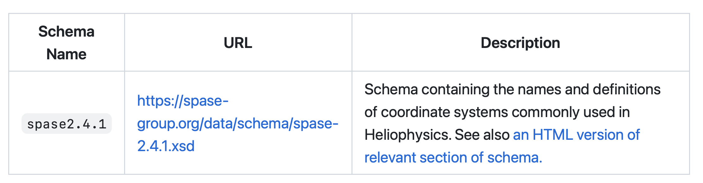
SPASE and HAPI: Coordinate System alignment
HAPI allows specification of computer readable coord. sys names
optional HAPI info keyword: coordinateSystemSchema
SPASE seems to be the only machine readable list of Heliophysics coord systems
optional HAPI parameter keyword: coordinateSystemName
  values are any coord system listed in SPASE 2.4.1

Slide 47
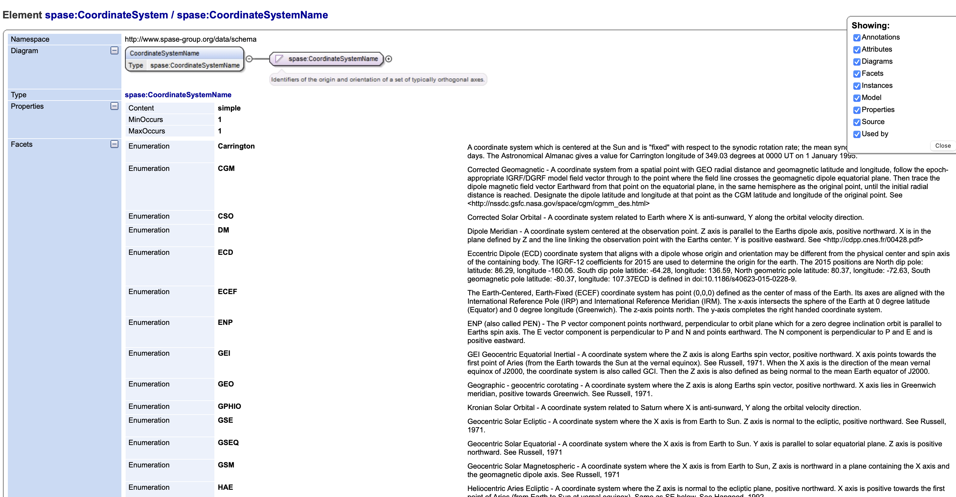

Slide 48
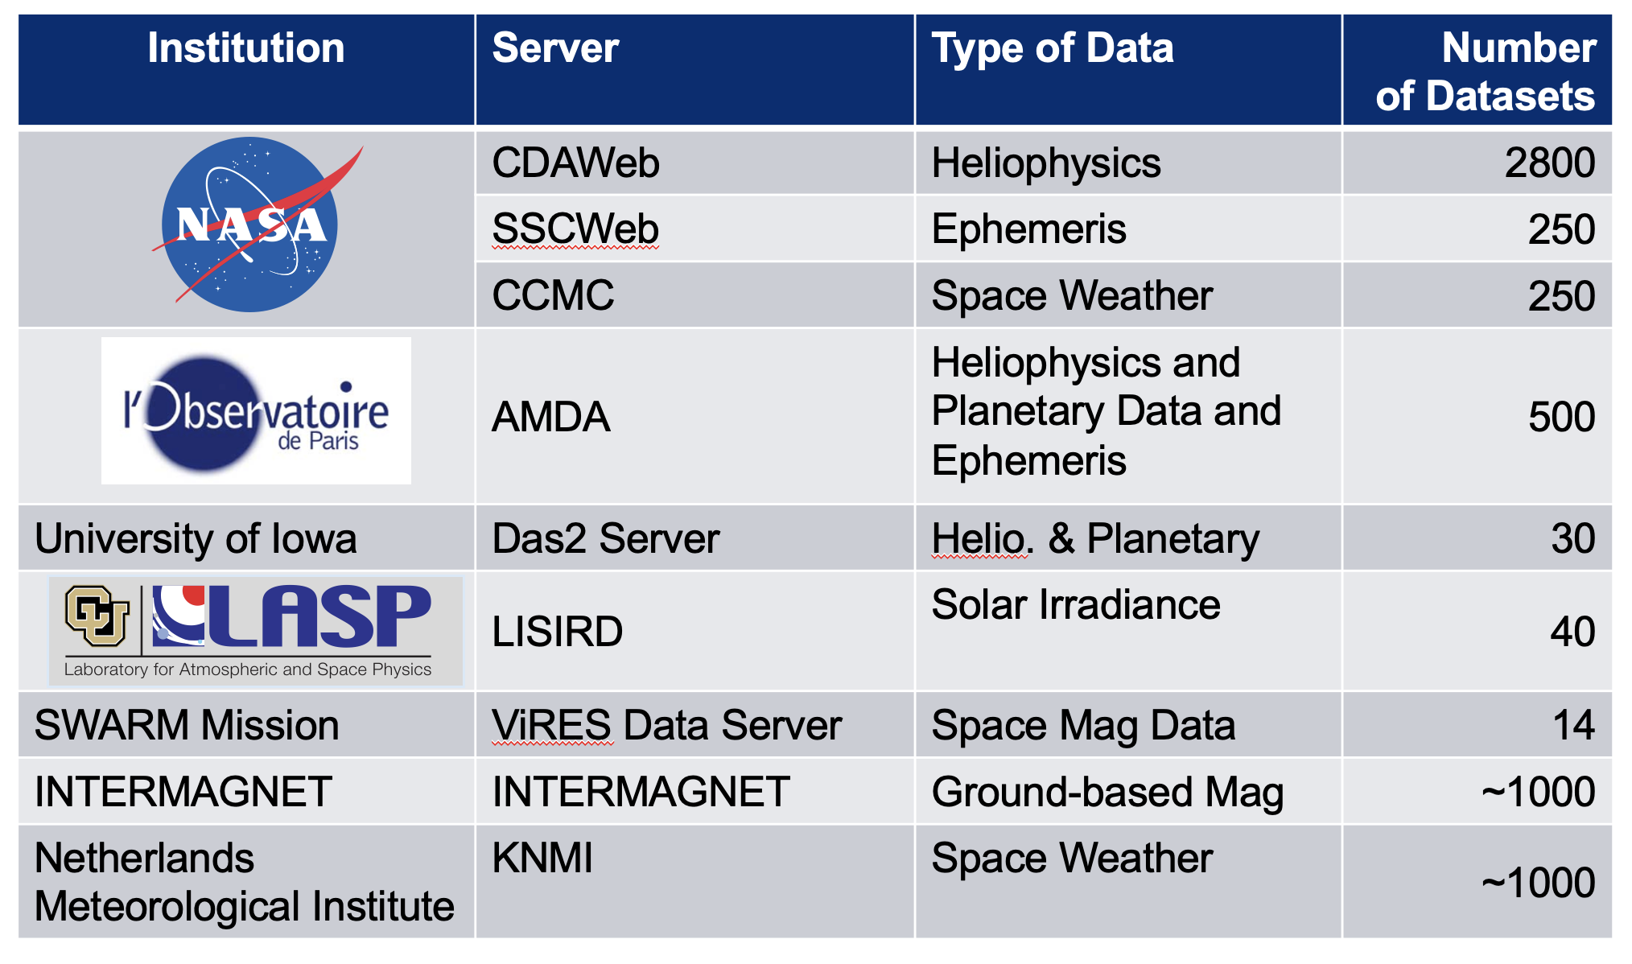
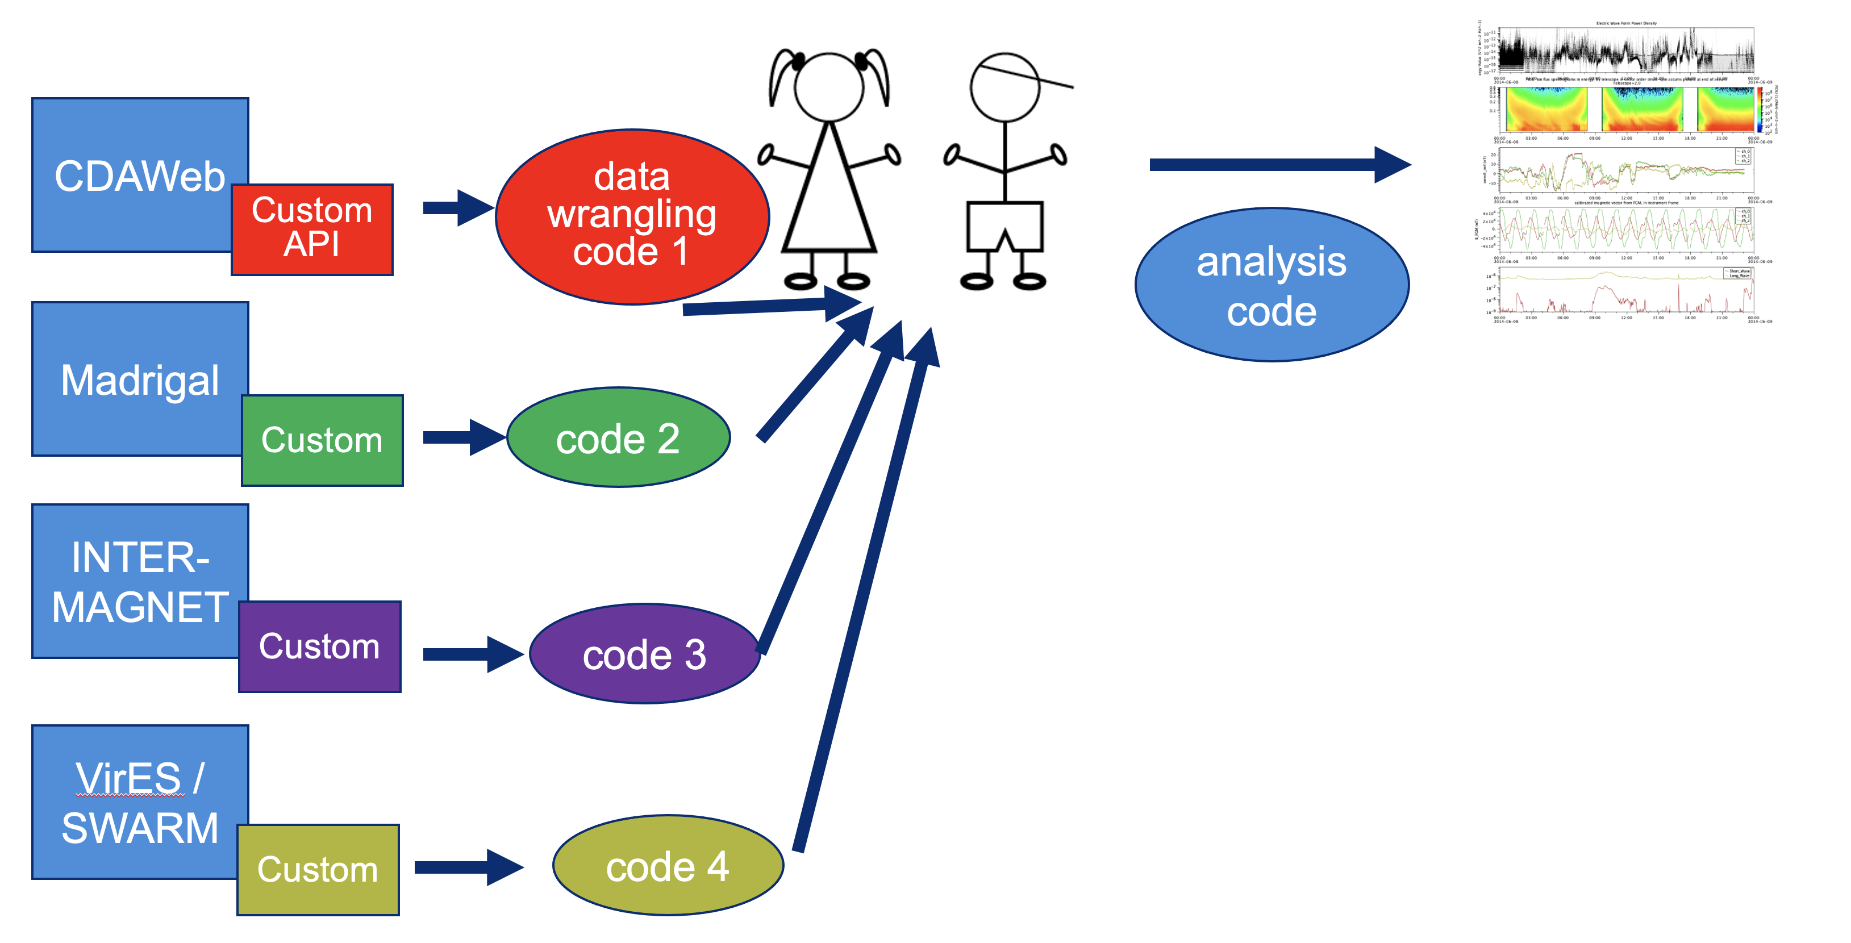
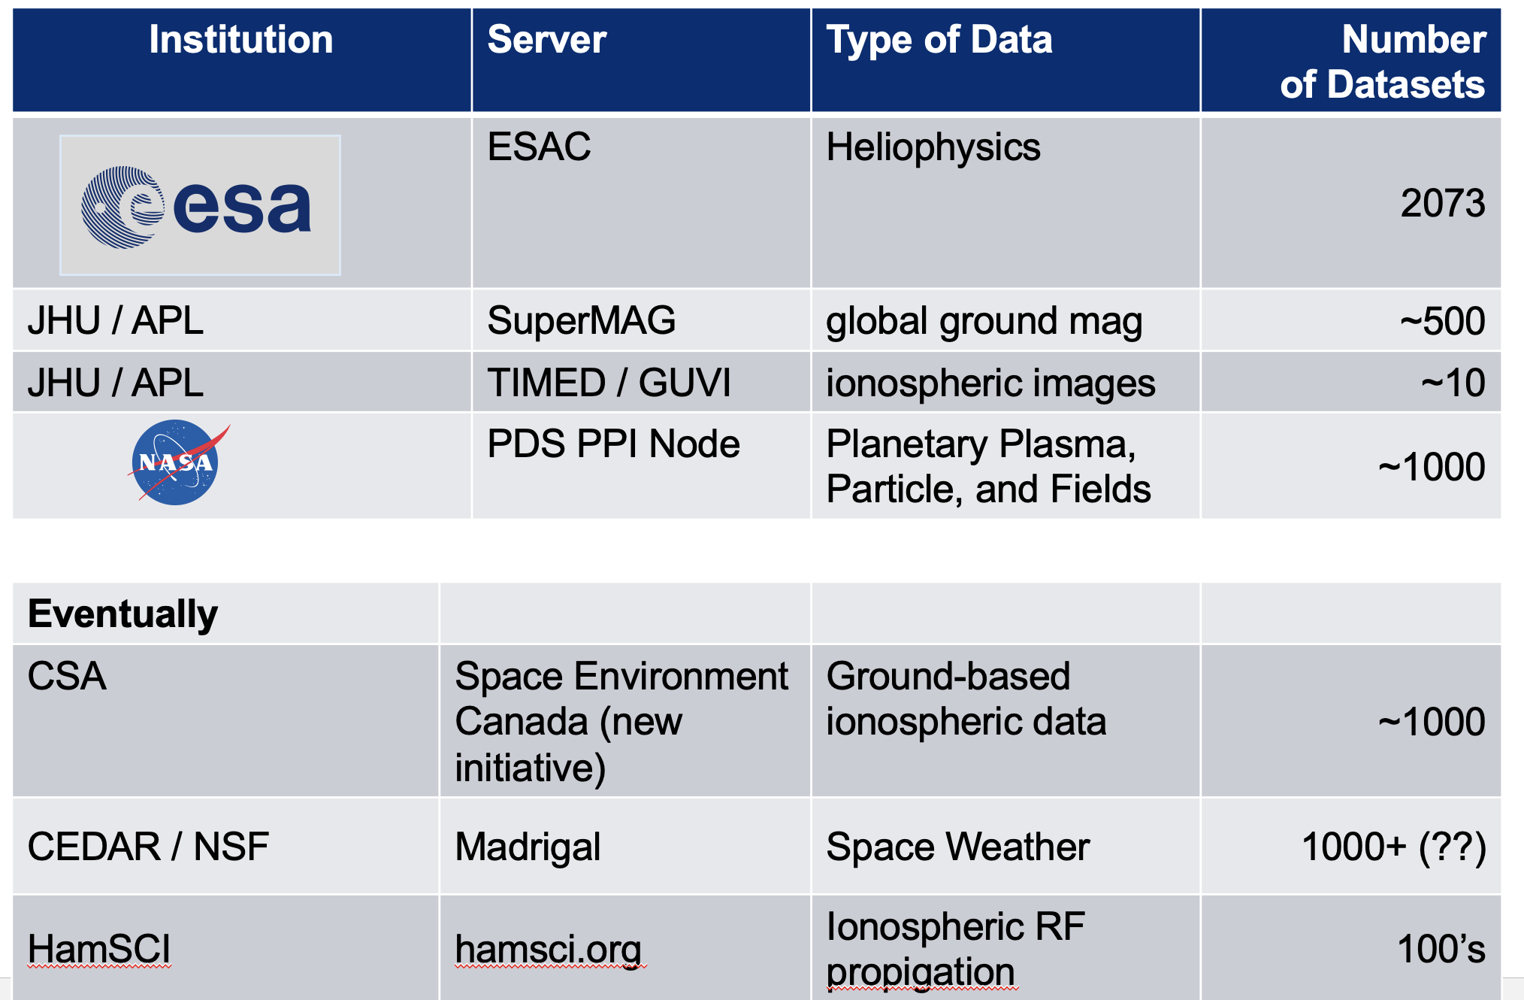
HAPI is making access easier
Lots of servers
Uniform access
Multiple Analysis Options
Libraries
Python library (Bob Weigel)
IDL library (Scott Boardsen)
Java library (Jeremy Faden, Larry Brown)
Matllab library (Bob Weigel)
R library (Daniel Wilborn)
Apps
SPEDAS (IDL, Eric Grimes, Jim Lewis)
PySPEDAS (Eric Grimes; uses above Python library)
Autoplot (Jeremy Faden – uses internal code)
hapi-server.org/servers (JavaScript, Bob Weigel)
CCMC Kamodo model/data comparisons
KNLM visualizer (JavaScript, Eelco Doornbos)
LASP Space Weather Data Portal
(JavaScript, Jenny Knuth)

Slide 49
Backup

Slide 50
The importance of filenames (and URI templates)
a URI template is a string representing a filename as a URL-like entity with date related variables:
URL like: http://server.org/data/2023/mag_data_2023-01-01.cdf
become this: http://server.org/data/$Y/mag_data_$Y-$m-$d.cdf
Store the URI template strings for a dataset in the SPASE record to allow for easier, automated access to the hierarchy of files.

Slide 51
Using HAPI to serve images
Time | SCAttitude | Quality | PixelLookDirns | URI string
t0 | matrix[3,2] | q0 | m0[500,500] | http://data.org/image1.fits
t1 | matrix[3,2] | q1 | m1[500,500] | http://data.org/image2.fits
t1 | matrix[3,2] | q2 | m2[500,500] | http://data.org/image3.fits
t2 | matrix[3,2] | q3 | m3[500,500] | http://data.org/image4.fits
Images listed by reference as URI’s (most likely URLs)
many client programs know what to do with image data (standards are old / stable)
each image’s metadata can be listed in other HAPI parameters in each record
filtering of images by metadata properties can be done on the client using client specific knowledge about this image type (another standard here could be useful)
DANGER: do not use this to list time series files (then you are just a listing service)

