Slide 1
Table Access Protocol (TAP): interoperability with the VSO
IHDEA Meeting
2023 October 12-13
E. J. Mansky (ADNET/NASA) on behalf of the VSO team

Slide 2
Current Status:
REST/TAP code in the VSO has been in production since April 2023
https://vso.nascom.nasa.gov/cgi-bin/search
or:
https://sdac.virtualsolar.org/cgi/search
PROBA2 data searchable under Provider ESA and Source PROBA2
SOAR data searchable under Provider ESA and Source SOAR (testing)
available via all 3 VSO clients (web, IDL/SSW and SunPy)

Slide 3
Integration of REST/TAP services into the VSO:
VSO Metadata DB table services:
MariaDB [VSO]> select * from services;
+----------+--------+---------+-------------+----------+--------------+------------+--------------+--------------------------------+----------+--------------------+---------------+
| PROVIDER | SOURCE | DP_TYPE | DP_BASEPATH | SRV_TYPE | SRV_LOCATION | SRV_PREFIX | SRV_PROTOCOL | SRV_URL | SRV_PORT | SRV_METHODS | SRV_MECHANISM |
+----------+--------+---------+-------------+----------+--------------+------------+--------------+--------------------------------+----------+--------------------+---------------+
| SDAC | EUNIS2 | Python | NULL | REST | remote | eunis2 | http | 127.0.0.1 | 5002 | Query:GetData:Ping. | JSON |
| ESA | PROBA2 | TAP | NULL | TAP | remote | tap | http | p2sa.esac.esa.int/p2sa-sl-tap/ | 80 | Query:GetData:Ping | NULL |
| SDAC | PSP | Python | NULL | REST | remote | psp | http | 127.0.0.1 | 5003 | Query:GetData:Ping | JSON |
| SDAC | SO2 | Python | NULL | REST | remote | so2 | http | 127.0.0.1 | 5004 | Query:GetData:Ping. | JSON |
+----------+--------+---------+-------------+----------+--------------+------------+--------------+--------------------------------+----------+--------------------+---------------+
6 rows in set (0.00 sec)
Store URL data for REST/TAP services in new DB metadata tables
Construct the full URL from the DB data for the specified REST/TAP Data Provider
Pass the needed URL to the appropriate Perl thread for processing
Build and send the HTTP request to the specified REST/TAP Data Provider in the query
Receive and process the response from the REST/TAP service

Slide 4
Apache sessionID
Needed to distinguish different REST/TAP queries from one another in the backend Perl code
MariaDB [vso]> show columns from sessions;
+-----------+----------+------+-----+---------+-------+
| Field | Type | Null. | Key | Default | Extra |
+-----------+----------+------+-----+---------+-------+
| ID | char(16) | NO | PRI |
| LENGTH | int(11) | YES | NULL
| A_SESSION | text | YES | NULL
+-----------+----------+------+-----+---------+-------+
3 rows in set (0.000 sec)
MariaDB [vso]> select count(*) from sessions;
+----------+
| count(*) |
+----------+
| 182 |
+----------+
1 row in set (0.000 sec)

Slide 5
TAP Query code
# TAP branch
elsif ( $srv_type eq 'TAP') {
my $tstart = $block->{'time'}{'start'};
my $tend = $block->{'time'}{'end’};
my $adql_query = "SELECT+\*+FROM+v_observation+WHERE+((instrument_name=\’”.
uc($block->{'instrument'})."\'))+AND+begin_date>\'".$dt_start."\'+AND+end_date<=\'".$dt_end."\’”;
my $tap_query = "REQUEST=doQuery&LANG=ADQL&FORMAT=json&QUERY=$adql_query";
my $uri = $srv . '/sync?' . $tap_query;
my $request = $srv_mech && $srv_mech eq 'JSON' ? HTTP::Request::JSON->new(POST => $srv . '/sync')
: HTTP::Request->new('POST', $uri, new HTTP::Headers);
$request->json_content( { "REQUEST" => "doQuery",
"LANG" => "ADQL",
"FORMAT" => "\"" . lc($srv_mech) . "\"",
"QUERY" => $adql_query,
"PAGE" => 1,
"PAGE_SIZE" => 50000,
}) if $srv_mech && $srv_mech eq 'JSON';
my $ua = LWP::UserAgent->new;
my $response = $ua->request($request);
….

Slide 6
Construction of the Hash
my (@tap_fieldnames, @tap_fieldtypes);
foreach my $tap (@{$tap_metadata}) {
push @tap_fieldnames, $tap->{'name'};
push @tap_fieldtypes, $tap->{'datatype'};
}
my $vso_tap_data = [];
foreach my $tdata (@tap_data) {
my $esa_data;
my $tap = each_array(@tap_fieldnames, @$tdata); # combine elements of arrays tap_fieldnames and tdata pairwise into an array iterator tap then hence into a hash eas_data
while (my ($field, $value) = $tap->() ) {
$esa_data->{$field} = $value;
}
$esa_data->{'file_path'} =~ s/\\//g; # strip backslashes from pathname
$esa_data->{'science_object_name'} =~ s/\\//; # strip backslashes from science object name
my $wavemin = Math::BigFloat->new($esa_data->{'wavelength_range'});
my $wavemax = Math::BigFloat->new($esa_data->{'wavelength_range'});
my $vso_data = { 'provider' => $p->{'provider'},
'source' => $esa_data->{'observatory_name'},
'instrument' => $esa_data->{'instrument_name'},
'physobs' => lc($esa_data->{'observation_type'}),
'size' => $esa_data->{'file_size'},
'fileid' => $esa_data->{'file_path'} . '/' . $esa_data->{'file_name'},
'time' => { 'start' => $esa_data->{'begin_date'},
'end' => $esa_data->{'end_date'},
},
'wave' => { 'wavemin' => $wavemin,
'wavemax' => $wavemax,
'wavetype' => 'euv',
'waveunit' => 'Angstrom',
},
'extent' => { 'type' => uc($esa_data->{'science_object_name'}) },
'info' => { 'required' => $asession },
};

Slide 7
TAP GetData code
elsif ($srv_type eq 'TAP’) {
…
if ($srv_loc eq 'remote') {
my $uri = $srv . "/GetData?provider=$provider&source=$source&method=$method->[0]&sc_id=$sc_id&data=$fdata";
my $http_request = $srv_mech && $srv_mech eq 'JSON' ? HTTP::Request::JSON->new(POST => $srv . "/GetData")
: HTTP::Request->new('POST', $uri, new HTTP::Headers);
$http_request->json_content( { provider => $provider,
source => $source,
sc_id => $sc_id,
method => $method->[0],
data => $fdata
}) if $srv_mech && $srv_mech eq 'JSON';
my $ua = LWP::UserAgent->new;
my $fdata;
my $tapdata = { method => [ $method->[0] ],
info => { 'no_invalid_records' => 0,
'no_records_requested’ => scalar(@{$request->{'files'}{$rprovider}}),
'no_records_returned’ => scalar(@{$request->{'files'}{$rprovider}}),
},
data => $self->_constructTAP_URLs($method->[0], $srv_proto, $srv_url, \@{$request->{'files'}{$rprovider}}),
};
…

Slide 8
Construction of the TAP GetData URLs
foreach my $file (@{$files}) {
if ($file =~ m/\/(\w+\.fits)$/) {
my $filename = $1;
if ($filename =~ m/^(\w{1,4})_/) {
my $instrument = $1;
$instruments->{$instrument}++;
push @{$tap_filenames->{$instrument}}, '\'' . $filename . '\'';
if ($getdata_method eq 'URL-FILE’) {
my $tap_product_query = $srv_proto . '://' . $srv_url .
"data?retrieval_type=PRODUCT&QUERY=SELECT+file_path,+file_name+FROM+p2sa.v_" . $instrument .
"_observation+WHERE+file_name+=\'$filename\’”;
$tap_product_query = [ $tap_product_query ];
push @{$tapURLs}, { 'provider' => $provider,
'url' => $tap_product_query,
'fileid' => \@{$tap_product_query} };
}
}
…

Slide 9
TAP GetData for IDL/SSW & SunPy clients
my $pre = "\<!\[CDATA\[";
my $post = "\]\]\>";
….
'url' => $email ? $pre . $tap_product_query . $post : $tap_product_query,
SunPy client
IDL/SSW client

Slide 10
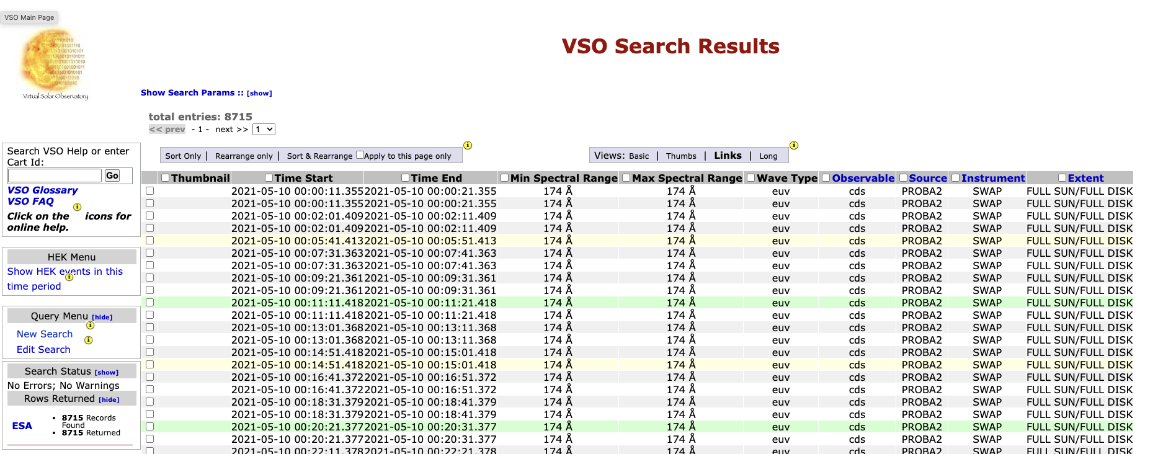
TAP Query results

Slide 11
TAP GetData results

Slide 12
Questions ?

