Slide 1
DOI implementation at Nagoya University and JAXA
T. Hori¹, Y. Miyoshi¹, A. Shinbori¹, C.-W. Jun¹, S. Nakamura¹, T. Sori¹, A. Maeda¹, T. Segawa¹, M. Nose’², S. Masuda¹, Y. Otsuka¹, K. Shiokawa¹, I. Shinohara³
1. ISEE, Nagoya Univ., 2. Nagoya City Univ., 3. JAXA/ISAS
E-mail: tomo.hori _at_ nagoya-u.jp

Slide 2
How to promote the data citation with data DOIs
Establish a permalink
DOI – landing page – Data file repository
Encourage the users to cite data with this scheme
Data citation with DOI
individual datasets used
papers
DOI
Data file repository

Slide 3
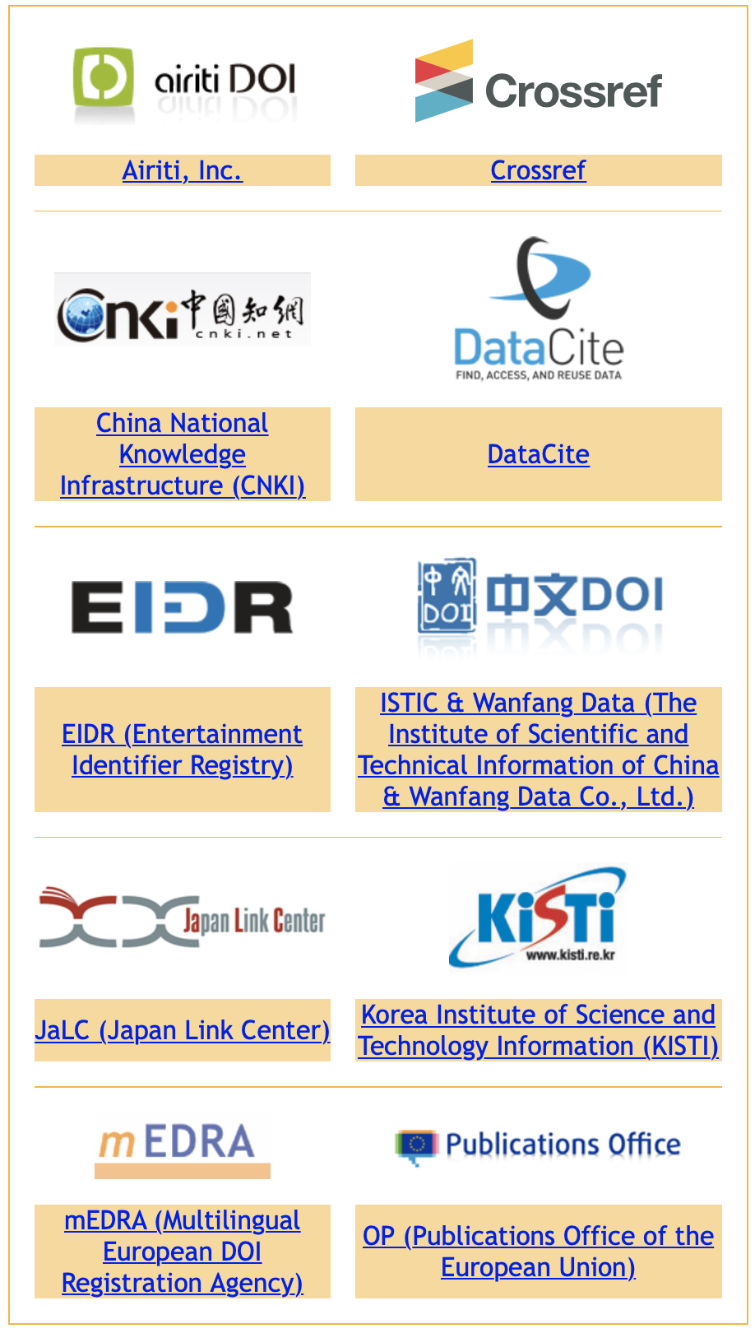
We have been minting DOIs since 2020
Since May 2020, ISEE has been a member of the Japan Link Center (JaLC), which is an official registration agency of DOI.
ISEE DOI-prefix: 10.34515
Institute of Space-Earth Environmental Research (ISEE), Nagoya Univ.
Requests for DOI regist.
Center for Integrated Data Science (CIDAS)
JaLC
Center for Heliospheric Science (CHS)

Slide 4
DOI activity for space physics data in Japan
a full range of Antarctica / Arctic data including atmosphere / ionosphere / magnetosphere data
Atmosphere / ionosphere data / Geomagnetic indices
WDCs in Japan
ERG satellite data (with ISAS), Hinode-SC scientific products, Ground-based observation / experimental data
Planetary science data (Akatsuki, Hayabusa2)
JAIRO cloud, Institutional repositories, university libraries
a much broader scope of research data as well as publications, theses, … in any research field

Slide 5
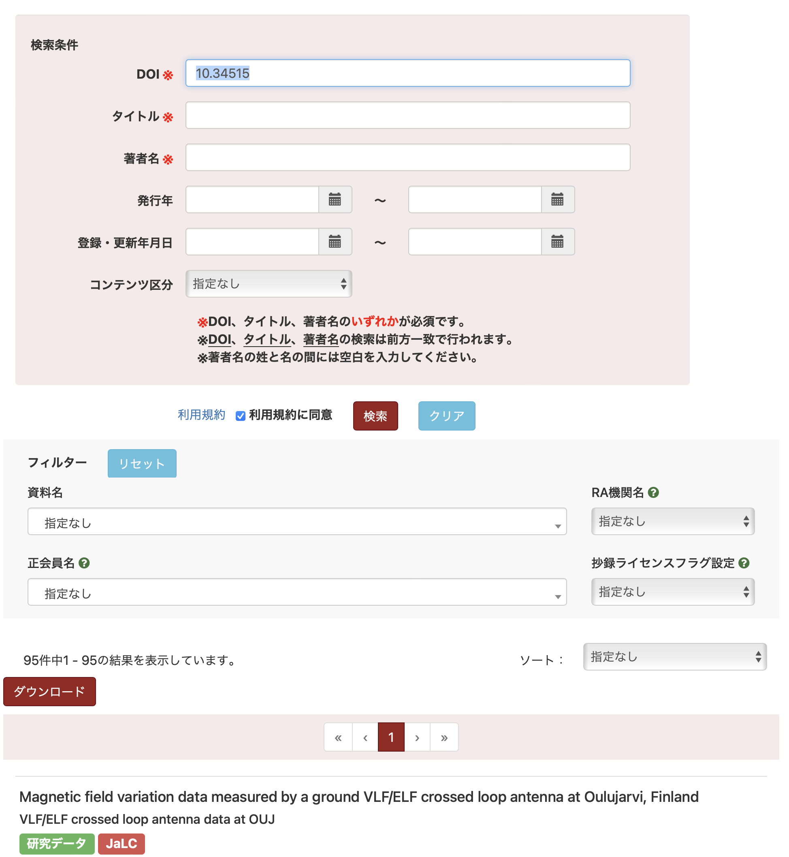
What's done so far?
35 datasets have been DOI'd since last year, leading to a total of 95 datasets with DOIs.
Newly registered datasets since last year include:
Some higher-level data of Arase satellite
Ground magnetometer, VLF/ELF receiver, riometer data by ISEE and PWING project
https://japanlinkcenter.org/app/pub/search/action?doi=10.34515&title=&author=&pubYearFrom=&pubYearTo=&insDateFrom=&insDateTo=&siteName=&journalName=&raNameKbn=&thirdPartyUse=&sortKey=&searchtype=0&page=1&contentsKbn=

Slide 6
Some examples of the datasets that DOIs were registered for by our efforts
DOI | Dataset title | Remarks
10.34515/DATA.ERG-01000 | ERG (Arase) HEP Lv.2 3-D flux data | Among tens of datasets from ERG (Arase) satellite
10.34515/CATALOG.HINODE-00000 | Hinode Flare Catalogue | List of solar flares during the Hinode operation period
10.34515/DATA.GND.0013-0006-0207_v01 | 100 Hz EMCCD all-sky camera data at Gakona | by the PWING and PsA projects
10.34515/DATA.C14-00001 | Carbon-14 Data: a single-year cosmic ray event at 5410 BCE | Experimental data
10.34515/DATA.GND-0033-0002-0101_v01 | Induction magnetometer data at Nain, Canada | by the PWING project
10.34515/DATA.HSC-00000 | ISEE Database for Nonlinear Force-Free Field of Solar Active Regions | 3-D B-field of active regions deduced with the NLFFF method
10.34515/DATA.GND-0004-0002-0201_v01 | VLF/ELF crossed loop antenna data at Athabasca, Canada | by the PWING project
10,34515/DATA.GND-0015-0008-0101_v01 | 30 MHz broad-beam riometer data at Husafell, Iceland | by the PWING project
A total of 95 datasets, and still counting up.

Slide 7
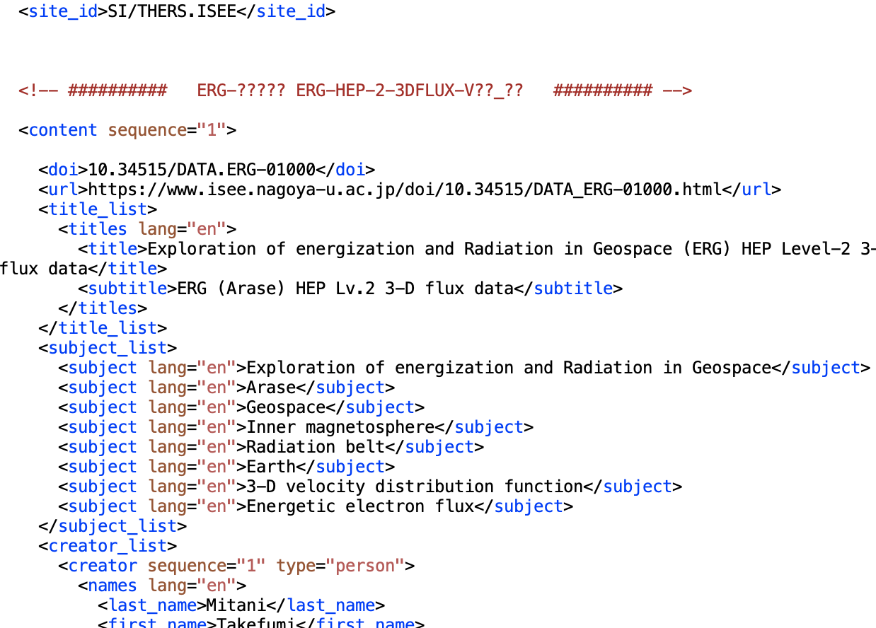
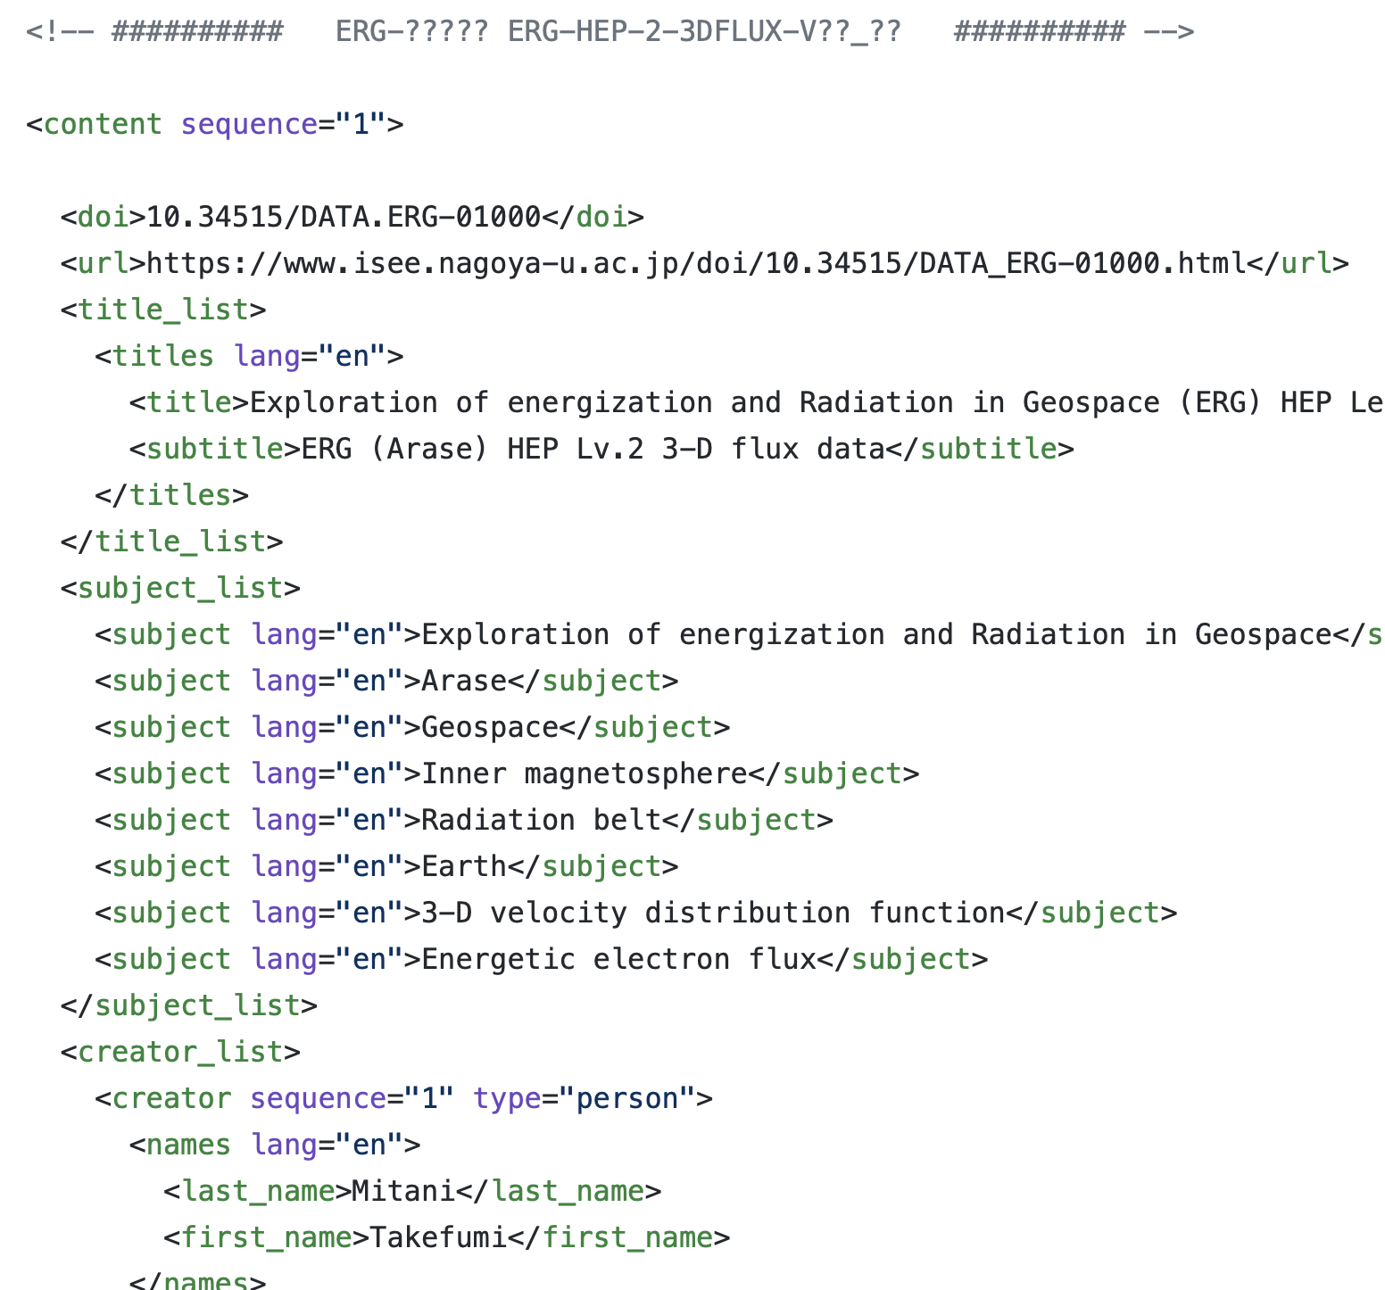
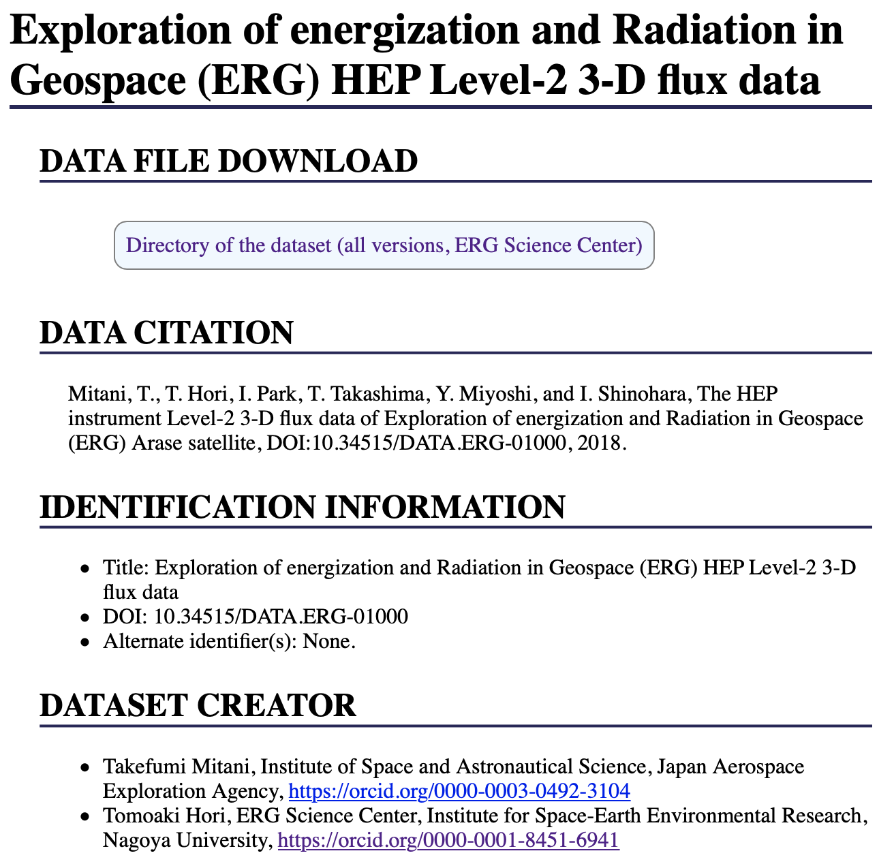
How we registered DOIs and prepare landing pages
A super set XML of DataCite requirements and some additional elements is used to generate a JaLC XML and the landing page.
XML following the JaLC schema
For each dataset
Java + xslt + shell
XML
HTML
An XML file consisting of DataCite + additional elements, prepared by instrument PIs and CHS members.
Landing page

Slide 8
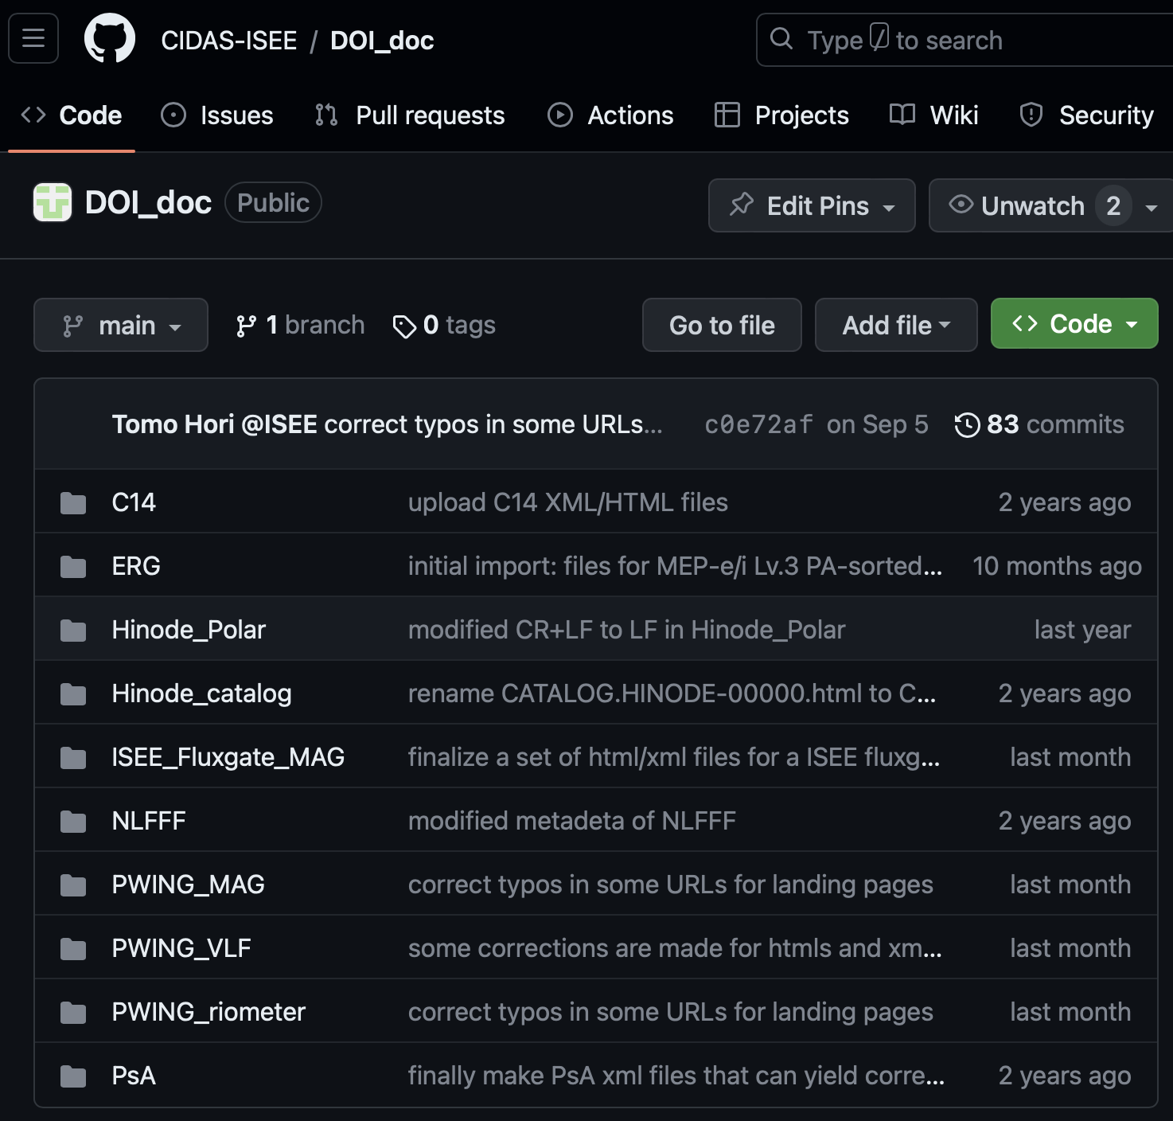
How we registered DOIs and prepare landing pages
The prepared XML forms and related tools are edited, reviewed, and version-controlled on a repository of Github.
For each dataset
An XML file consisting of DataCite + additional elements, prepared by instrument PIs and CHS members.
https://github.com/CIDAS-ISEE/DOI_doc

Slide 9
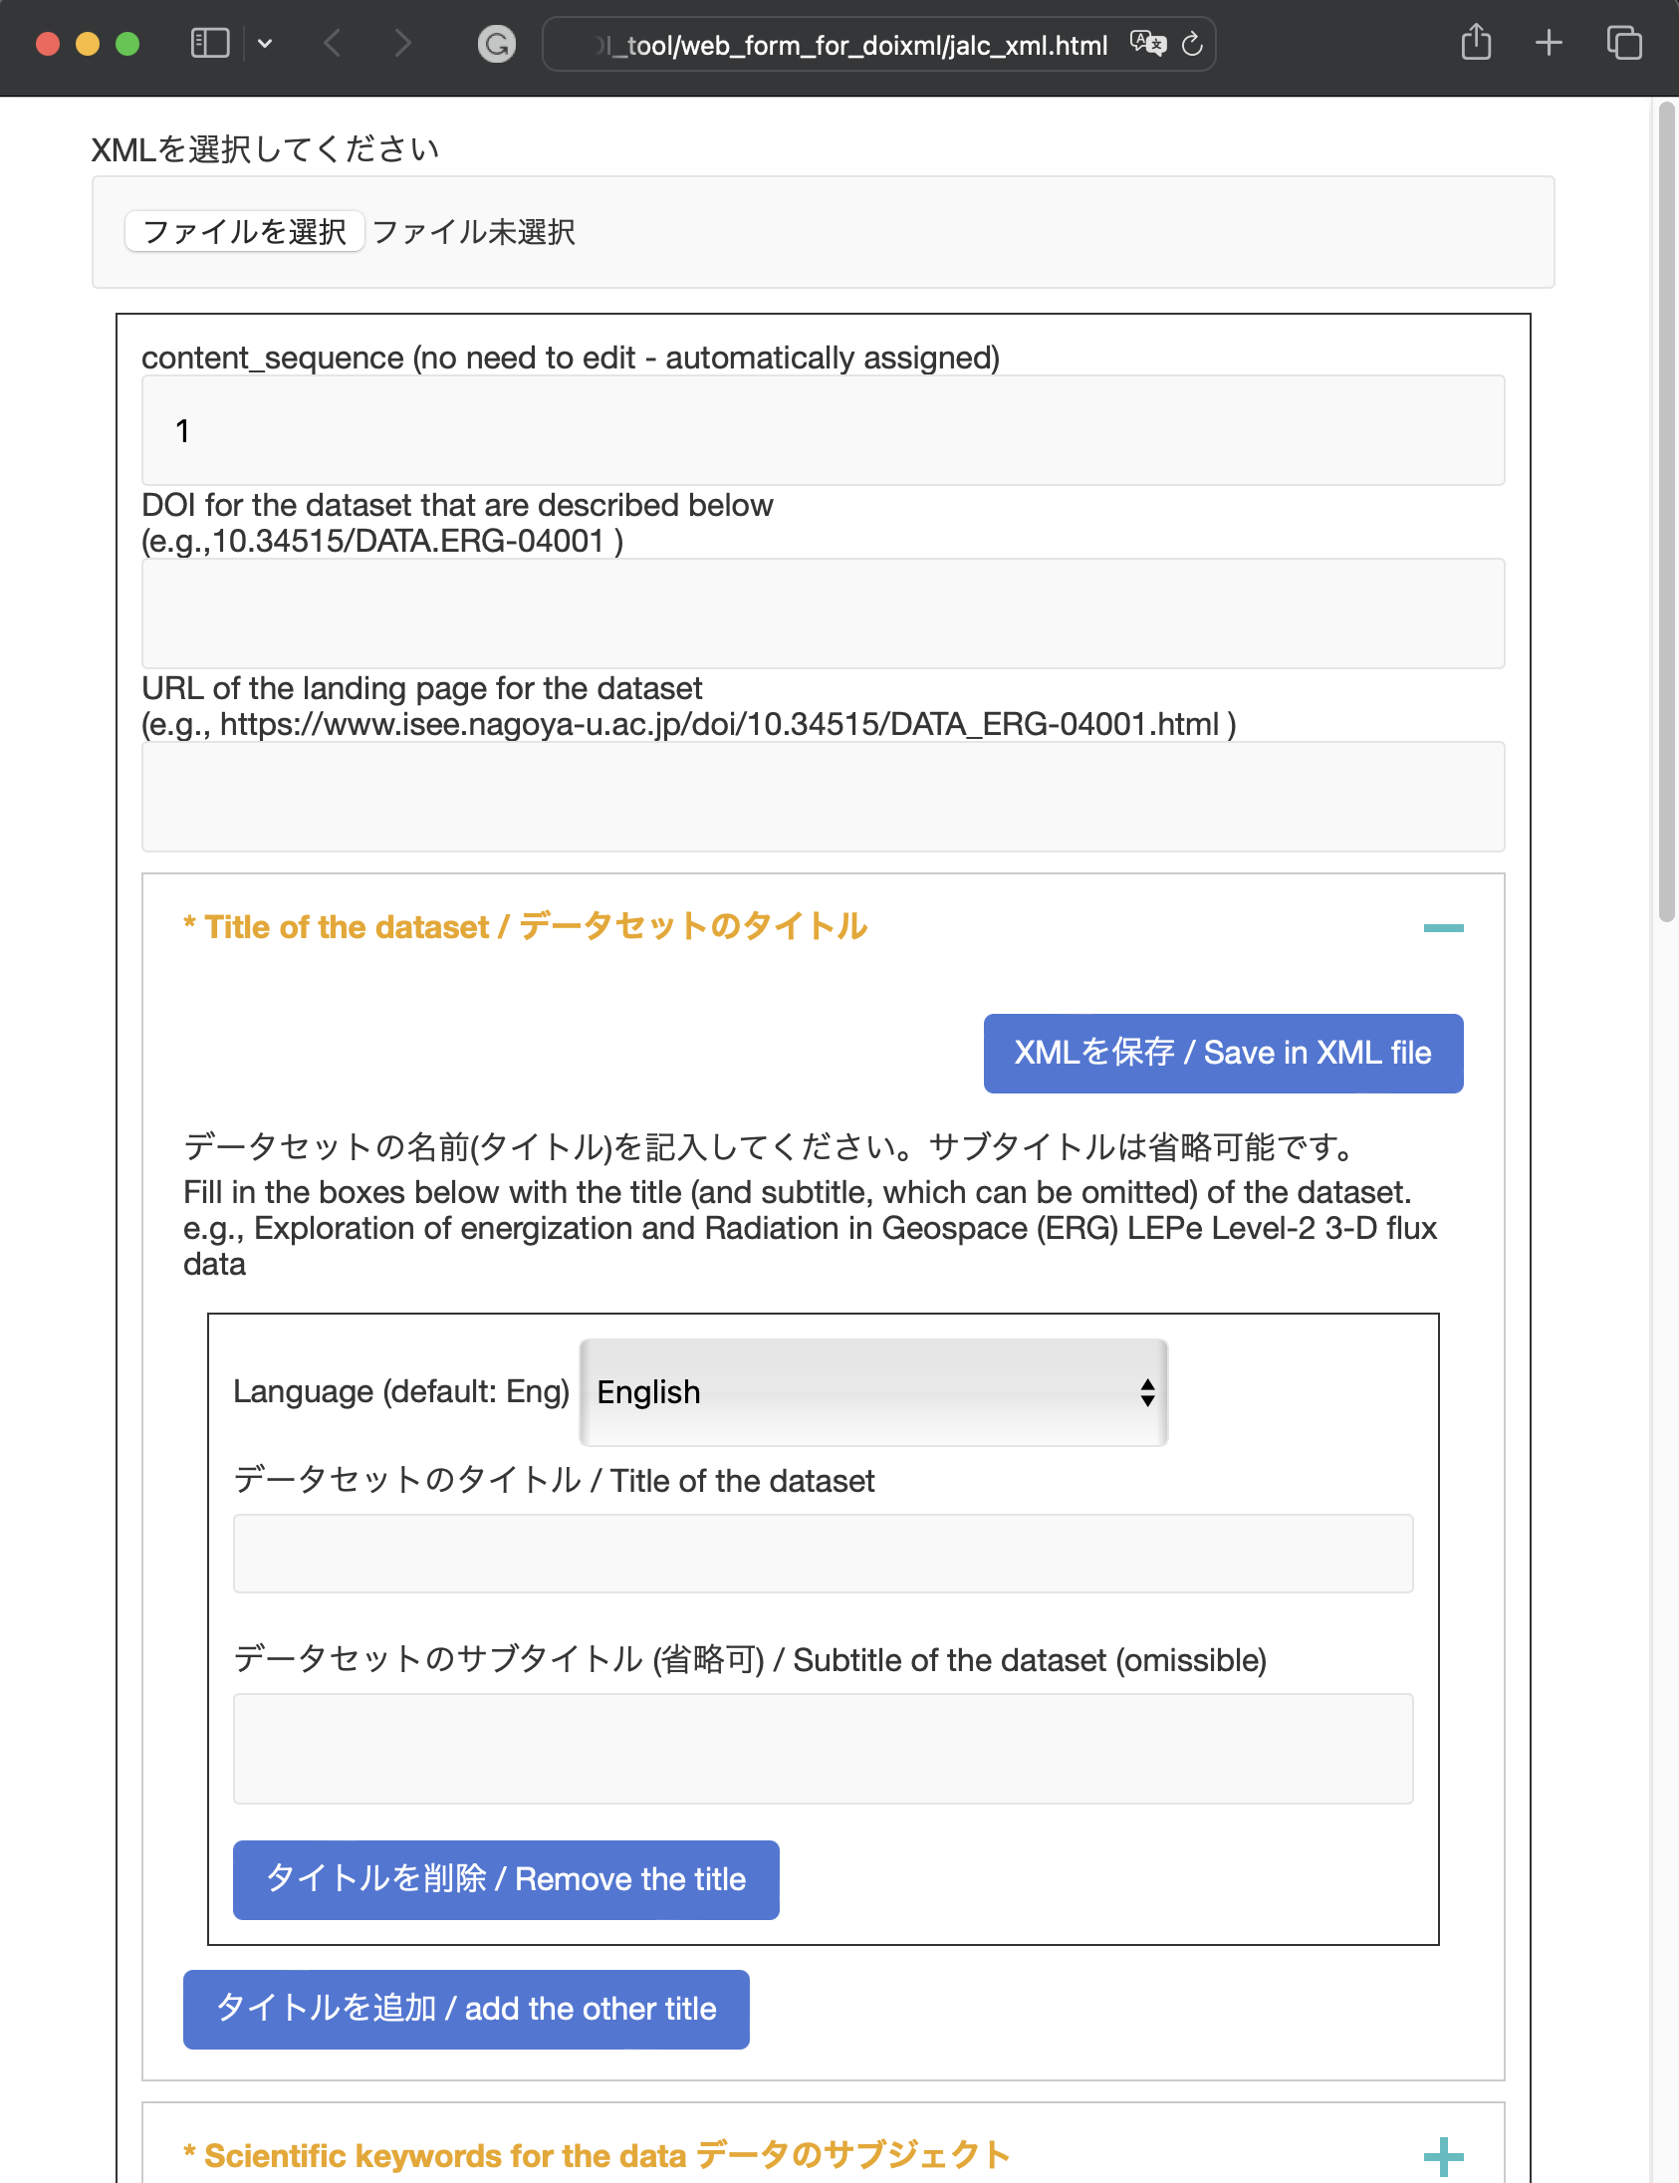
A Javascript-based web form for making a regist. XML file
By just filling in the boxes with necessary metadata, anybody can easily generate an XML file in the designated format.

Slide 10
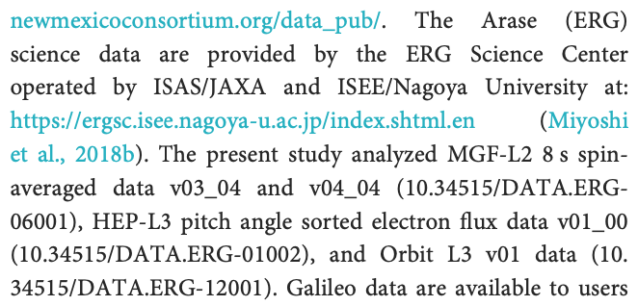
Dataset DOI + version No. can specify a unique data file
The ERG (Arase) project requests all data users to explicitly state a DOI and file version number of used data files in scientific articles.
HEP Level-3 pitch angle sorted electron flux data of Arase satellite DOI: 10.34515/DATA.ERG-01002
In the data availability statement of a journal article
Data files
ver. 01_00
Data files
ver. 01_01
Data files
ver. 02_00

Slide 11
Summary and discussion
Summary
We register DOIs for satellite data (in collaboration with JAXA/ISAS and NAOJ) and various kinds of ground observation data to promote an ecosystem based on the data citation.
Open questions, discussion, thought...
If the same data files are archived in a project-managed data archive and a PDS archive with separate DOIs registered, then what happens?
A data file hosting service is needed for promoting this scheme to small research groups and individual researchers?

