Slide 1
Feedback from IUGONET and other Japanese institutes in implementing SPASE 2.6.0 especially in the field of Thermosphere/Ionosphere
IHDEA2023
Simulation and Model Metadata
09:50-10:05 2023/10/13
*Atsuki Shinbori¹, Chihiro Tao², Hidekatsu Jin², Yoshimasa Tanaka³, Shuji Abe⁴, and Masahito Nosé⁵
1. Institute for Space-Earth Environmental Research (ISEE), Nagoya University
2. National Institute of Information and Communications Technology (NICT)
3. National Institute of Polar Research (NIPR)
4. International Research Center for Space and Planetary Environmental Science (i-SPES), Kyushu University
5. Nagoya City University
Notes:
My name is Atsuki Shinbori, and I came from ISEE, Nagoya University. I would like to talk about IUGONET data analysis system for a study of coupling processes in the solar-terrestrial system. In this talk, we focus on a recent advance of the IUGONET data analysis system and activity results.

Slide 2
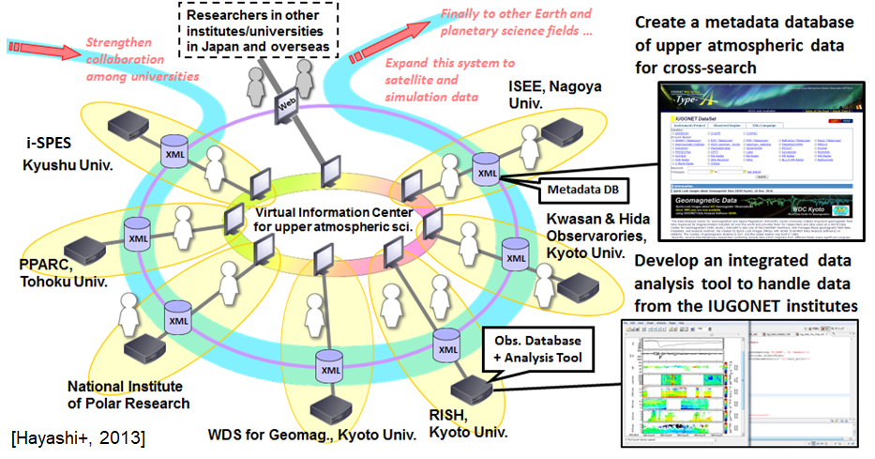
1. Introduction
1.1 Purpose of the IUGONET project and coverage of solar-terrestrial physics data
The Inter-university Upper atmosphere Global Observation NETwork (IUGONET) project aims at establishing “e-infrastructure” for researchers to effectively find, get, and analyze various kinds of upper atmospheric data spread over Japanese universities and institutes.
To promote solar-terrestrial physics (STP) science
To construct an international human network and develop human resource
To expand new field researches with a collaboration to data science community
The IUGONET project mainly deals with ground-based STP observation data (including some meteoritical data).
We now use the SPASE 2.4.0 metadata model and IUGONET extension 2.4.0.1 to operate the IUGONET metadata database.

Slide 3
1. Introduction
1.2 Current status of the IUGONET metadata database and attempt to deal with thermosphere/ionosphere models
Current status of the IUGONET metadata database (Type-A)
Ground-based observation data
SPASE 2.4.0
+
IUGONET2.4.0.1
Magnetometer, riometer, camera, radar etc.
IUGONET Type-A
We added the SpacitalCoverage item as a IUGONET extension.
Satellite observation data
CHAMP and COSMIC RO data
Model data
SPASE 2.6.0
Attempt to extend to simulation data
Atmospheric/ionospheric model

Slide 4
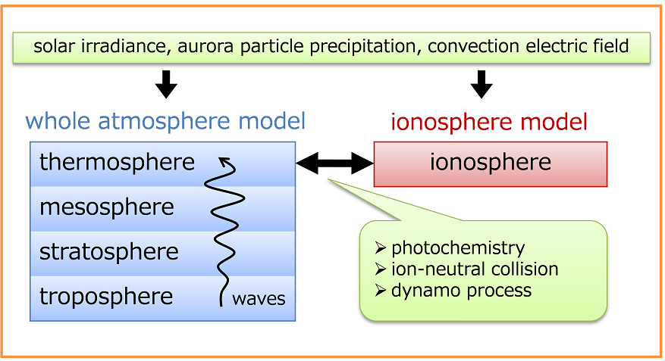
2. GAIA model
2.1 An overview of the GAIA model
The Ground-to-topside model of Atmosphere and Ionosphere for Aeronomy (GAIA) model solves the physical processes of vertical coupling from the Earth's atmosphere to ionosphere.
GCM part
Coupler part

Slide 5
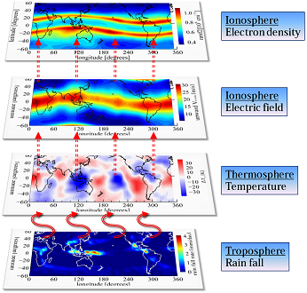
2. GAIA model
2.2 Major scientific result of the GAIA model
The persistent wavenumber 4 structure in the iongitudinal variation can be reproduced by the GAIA model.
Plasma physics
Upper atmospheric physics
Meteorology
[Jin et al., 2011]

Slide 6
2. GAIA model
2.3 Input and output data of the GAIA model
Input parameters
ModelRun→InputParameter (SPASE 2.6.0)
For upper atmosphere and ionosphere:
Solar F10.7 flux, auroral particle precipitation, polar cap potential
For lower atmosphere (troposphere):
Meteorological reanalysis data (JRA55 or JRA25) ---pressure, wind, temperature
JRA25: Japanese 25-year ReAnalysis
JRA55: Japanese 55-year ReAnalysis (https://jra.kishou.go.jp/JRA-55/index_en.html)
Output parameters
NumericalOutput (SPASE 2.6.0)
GCM part: wind velocity, pressure, temperature, rain fall precipitation etc.
Coupler part: wind velocity, electric field, molecular density etc.
Data format: NetCDF (familiar with a meterology field)

Slide 7
3. Feedback to the SPASE 2.6.0 model
3.1 Questions/comments to adopt the SPASE 2.6.0 model to GAIA simulation data
(1) Relationship among NumericalOutput, ModelRun, and Model
How ModelRun is referred from NumericalOutput?
NumericalOuput/InputResoueceID should be used?
Model
Both ModelRun and Model categories have the same name tag “InputResourceID”.
[Proposal for solution]
Model run
For ModelRun
InputResourceID → ModelID
For NumericalOuput
InputResourceID → ModelRunID

Slide 8
3. Feedback to the SPASE 2.6.0 model
3.1 Questions/comments to adopt the SPASE 2.6.0 model to GAIA simulation data
(2) Necessity to add some new vocabulary of Model/ModelType , etc.
The original vocabulary included in the SPASE 2.6.0 model is defined for simulations of space plasma physics in the heliosphere/magnetosphere
In the current version, we cannot comprehensively write the metadata for the GAIA model description and output parameters.
Current version
Required vocabulary
Empirical, Hybrid, MHD, PIC, Paraboloid, TestParticle
GCM, NonHydrostatic, ElectrostaticHD, IonNeutralFluid, CoupledAtmosphere, etc.
Added in the SPASE model in future

Slide 9
3. Feedback to the SPASE 2.6.0 model
3.1 Questions/comments to adopt the SPASE 2.6.0 model to GAIA simulation data
(2) Necessity to add some new vocabulary of Model/ModelType, etc.
[Proposal for solution]
We send a list of additional terms and their description to the SPASE developer team after discussion with the GAIA developer team as follows.
For example,
“IonNeutralFluid” ---“A physical model to describe the fluid motion of neutral and ion in partially ionized plasma”
“GCM”---- “Mathematical models representing physical processes of the atmosphere and/or ocean”
“NonHydroDynamics”---”Mathematical models representing physical processes of the atmosphere and/or ocean, without assuming hydrostatic equilibrium”
By adding new vocabulary used in other research fields, the SPASE metadata model will be useful for interdisciplinary research data search.

Slide 10
3. Feedback to the SPASE 2.6.0 model
3.1 Questions/comments to adopt the SPASE 2.6.0 model to GAIA simulation data
(3) Request to add SpaticalCoverage in the Parameter of the SPASE model
The GAIA model is composed of several: atmosphere model, ionosphere model etc.
Ionospheric model
Time and spatial resolution of the output parameters are different between parameters from different models.
Atmospheric
model
We want to ask the SPASE team to add SpatialCoverage in the next subversion (2.7.0?) of the SPASE model.
[Jin et al., 2011]

Slide 11
4. Summary
1. Because GAIA model data are very useful for understanding the physical processes in the Earth's atmosphere and ionosphere, we have tried to create the metadata for the GAIA data and to register them to the IUGONET metadata database.
2. We have three major concerns for the SPASE 2.6.0 model as follows.
(1) Relationship among NumericalOutput, ModelRun, and Model
(2) Necessity to add some new vocabulary of Model/ModelType, etc.
(3) Request to add SpaticalCoverage in the Parameter of the SPASE model
3. We continue to discuss some issues and suggestions to adopt the GAIA model data to the SPASE model and send them to the SPASE developer team.
4. By extending a vocabulary coverage of the SPASE metadata model, it will become a useful tool to promote interdisciplinary studies of geoscience and planetary science.

