Slide 1
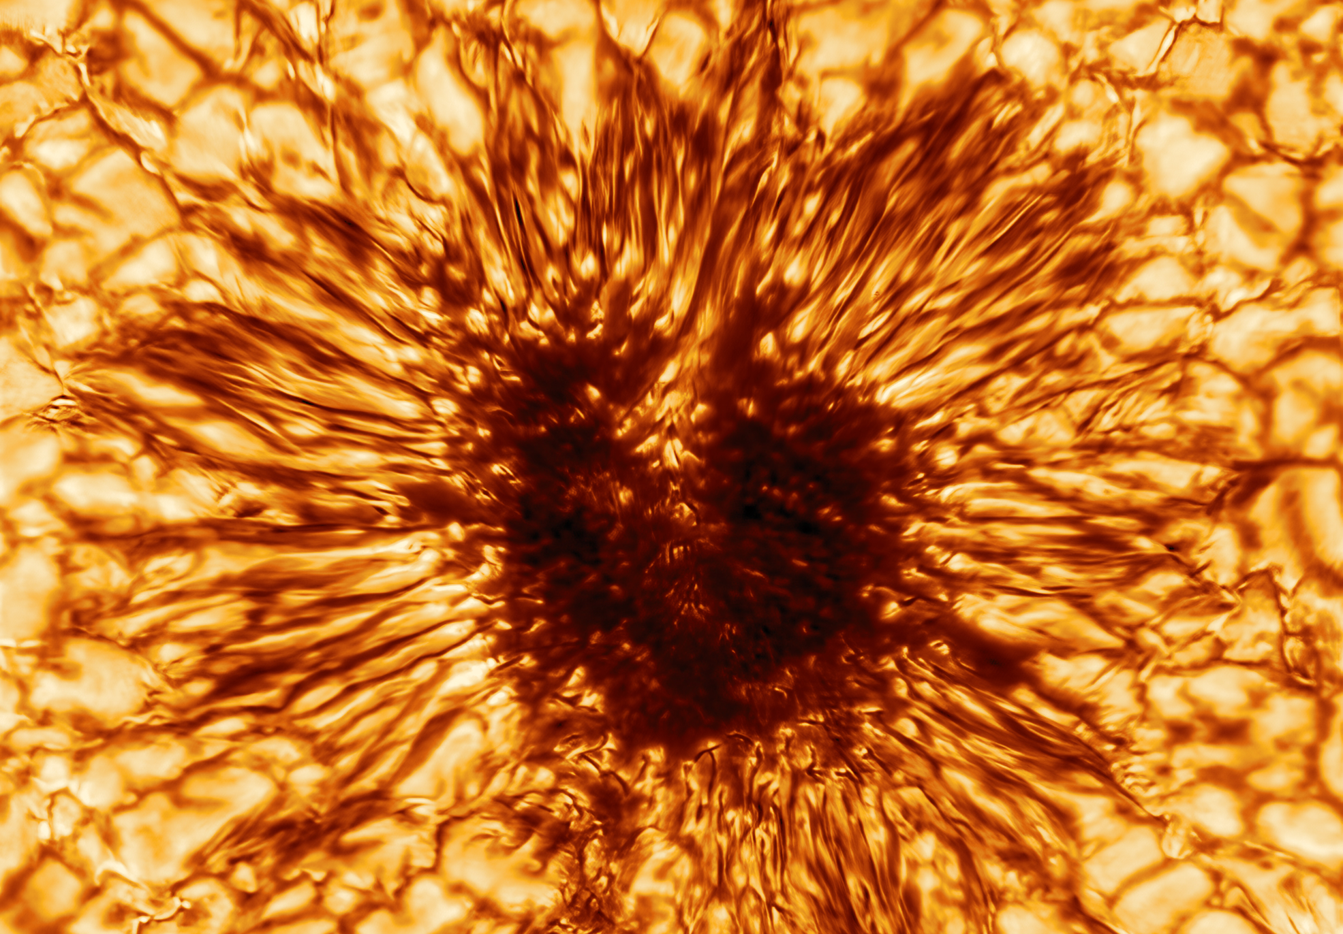
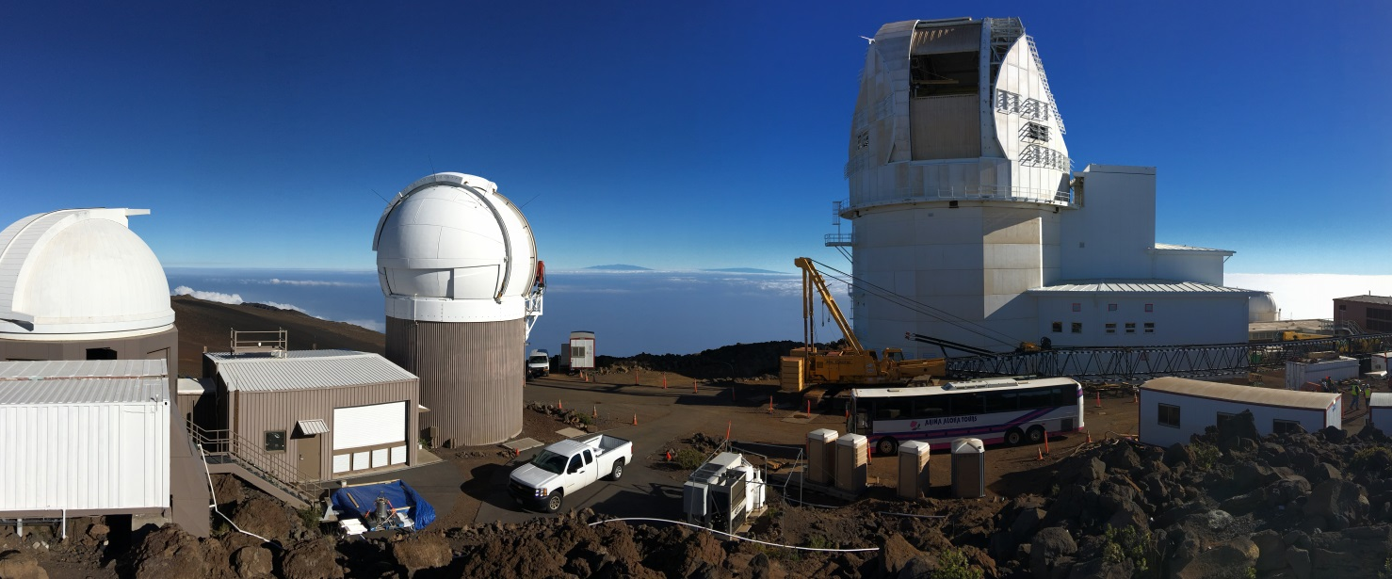




The Daniel K. Inouye Solar Telescope (DKIST):
All things Metadata + Other Bits
Alisdair Davey – DKIST DC Scientist
National Solar Observatory
adavey@nso.edu
7th IHDEA meeting, October 12-13, 2023, JHUAPL.

Slide 2
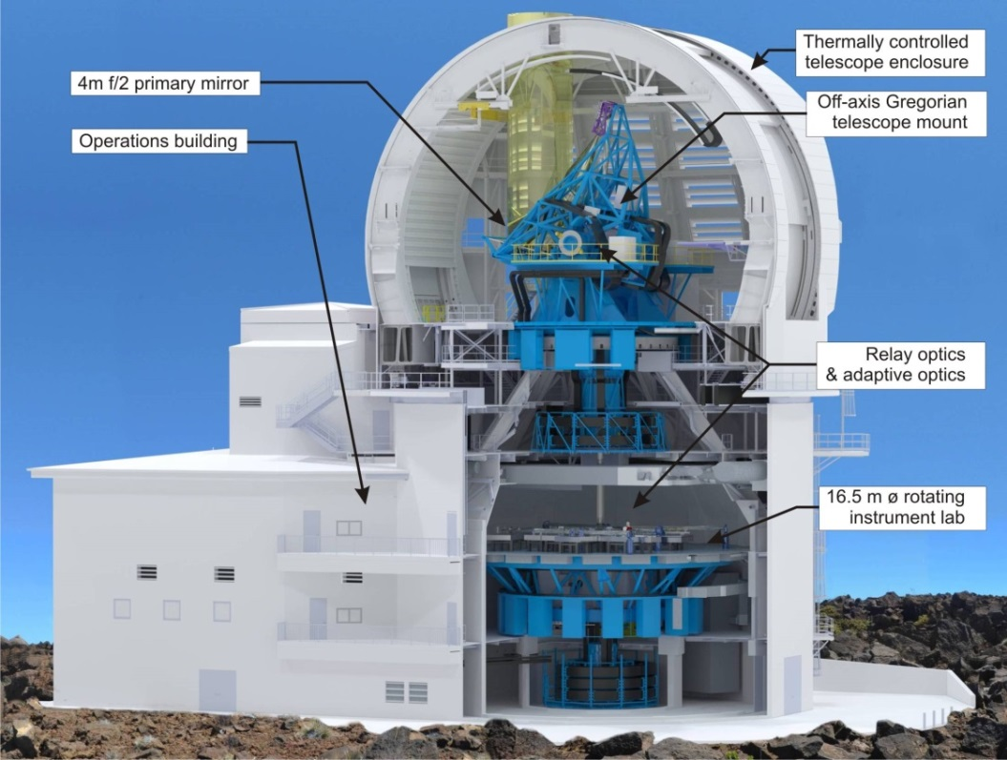
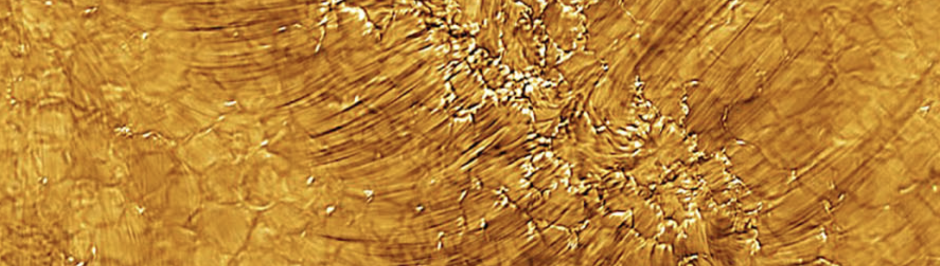
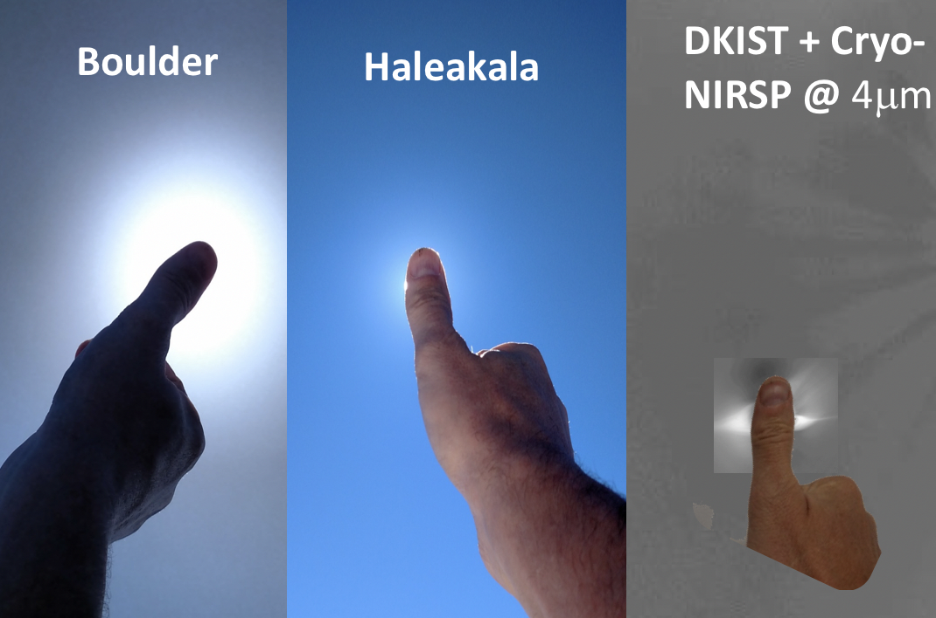
Daniel K. Inouye Solar Telescope (DKIST)
Daniel K. Inouye Solar Telescope (DKIST) is a four-meter aperture, all
reflecting, off axis Gregorian design, which minimizes scattered light and
thermal management
Constructed on Haleakalā, Maui, a site that has excellent seeing and
coronal skies with very low-scattered light
Features integrated adaptive optics and 5 complex, multi-camera
instruments designed for high-precision spectra-polarimetry, capable of
probing the solar atmosphere simultaneously at multiple heights. There
is also the capability to upgrade or replace these instruments in the
future
Magnetic fields in Solar plage regions
7th IHDEA meeting, October 12-13, 2023, JHUAPL.

Slide 3
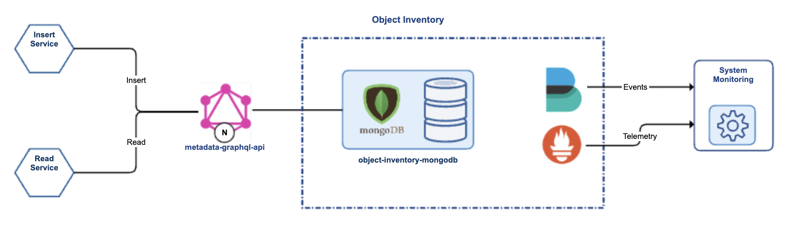
DKIST metadata, metadata registry and data access protocol
repository
Data Center Project Documentation – in ”glorious” detail!
  https://nso.atlassian.net/wiki/spaces/DPD/overview?homepageId=3670058
Raw frame inventory (repository)
  SPEC-0122 – FITS spec for raw data
Dataset inventory (repository)
  Inventory of calibrated Level 1 data
  SPEC-0214 – FITS spec for calibrated data
  ASDF for putting metadata in users’ hands
Data Center Access Protocol (REST API)
  https://api.dkistdc.nso.edu/datasets/docs
How do I use the Data Center Search API
  https://nso.atlassian.net/wiki/spaces/DHDT/pages/1438384129/How+do+I+use+the+Data+Center+Archive+Search+API
→
→
Frame inventory design
7th IHDEA meeting, October 12-13, 2023, JHUAPL.

Slide 4
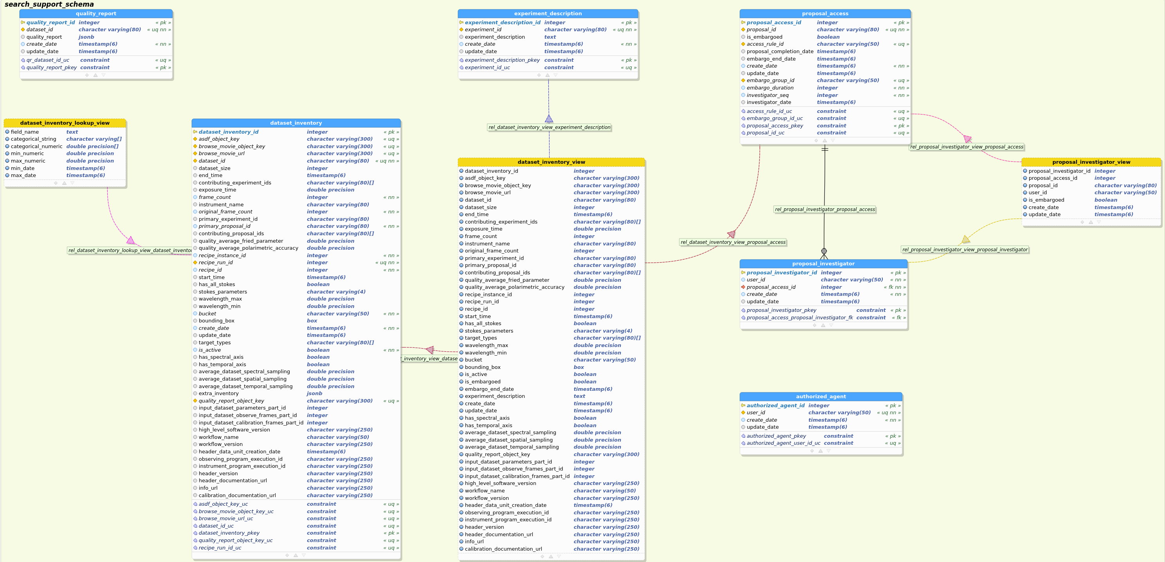
Logical Data Model
The data model for
the Search Support
database consists
of multiple tables
7th IHDEA meeting, October 12-13, 2023, JHUAPL.

Slide 5
Dataset Inventory Attributes
Attribute | Attribute
asdfObjectKey bottomLeft browseMovieArchiveKey browseMovieURL bucket cadence contributingExperimentIdArray contributingProposalIdArray datasetId datasetSize endTime exposureTime fieldOfViewX fieldOfViewY filterWavelengthList frameCount | instrumentName observable originalFrameCount primaryExperimentId primaryProposalId qualityFrameworkAverageFriedParameterValue qualityFrameworkPolarimetricAccuracy reciepeInstanceId recipeId recipeRunId startTime stokesParameters targetType topRight wavelengthMax wavelengthMin
Dataset Inventory contains
all the required attributes to support
the Search API.
  Defined by science
  requirements, plus calibration
  and DC requirements
Used both internally and externally
7th IHDEA meeting, October 12-13, 2023, JHUAPL.

Slide 6
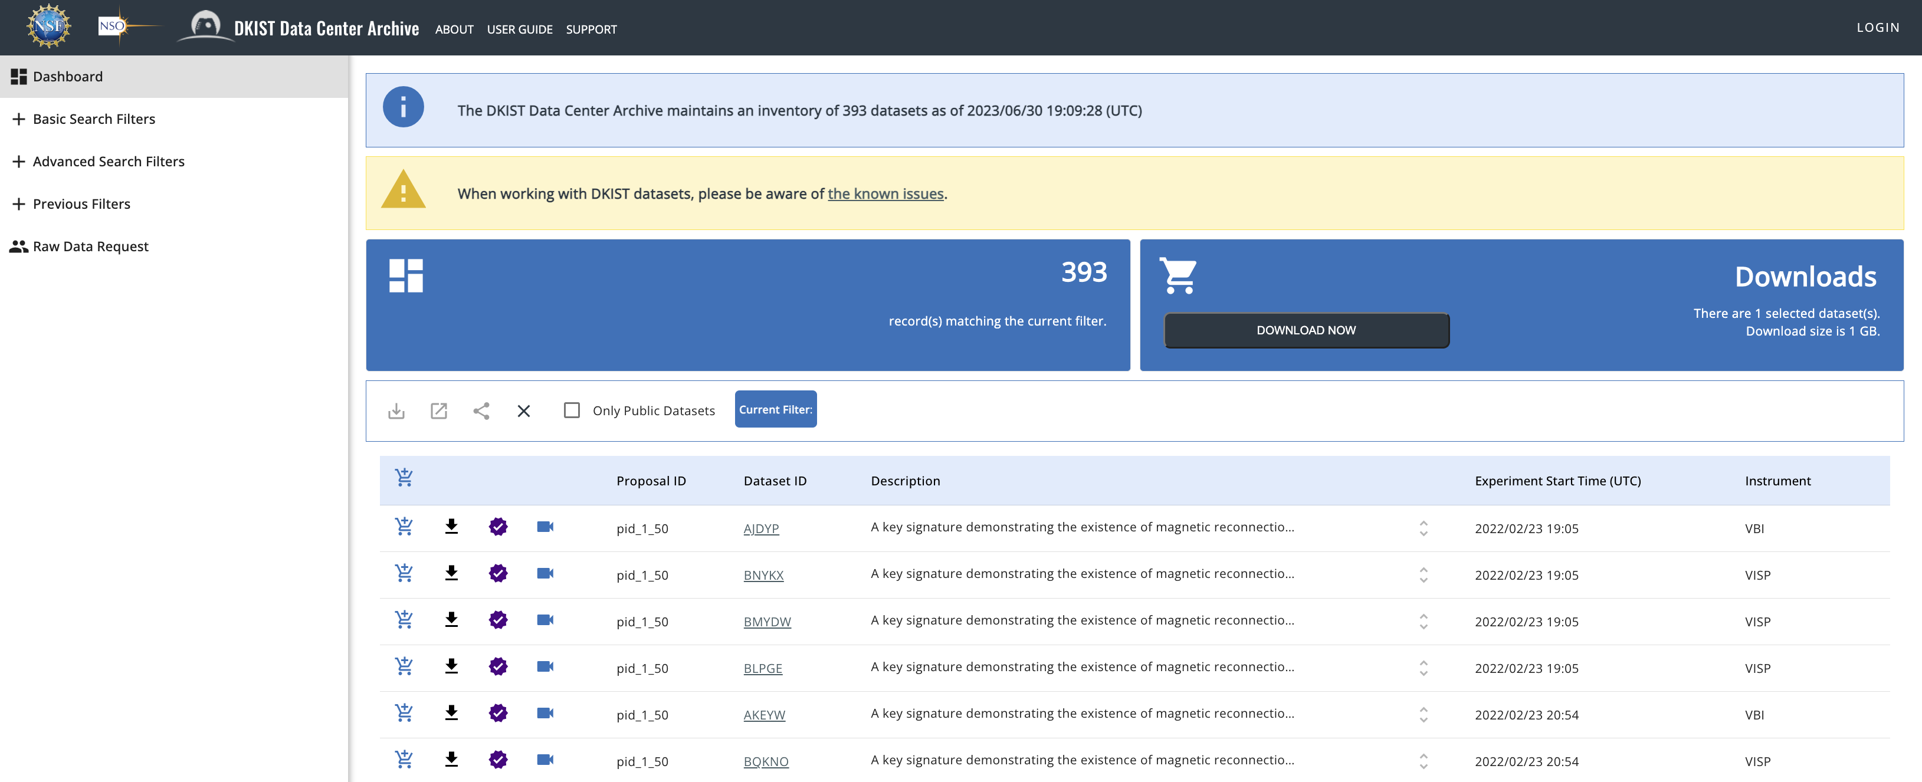
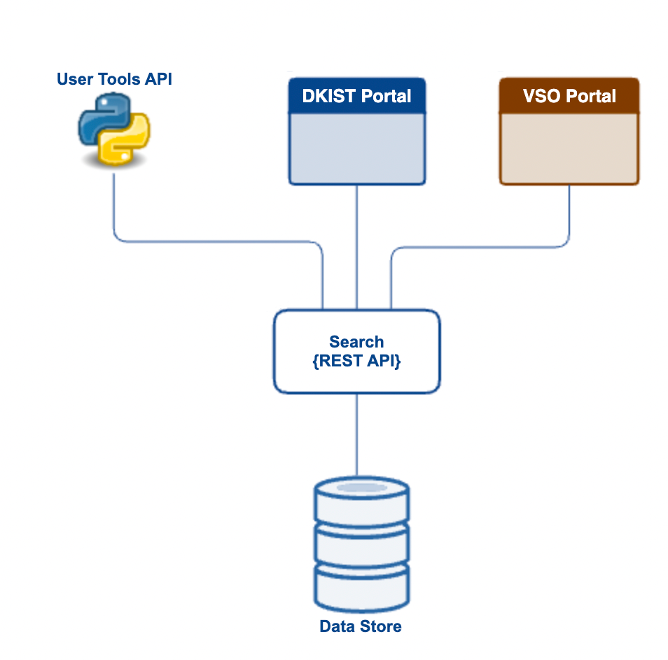
Dataset Search API
The DKIST Data Center Archive provides a REST API for both internal use and for external users (including the DC itself) who would like to integrate a search function into code modules or other software to which the users have access. The search API is used by the DKIST Data Portal, the User Tools, and the Virtual Solar Observatory (VSO) to search for data. With a well-defined API, users can also access it via any programming language they chose.
7th IHDEA meeting, October 12-13, 2023, JHUAPL.

Slide 7
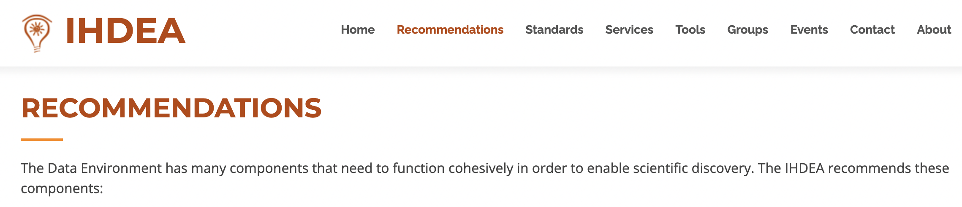
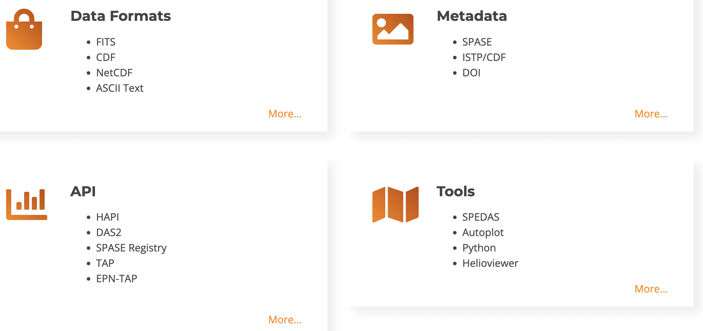
IHDEA Recommendations
7th IHDEA meeting, October 12-13, 2023, JHUAPL.

Slide 8

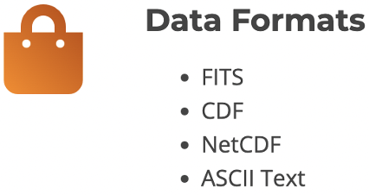
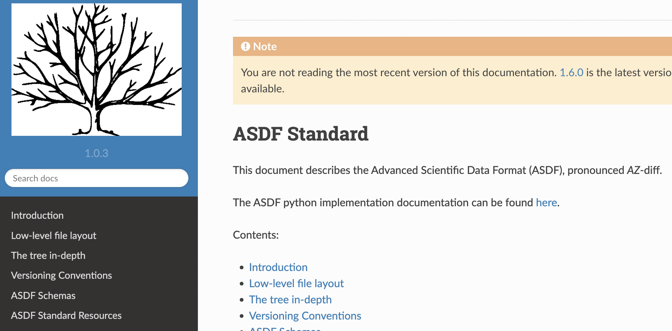
Data Formats (Calibrated Data)
✓
Dataset – roughly a collection of observations with the same instrument, wavelength, and mode.
Each dataset contains FITS files in a format compliant with the FITS 4.0 standard as well as the SOLARNET Metadata recommendations for Solar Observations.
Browse movies are in MP4.
Quality report is in PDF.
All the metadata from all the FITS files in a
dataset is provided in ASDF files. ASDF is a format
used by JWST for images. We only use it for
metadata.
  Working on including quality information in machine
  readable form in ASDF files.
7th IHDEA meeting, October 12-13, 2023, JHUAPL.
Notes:
https://docs.dkist.nso.edu/projects/data-products/en/stable/specs/spec-214.html

Slide 9
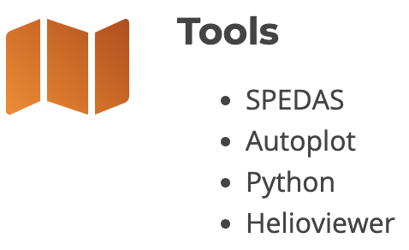


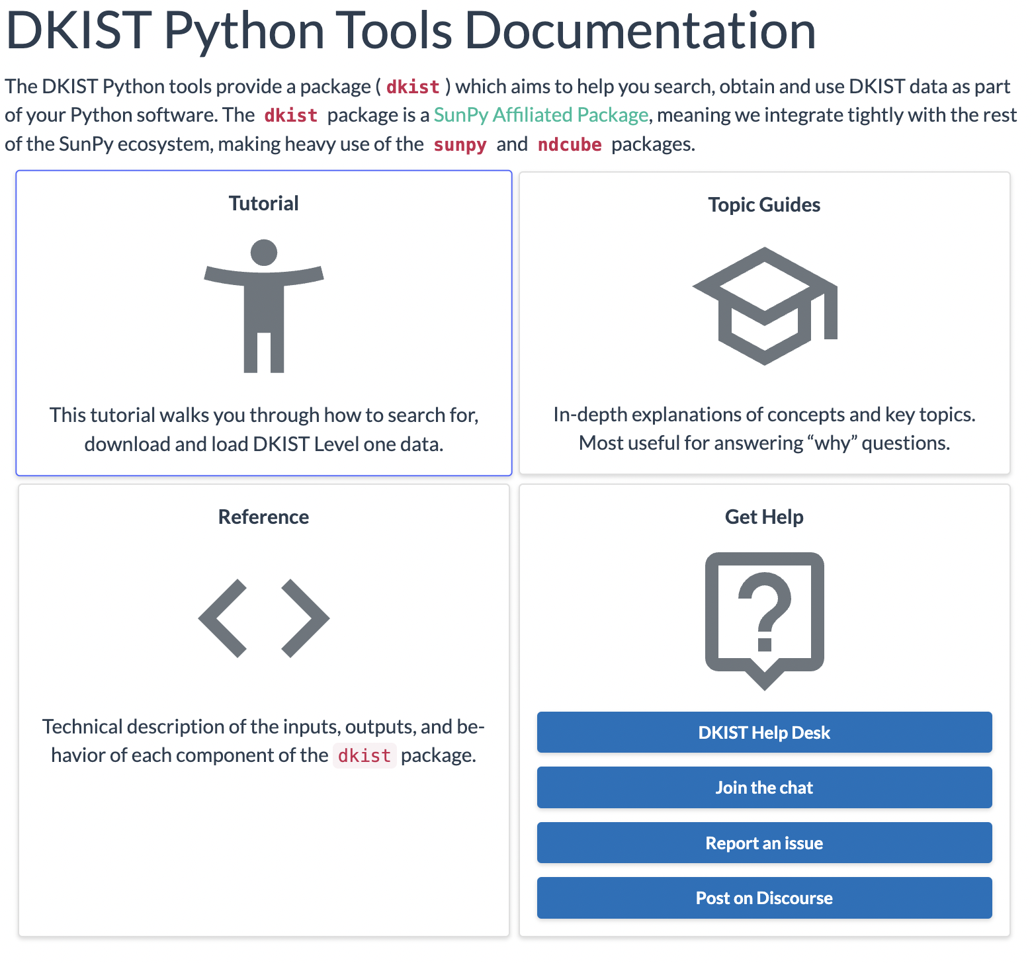
Tools
✓
The dkist package is developed by the DKIST Data Center
team (Stuart Mumford), and is designed to make it easy to
obtain and use DKIST data in Python. The dkist package only
provides DKIST specific functionality as plugins and extensions
to the wider SunPy and scientific Python ecosystem. Most of
the development effort required to support DKIST data
happened in packages such as ndcube, sunpy and astropy.
Provides search and download capabilities for both data and
metadata (ASDF)
Provides tools to use ASDF file for finer granularity search
and identification of data subsets to download
Provides data interaction and analysis (with wider Python
ecosystem)
7th IHDEA meeting, October 12-13, 2023, JHUAPL.

Slide 10
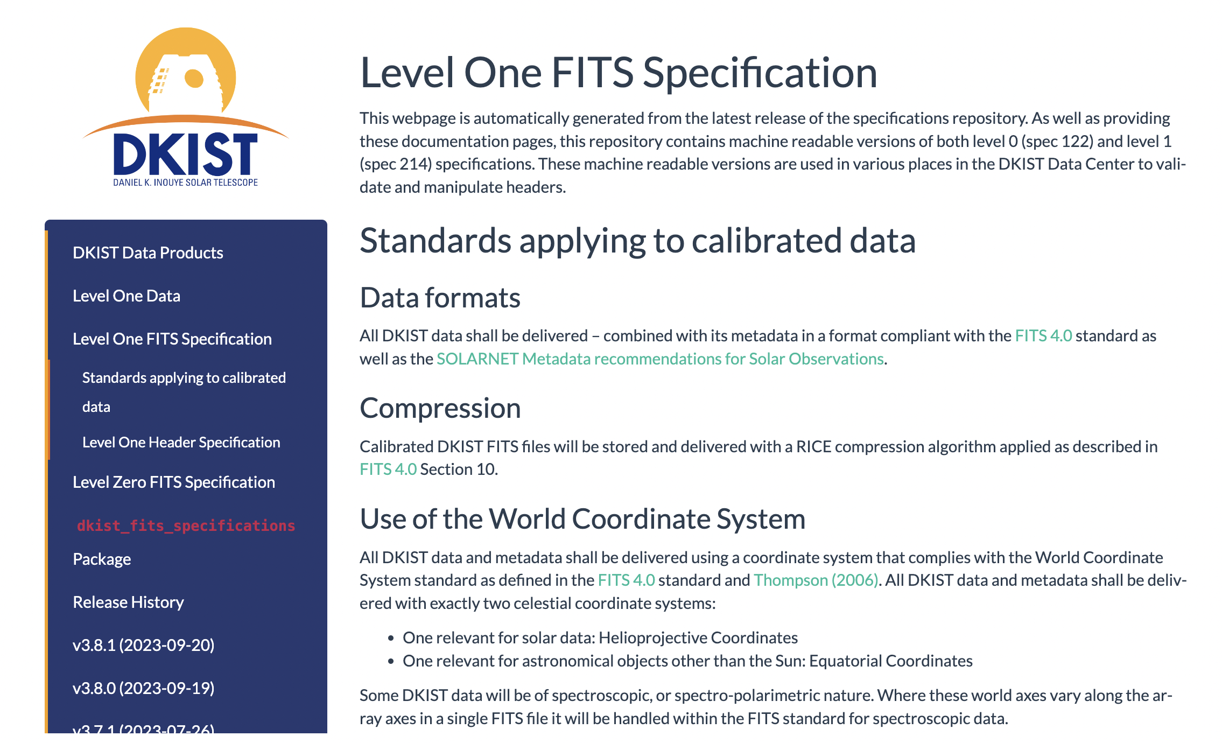
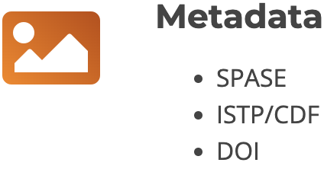

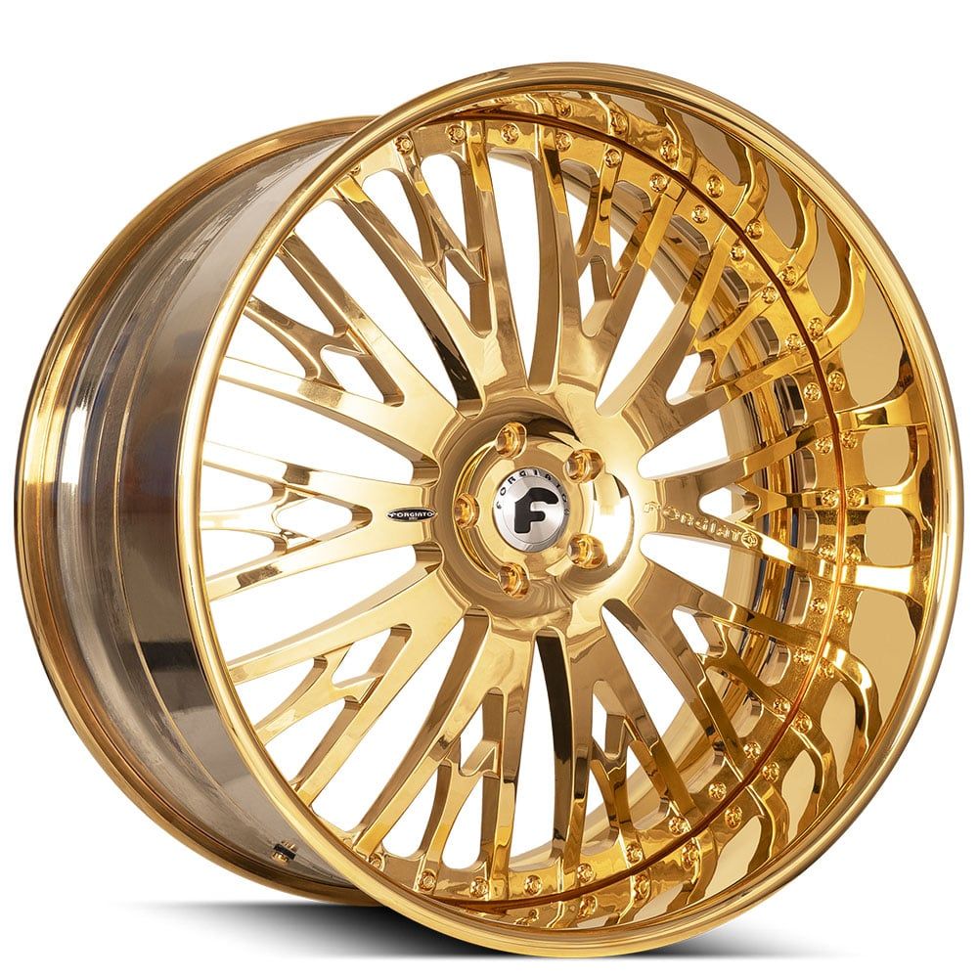
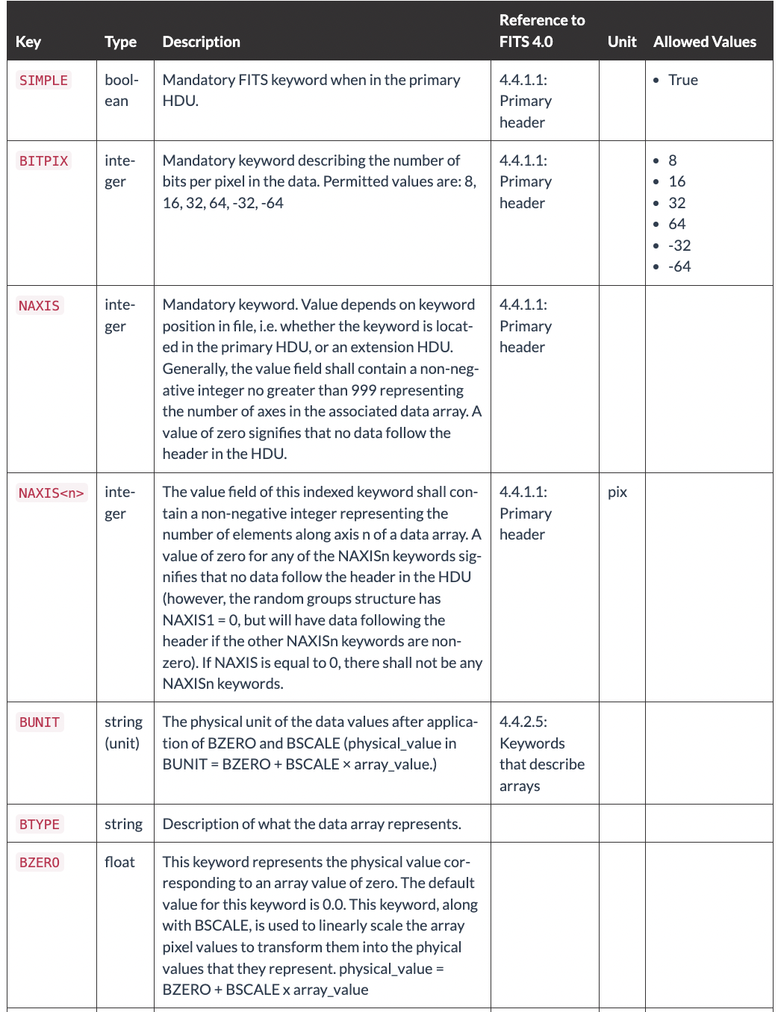
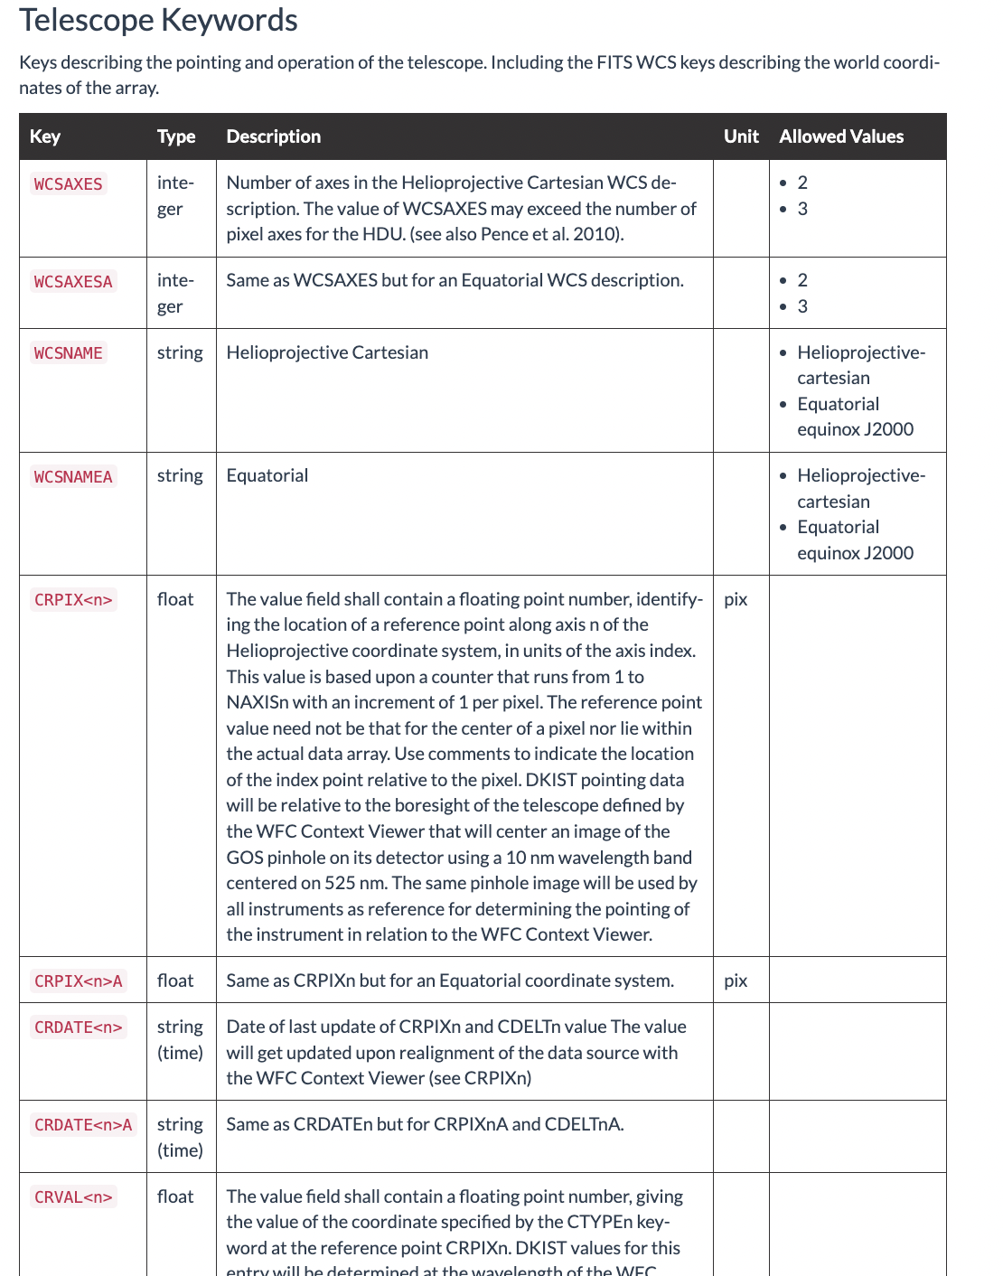
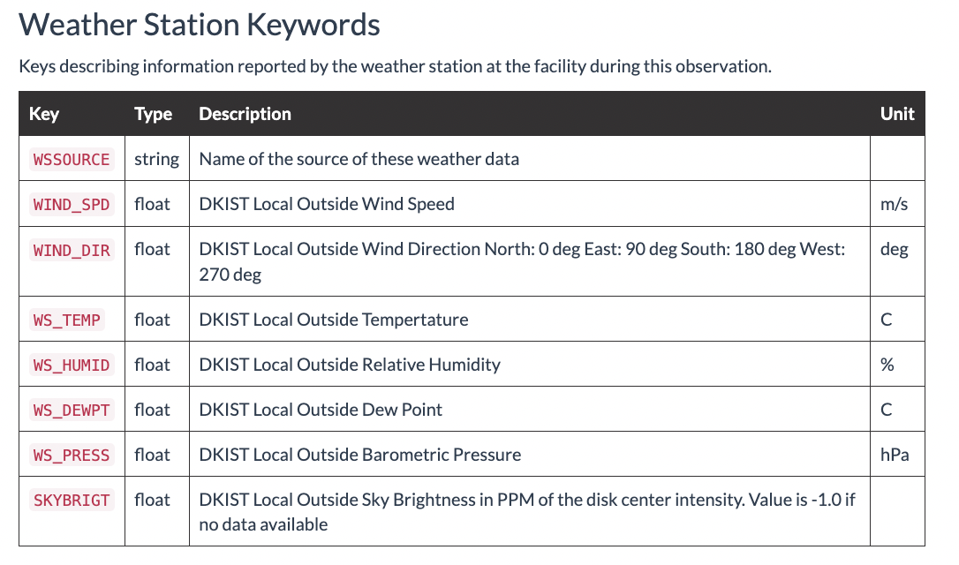
Metadata
✘
https://docs.dkist.nso.edu/projects/data-products/en/stable/specs/spec-214.html
7th IHDEA meeting, October 12-13, 2023, JHUAPL.

Slide 11

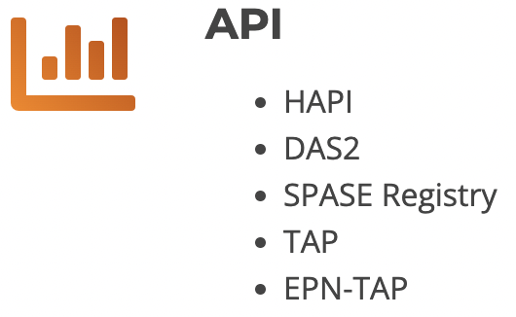
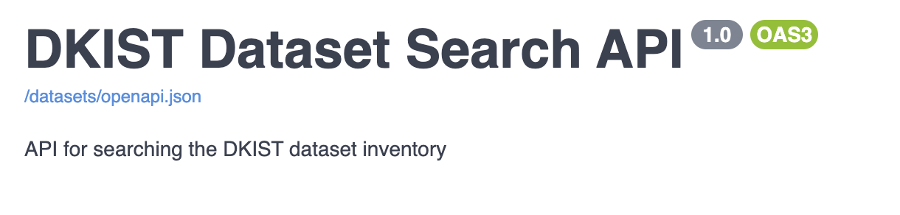
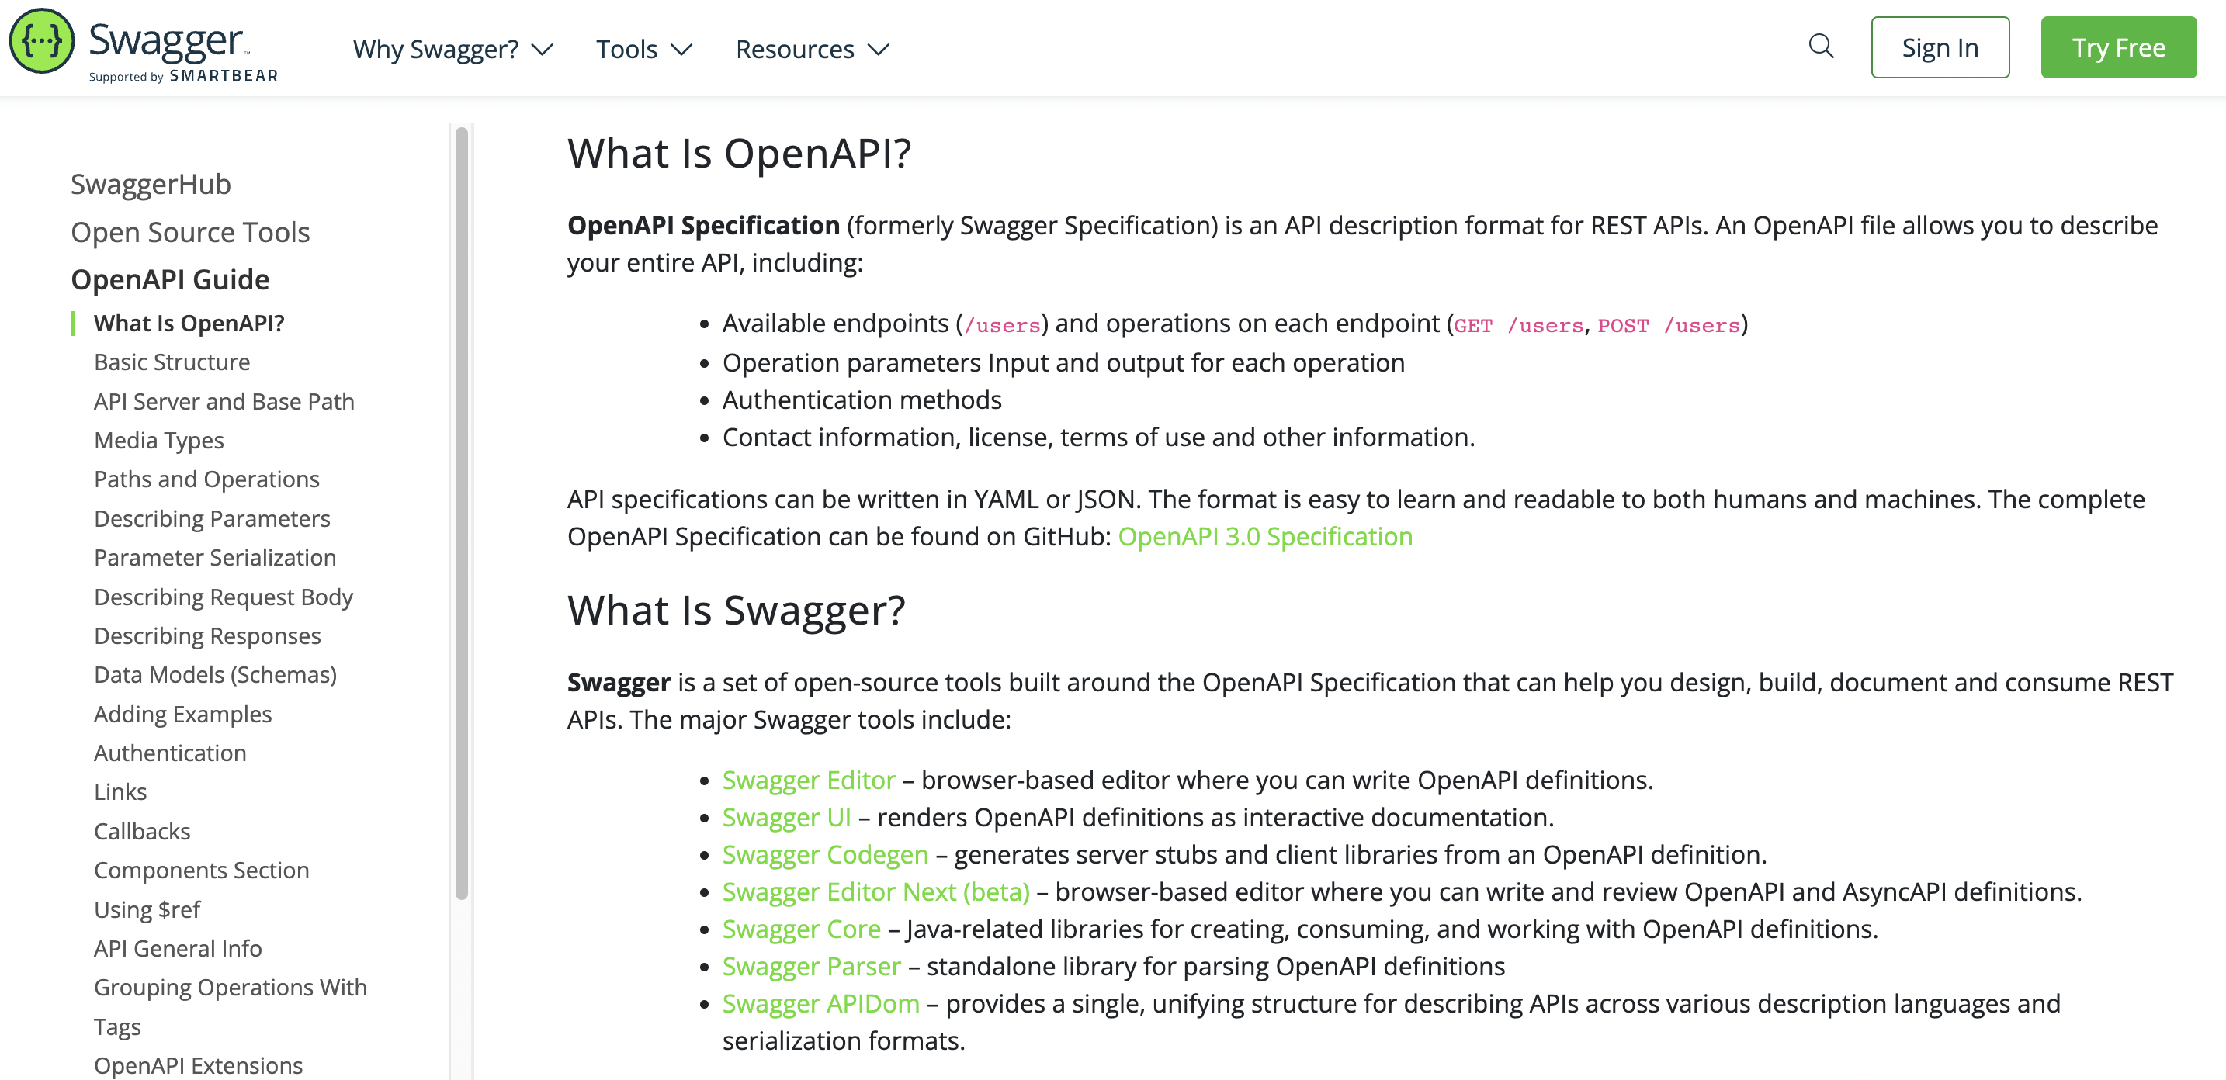
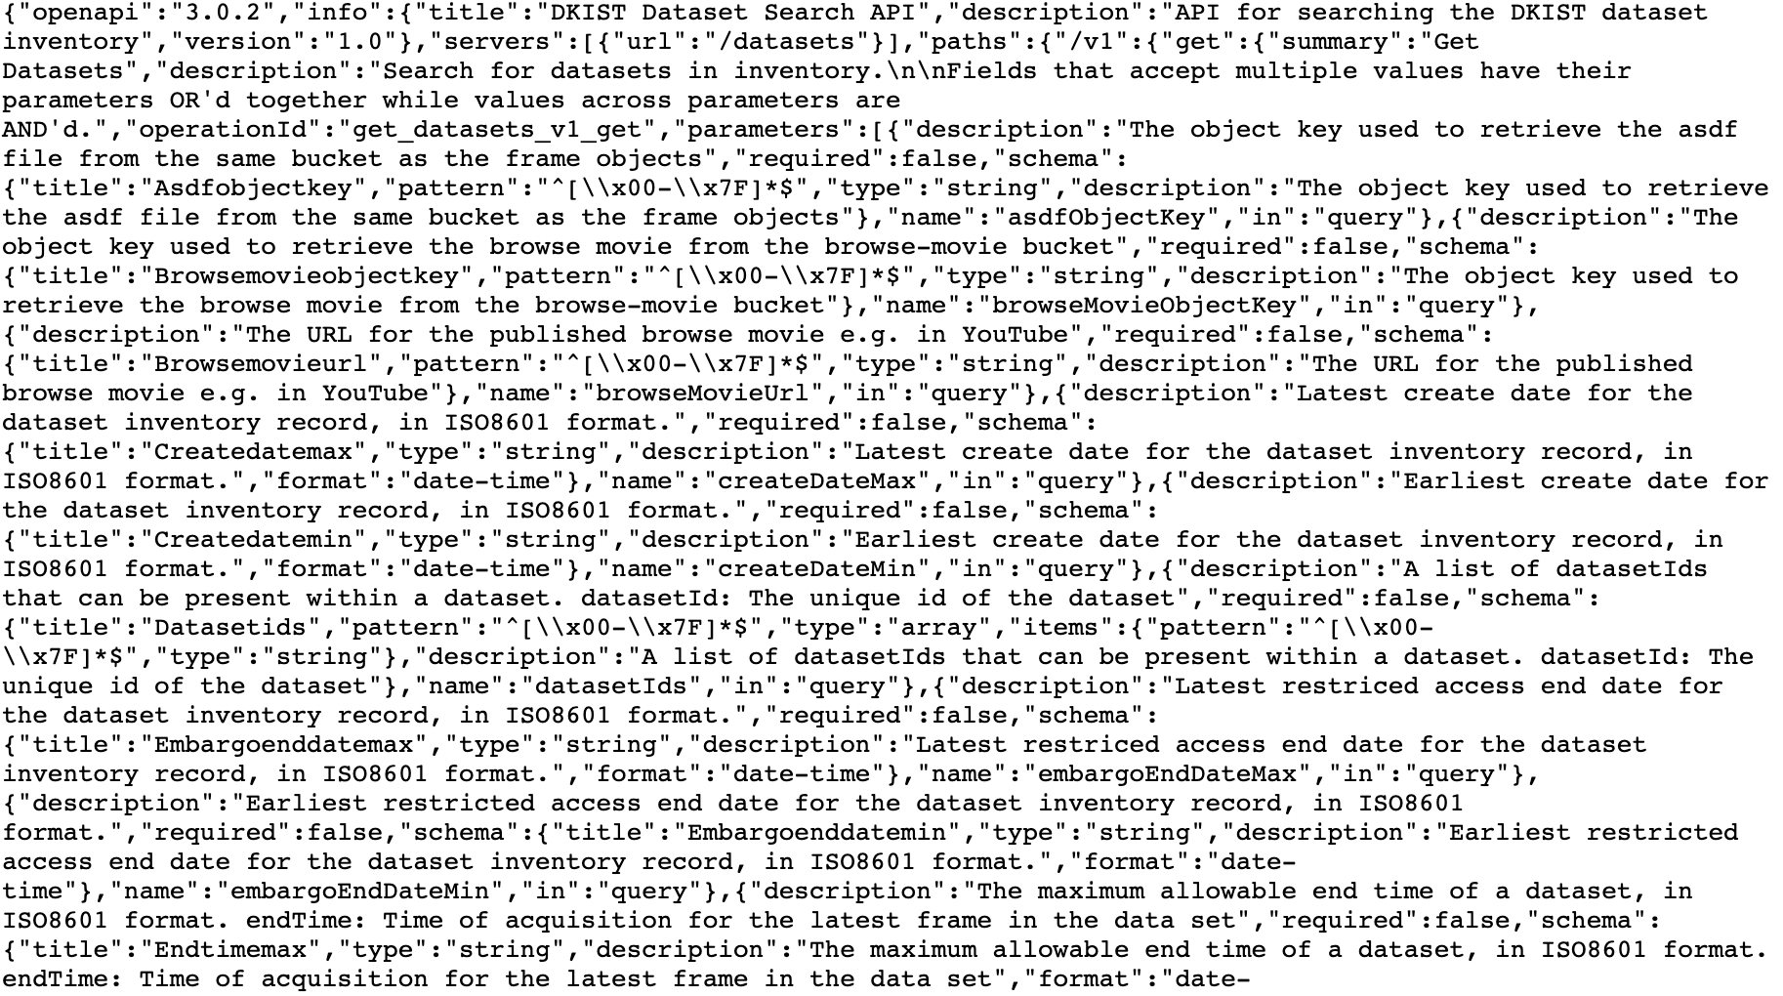
API
✘
https://api.dkistdc.nso.edu/datasets/docs#/
7th IHDEA meeting, October 12-13, 2023, JHUAPL.

Slide 12
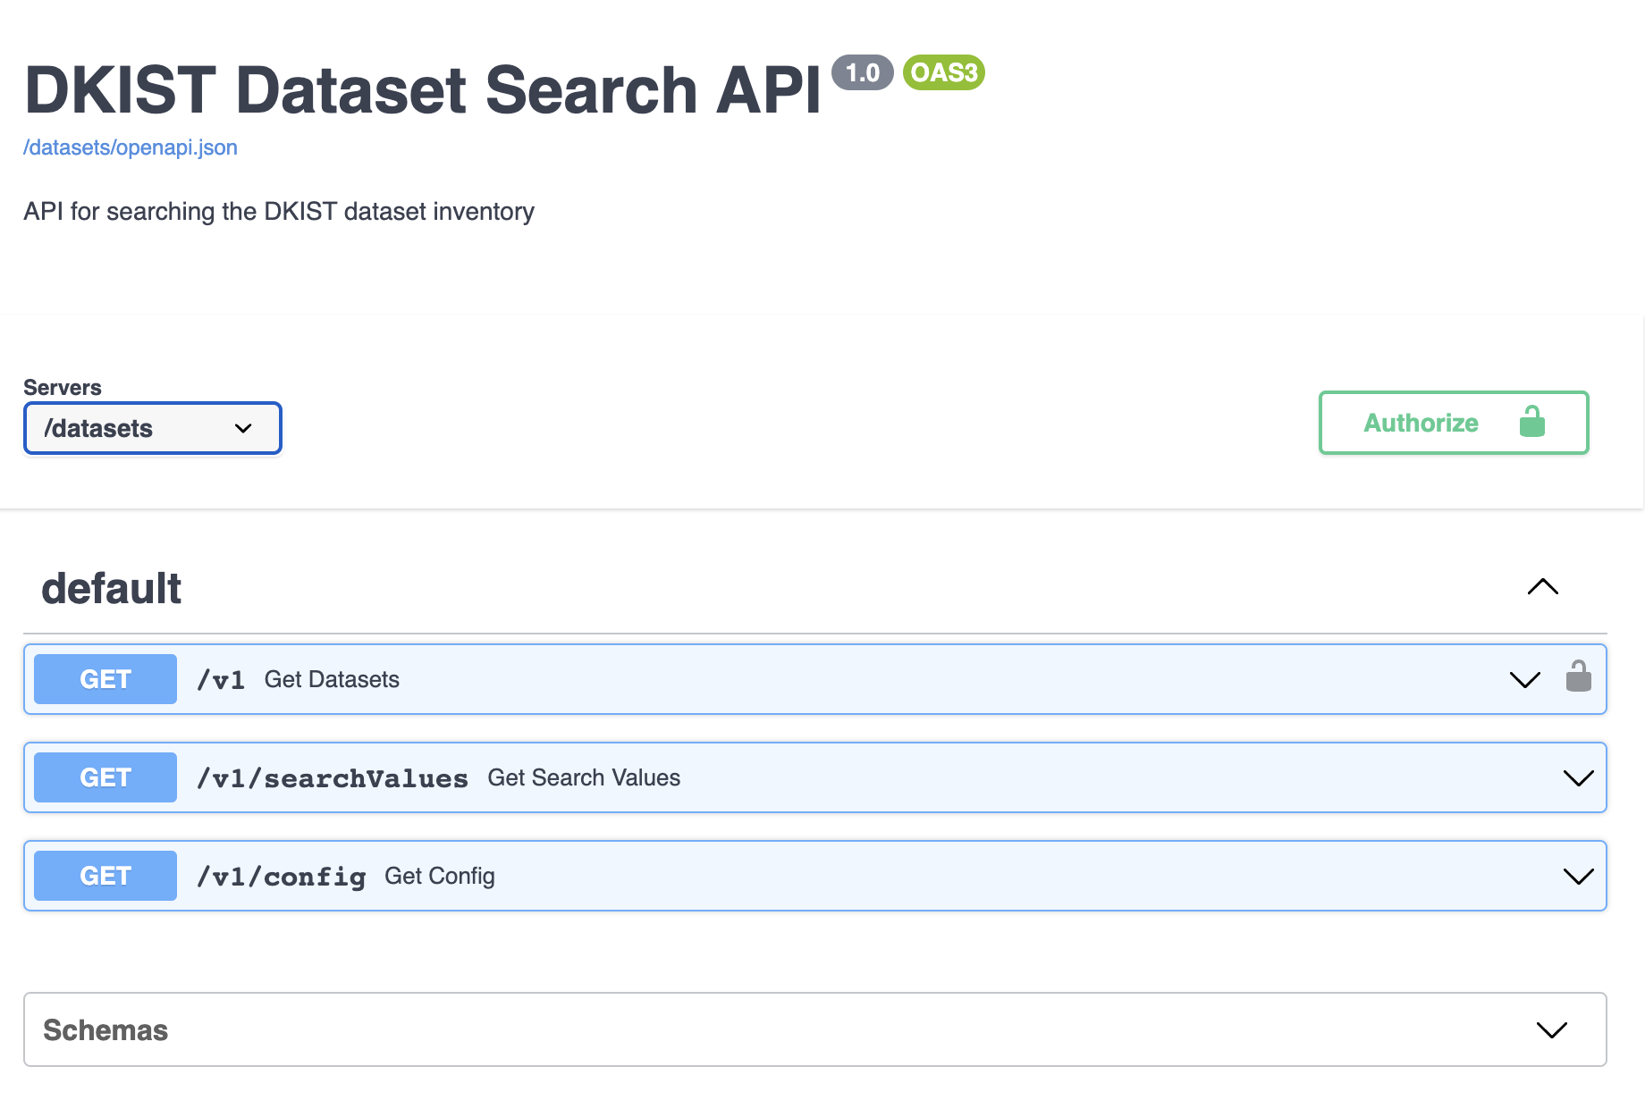
API
✘
https://api.dkistdc.nso.edu/datasets/docs#/
7th IHDEA meeting, October 12-13, 2023, JHUAPL.

Slide 13
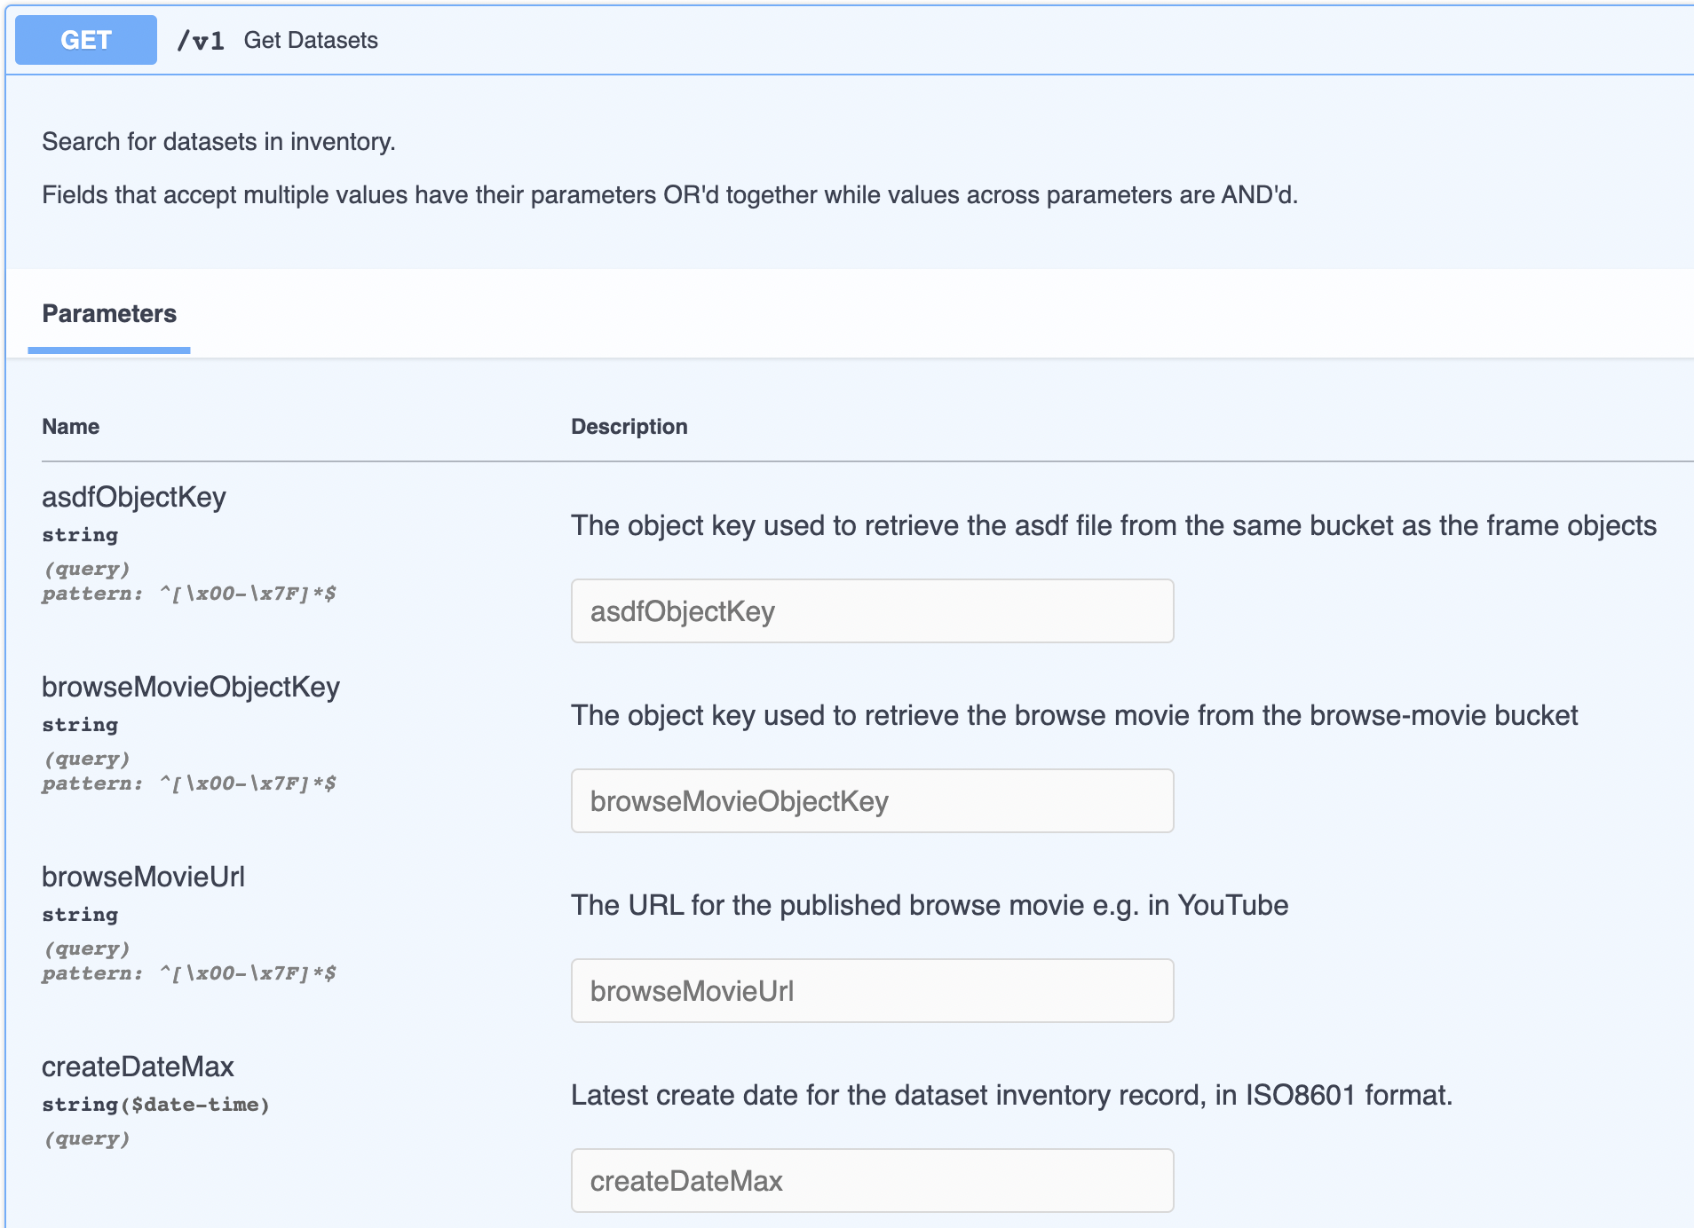
API
✘
All the parameters are fully described
https://api.dkistdc.nso.edu/datasets/docs#/default/get_datasets_v1_get
7th IHDEA meeting, October 12-13, 2023, JHUAPL.

Slide 14
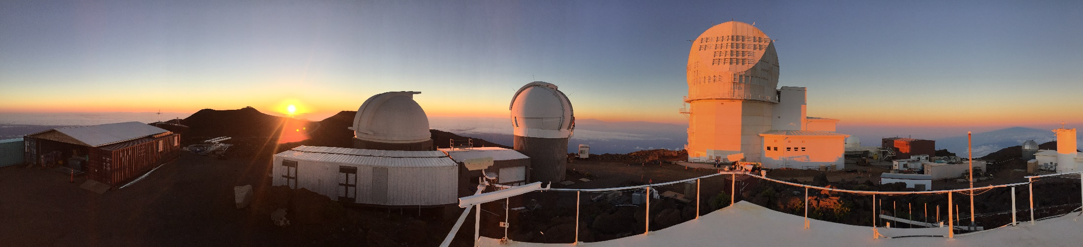
Summary
Metadata
  Dataset inventory 1st defined by science requirements
  Our own standard but it is very well documented
Dataset Search
  REST API built on OpenAPI V3. Again, very well documented
  Used both internally and for external access (User Tools/Web interface)
7th IHDEA meeting, October 12-13, 2023, JHUAPL.

