Slide 1
PyHC: updates since IHDEA 2022
Julie Barnum
LASP | University of Colorado Boulder
7th IHDEA Meeting, JHU|APL, Laurel, MD, October 12-13, 2023

Slide 2
PyHC (Super) Quick Background
Who we are
Promoting and facilitating the use and development of Python for Heliophysics.
A community knowledge base for performing heliophysics research in Python, aiming to provide a variety of tutorials, resources, a list of useful packages, general discussion, and advice.
pyhc.org
Projects
Core projects: PlasmaPy, SunPy, pySPEDAS, SpacePy, pysat, Kamodo, HAPI
Other widely-used projects
Un-evaluated projects
Domains
Science: Solar, Heliospheric, Geospace Sciences (Magnetosphere), and ITM
Software Capability: Modelling, ML, plotting, wrappers for other libraries, CDF writers, etc.
Mission software: db-processing, CCSDSpy, space-packet-parser

Slide 3
PyHC (Super) Quick Background
Bi-weekly telecons
Project intros/updates, continued discussions from meetings/past telecons, outside speakers
PyHC bi-annual meetings
Last was Spring ‘23
No Fall ‘23 (folded into DASH meeting); look out for a potential mid-point meeting in Feb.
Out of cycle meeting in late Feb?
Upcoming meetings
AGU 2023 in San Francisco, CA
SH33E - Implementations in Python for Solar and Space Physics Poster (Wed, Dec 13th 14:10 - 18:30 PM PT)
4th Eddy Cross-Discipline Symposium, ADASS, AMS, TESS 2024, PyHC 2024 Summer School, software standards workshop (more info TBA), COSPAR’s 45th Scientific Assembly

Slide 4
Updates since last IHDEA meeting

Slide 5
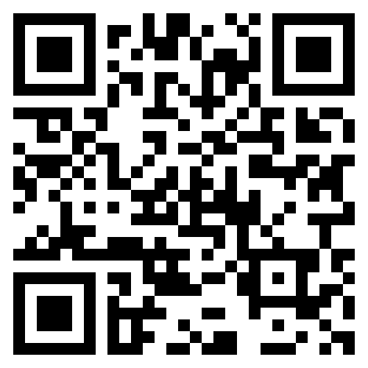
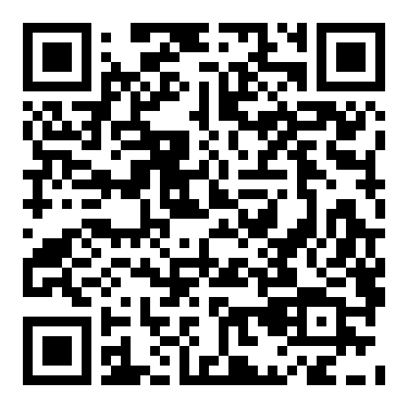
PyHC General Updates
Links links links
PyHC ROR ID: https://ror.org/012prn105
PyHC telecons/meetings on PyHC YouTube: https://www.youtube.com/@pythoninheliophysicscommun3732
Our website now findable @ https://pyhc.org
PyHC gallery
Beta Jupyter Book implementation
Can submit regular .ipynb notebook files now (in place of .py format required previously).
Adding new examples is easier than ever!
Links to dockerized pyhc-gallery image
https://hub.docker.com/r/spolson/pyhc-gallery
ROR ID
YouTube
Website

Slide 6
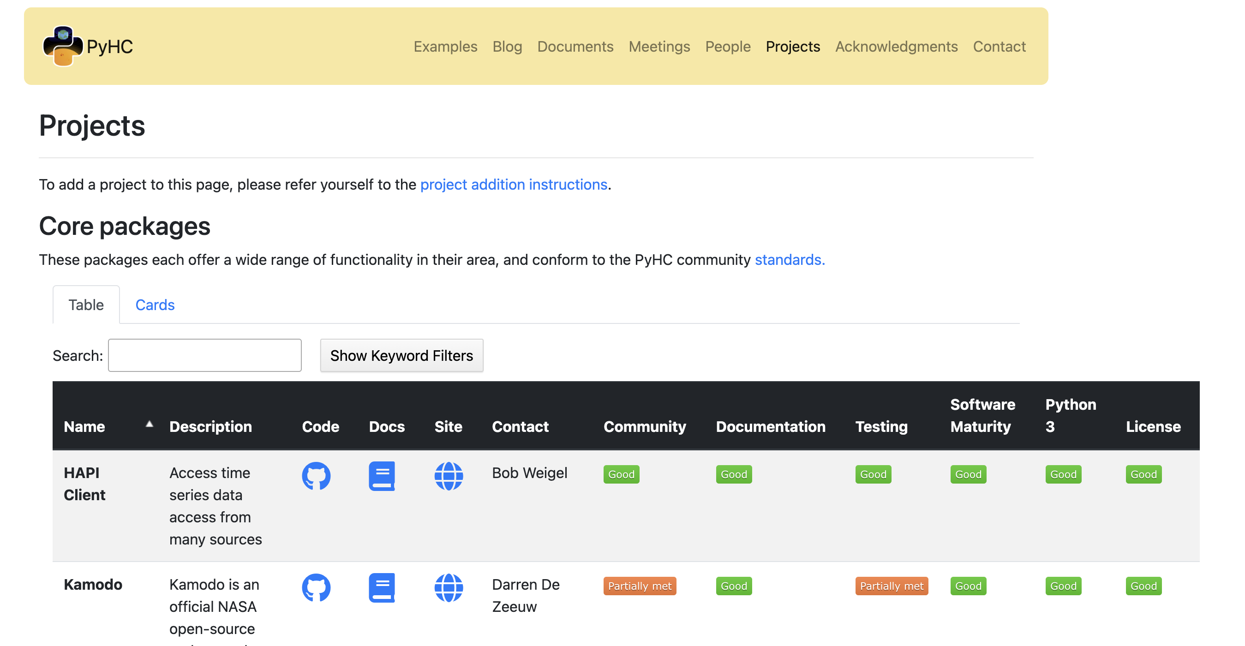
PyHC Project Updates
Light project restructure
Creation of “unevaluated packages” (mostly Michael Hirsch projects…)
Package changes/additions
Core projects: PlasmaPy, SunPy, pySPEDAS, SpacePy, pysat, Kamodo, HAPI
Other widely-used projects
PyGS, LOFAR-SUN, CCSDSPY, space-packet-parser, XRTpy, GeospaceLAB, SkyWinder, SkyWinder-Analysis

Slide 7
PyHC Virtual Environment
End goal: all PyHC software bundled into one dockerized environment, installable from PyPI/Conda. Hits our goal of an interoperable environment!
Put into HelioCloud
Maintain on a regular basis
Previous efforts resulted in the PyHC 2022 summer school container
Spring 2023 meeting
Hackathon group that condensed the allowable ranges of requirements into one PIP-installable "requirements.txt" file (Python virtual environment)
file uploaded to Github https://github.com/sapols/pyhc-environment-files/tree/main
"import-test.py" file created that imports every PyHC package
Successfully ran on Mac OS, with efforts to improve problems with Windows!
BIG moment of success for PyHC 🎉
Docker images that use this new PyHC environment available on Docker Hub
See Shawn’s talk for more…

Slide 8
PyHC—pyOpenSci Partnership
pyOpenSci: “We build diverse community that supports free and open Python tools for processing scientific data. We also build technical skills needed to contribute to open source and that support open science. Join our global community.”
Tools for the community
Software peer reviews
Fast tracks the JOSS process
Community partnerships
“develop community-specific standards that are used in our reviews to evaluate whether a package meets affiliation requirements”
Pangeo and Astropy ones exist now
Python packaging guide
Community driven; guide of best practices when creating Python packages
Website: https://www.pyopensci.org/

Slide 9
PyHC VIP Badge
Why?
Add a VIP badge to improve package quality, robustness, and confidence
Required of core packages (strive for this with other packages)
Same tiering (core, other, and un-evaluated), but with a new column for the badge
VIP (Verified Interoperable Package)
Completes self-evaluation
SPASE registration
Successfully installs in the PyHC environment
Contributes a gallery example (ideally, one that involves multiple PyHC packages)
Package available on conda?
Successfully completes pyOpenSci/PyHC code review process
Obtains a DOI either by writing 1-2 pages for JOSS (code review already complete!) or by registering on Zenodo (5-10 minutes). Include links to info for both on the website.
Steps before adoption
Telecon coming Mon, Oct 16th on PHEP process (Jon N. leading the discussion)
https://docs.google.com/document/d/1E1Sfm2oWm4NR8Dd3MzCKpkzwIrOpmSYjQDCPdRleOQA/edit
Finalize requirements, approve via the PyHC leadership and core package leads(?)
Decide if we want to impose deadlines

Slide 10
PyHC 2024 Summer School
What
“Building upon the success of our inaugural event”
Continue with package intros, with a deeper focus on integration and student involvement.
Why
Educate students and early career scientists in the software capabilities available through PyHC, and get them involved in the community.
Ownership of these living package tools is community-driven!
Expose heliophysics researchers to cloud-based research approaches. (Serve as another big test of HelioCloud and updated capabilities.)
Improve PyHC as a whole.
Create a more diversified community.
Learn where our software/resource gaps are (encourage feedback from attendees for this).
Create collaborations to address gaps.
Motivate PyHC packages to continue working on package interoperability.
Identify better ways to coordinate among conceptually similar packages
Leverage open science to create more durable analysis capabilities.
Add examples for the PyHC Gallery.

Slide 11
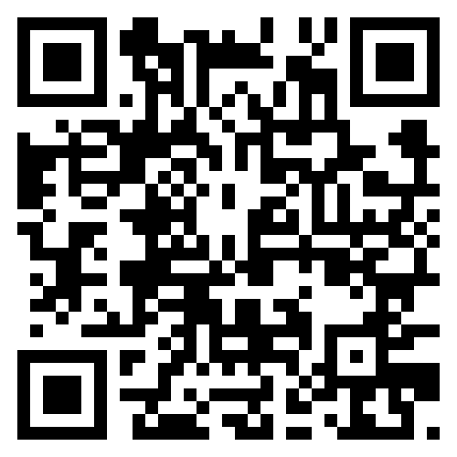
PyHC 2024 Summer School
Where: Laboratory for Atmospheric and Space Physics (LASP) in scenic Boulder, Colorado, USA
When: Monday, May 20th - Friday, May 24th 2024
Who: graduate students, early career scientists, and anyone eager to deepen their understanding of Python in the Heliophysics and Space Weather disciplines!
What will this cost me?
The event is FREE!
Check out the summer school’s web page for upcoming details (e.g. registration link)!
https://heliopython.org/summer-school-24

Slide 12
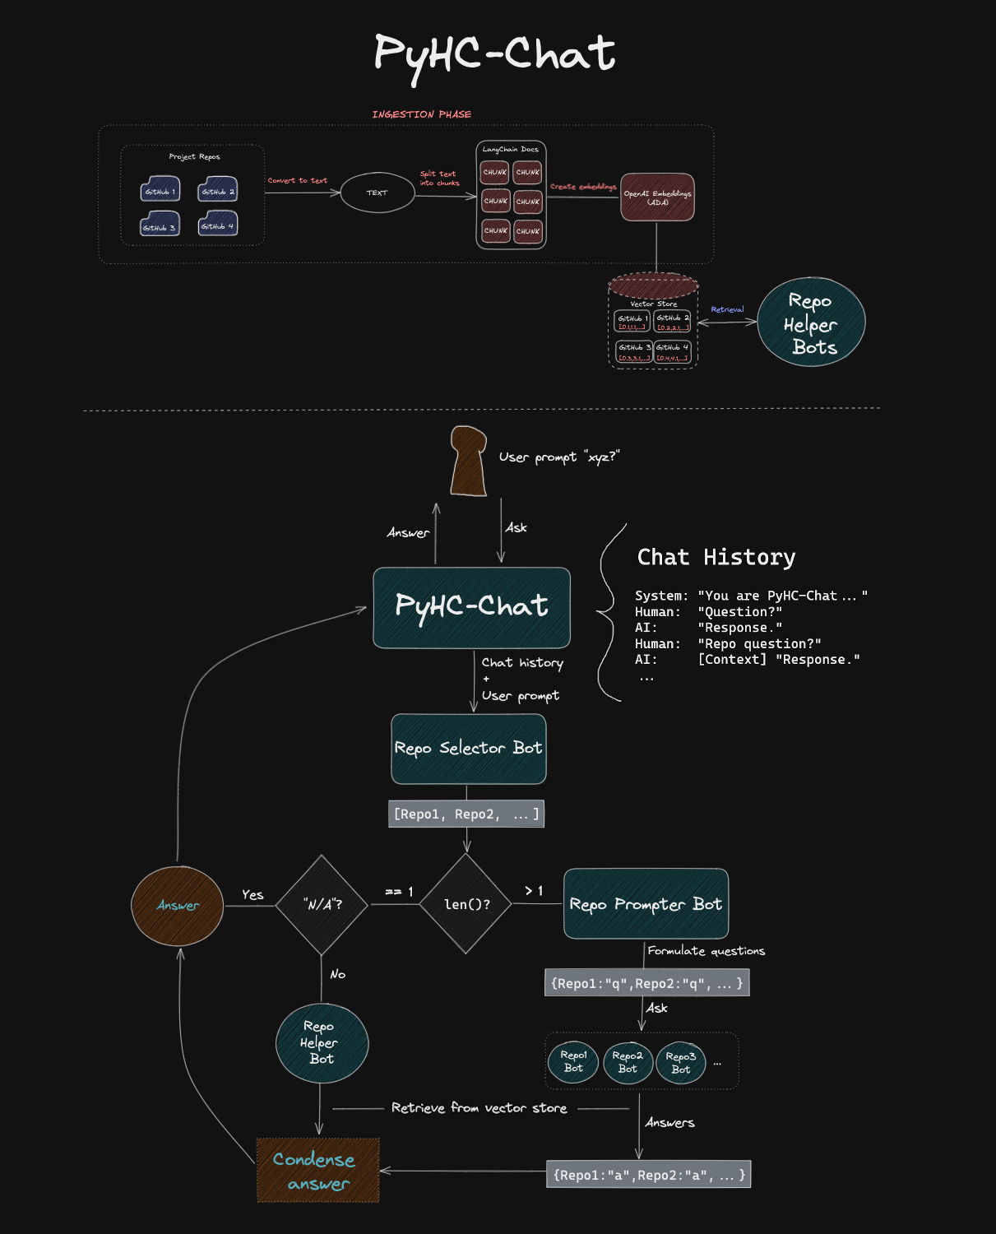
PyHC and AI
Integration of AI capabilities into PyHC
Shawn Polson (PyHC Tech Lead) presented on this at our spring 2023 meeting (demoed at DASH)
Prototype answers questions about PyHC and PyHC packages, powered by GPT-4 and written in Python
The vision:
“PyHC-Chat”
One-stop-shop to learn anything PyHC, it’ll do your research, write your code, then write your paper too, accomplish PyHC goals with amazing speed, and be a developer bot floating around GitHub
Want to learn more?
PyHC YT, Github (https://github.com/sapols/PyHC-Chat)
PyHC telecon on Mon, Oct 30th (9 AM MT)
Chat with Shawn!

Slide 13
PyHC and Mission Engagement
Leveraging grass-roots good will for better software is important, but to make mission-level capabilities, we need to fuse the community efforts with the mission activities…
Ideas
Get involved with missions early
Help educate scientists on OSS and open science processes
Help educate PyHC on software gaps, needed additions or modifications, etc.
Implementation Example: GDC
Spoke with the scientists in the Geospace Dynamics Constellation mission (GDC) at their science team meeting
Invited mission leads to speak on a PyHC telecon
Invited to attend our summer school (next one is in 2024), bi-annual meetings, telecons, our AGU sessions, DASH, etc.

Slide 14
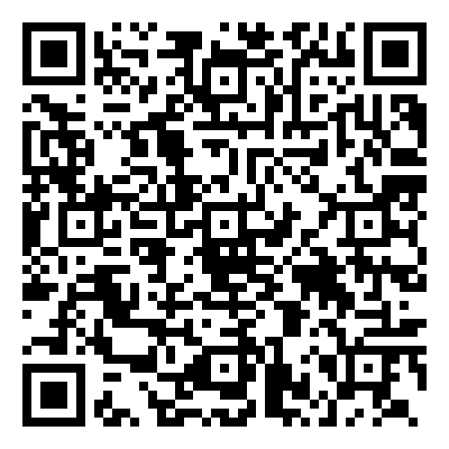
Connect with PyHC
Website: https://www.pyhc.org/
Upcoming telecon and meeting info on the Meetings page, PyHC packages info on Projects page, etc.
YouTube channel: https://www.youtube.com/@pythoninheliophysicscommun3732
PyHC mailing list (the most official way of “joining” that exists)
https://heliopython.org/contact/
Chat rooms
Element Chat: https://app.element.io/#/room/#heliopython:openastronomy.org
OR join our Slack (bridged to Element) via the QR code
Social Media
Follow us on Twitter (now X): https://twitter.com/PyHC_official
Further questions? Want to get your project added to the ecosystem? Drop me a line.
Julie.Barnum@lasp.colorado.edu

