Slide 1
Machine Learning-Ready Data Sets in Heliophysics
Viacheslav (Slava) Sadykov
Georgia State University, Atlanta, GA, USA
IHDEA Meeting 2023
10/12-10/13, 2023, JHU/APL, Laurel MD

Slide 2
Outline
Introduction to Machine Learning-Ready Data Sets
Why do we need such data sets in Heliophysics?
Key Principles Behind ML-Ready Data Sets
Examples of ML-Ready Data Sets in Heliophysics (Very Subjective Selection)
Historic examples of data sets
Current examples and related research
Highlighting Common Denominator
Open Discussion

Slide 3
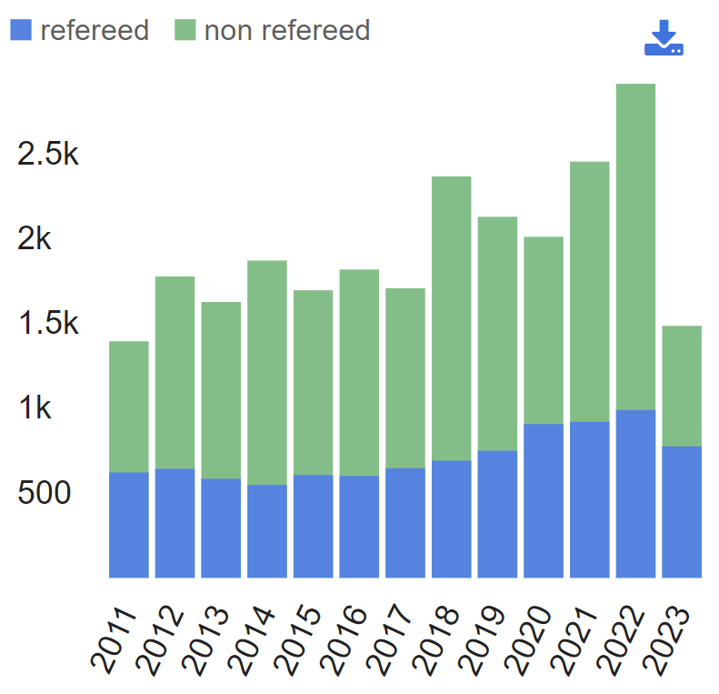
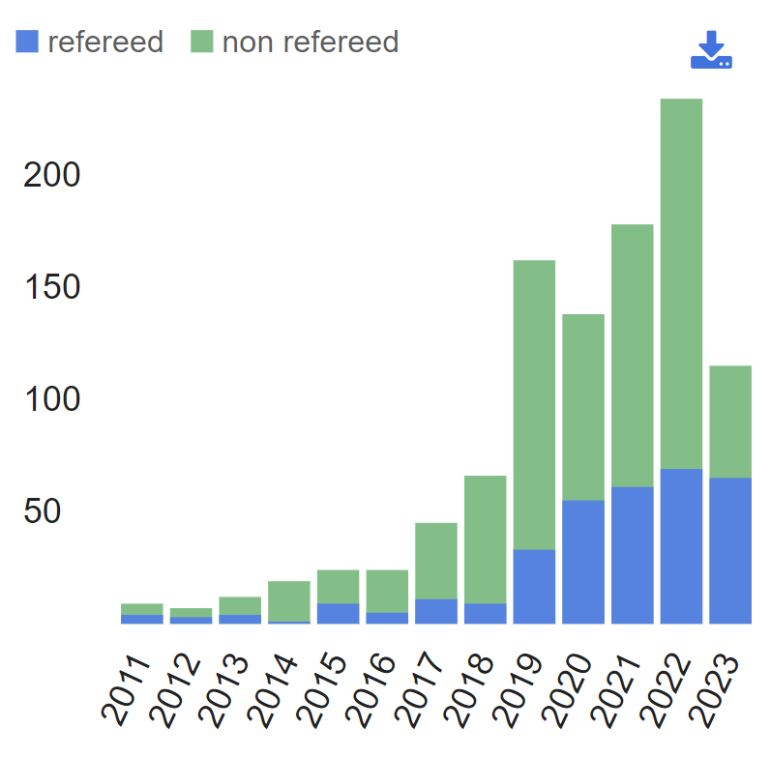
Two Plots from NASA ADS
Proxy for number of contributions in Heliophysics
(‘Heliophysics’, ‘Space Weather’, etc, in the abstract)
Same with machine learning keywords added
(‘Machine learning’, ‘Artificial intelligence’, etc, in the abstract)

Slide 4
Data Preparation in Machine Learning
Data preparation is a key challenge in machine learning:
The typical number mentioned is that 80% of time goes to data preparation
This steps includes data preprocessing and cleaning, data set partitioning, data normalization, etc.
Data preparation is an unavoidable step in the machine learning research
“Garbage in – garbage out”

Slide 5
ML-Ready Data Sets
How to make a salad?
Find a salad recipe
Order a salad kit online
Make some shopping at the grocery store
Preprocess the ingredients (wash them, cut them, etc)
Make a salad (mix the ingredients or cook them if required)
Enjoy!

Slide 6
Signatures of ML-Ready Data Sets
Completeness
Integrability
Sufficiency
Cleanliness
Understandability
Accessibility
Be accessible to the target users with no extra steps / contacts / (cost?)
Users are given access to the entire collection of data, not only a subset
All pieces needed for the training/testing and understanding of the data are there
The amount of data is sufficient for machine learning applications
Data set is pre-processed, cleaned, the data are verified
Ready to use for non-domain experts, i.e., the key domain knowledge is simplified
Following Nita et al. 2022 (white paper), Masson et al. 2024 (ASR, under review)

Slide 7
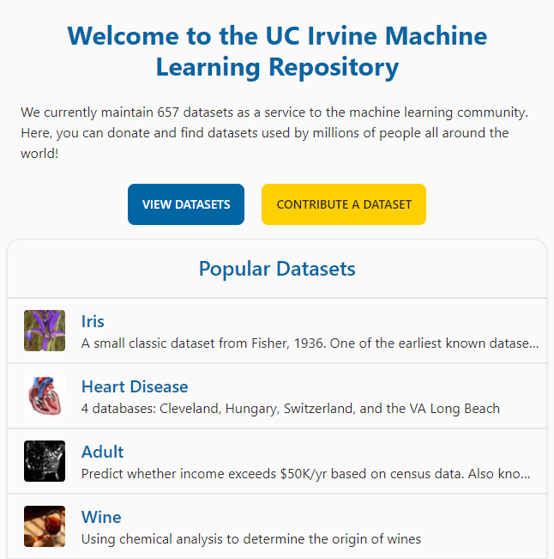
Where to Find ML-Ready Data Sets?
Heliophysics ML-Ready data sets are often stored in the general-purpose data repositories (like Harvard Dataverse, Zenodo, or even local repositories)
In general, there are more specific repositories for ML research data set exist:
Examples: UC Irvine Machine Learning Repository (https://archive.ics.uci.edu/), Kaggle (https://www.kaggle.com/), etc.
User-maintained lists: Ryan McGranaghan’s List of Curated / Challenge Data Sets: (https://github.com/rmcgranaghan/data_science_tools_and_resources/wiki/Curated-Reference%7CChallenge-Data-Sets)
Credits: https://archive.ics.uci.edu/

Slide 8
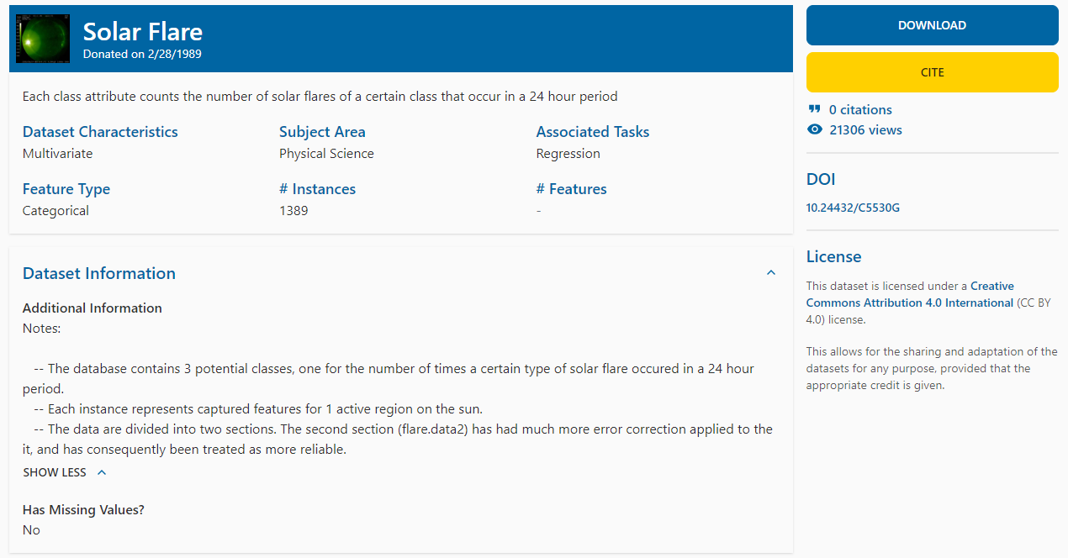
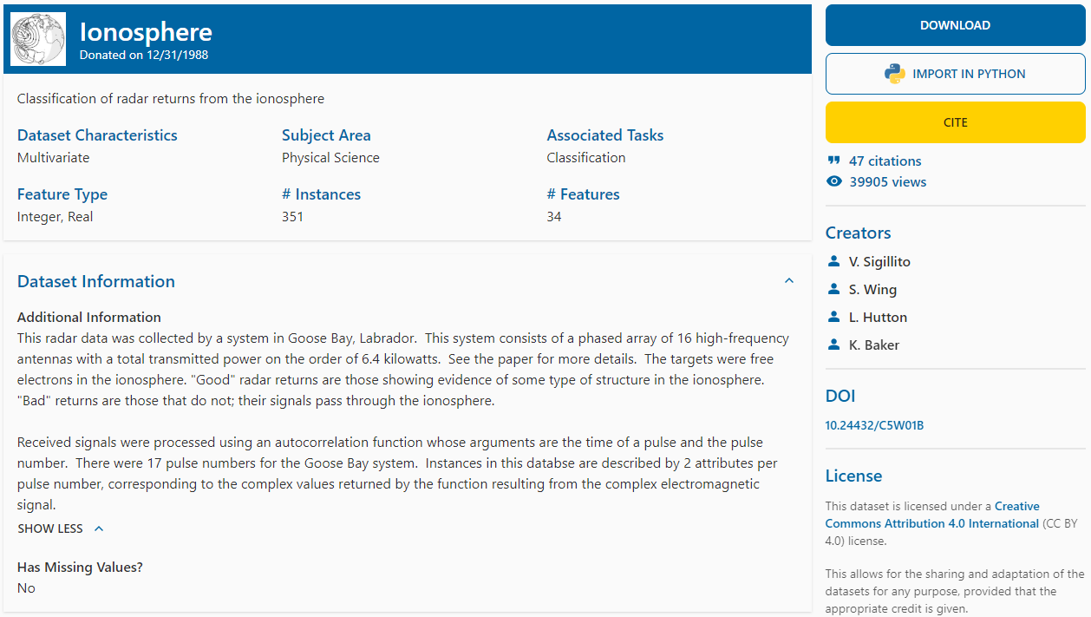
Historical Examples in Heliophysics

Slide 9
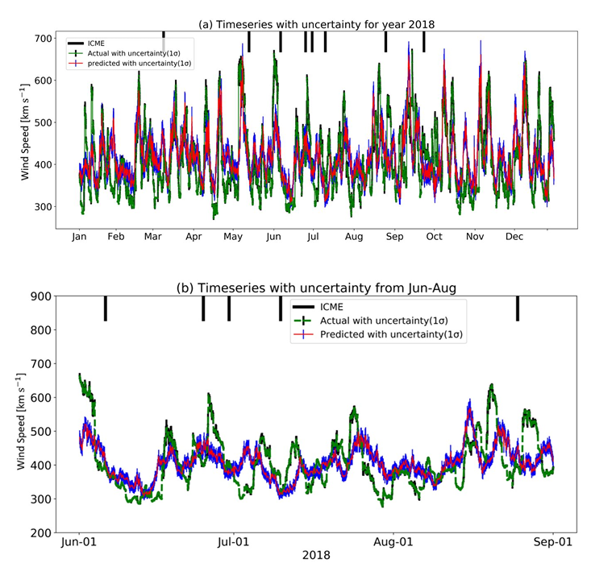
SDO Data Set (Galvez et al. 2019)
A curated data set from the NASA Solar Dynamics Observatory (SDO) for 2010-2018 observations
Combines the data from all three instruments (HMI, AIA, EVE) with a unified cadence for all three and unified parameters for imaging instruments (512x512 with the fixed size of the Sun)
Other corrections (removal of corrupted data, degradation for SDO/AIA, etc) is applied
Observed VS predicted solar wind.
Credits: Hemapriya and Saurabh (2021)

Slide 10
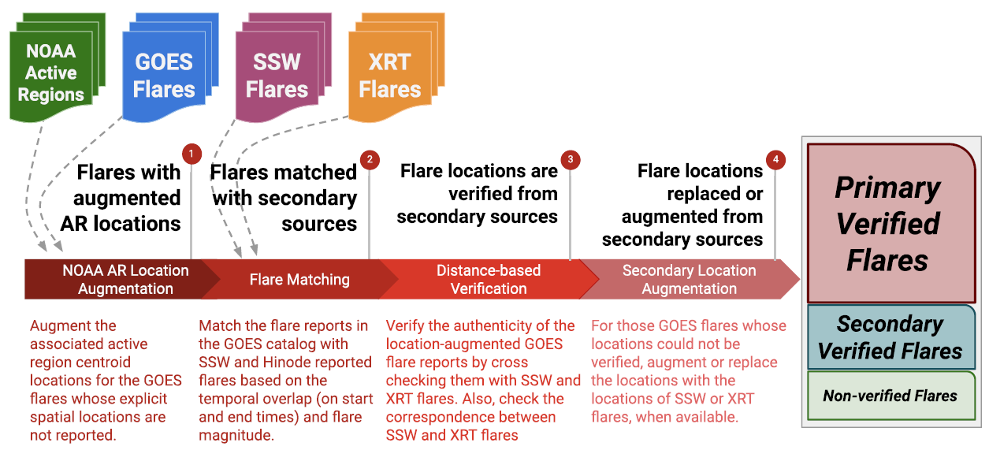
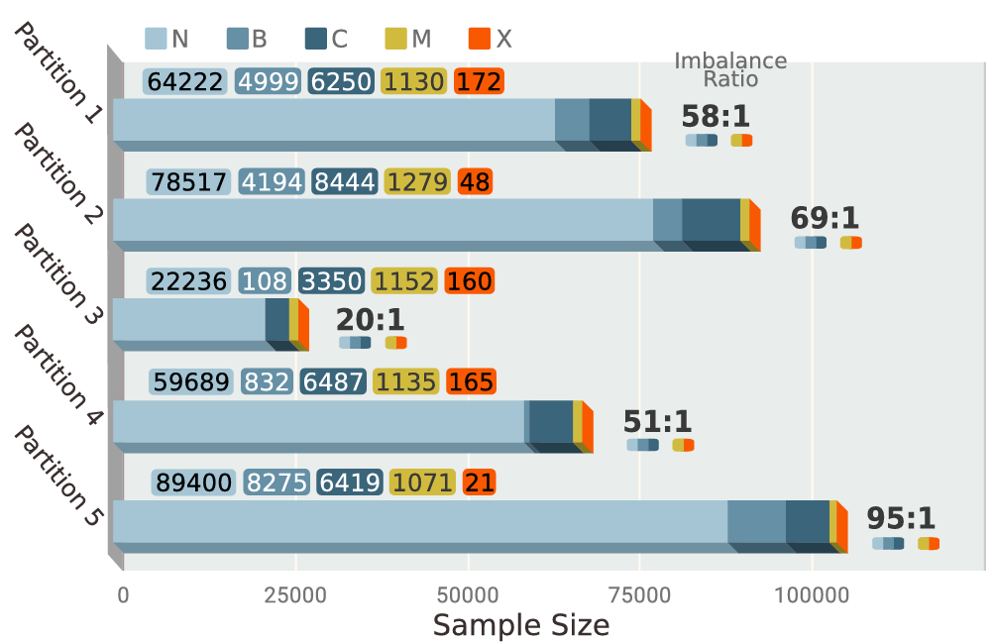
SWAN-SF (Angryk et al. 2020)
Space Weather Analytics for Solar Flares (SWAN-SF) contains the properties of the magnetic field in solar active regions and used for solar flare prediction
The flare locations are verified. The data set has 5 partitions ensuring the removal of the temporal coherence aspect and maintaining a comparable class-imbalance
Great visibility outside of solar physics domain (18 vs 64)
Credits: Angryk et al. (2020)
Credits: Ahmadzadeh et al. (2021)

Slide 11
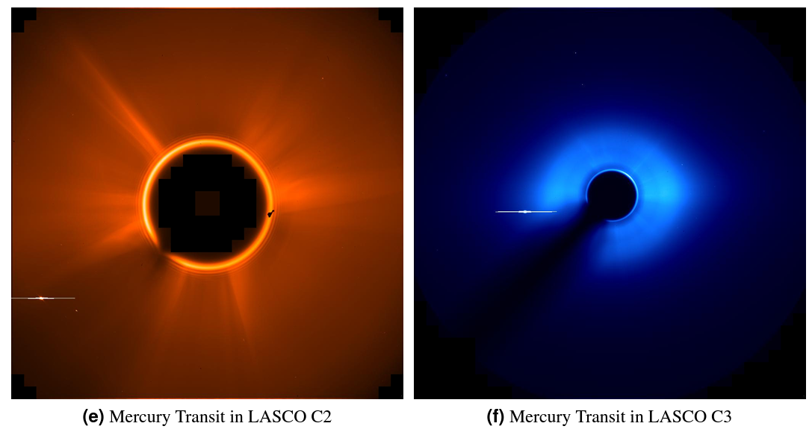
SOHO Data Set Tool (Shneider et al. 2021)
Represents a Python tool for generating the AI/ML-ready data set using either SoHO MDI/EIT/LASCO or SDO HMI/AIA data
Takes into account the instrument degradations, differences in the spatial resolutions, and time synchronization
Used in several applications like Dst forecasting or sunspot detection and classification
Examples of samples to be removed (such as the planetary transit times). Credits: Shneider et al. (2021)

Slide 12
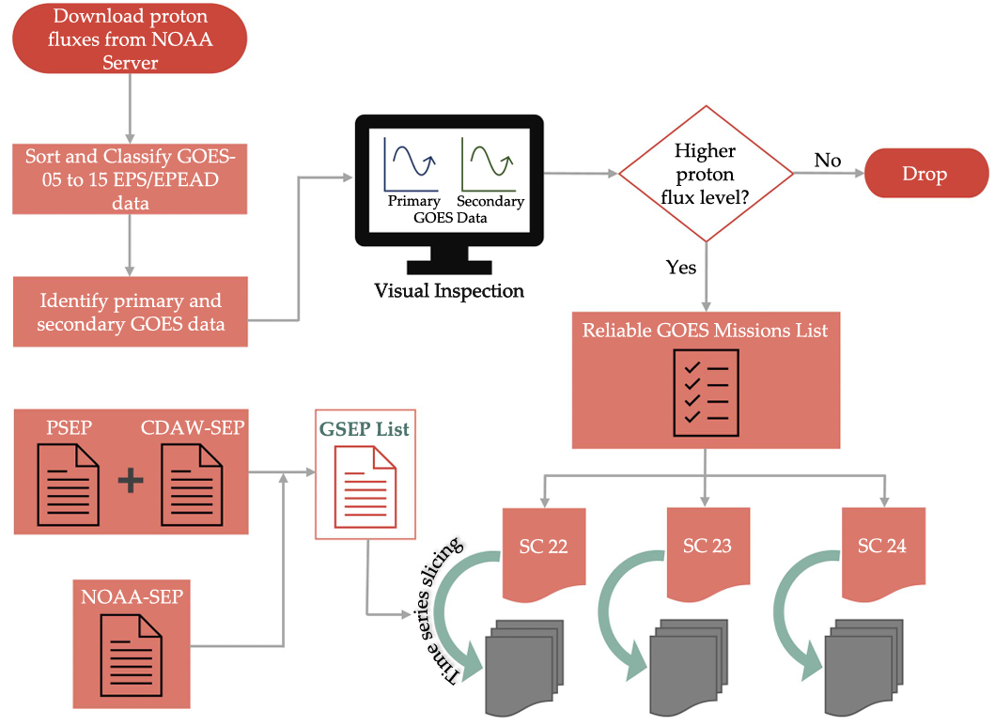
GSEP (Rotti et al. 2022)
Integrated Geostationary Solar Energetic Particle Events Catalog (GSEP) contains the time series data of 341 SEP events observed by GOES spacecraft series
The metadata contains information about the associated events (CMEs and solar flares)
Can be used to studying SEP events, their precursors, etc.
Credits: Rotti et al. (2022)

Slide 13
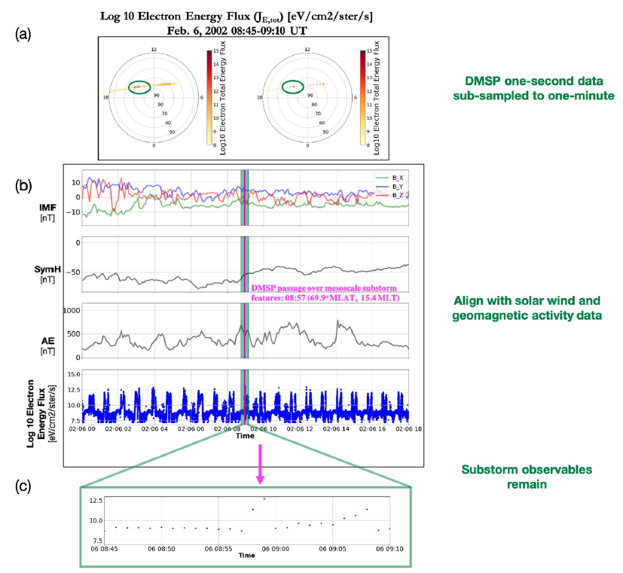
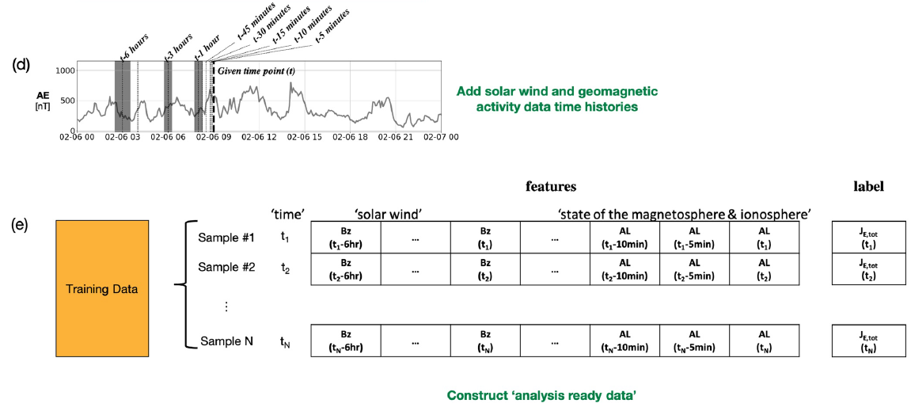
DMSP Particle Precipitation (McGranaghan et al., 2020)
Targeted at modeling electron particle precipitation from the magnetosphere to the ionosphere using the particle precipitation data obtained with 51 satellite years of the Defense Meteorological Satellite Program (DMSP) observations temporally aligned with the measurements of the solar wind and geomagnetic activity
Credits: McGranaghan et al. 2021

Slide 14
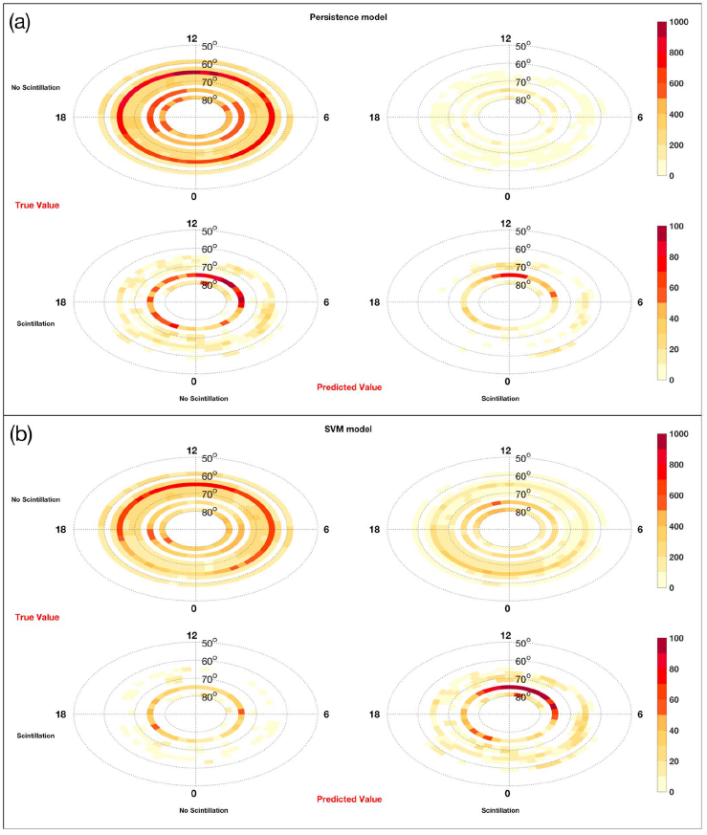
Ionospheric Scintillations (McGranaghan et al. 2018)
Measurements of the Canadian High Arctic Ionospheric Network (CHAIN) co-aligned with the solar wind and geomagnetic activity data and contains two partitions for the years 2015 and 2016
Comparison of the ionospheric scintillation predictions using the persistence and SVM models
Credits: McGranaghan et al. 2018

Slide 15
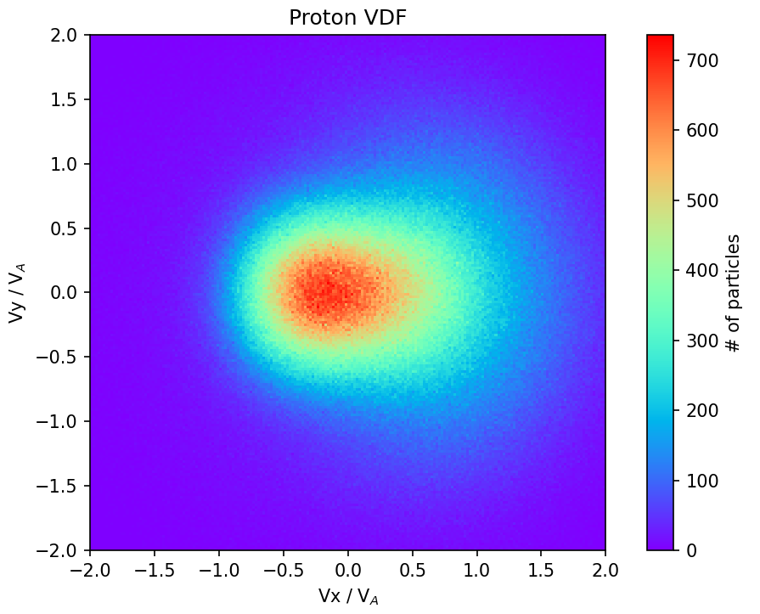
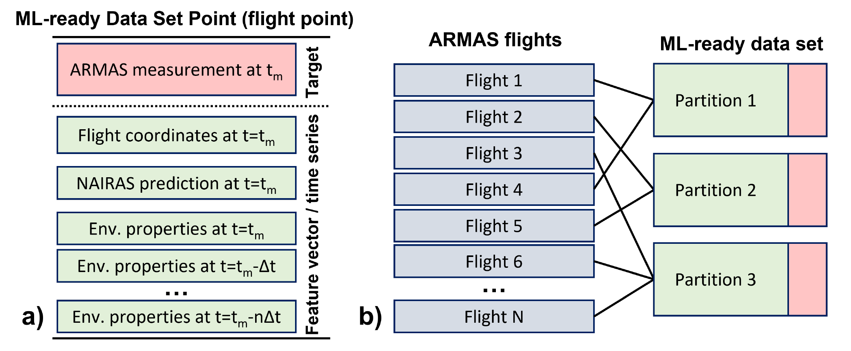
Ongoing Data Set Preparation Efforts
ML-ready data sets for prediction of the effective dose rate measurements in airplane flights
ARMAS measurements during over than 1000 flights connected to the environmental properties (cosmic ray measurements, geomagnetic, solar wind and solar activity measurements) serving as targets
The major challenge: sparsity of the airplane flight data
ML-ready data set for identification and categorization of ion-kinetic instabilities in solar wind
Ion velocity distribution functions, as well as their quantification in terms of statistical moments, from hybrid-PIC simulations, and related presence and category of the instability
Example of the stable velocity distribution function for protons (left).
Airplane flight radiation database structure (right).

Slide 16
Convergence and Divergence
Converging points among the data sets:
Distinguish themselves with respect to the general category of ‘catalogs’ or ‘data sets’ by having additional steps towards data preprocessing, data cleaning, normalization, partitioning, etc.
Are usable for ML applications with the relatively light effort (on average)
Diverging points among the data sets:
Either have a relatively well-defined goal / target behing (SWAN-SF, Ionospheric scintillations, PrecipNet data set) or be of a general purpose in nature (SDO and SOHO data sets)
Provision of the data set partitioning along with the dataset itself (the partitioning typically allows to take into account some domain knowledge)
Differ significantly in data sizes (10 MB for GSEP data set, 6.5 TB for SDO data set) and data formats (a single CSV file VS FITS files for individual instances)

Slide 17
Links to Data Sets
Ryan McGranaghan’s List of Curated / Challenge Data Sets: https://github.com/rmcgranaghan/data_science_tools_and_resources/wiki/Curated-Reference%7CChallenge-Data-Sets
Links to historic data sets:
Solar flare prediction: https://archive.ics.uci.edu/dataset/89/solar+flare
Ionosphere sensing: https://archive.ics.uci.edu/dataset/52/ionosphere
Mentioned ML-ready data sets:
SWAN-SF: https://dataverse.harvard.edu/dataset.xhtml?persistentId=doi:10.7910/DVN/EBCFKM
SDO data set: https://purl.stanford.edu/nk828sc2920
SOHO ML tool: https://github.com/cshneider/soho-ml-data-ready
GSEP: https://doi.org/10.7910/DVN/DZYLHK
Ionospheric scintillations: https://dx.doi.org/10.6084/m9.figshare.6813131.v1
Particle precipitation: http://dx.doi.org/10.5281/zenodo.4281122

Slide 18
Literature List
Nita et al. (2022), eprint arXiv:2203.09544
Galvez et al. (2019), The Astrophysical Journal Supplement Series, Volume 242, Issue 1, article id. 7, 11 pp.
Angryk et al. (2020), Scientific Data, Volume 7, Issue 1, article id.227.
Shneider et al. (2021), eprint arXiv:2108.06394
Rotti et al. (2022), The Astrophysical Journal Supplement Series, Volume 262, Issue 1, id.29, 10 pp.
McGranaghan et al. (2018), Space Weather, 16(11), 1817–1846, doi:10.1029/2018SW002018
McGranaghan et al. (2021), Space Weather, 19(6), e2020SW002684

Slide 19
Open Discussion
What makes the ML data sets specific?
How SPASE could be used to describe ML-ready data sets?

