Slide 1
HelioCloud
Infrastructure for big and open science
Christopher Jeschke
Assistant Group Supervisor for Analysis and Applications (SRN) Space Exploration Sector (SES)
Johns Hopkins Applied Physics Lab
chris.jeschke@jhuapl.edu

Slide 2
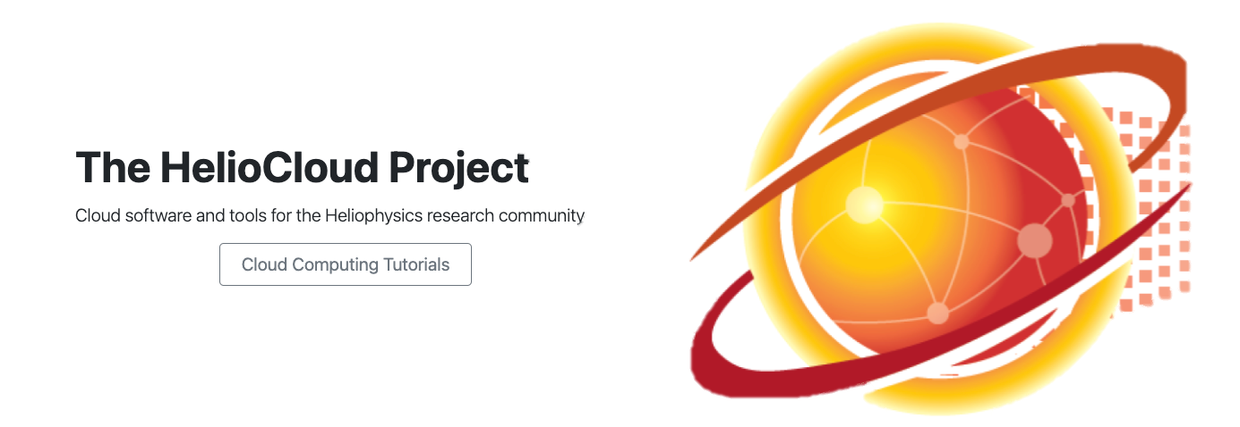
Introduction
Today we will present an overview of HelioCloud – a platform designed to offer an easy on-ramp for heliophysics researchers with interest in cloud computing - Amazon Web Services (AWS) specifically.
The mission of the HelioCloud project is simple: Setup a scientist-friendly AWS environment supportive of Heliophysics research to enable:
Increased exploration of “big” data sets and/or advanced computing capabilities in Heliophysics research. This is research that might otherwise be challenging or impossible in more confined environments (e.g. a laptop) where storage, cpu and memory are limited.
Simplifying data sharing and collaboration across the Heliophysics research community to foster the growth of open science.

Slide 3
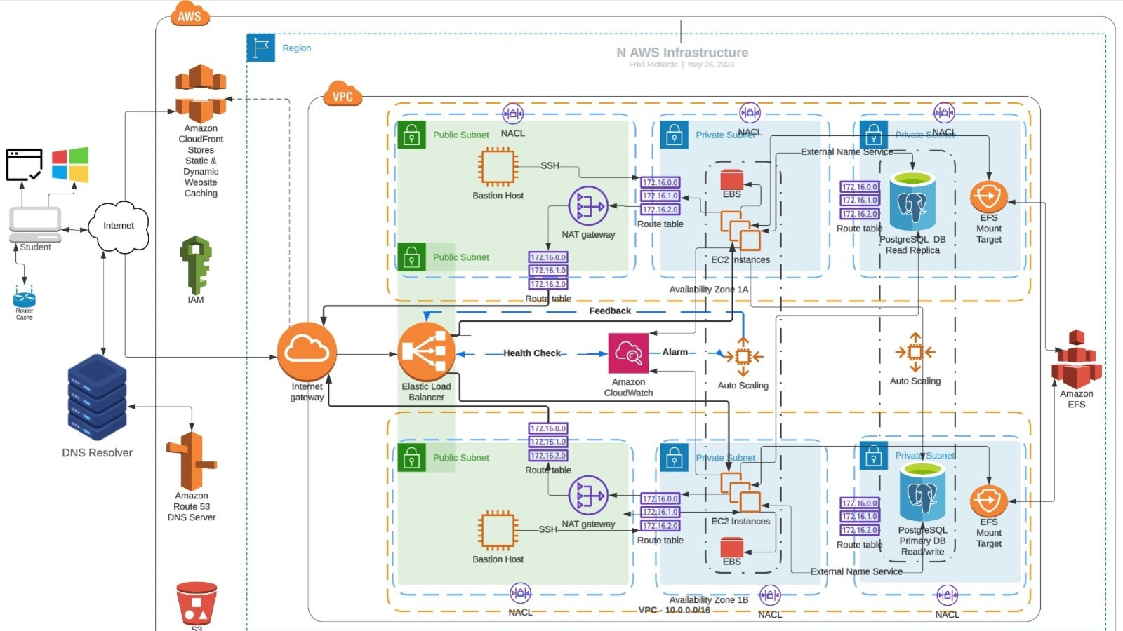
Science Problem
The computing capabilities offered by cloud computing service providers – AWS, Azure, Google, etc – are vast and powerful, but with a substantial learning curve. Unfortunately, learning to leverage them for scientific research requires an investment of time and capital most Heliophysics researchers never have.
Consequently, researchers may not be exploring cloud computing capabilities to their fullest extent. What more could individual researchers be accomplishing if it were simply easier to get up and going on a service like AWS?
A complicated AWS architecture ?!

Slide 4
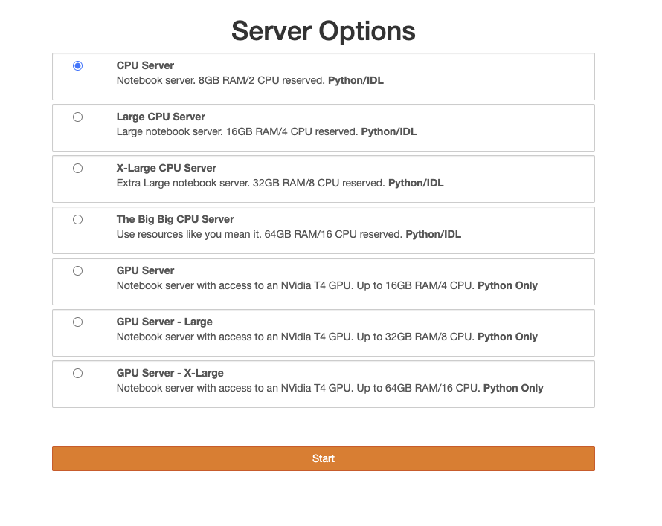
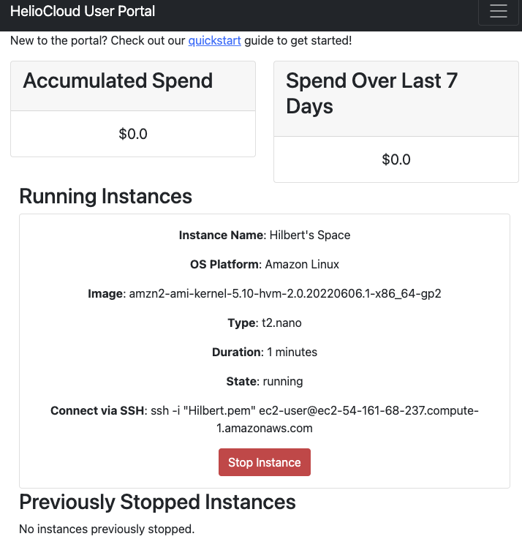
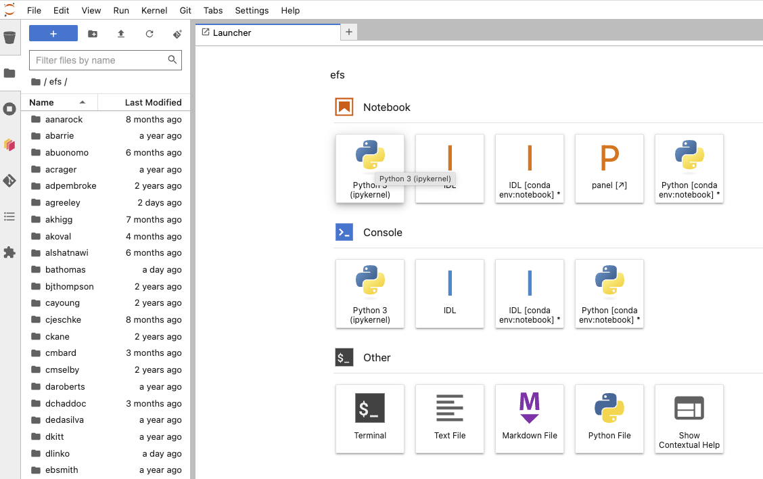
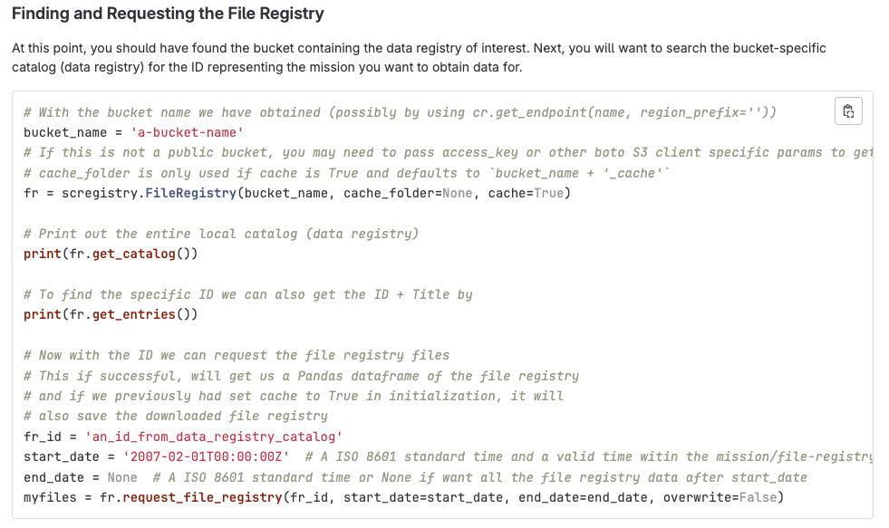
HelioCloud
HelioCloud is our answer to this problem: a heliophysics workbench for AWS, containing capabilities every researcher can make use of. You have the option to get up and going fast (Daskhub), create a customized research compute environment (Dashboard) and/or store and share your heliophysics data sets (Registry).
Datasets
HelioCloud
Daskhub
Jupyterhub on Kubernetes with w/ multiple Heliophysics ready server images available (Python libs from PyHC & Dask , IDL, Matlab, Fortran) along with multi-user shared storage.
Drops a researcher right into a familiar Python notebook environment. Great option for getting up and going on research, while also scalable to larger analysis using Dask for parallelism.
Dashboard
Start your own EC2 instance by selecting from a curated set of heliophysics ready Amazon Machine Images.
Simplifies EC2 host creation with appropriate cost guardrails. Researcher can then remote into the instance and customize it to their liking.
Registry
Store, catalog, share and retrieve heliophysics research datasets within your own Heliocloud and across Heliocloud instances.

Slide 5
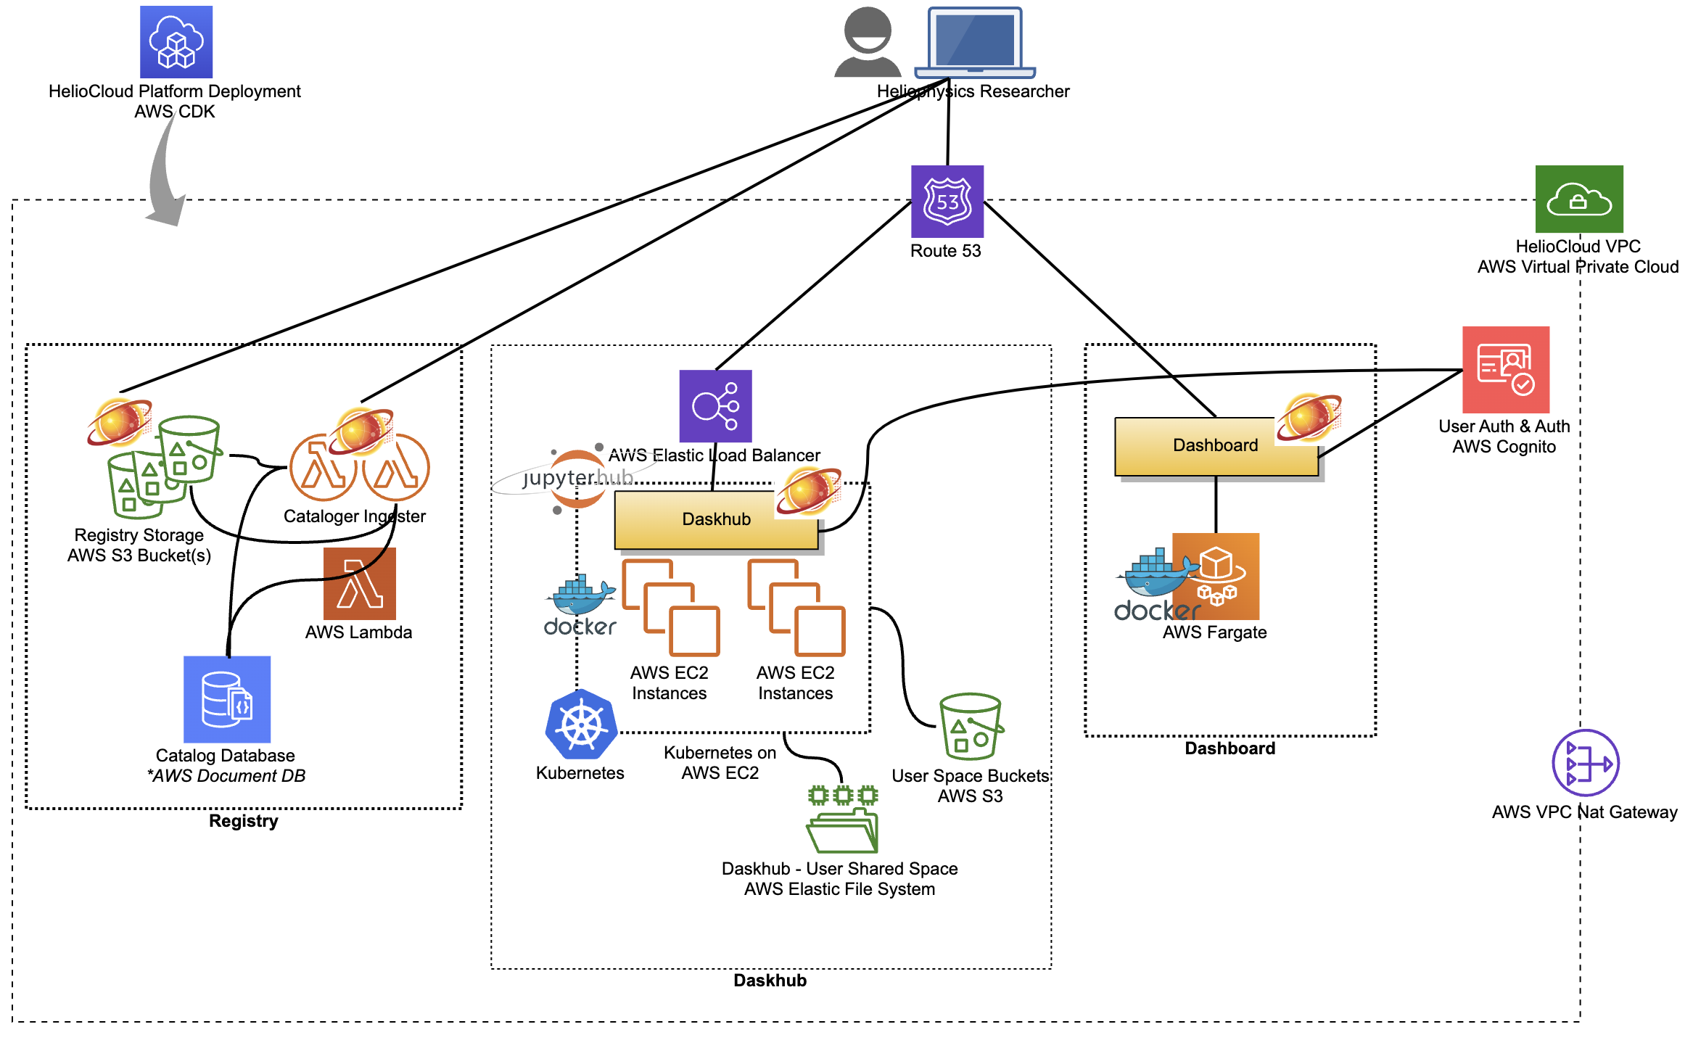
HelioCloud: Architecture
HelioCloud is deployed into a single region within your AWS Account. It is comprised of a number of AWS services & Python apps:
A Virtual Private Cloud (VPC) is created as the networking ‘container’ for the HelioCloud instance.
The Dashboard is a Python Flask app deployed in a Docker container to AWS Fargate.
The Daskhub is composed of a Kubernetes cluster deployed atop AWS EC2, with Docker images containing Jupyterhub, PyHC libraries, etc. An AWS EFS share is created for user data storage.
AWS Route 53 is configured to provide the external DNS entries needed to reach Daskhub & Dashboard (e.g. daskhub.myheliocloud.org).
A combination of AWS Lambda functions, S3 buckets and DocumentDB comprise the Registry implementation.
All of these are provisioned and configured via a single AWS Cloud Development Kit “app” we have written, simply called “HelioCloud Platform”. It does the magic of building a HelioCloud instance.

Slide 6
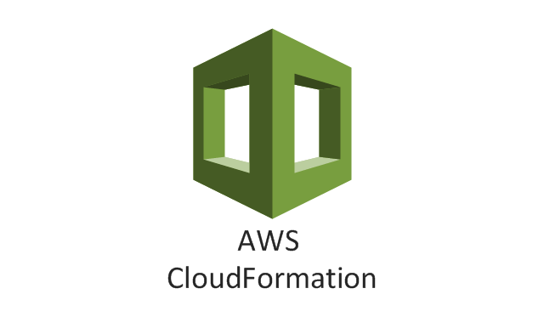
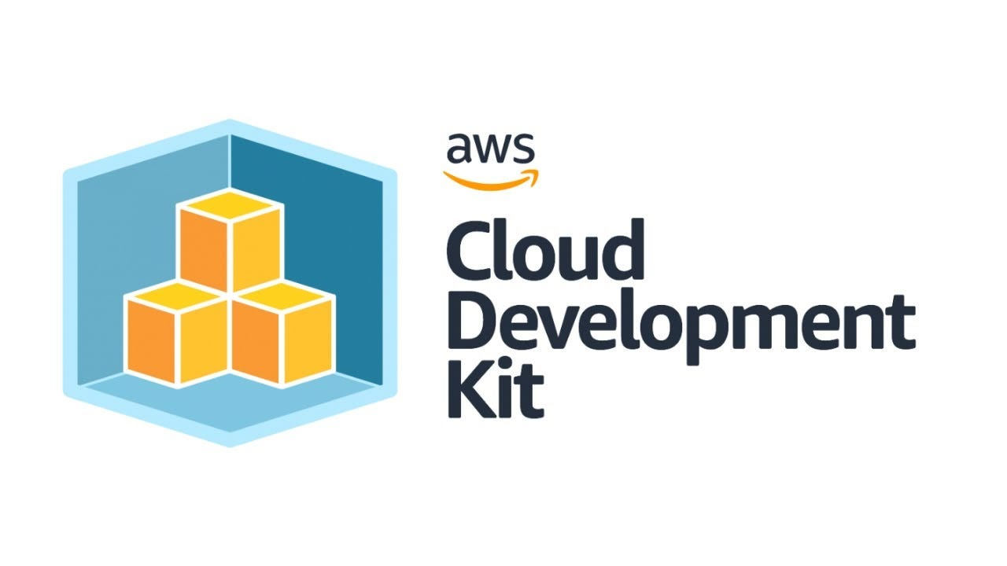
Challenge: Creating a push-button deployment
One of the most important issues to address was making a HelioCloud deployment simple. We had a vision of a single, deployable solution, but had built our first HelioCloud instance by developing and setting up each of the modules (Dashboard, Daskhub and Registry) separately while building out their capabilities. This would be very difficult to reproduce as it involved uniquely configuring more than 12 different instances of AWS services.
The solution was to adopt an Infrastructure-as-Code (IaC) approach like those being leveraged in the cloud devops community for automatically building and maintaining complex cloud environment setups. We had a number of tools to chose from:
The AWS Cloud Development Kit (CDK) proved easy to pick up and use, primarily because it supported Python natively – a language the team had significant depth in.

Slide 7
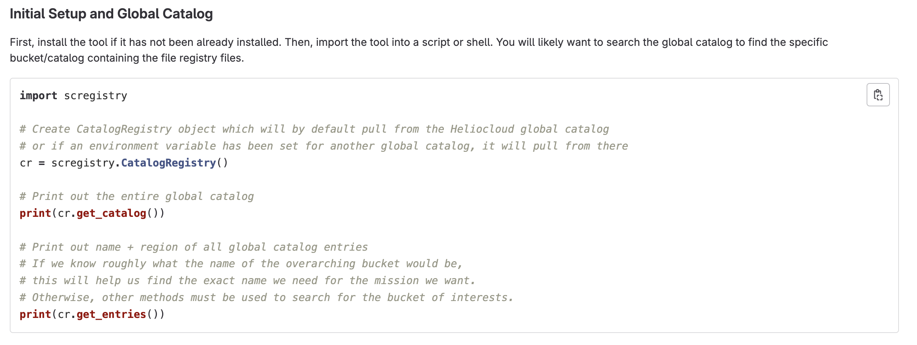
Challenge: How to share data amongst clouds
Another problem we faced was how to enable HelioCloud instances to share data amongst one another. We wanted any HelioCloud instance to be able to pull published data from any other HelioCloud instance – preferably in a way that could be incorporated directly into research code.
Along the came the idea for a global HelioCloud catalog and API – the Shared Cloud Registry (pip install scregistry). Individual HelioCloud instances can register with the global catalog to publish the data stored in their individual Registries.
(Note: We are still working how to enforce the Requester Pays option for AWS S3 buckets.)
JHUAPL
Institution B
Global Catalog
Institution A
GSFC/NASA

Slide 8
Challenge: Allocating and controlling costs
Caveat: Not an easy problem! Still working on this one….
Cost management in AWS takes some forethought and finesse:
By default, costs just roll up to the account level. Determining “per user” costs requires some forethought in your environment’s design and implementation.
It is VERY easy to burn $$ up through a combination of over/under utilized resources. Guardrails are necessary to protect users.
AWS Tagging provided us one means to tag resources (ex: EC2 instances) with HelioCloud user names to track costs … but that is only part of the puzzle. We still want protections in for over/under utilizing resources (ex: leaving a hefty ML ready EC2 instance running idle for 1 month!)
Dashboard (HelioCloud)

Slide 9
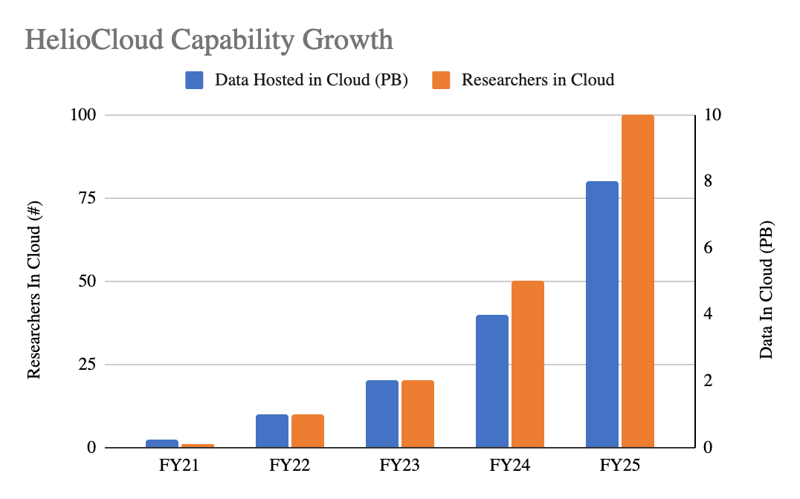
Where HelioCloud is headed….
Live instance at GSFC/NASA currently in use w/ ~20 end-users. Looking for more organizations that want to give our MVP a try.
Now uploading 1.5 PB of data to the GSFC HelioCloud’s Registry to exercise sharing capabilities:
Mission (SPDF lvl2, SDAC)
Contributed research data (ex: “ML Ready”)
Public beta release targeted for end-of-year 2023. Will be released on Github.
Feature roadmap:
Improvements to cost allocations, controls & reporting:
Automatic attribution of costs to users/projects
Automatic shutdown of idle EC2 hosts
Prepay/subscription model for usage
Registry improvements:
Global catalog for HelioCloud instances to use with Registry API. Access data in other HelioClouds!
Searchability
Compute & storage improvements:
More GPU & ML options
Container registry: publish & share Docker containers customized for Heliophysics research
Improvements to shared/private storage
User experience improvements for all modules: Portal, Daskhub & Registry
JHUAPL
Institution B
Global Catalog
Institution A
GSFC/NASA
Help inform our feature backlog with your ideas!

Slide 10
How to get it
HelioCloud is in MVP right now and we are providing access to the code and support from the development team on request. If you are interested in setting up your own instance, reach out to us at one of:
Email: heliocloud@groups.io or any of the contacts listed in this presentation
Check out our homepage & Github
If you have a GitHub account, let us know and we can grant individual access to the repositories along with installation instructions. All you need for an install is an AWS Account.
Exception: Our scregistry Python package is already released and installable via pip. If you already have an AWS account, you can get familiar with the registry API immediately:
pip install scregistry
Github repository at https://github.com/heliocloud-data/scregistry

Slide 11
Contact Info
Project homepage: Heliocloud.org
GitHub: https://github.com/heliocloud-data/
Contact the team: heliocloud@groups.io
Today’s Presenter: Chris Jeschke (chris.jeschke@jhuapl.edu)
HelioCloud Development Team:
Name | Organization
Dr. Brian A. Thomas, PhD | NASA GSFC
Dr. Jon Vandegriff | Johns Hopkins APL
Dr. Sandy Antunes | Johns Hopkins APL
Dr. Wenli Mo | Johns Hopkins APL
Dr. Vicki Toy-Edens | Johns Hopkins APL
Mr. Jeffrey Bradford | ADNET Systems Inc
Mr. Christopher Jeschke | Johns Hopkins APL
Mr. Nicholas Lenzi | Johns Hopkins APL
Ms. Sarah Rourke | NASA GSFC
Mr. Peter Shumate | Johns Hopkins APL

