Slide 1
From White Light to Ultraviolet: Integrating Object Oriented Programming into Data Pipelines for the CCOR and SUVI Imagers
Gabriel Dima^{1,2}, Donald Schmit^{1,2}, William Rowland², Vicente Salinas^{1,2}, Kevin Hallock^{1,2}, Chris Bethge^{1,2}, Jonathan Darnel^{1,2}, Ann Mahon^{1,2}, Elysia Lucas^{1,2}, Alison Jarvis^{1,2}, Ale Pacini², Laurel Rachmeler², Jeff Johnson^{1,3}, Nathan Miles^{1,3}, Vic Pizzo³, Steve Hill³, Natsuha Kuroda⁴, Arnaud Thernisien⁴, John Spitzak⁴, Nathan Rich⁴
1-Cooperative Institute for Research in Environmental Science
2-NOAA National Centers for Environmental Information
3-NOAA Space Weather Prediction Center
4-Naval Research Laboratory

Slide 2
National Environmental, Satellite, Data, and Information Service (NESDIS)
Space Weather Office
Office of System Architecture and Advanced Planning
National Centers for Environmental Information (NCEI)
Office of Geostationary Earth Orbit Observations
Space weather forecast
Low latency
Reliable
Accurately calibrated
National Weather Service
Space Weather Prediction Center (SWPC)
Vendors
GOES 16 (2016)
GOES 17 (2018)
GOES 18 (2022)
GOES-U [19] (2024)
Solar Ultraviolet Imager (SUVI)
6 channel UV imager
2 min cadence
Compact CORonagraph (CCOR)
single channel white light imager
15 min cadence
GOES-U [19] (2024)
SWFO-L1 (2025)
VIGIL-L5 (2029?)

Slide 3
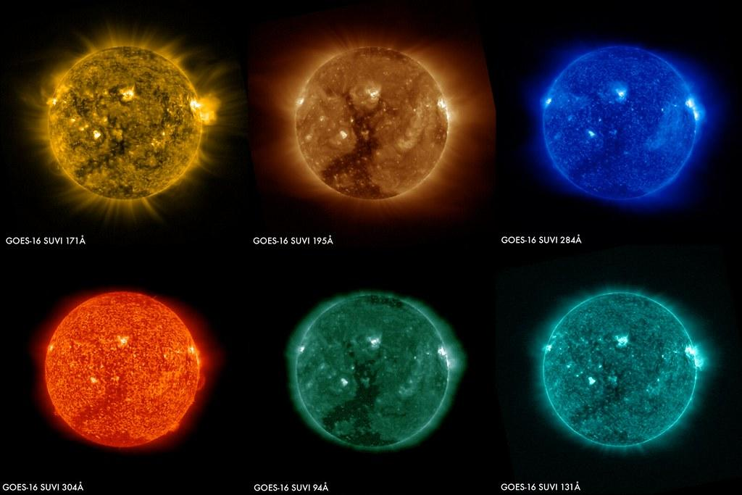
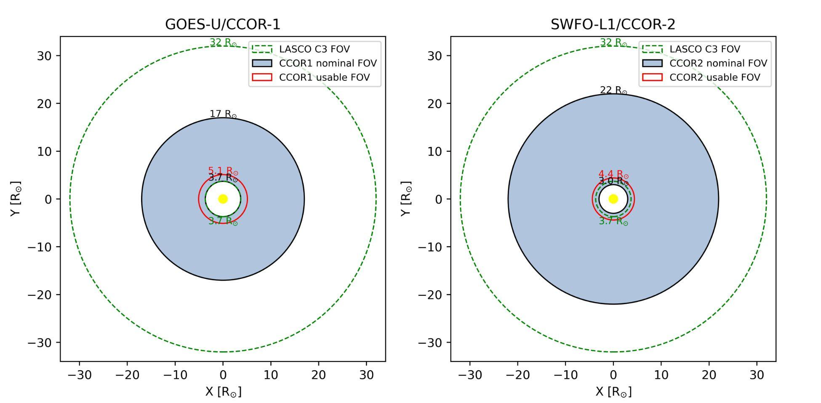
Solar Ultraviolet Imager (SUVI) series
Compact CORonagraph (CCOR) series
A tale of two Technical Task Agreements . . .
Vendor writes and controls the ground processing algorithm (GPA) for analyzing data between L0 -> L1
NCEI writes Python algorithms to generate L2 products (e.g thematic maps, flare predictions) made to run on SWPC systems
L2 products are conceived in collaboration by NCEI/SWPC
Vendor writes and delivers a starting working (IDL) pipeline for data processing from L0 -> L2, but does not process data after instrument commissioning
NCEI/SWPC translate the pipeline to Python and run separate versions:
SWPC / NCEI generate operational / retrospective L1 and L2 products
Main difference lies in the data used for the background images and possibility for reprocessing to account for instrument degradation

Slide 4
Satellite Product Analysis and Distribution Enterprise System (SPADES)
Configuration driven algorithm execution architecture used by both NCEI and SWPC for running algorithms.
SWPC and NCEI have distinct implementations designed to interface with the algorithms in the same manner.
e.g. SPADES-Demo used by NCEI is Java based, while SPADES-lite used by SWPC is Python based
Real-time processing drives algorithm features:
Inputs are all present at run time
Must be completed within a limited time frame
No hard coding directory paths or other parameters into the code
SPADES Control Segment manages algorithms through JSON configuration files:
Configurable Business Logic (CBL)
Run Level Configuration (RLC)
Science Team
T2O
Production Code Test Results Valid?
Yes
Make Public
Yes
Prototype New Code/Rev
*Develop Ops Code
Production Code Test Results Valid?
No
No
DevTeam

Slide 5
SPADES - CBL and RLC
Example CBL
"g16-sgps-l2-int1m.json":
{
"name": "g16-sgps-l2-int1m",
"alg_id": "seis",
"algorithm": "sgps/src/python/sgps_int.py",
"dir_inputs": {
"sgps-l2-avg1m": [
"/nfs/goesr_private/l2/data/goes16/sgps-l2-avg1m"
],
"sgps-l2-int5m": [
"/nfs/goesr_private/l2/data/goes16/sgps-l2-int5m"
]
},
"base_cleanup_run_config_path": "/tmp/spades_seis_working/rlc/archive/g16-sgps-l2-int1m",
"base_cleanup_data_path": "/tmp/spades_seis_prod/archive/GOES-16",
"dir_config": "/nfs/goesr_private/workspaces/g16-sgps-l2-int1m/",
"dir_outputs": {
"sgps-l2-int1m": "/nfs/goesr_private/l2/data/goes16/sgps-l2-int1m"
},
"supported_environments": [
"dn"
],
"input_platforms": [
"G16"
],
"output_platform": "G16",
"duration_seconds": 86400,
"leading_buffer_seconds": 0,
"trailing_buffer_seconds": 0,
"timeout_to_ship_seconds": 579,
"force_timeout_millis": 5000,
"static_run_config": {
"num_secs_to_int": 60,
"root_workspace_dir": "/tmp/spades_seis_working",
"nc_master_int": "sgps/static_required/master_templates/MASTER_sgps-l2-int1m.nc",
"log_level": "WARNING",
"environment": "dn"
},
"retrospective_run_config": {
"chunk_size_days": 90,
"buffer_size_days": 30,
"output_dir_format": "YYYY/MM",
"alg_repo": "/nfs/goesr_private/goesr_l2_algs/goesr_l2_seiss_algs"
}
}
start time: 20170901T000000Z, end time: 20170902T000000Z
Example RLC
"dn_g16-sgps-l2-int1m_G16_20170901T000000Z_20170902T000000Z_c20210712T211317Z.json":
{
"platform": "G16",
"start_time": "20170901T000000Z",
"end_time": "20170902T000000Z",
"delta_time": 86400,
"files_input": {
"sgps-l2-avg1m": {
"filenames": [
"/nfs/goesr_private/l2/data/goes16/sgps-l2-avg1m/2017/09/dn_sgps-l2-avg1m_g16_d20170901_v2-0-0.nc"
],
"file_count": 1
},
"sgps-l2-int5m": {
"filenames": [
"/nfs/goesr_private/l2/data/goes16/sgps-l2-int5m/2017/09/dn_sgps-l2-int5m_g16_d20170901_v1-0-3.nc"
],
"file_count": 1
}
},
"dir_outputs": {
"sgps-l2-int1m": "/nfs/goesr_private/l2/data/goes16/sgps-l2-int1m/2017/09"
},
"log_level": "WARNING",
"num_secs_to_int": 60,
"root_workspace_dir": "/nfs/goesr_private/workspaces/g16-sgps-l2-int1m/s201709010000_e201709230000",
"nc_master_int": "sgps/static_required/master_templates/MASTER_sgps-l2-int1m.nc",
"environment": "dn"
}
Configurable Business Logic (CBL)
Information about how a system can execute an algorithm
Specifies path to algorithm script to execute, path to directories containing all possible input files, duration seconds of product window, static run configuration, etc
Run Level Configuration (RLC)
Configuration parameters for a single invocation of an algorithm
Contains information such as specific input files, start and end time of processing window
Control Segment
Generates one or more RLCs based on the information contained in a provided CBL
Notes:
Add in SNS+SQS based on RLCs

Slide 6
SPADES-Science - SWFO, GOES, and
DSCOVR Science+Retrospective
Control Segment
Identify relevant files
Stage relevant files to EFS
Create Run Level Config (RLC) for relevant files
Spin up Fargate Workers for execution
Queue execution of RLCs in Fargate
Confirm execution, manage downstream algorithm dependencies
Ensure completed outputs are written to S3, then purged from EFS.
Worker-nodes
Pull tagged image from ECR
Execute algorithms based on RLCs received from Control Segment
Report success, failure, logs to Control Segment
CI Pipeline (*)
Receive Dev code changes
Automated validation
Create Image
Deploy to ECR
Schedule Workers
Fargate
Status
Images (Code)
L0b-L3 Data
RLCs, Logs
L0b-L3 Data
L1-L3 Data
RLCs, Logs
SWFO Archive, Science Center
Reprocessed L1-L3
S3
Reprocessed L1-L3
EFS
This system is currently being used to create scientifically authoritative DSCOVR and GOES-R data.
Notes:
Add in SNS+SQS based on RLCs

Slide 7
Implementation of CCOR pipeline in development
NCEI LUT file
Input L0b FITS files
NCEI FITS header template
Divide by Exposure Time and binning
x.norm_exposure()
x.correct_binning()
Convert to MSB
x.apply_calfac()
Initialize CCOR Image class
x = CCORProcNCEI()
Compute Background (previous 4 weeks)
x.calc_l1b_backg()
Compute Background
(data ± two weeks)
x.calc_l2_backg()
Vignetting correction
x.get_calimg()
x.apply_flat_correction()
Bias subtract and rectify
x.ccor_bias()
Remove Background
x.remove_backg()
Remove Background
x.remove_backg()
L15
CCOR-2 Retrospective
Apply linearity correction
x.apply_lincorr()
L1b
CCOR-1 Operational Input
L1b
CCOR-1 Retrospective
Compute Background
(data ± one week)
x.make_daily_med()
x.make_monthly_min()
Create bad pixel mask
x.make_mask()
Convert to MSB
x.apply_calfac()
Convert to MSB
x.apply_calfac()
Calculate image statistics
x.calc_stats()
Vignetting correction
x.get_calimg()
x.apply_flat_correction()
Remove Background
x.remove_backg()
Vignetting correction
x.get_calimg()
x.apply_flat_correction()
Save DN to MSB factor
x.get_calfac()
L1a
CCOR-2 Operational Input
CCOR-1,2 Retrospective
L2
CCOR-1 Operational Input
L2
CCOR-1 Retrospective
L2
CCOR-2 Retrospective
Notes:
Note on background computation: See slide 4, deliverables. Next vender expected gpa delivery is sept 30 and we expect these routines to be included.

Slide 8
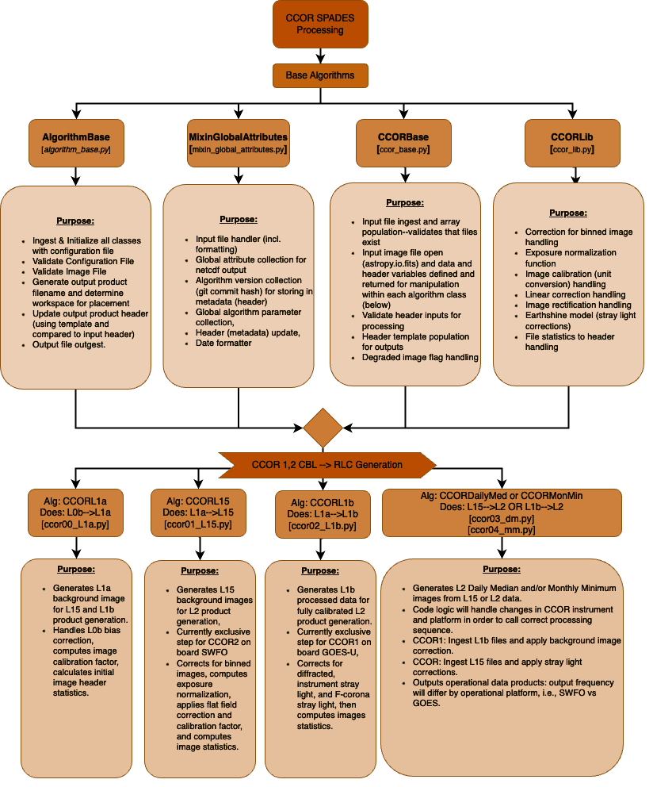
Implementation of CCOR pipeline in SPADES
Processing methods, file handling and metadata handlers are organized into separate classes.
These class methods are then called inside worker algorithms that use RLC files to determine processing parameters.

