Slide 1
Physics-Informed Neural Networks (PINNs) for MHD: Results and Issues
Eric Winter (JHU/APL, GMU)
Bob Weigel (GMU)
Data, Analysis, and Software in Heliophysics (DASH)
Johns Hopkins University Applied Physics Laboratory
2023-10-10

Slide 2
${(x, ψ}_{0})_{i}$ = The $i$th of of n_{t} training points mapping${ input vector x=\left(t,x,y,z,…\right) to output ψ}_{0}$
$θ$ = neural network parameters (weights and biases)
“data loss function” for i=1…n_{t}
$$ψ_{i}$$
$$x_{i}$$
$$N(θ,x_{i})$$
$$L_{d}=RMS(ψ_{i},ψ_{i0})$$
$${θ→θ−η∇}_{θ}L_{d}$$
$$∇_{θ}L_{d}$$
“Traditional” NN used for function fitting
Notes:
A neural network node makes a weighted combination of inputs, then applies a transfer function.
A traditional neural network takes a set of inputs x and known outputs psi0. For example, this could be (t, x, y, z, psi0) for each of thousands of training points.
Pass all inputs to neural network, compare psi to psi0, compute RMS error – just like any other data fitting routine.
Update parameters theta using standard minimization techniques – just like and other data fitting routine.
Iterate until convergence achieved.
A PINN builds on this by using a different loss function…

Slide 3
“residual loss function” for i=1…n_{t}
$$ψ_{i}$$
$$N(θ,x_{i})$$
$$G(x_{i},ψ_{i},{∇_{x}ψ}_{i})$$
$$L_{res}=RMS(G_{i})$$
$$x_{I}$$
$${∇_{x}ψ}_{i}$$
$${θ→θ−η∇}_{θ}L$$
$$∇_{θ}L$$
$$L=w_{res}L_{res}+w_{d}L_{d}$$
“Physics-Informed” NN – A numerical approximation to ODE or PDE is computed
Notes:
A “physics-informed” neural network takes a set of inputs x and known outputs psi0, and differential equations G. For example, this could be (t, x, y, z, psi0) for each of thousands of training points.
Pass all inputs to neural network, compare psi to psi0, compute RMS residual – just like any other data fitting routine.
Weighted combination with data loss
Update parameters theta using standard minimization techniques – just like and other data fitting routine.
Iterate until convergence achieved.

Slide 4
The Ideal MHD Equations
$$x→\left(t,x,y,z\right) ψ ∈(n,P,v,B)$$
Conservation of mass
$$\frac{∂n}{∂t}+∇∙\left(nv\right)=0$$
$$mn\left[\frac{∂v}{∂t}+\left(v∙∇\right)v\right]=qn\left(E+v×B\right)−∇P$$
Conservation of momentum
Conservation of energy
$$∇P=γk_{B}T∇n$$
Faraday’s Law
$$\frac{∂B}{∂t}+\left(v∙∇\right)B+B\left(∇∙v\right)−\left(B∙∇\right)v=0$$
Notes:
The MHD equations are a set of coupled PDEs
Use one network per variable
Inputs are (t, x, y, z), and data as the boundary or initial conditions

Slide 5
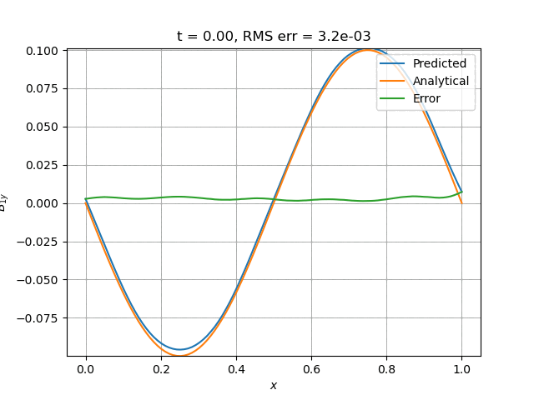
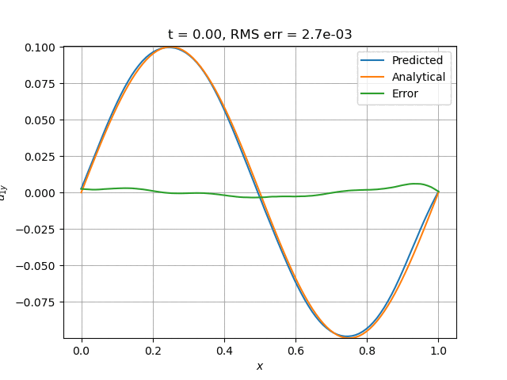
MHD in 1-D: Electron plasma waves
B_{y}
u_{y}
Notes:
B1y and u1y are 90 degrees out of phase, as expected
Results created with a 4x100 network
Layer 1: 100x2 + 100 = 300
Layer 2: 100x100 + 100 = 10,100
Layer 3: 100x100 + 100 = 10,100
Layer 4: 100x100 + 100 = 10,100
Output: 100x1 = 100
Total = 30,400 parameters

Slide 6
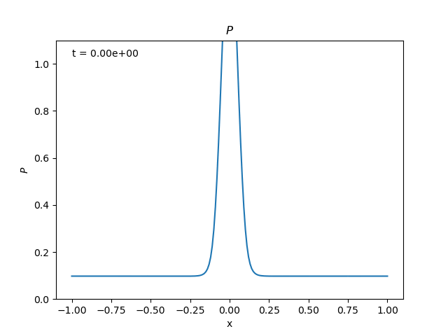
MHD in 1-D: 1-D blast wave
Notes:
Initial blast wave is Gaussian
The hat function didn’t work – discuss at end
Gaussian has same total energy as hat function

Slide 7
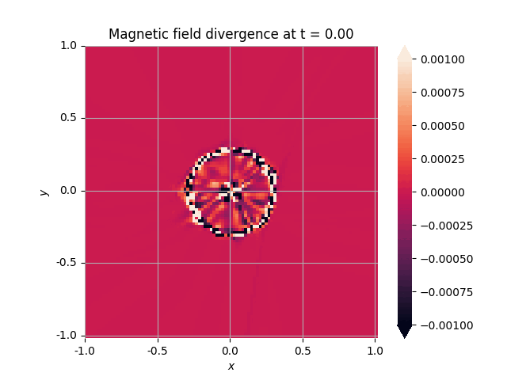
MHD in 2-D: 2-D magnetic loop advection
Notes:
Line current coming out of the screen, ring current returning at r = 0.3.

Slide 8
MHD in 2-D: 2-D blast wave
log₁₀(P)
Notes:
Initial condition is a sharp 2D Gaussian of same total energy as hat function
Blast should dissipate over a time scale of inverse sound speed

