Slide 1
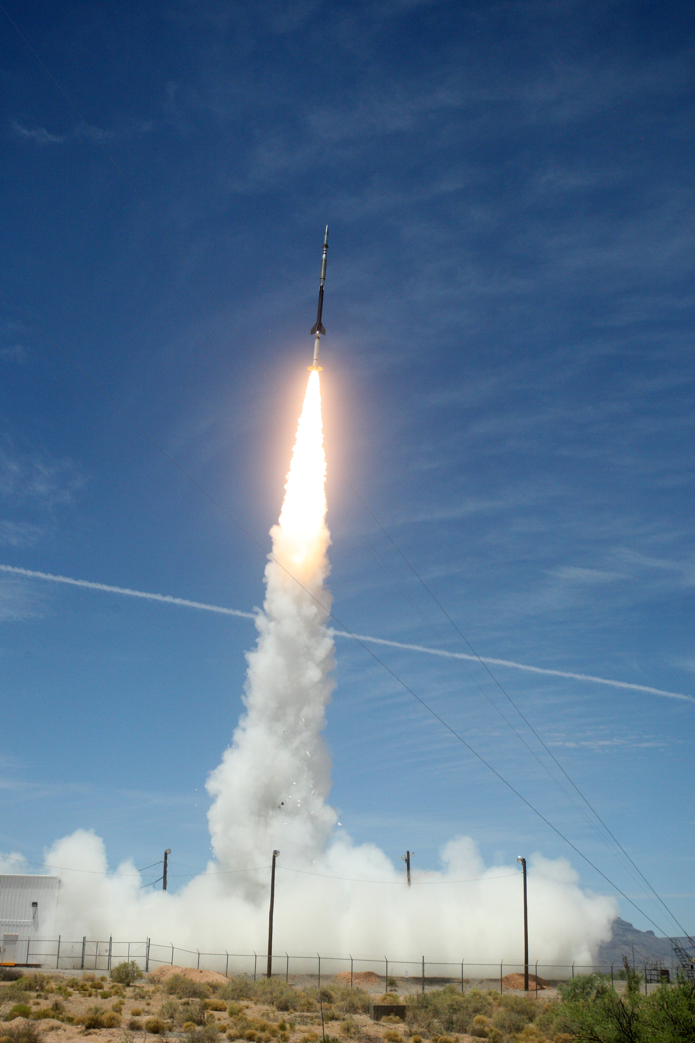
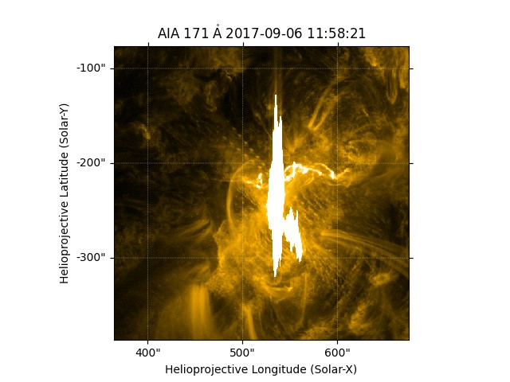
Bidirectional Learning of Multi-steps Temporal and Lag Sequence of Active Regions for X-Class Solar Flare Forecast Using Gated Recurrent Units (GRU) of Recurrent Neural Networks.
Authors:
Ndifreke Nyah, Robert Walsh, Daniel Gass
School of Engineering and Computing

Slide 2
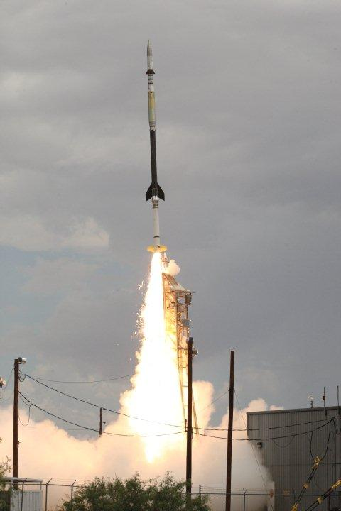
Overview
Introduction:
Data Source and Training Data Preprocess
ML Forecasting Model
Result

Slide 3
Introduction
Motivation
Solar flare campaign involving High-resolution Coronal Imager (Hi-C) and the Focusing Optics X-ray Solar Imager (FOXSI)
Aim
Developing a solar forecasting tool using Machine Learning
Initial Focus
X-class flares: x-flare or no-x-flare
Data Source: SDO/AIA datasets- EUV emission images
Apply Bidirectional-GRU of RNN, a machine learning method to decide on flare or flare forecast will occur

Slide 4
Data Source and Training data Pre-processing I
High Intensity: SDO/AIA EUV wavelength channels (171, 193, 211, 335)
Data Pipeline
Download cuts sdo/aia files
merge and sort all wavelengths
Extract grayscale images, resize, create flare and no-flare labels
Create multistep lag sequence window
Download sdo/aia cut files for all wavelengths based on Helioprojective Cartesian - coordinates, temporal time sequence of flare occurrence up to max time and 30 minutes before flare occurs
Extracts 512 by 512 and resize with inter-linear Interpolation method to 256 by 256
Mult-step sequence window with lag- currently the window is set to 4 with 12seconds resolution per image sample = 48seconds
BI-GRU Machine Learning for training and model testing

Slide 5
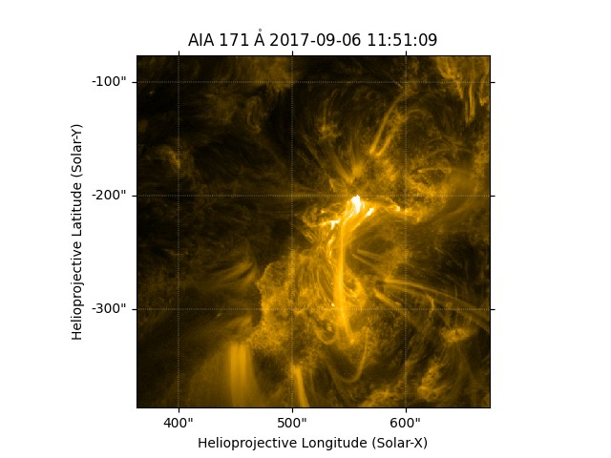
Data Source and Training data Pre-processing II
A Muti-step lag input window(w) = t + 4
335
 | is1
171
193
211
t/12secs
is1 | is2
Full images: wavelengths
is2 | is3
is3
NW
N sorted samples
isNW
Before X-flare
During X-flare
is = image step
NW = No of Windows

Slide 6
Forecasting Model: Bidirectional Gated Recurrent Unit (BI-GRU) for Solar Flare Forecast
Long term dependencies, few parameters, and bidirectional capabilities (G. Shen etal, 2018; ). Given input $x_{t}$: $t=1,2,3…. T$ and $x$ as multiple lag $1d$ image from 4 different SDO/AIA wavelengths with $t−1$
In our GRU, update gate $U_{t}=σ\left(w_{U}\left[x_{t},h_{t−1}\right]+b_{u}\right)$ , reset gate $r_{t}=σ\left(w_{r}\left[x_{t},h_{t−1}\right]+b_{r}\right)$ , forward candidate vector update ${\tilde{h}}_{t}=Relu\left(w_{h}\left[x_{t},x_{t}.h_{t−1}\right]+b_{u}\right)$ and the overall computation can be seen as $h_{t}=U_{t}⋅h_{t−1}+\left(1−U_{t}\right)⋅{\tilde{h}}_{t}$
Where $h$=hidden neuron, $w$=weight, $b$= bias
In our case, Bi-directional(BI-GRU) approach: concatenate forward update (from t=1 to t=T) and backward update (from t=T to t=1)
Finally, we map the multiple output scores from BI-GRU on a dense layer using SoftMax activation function for X-flare and no-X-flare forecast.

Slide 7
Evaluation and Result
Evaluation: Prediction of Flare(1) or No-Flare(0) on 13283 test data
Prediction: A predicted class is a class with maximum Bayes' likelihood probability.
Performance:
TPR = TP/(TP+FN)
TNR = TN/(TN+FP)
ACC = (TP+TN)/(TP+TN+FP+FN)
TSS = TP/(TP+FN)-FP/(FP+TN)
Metrics | BI_GRU-RNN (%)
ACC | 70.9
TPR | 61.8
TNR | 38.6
TSS | .53
Result: learning outcomes from (train/validation- 49760/5676) sample sizes. Epoch from 010 to 362 with a using 48secs(4 wavelengths) forecast window.
- Loss reduction: from 0.18 to 0.07
- MSe reduction train/val: from 0.41/0.40 to 0.18/0.18

Slide 8
Future Works
to improve the Forecasting Algorithm and compare it with related algorithms
to modify the data pipeline to a real-time data pipeline
to increase the forecasting window

Slide 9
THANKS FOR LISTENING

